Slide 1
Numerical Data Visualization
UNIT II · TOPIC 6
Data Visualization
Business Management Tools I (AE25UCBM001) · SAGE University, Bhopal
Notes:
This session covers the two main charts for numerical data: the histogram and the box plot. Students learn how to read shape, centre, spread and outliers, and how to compute quartiles and outlier fences correctly.

Slide 2
What you will learn
Build a histogram and choose a sensible bin width.
Explain how a histogram differs from a bar chart.
Compute quartiles, IQR and outlier fences.
Read a box plot: median, box, whiskers and outliers.
Handle edge cases: values on bin edges and different quartile methods.
BIG IDEA
4
things to read in any numerical chart: centre, spread, shape and outliers.
Notes:
Ask students what the average delivery time is for a food app. Then ask whether the average tells them how bad the worst deliveries are. That gap is why we draw distributions.

Slide 3
Why we draw the distribution
A distribution shows how often each range of values occurs.
One average hides the spread. Two shops can both average 30 minutes and differ a lot.
Centre: where the typical value sits (mean or median).
Spread and shape: tight or wide, symmetric or stretched to one side.
Outliers: values far from the rest. They may be errors or real events.
DATA USED TODAY
Delivery times in minutes for 20 orders from a Bhopal food outlet. Illustrative data: 12, 15, 18, 20, 22 ... 45, 95.
Notes:
We will use the same 20 delivery times for the whole session, so students can check each number. Write the data on the board in sorted order.

Slide 4
How to build a histogram
1 Find the range
2 Pick a bin width
3 Fix the bin edges
4 Count per bin
5 Draw touching bars
Smallest 12, largest 95. The data spans 83 minutes.
Equal-width bins. Aim for roughly 5 to 15 bins. Here width 10 gives 9.
Start at a round number, here 10. Edges: 10, 20, 30, up to 100.
Count values in each bin. Include empty bins so gaps show.
Bars touch because the x axis is a continuous number line.
A histogram has no gaps between bars. A bar chart does. That is the visual clue.
Notes:
The difference from a bar chart: histogram bins are ranges of one numerical variable, and their order is fixed. Bar chart categories are separate labels.

Slide 5
Histogram of 20 delivery times
WHAT IT SHOWS
Most orders (14 of 20) arrive in 20 to 39 minutes.
The tallest bin is 20 to 29 with 8 orders.
The shape is right-skewed: a long tail to the right.
The lone order at 90 to 99 minutes is far from the rest.
Notes:
Counts: 3 + 8 + 6 + 2 + 0 + 0 + 0 + 0 + 1 = 20. Right-skewed means the tail stretches to the high side. Delivery times, incomes and waiting times are often like this.

Slide 6
Edge case: a value sitting on a bin edge
WORKED EXAMPLE
One order took exactly 20 minutes. Bins are 10 to 20 and 20 to 30. Which bin does 20 go into?
Left-closed bins [10, 20): include 10, exclude 20. The 20 goes into 20 to 30.
Counts: 3, 8, 6, 2, 0, 0, 0, 0, 1. This is what the chart shows.
Right-closed bins (10, 20]: exclude 10, include 20. The 20 goes into 10 to 20.
Counts: 4, 8, 6, 1, 0, 0, 0, 0, 1. Same data, different bars.
TAKEAWAY
The edge rule changes the counts. Python (numpy, pandas) is left-closed. Excel histogram tools can differ, so check and state the rule.
Notes:
Both counts total 20. With right-closed bins, 10 is not an issue here because no value equals 10 exactly, but 20 and 40 move down a bin. Tell students to look at the bin labels such as (10, 20] in Excel.

Slide 7
Bin width changes the story
Bin width | Bins | Highest bar | What you see
5 minutes | 18 | 5 orders | Jagged. Bars of 1 to 5 show noise, not pattern.
10 minutes | 9 | 8 orders | Clear hump at 20 to 29 and a lone far value.
50 minutes | 2 | 19 orders | 19 and 1. The shape is lost.
Same 20 delivery times, three bin widths (bins start at 10, or 0 for width 50).
Notes:
Too narrow gives a comb of tiny bars. Too wide gives a block. There is no single right width, so try two or three and choose the one that shows the pattern honestly. Excel picks a width automatically, and you can change it under Format Axis.

Slide 8
Quartiles, IQR and fences, step by step
WORKED EXAMPLE
Sorted data (n = 20): 12, 15, 18, 20, 22, 23, 25, 26, 27, 28, 29, 30, 31, 32, 34, 35, 38, 40, 45, 95. Find the outliers.
Median: average of the 10th and 11th values: (28 + 29) / 2 = 28.5.
Q1 (QUARTILE.INC): position 1 + 0.25 x 19 = 5.75, so 22 + 0.75 x (23 - 22) = 22.75.
Q3: position 15.25, so 34 + 0.25 x (35 - 34) = 34.25. IQR = 34.25 - 22.75 = 11.5.
Fences: lower = 22.75 - 1.5 x 11.5 = 5.5. Upper = 34.25 + 1.5 x 11.5 = 51.5.
RESULT
No value is below 5.5. Only 95 is above 51.5, so 95 is the one outlier. The largest value inside the fence is 45.
Notes:
IQR is the interquartile range, the spread of the middle half of the data. The 1.5 x IQR rule is a convention, not a law. Ask students: if the fence were 3 x IQR, would 95 still be an outlier? Upper fence would be 68.75, so yes.

Slide 9
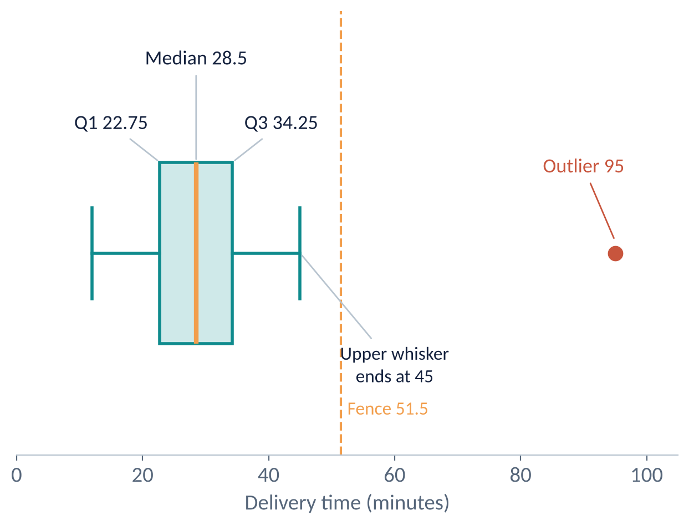
The box plot of the same 20 times
HOW TO READ IT
Box spans Q1 to Q3 (22.75 to 34.25): the middle half of orders.
The orange line is the median, 28.5.
Whiskers reach the furthest values inside the fences: 12 and 45.
The red dot at 95 lies beyond the upper fence of 51.5.
Notes:
A box plot packs five numbers into one picture: the smallest and largest non-outlier values, Q1, the median and Q3. It is excellent for comparing several groups side by side, for example delivery times by area.

Slide 10
Edge case: quartile methods differ
Method | Q1 | Q3 | IQR | Upper fence
Excel QUARTILE.INC / numpy | 22.75 | 34.25 | 11.5 | 51.5
Excel QUARTILE.EXC | 22.25 | 34.75 | 12.5 | 53.5
Median of each half (by hand) | 22.5 | 34.5 | 12.0 | 52.5
All three agree here that 95 is the only outlier. Always name the method you used.
Notes:
Textbooks, calculators and software use slightly different rules, so students may get different Q1 values and think they made a mistake. The differences are small and shrink with more data. For exams, follow the method the lecturer states. For work, use QUARTILE.INC.

Slide 11
What one outlier does to the mean
WORKED EXAMPLE
The 95-minute order might be a traffic jam or a typing error. See how it moves the average and the median.
With 95: total 625 minutes over 20 orders. Mean 31.25, median 28.5.
Without 95: total 530 over 19 orders. Mean 27.89, median 28.
Mean moved by 3.36 minutes. The median moved by only 0.5 minutes.
Decide: check the order record. Remove it only if it is an error, not just inconvenient.
TAKEAWAY
The median resists outliers, the mean does not. Report the median for skewed data such as delivery times, and always investigate outliers before removing them.
Notes:
If the 95 was real, it is a genuine service failure and the manager needs to know. Deleting real bad days to improve an average is data manipulation. Ask students how they would find out which it was.

Slide 12
Traps and edge cases
1
Bars that do not touch
2
Skipping empty bins
3
Unequal bin widths
A histogram with gaps between bars looks like a bar chart. Set gap width to near zero.
Dropping empty bins hides the gap before the outlier. Keep them so the distance is visible.
Mixed widths such as 0 to 10 and 10 to 50 distort the shape. Use equal widths in a basic histogram.
4
Outlier is not always wrong
5
Small samples
6
Skew and the mean
The 1.5 x IQR rule only flags unusual values. Investigate before you delete anything.
A box plot of 5 values or a histogram of 10 values can mislead. Show the raw points too.
For skewed data the mean sits toward the tail. The median is a fairer centre.
Notes:
The unequal bin widths trap catches people who copy age groups such as 0 to 18, 18 to 60, 60 and above into a histogram. Without adjusting heights, the wide bins look much taller than they are.

Slide 13
Quartiles, fences and charts in Excel
Lines 1 and 2: Q1 and Q3 of the delivery times.
Line 3: IQR, assuming Q1 is in E1 and Q3 is in E2.
Lines 4 and 5: the lower and upper outlier fences.
Charts: Insert > Charts > Histogram, and Box and Whisker. Check the quartile setting.
EXCEL
=QUARTILE.INC(A2:A21,1)
=QUARTILE.INC(A2:A21,3)
=E2-E1
=QUARTILE.INC(A2:A21,1)-1.5*E3
=QUARTILE.INC(A2:A21,3)+1.5*E3
Notes:
Excel 365 has built-in Histogram and Box and Whisker charts under Insert, Statistical charts. The box and whisker chart has an option for inclusive or exclusive median, so students can reproduce either row in the methods table.

Slide 14
Practice questions
Data: 4, 6, 7, 8, 9, 10, 12, 30. Compute Q1, Q3 and IQR using QUARTILE.INC.
1
Using the data in question 1, find the fences. Is 30 an outlier?
2
How is a histogram different from a bar chart?
3
A value of 50 falls exactly on an edge between bins 40 to 50 and 50 to 60. What decides its bin?
4
Notes:
Give five minutes. Check question 1 with a calculator: positions are 1 + 0.25 x 7 = 2.75 and 1 + 0.75 x 7 = 6.25. Question 2 is the standard outlier check.
ANSWERS
1. n = 8. Q1 position 2.75: 6 + 0.75 x 1 = 6.75. Q3 position 6.25: 10 + 0.25 x 2 = 10.5. IQR = 3.75.
2. Upper fence = 10.5 + 1.5 x 3.75 = 16.125. Lower = 6.75 - 5.625 = 1.125. 30 > 16.125, so yes.
3. Histogram bars are ranges of one numerical variable, in order, and touch. Bar chart bars are separate categories.
4. The edge rule. Left-closed puts it in 50 to 60. Right-closed puts it in 40 to 50. State the rule.

Slide 15
Key takeaways
Histogram: equal-width bins, touching bars, shows shape, centre, spread and gaps.
✓
Bin width changes the picture, and the edge rule changes the counts.
✓
Box plot: Q1, median, Q3, whiskers, and dots beyond the fences.
✓
Outlier fences: Q1 - 1.5 x IQR and Q3 + 1.5 x IQR. Investigate before deleting.
✓
Name your quartile method, and prefer the median for skewed data.
✓
Next: Trend Visualization

