Slide 1
Labeling and Annotation Best Practices
UNIT II · TOPIC 10
Data Visualization
Business Management Tools I (AE25UCBM001) · SAGE University, Bhopal
Notes:
This session is about the words on a chart. A chart with good labels can be understood in ten seconds without anyone explaining it. We cover titles, axis labels with units, direct labels and annotations.

Slide 2
What you will learn
Write chart titles that state the finding, not just the topic.
Label axes with the measure and its unit, such as "Sales (₹ lakh)".
Replace legends with direct labels where the chart allows it.
Add annotations that explain spikes, drops and turning points.
Fix a poorly labelled chart by comparing a before and an after version.
TEST
10 s
A stranger should get the main message from your chart in about ten seconds, with no spoken help.
Notes:
Show a chart titled "Sales" with no units and ask what the numbers mean: rupees, lakh, units, crore? Nobody knows. That is the cost of missing labels.

Slide 3
Why labels matter
Charts get shared on WhatsApp and in PDFs, without you there to explain them.
Missing units turn a number into a guess. Is 45 in rupees, thousands or lakhs?
Default titles such as "Chart Title" or "Series1" tell the reader nothing.
Labels reduce effort: the reader should not look back and forth between legend and line.
EXAMPLE
A bar labelled 45 could be ₹45, ₹45,000 or ₹45 crore. The unit decides whether the shop is tiny or huge.
Notes:
The point is that labels are part of the data, not decoration. Excel gives default titles and legends, so you must edit them every time.

Slide 4
Four kinds of labels
1
Title
2
Axis labels and units
Says what the reader should learn. Put a short subtitle for the period, place and unit when needed.
Name the measure and its unit on each axis. Use readable numbers: 5 lakh, not 500000.
3
Direct labels
4
Annotations
Write series names and key values on the chart itself, next to the line or bar. Skip the legend lookup.
Short notes with an arrow or highlight on events that explain the data: a festival, a rival, a price change.
Notes:
These four work as a checklist. For each chart you make, tick all four. The next slides go through them one at a time.

Slide 5
Topic titles vs finding titles
Topic title: says what it is
Finding title: says what it means
Describes the data but not the point.
Example: "Monthly orders, Apr to Mar".
The reader must find the message alone.
Fine for a data appendix or dashboard tile.
States the message in one clear sentence.
Example: "Orders fell 33% after a rival opened".
The reader gets the point even if they skim.
Best for reports, emails and presentations.
Good finding title: a verb, a number and a comparison. Keep it under about 12 words and make sure the chart really shows it.
Notes:
Ask the class to turn "Sales by region" into a finding title. They need data to do it, which is the point: you write the title after you find the insight.

Slide 6
Axis labels: weak vs strong
Where | Weak | Strong | Why
Y axis | Sales | Sales (₹ lakh) | Unit is stated
X axis | Date | Month (Apr to Sep 2025) | Period is stated
Y axis | 500000 | 5 lakh | Fewer zeros to read
Legend | Series1 | Online orders | Meaningful name
Percent | 0.125 | 12.5% | Matches how we speak
If a unit or period is obvious from the title, you may drop it from the axis, but never drop both.
Notes:
Mention that in Excel you can format axis numbers as 0.0,, for millions or with a custom format. Many Indian reports use lakh and crore, so state which one you used.

Slide 7
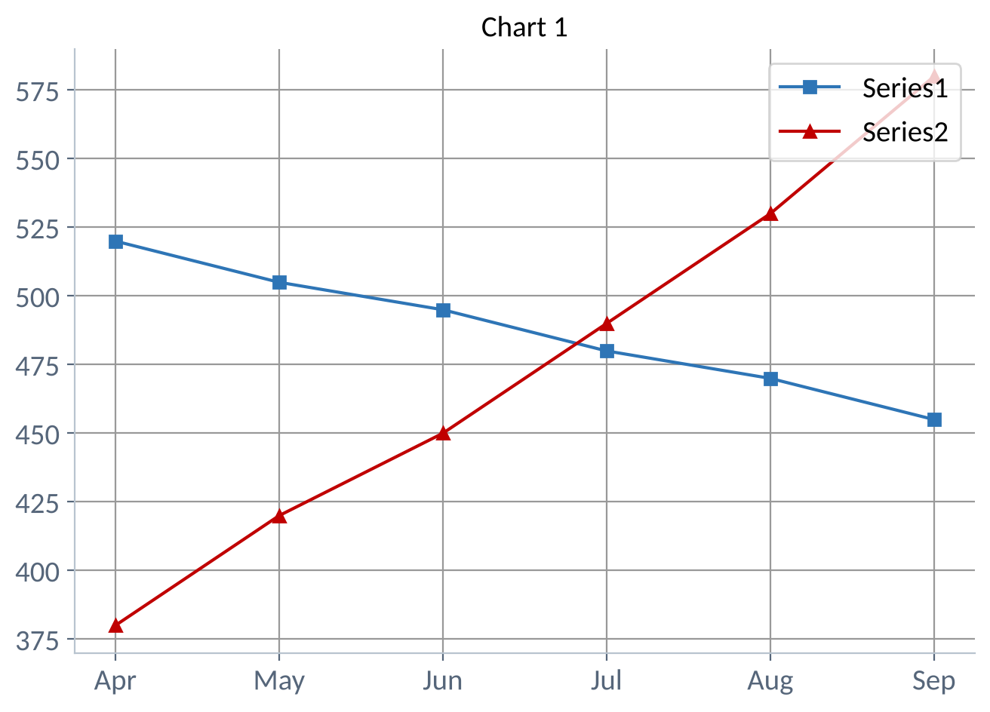
Before: the unlabelled chart
WHAT IS WRONG
Title "Chart 1" says nothing.
No axis titles or units. Orders? Rupees?
"Series1" and "Series2" force the reader to guess.
Dark gridlines compete with the lines.
No sign of what happened when the lines cross.
Notes:
This chart uses real data on the next slide. Give students 30 seconds to write down what they would change. Collect their ideas before moving on.

Slide 8
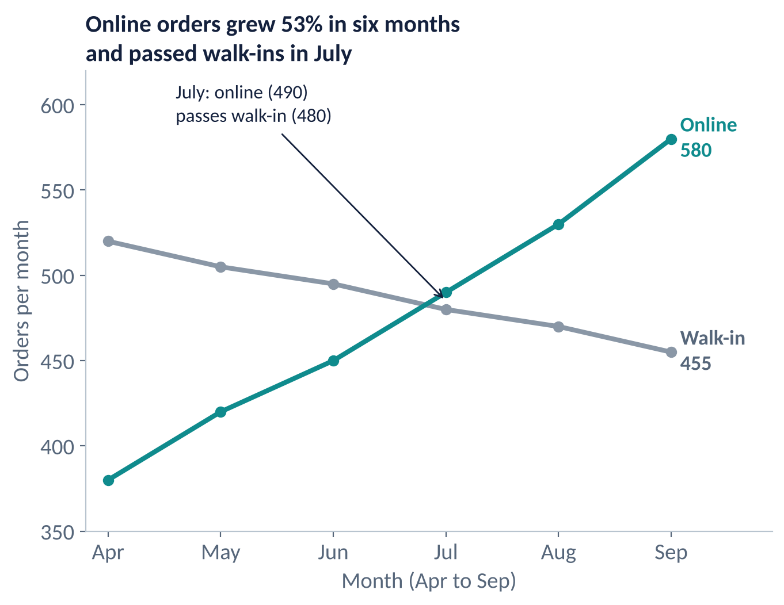
After: same data, fully labelled
WHAT CHANGED
Finding title with a number.
Axis titles with measure and period.
Direct labels at line ends replace the legend.
Teal for the story line, grey for the other.
An annotation marks the July crossover.
Notes:
Same numbers, same chart type. Only the labels changed, yet this version can be understood without anyone talking. Point out that the label colours match the line colours, which links the two without a legend.

Slide 9
Write a finding title with numbers
WORKED EXAMPLE
A cafe tracks monthly orders in two channels from April to September (illustrative data).
Online: 380 in April to 580 in September. (580 - 380) / 380 = +52.6%.
Walk-in: 520 in April to 455 in September. (455 - 520) / 520 = -12.5%.
Crossover: July is the first month online (490) beats walk-in (480).
Title: "Online orders grew 53% in six months and passed walk-ins in July".
RESULT
Round numbers in titles (53%, not 52.6316%), but keep the exact values in the data labels or table.
Notes:
Notice that the title uses two facts from the data: growth and crossover. Ask students if they can add the walk-in decline without making the title too long. Often a subtitle is better.

Slide 10
Direct labels instead of a gridline hunt
WHAT IT SHOWS
Each bar carries its value, so the value axis can go.
Category names sit on the bars, so no legend is needed.
Delay is 46 of 110 complaints, which is 42%.
Colour plus the order of bars tell the same story.
Notes:
Check: 46 + 31 + 18 + 9 + 6 = 110, and 46 / 110 = 41.8%, shown as 42%. Horizontal bars suit long category names, which would be cramped on a column chart.

Slide 11
Add an annotation in Excel
WORKED EXAMPLE
Your monthly orders line chart has a sharp drop in November. Explain it on the chart.
Select the November point, right-click, then Add Data Label. Keep only the value.
Insert a text box: Insert > Text Box. Write "Rival cafe opens 200 m away". Keep it under 8 words.
Add an arrow from the note to the point (Insert > Shapes > Arrow) in dark grey.
Group the items: select all, right-click > Group, so they move together.
RESULT
The drop now has a reason. Annotate only 1 to 3 events so the chart does not become a diary.
Notes:
In Power BI and Tableau the equivalent is a text annotation or reference line. Warn that annotations must stay true to the data: say what happened, and avoid claiming cause unless you know it.

Slide 12
Traps and edge cases
1
Truncated axis, no warning
2
Over-labelling
A bar axis starting at 40 instead of 0 makes small gaps look huge. Start bars at zero, or say so clearly.
A value on every point of a 36-month line is unreadable. Label the first, last, peak and low.
3
Rotated and crowded text
4
Claiming cause
Diagonal labels slow reading. Use horizontal bars or shorter names such as "Jan" instead of "January 2025".
An annotation saying "because of the rival" implies cause. Write "after" unless you have proof.
Notes:
The last point is the one that matters most in business. Two things happening in the same month does not prove one caused the other. Use words like "after" or "coincided with".

Slide 13
Practice questions
Rewrite the title "Sales by quarter" for data where Q4 sales are 25% above Q3.
1
Name three things wrong with an axis labelled "Revenue" showing 500000, 1000000, 1500000.
2
When is a legend better than direct labels?
3
A line chart has 24 monthly points. Which should you label?
4
Notes:
Give four minutes. For question 1, accept any reasonable wording as long as it has a number and a direction.
ANSWERS
1. Example: "Q4 sales rose 25% above Q3". The title states the finding and the size of the change.
2. No unit (₹ or $), too many zeros, no period. Better: "Revenue (₹ lakh)" showing 5, 10, 15.
3. With many overlapping series, or when labels would collide. Otherwise direct labels save the reader a lookup.
4. Label first, last, peak and lowest points, plus any annotated event. Labelling all 24 clutters the chart.

Slide 14
Key takeaways
Title: state the finding, with a number if you can.
✓
Axes: name the measure and the unit on each one.
✓
Direct labels: put names and key values on the chart, not in a legend.
✓
Annotations: explain 1 to 3 key events with short notes and arrows.
✓
Never claim cause from timing alone. Say "after" or "coincided with".
✓
Next: Data-Ink Ratio and Minimalist Design

