Slide 1
Storytelling with Visuals
UNIT II · TOPIC 12
Data Visualization
Business Management Tools I (AE25UCBM001) · SAGE University, Bhopal
Notes:
This session turns charts into messages. A chart shows data, a story shows what the data means and what to do. We use a three-part structure and one worked example with a line chart.

Slide 2
What you will learn
Explain the difference between showing data and telling a story with it.
Use the context, conflict and resolution structure for a data story.
Guide the reader's eye with a finding title, highlight colour and annotations.
Build a short story from a line chart, with numbers computed from the data.
Avoid misleading stories: cherry-picking, truncated axes and false cause.
BIG IDEA
1
chart, one message. The audience should leave knowing what happened and what to do next.
Notes:
Ask: when your friend tells you about a match, do they read the scoreboard or tell what happened? Stories carry meaning. Charts alone often do not.

Slide 3
Data is not a story
A chart dump shows everything and leaves the audience to find the point.
A data story picks one message, builds towards it and ends with an action.
Know the audience: a manager wants the decision, an analyst wants the method.
Start with the so-what: what do you want them to know, feel or do after seeing it?
RULE OF THUMB
If you cannot say the message in one sentence, you do not have a story yet. You have a pile of charts.
Notes:
In a college project presentation, students often show every chart they made. Teach them to pick one, and keep the others in an appendix.

Slide 4
Context, conflict, resolution
1 Context
2 Conflict
3 Resolution
Set the scene. Show normal: what the data looked like and what was expected.
Show the break. A drop, a spike or a gap that surprises or worries.
Show what changed or what to do. End with a recommendation.
The same three beats work for a single chart, a three-slide mini story or a full report.
Notes:
This is the same shape as most films and novels, which is why audiences follow it easily. Ask students to name the three parts of a story they know and compare.

Slide 5
Chart dump vs chart story
Chart dump
Chart story
Six charts on one slide, all the same weight.
Titles name the topic: "Orders by month".
Rainbow colours, no focus point.
Ends with "any questions?".
One chart per slide, one message each.
Titles state the finding: "Orders fell a third".
Grey background data, one highlight colour.
Ends with a recommendation.
Same data in both. The difference is the choices: what to show, what to mute and what to say.
Notes:
Ask students which one they would rather sit through at the end of a long day. Emphasise that choosing what to leave out is part of the craft.

Slide 6
Story beats mapped to chart tools
Beat | Reader asks | On the chart | Tool
Context | What is normal? | Full line, plain colour | Clear axis and units
Conflict | What went wrong? | Shaded band at the dip | Highlight colour
Cause? | Why? | Short note at the event | Annotation + arrow
Resolution | What now? | Recovery marked, number shown | Direct label
Action | What do I do? | One line under the chart | Takeaway text
Match every story beat to one visible element on the chart.
Notes:
This table is the plan for the worked example. Walk down the rows and say which tool we will use. The cause row is careful on purpose: we give the event, not a proven cause.

Slide 7
Build the story: the data and the plan
WORKED EXAMPLE
A cafe near a Bhopal college logs monthly orders, April to March (hypothetical). A rival opens in November.
Data: Apr 820, May 840, Jun 860, Jul 845, Aug 870, Sep 890, Oct 905, Nov 640, Dec 610, Jan 650, Feb 720, Mar 810.
Context: Apr to Oct orders were steady, rising from 820 to a peak of 905.
Conflict: Dec low is 610. (610 - 905) / 905 = -32.6%, about a third lost.
Resolution: A student combo started in January. Mar is 810, which is +32.8% from Dec.
MESSAGE
Orders fell a third after the rival opened, then recovered most of the loss. Mar is still 10.5% below the Oct peak.
Notes:
Verify: 905 - 610 = 295, and 295 / 905 = 0.326. For recovery: 810 - 610 = 200, and 200 / 610 = 0.328. For the gap to peak: 905 - 810 = 95, and 95 / 905 = 0.105. Ask whether the combo caused the recovery. We cannot be sure, so we say "after".

Slide 8
Step 1: show the context plainly
WHAT IT SHOWS
Plain line with axis titles. This is the "before story" version.
The drop is visible but unexplained.
The axis starts at 500 for a line chart, which is acceptable. State it if it could mislead.
Next: add the title, highlight and notes.
Notes:
This is a first draft: readers can see a dip but not why it matters. For line charts the axis need not start at zero, as the eye reads the slope. For bar charts it must. Ask what is missing: a title, a reason and the size of the drop.

Slide 9
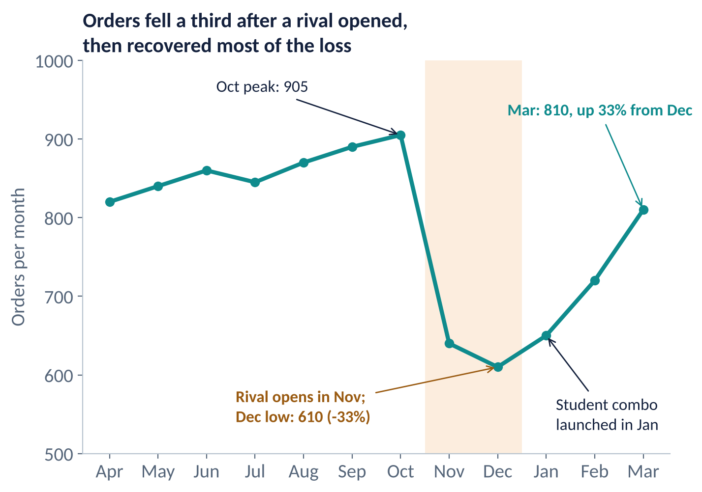
Step 2: add the title and the annotations
WHAT CHANGED
Finding title states the story in one line.
Amber band marks the conflict.
Peak and low are labelled with numbers.
A note marks the rival and the combo launch.
Final label shows the recovery: +33% from Dec.
Notes:
Compare with the previous slide. Same line, but now it tells the story without anyone speaking. Point out that only four annotations are used. Any more would turn the chart into clutter.

Slide 10
Rewrite titles as findings
Topic titles
Finding titles
Slide | Title
1 | Orders by month
2 | Orders: Nov to Dec
3 | Combo launch results
Slide | Title
1 | Orders held at 820 to 905 for seven months
2 | Orders fell 33% after a rival opened
3 | Orders are back to 810 after the combo
Read only the titles on the right and the story is already clear. That is the test of a good story deck.
Notes:
Called the skim test or the title test. If a busy manager reads only the slide titles, they should get the full story. Ask students to write a fourth title that ends with a recommendation.

Slide 11
Traps and edge cases
1
Cherry-picking
2
Misleading axis
Showing only the months that support your point. Show the full period, and say if you cut any.
A bar chart that starts at 600 makes a drop from 905 to 810 look huge. Start bars at zero.
3
False cause
4
Too many messages
"Orders fell because of the rival" is a claim. The data only shows the timing. Say "after".
One chart with five annotations and three highlight colours has no story. Keep to one message per chart.
Notes:
Story is persuasive, which is why honesty matters. Ask: if the rival opened in December and the drop began in November, would this story still stand? No. Always check that your timeline holds.

Slide 12
Practice questions
Name the three parts of a data story and give one chart element for each.
1
Orders: 905 in Oct, 610 in Dec. Find the percentage fall and write a finding title.
2
Why is "because of the rival" risky in an annotation? What is a safer wording?
3
A bar chart of the story starts its axis at 600. What is wrong and how do you fix it?
4
Notes:
Give four minutes. Check question 2: the decline is 295 on a base of 905, so 32.6%, which rounds to 33% in the title.
ANSWERS
1. Context (plain line and axes), conflict (shaded band or highlight), resolution (final label and recommendation).
2. (610 - 905) / 905 = -32.6%. Title: "Orders fell 33% from October to December".
3. Timing alone does not prove cause. Safer: "Rival opens in November" or "Orders fell after the rival opened".
4. It exaggerates the drop. Start bars at zero, or use a line chart where a non-zero start is accepted.

Slide 13
Key takeaways
A story has a message: one chart, one point, one action.
✓
Structure: context, conflict, resolution.
✓
Guide the eye: finding title, one highlight colour, a few annotations.
✓
Show your numbers: quantify the drop and the recovery.
✓
Stay honest: full period, honest axes, "after" and not "because".
✓
Next: Introduction to Visualization Tools

