Slide 1

#LifeKoKaroLift
Group Assignment:
Lending Club : EDA Case Study
Group facilitator : Sumit Rana
Team Member : Bhargava Srivathsan.G
ML_AI_C41 Batch

Slide 2
Problem statement
To Find the Various factors which could help in showcase the driving factors of the Loans default.
To understand various methods of analysis like Univariate and Bivariate.
To Gather various methods of visualizing the data and provide business recommedations.

Slide 3
Data understanding
The Input file contains the loan data in the period of 2007-2011
Total Rows in Original dataset: 39717
Total Columns in Original dataset: 111

Slide 4
Data Cleaning and Manipulation
There are columns in the dataset which contains all null values, so will have no impact on other variables
or on the output of loan credit. So these columns can be removed.
Some columns like 'policy_code' have only one unique value. So they can be removed as well as constant value
does not impact other variables.
Loan_status defines the current state of loan , so segmenting/filtering datasets on the basis of loan status
will help us compare defaulters from non-defaulters.
Cleaning removing columns which are unique identifiers for a row.
These unique identifiers are used for giving identification to each dataset and does not impact or correlate with any variable.

Slide 5
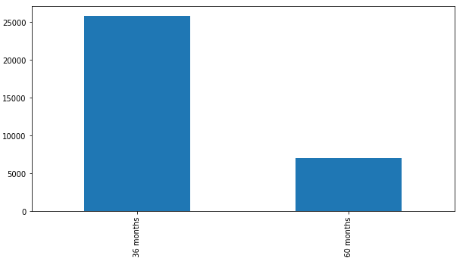
Data Cleaning and Manipulation - Cont
Insights:
Loan Terms for different tenure
Findings:
We could see there people having the loan tenure 25000 plus for 36 months period and 5000 plus people for the period of 60 months.

Slide 6
Data analysis - Univariate Analysis

