Slide 1

Touchless Mouse Control via Hand Gestures Using Residual Neural Network and MediaPipe
Batch No : 04
Presented By:
Digumarthi Srilikhitha : 21761A4218
Karna Bhargava : 21761A4228
Mettu Bharath Kumar : 21761A4238
Basa Bhavana Devi : 22765A4201
Under Guidance of :
Mr. P. Jagadeeswara Rao
Sr. Assistant Professor
LAKIREDDY BALI REDDY COLLEGE OF ENGINEERING
(AUTONOMOUS)
L.B.Reddy Nagar :: Mylavaram – 521 230 :: NTR Dist.:: A.P.
DEPARTMENT OF CSE(ARTIFICIAL INTELLIGENCE AND MACHINE LEARNING)

Slide 2
Contents
Abstract
Objective
Scope
Problem Statement
Basic Concepts
Literature Survey
Drawbacks in Existing System
Proposed System
Methodology
Algorithm & Libraries
Dataset
Implementation
Results
Conclusion
Future Work
References
Details of Journal Paper

Slide 3
Abstract
“Touchless Mouse Control via Hand Gestures enables users to control the system cursor with hand gestures without need for additional hardware.
Low-resolution in-built webcam as an input device to track hand movements.
Implemented by using the deep learning model ResNet-18 and libraries like OpenCV, Mediapipe, PyAutoGUI, PyTorch and PyCAW to ensure fast and accurate gesture recognition.
Key Words :
Hand Gesture Recognition, Virtual Mouse Webcam, Convolutional Neural Network, MediaPipe, ResNet18, OpenCV

Slide 4
Objective of project
This project aims to develop a virtual mouse via hand gestures by utilizing ResNet, OpenCv and Mediapipe.
Our Project makes the human-computer interaction safe and user-friendly.
By eliminating the need for physical input devices, all physical mouse operations are performed by this system.
The system is cost-effective, requiring only a standard webcam for real-time hand tracking.
It also improves accessibility for disabled users and promotes hygiene by reducing physical contact.

Slide 5
Scope of project
User Accessibility:
Touchless solution for daily tasks.
Beneficial for individuals with physical disabilities.
Applications:
Ideal for gaming, VR, and smart environments.
Suitable for hygienic, hands-free settings like healthcare.
Technology Integration:
Uses deep learning (ResNet) for gesture recognition and OpenCV for real-time hand tracking.
Affordable and accessible with minimal hardware (webcam).

Slide 6
Problem Statement
Traditional mouse devices require physical contact, which is not hygienic and can be difficult for disabled users to operate.
Current virtual mouse systems lack accuracy, fail to perform all mouse functions, and struggle in different lighting or noisy environments.
We need a smart, touchless solution that performs all mouse functions accurately, is user-friendly, and works for everyone."

Slide 7
Basic concepts
Touchless Interaction: Controls mouse cursor and actions via hand gestures, eliminating physical devices.
Core Technologies: Uses OpenCV (video processing), MediaPipe (hand tracking), and ResNet-18 (gesture recognition).
How It Works: Webcam captures gestures → Landmarks detected → Gestures mapped to mouse actions (clicks, scrolls).
Key Benefits: Hygienic (no contact), accessible (disability-friendly), and cost-effective (webcam only).
Applications: Ideal for healthcare, gaming, smart classrooms, and VR environments.

Slide 8
Literature Survey
S.No | Paper Title | Authors | Technologies Used | limitations
1 | Eyeball-Based Cursor Movement Control [1], 2021 | A. Sivasangari, D. Deepa, T. Anandhi, A. Ponraj, and M. S. Roobini | Haar Cascade Classifier, OpenCV, Dlib | Causes eye strain with prolonged use
2 | Face Gesture-Based Virtual Mouse Using Mediapipe [2], 2023 | A. Kumar Raja, C. Sugandhi, G. Nymish, N. Sal Havish, and M. Rashmi | CNN for facial recognition, Dlib for face landmark detection, OpenCV for gesture processing | Difficult to track multiple facial features, leading to inaccuracies
3 | Voice Assistant and Gesture Controlled Virtual Mouse Using Deep Learning Technique [3], 2024 | M. Raja, P. Nagaraj, P. Sathwik, K. Μ. Α. Khan, N. M. Kumar, and U. S. Prasad | Deep Neural Networks (DNN) for speech recognition, MFCC for feature extraction, Google Speech Recognition API | Background noise affects accuracy, best in quiet environments
4 | Virtual Mouse Input Control Using Hand Gestures [4], 2021 | M. Mishra, A. Gupta, V. Mehta, and R. Ranjan | MediaPipe Hand Tracking, OpenCV, Euclidean Distance Algorithm for gesture recognition | Requires wearing colored caps, reducing flexibility

Slide 9
Drawbacks in Existing System
Requires Additional Hardware – Users need to purchase finger caps for hand to detect hand accurately.
Limited Mouse Operations – The system supports only basic mouse functionalities, lacking advanced controls like Stop Cursor Movement, Volume Control and Brightness Control.
Dependency on Finger Distance – Mouse operations mainly based on the distance between each finger of hand, which may cause inaccuracies in hand gesture recognition.

Slide 10
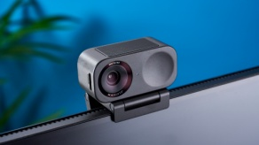
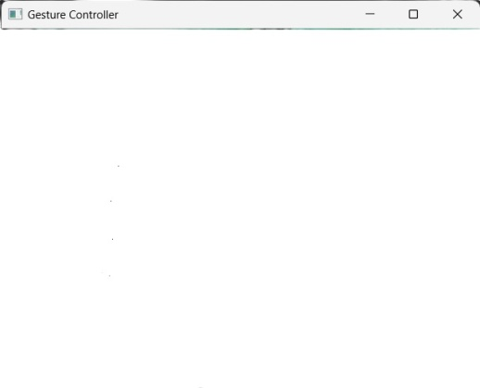
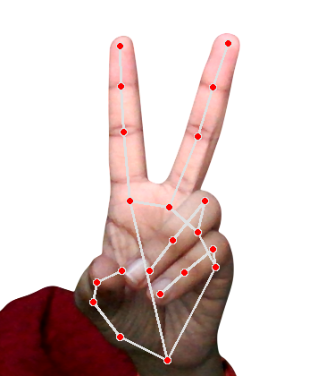

Proposed System
Technology Stack: Uses Deep Learning, ResNet, MediaPipe, OpenCV, and PyAutoGUI for gesture-based control.
Real-Time Tracking: Captures video frames via a webcam and converts them from BGR to RGB for processing.
Hand Landmark Detection: MediaPipe identifies 21 key landmarks for accurate gesture recognition.
Mouse Control: PyAutoGUI translates gestures into cursor movement and click actions.
Accessibility & Efficiency: Hands-free control using a standard webcam, making it cost-effective and user-friendly.
No Physical Input Required : Enables a completely touchless computing experience.

Slide 11
Methodology
Our project follows a structured approach to implementing a gesture-based virtual mouse system using Deep Learning, ResNet, MediaPipe, and OpenCV. The methodology includes four key phases:
Our project has following steps :
Capturing (Input Acquisition)
Processing (Preprocessing & Feature Extraction)
Detecting (Gesture Recognition & Mapping)
Tracking & Control (Hand Gesture to Mouse Control)

Slide 12
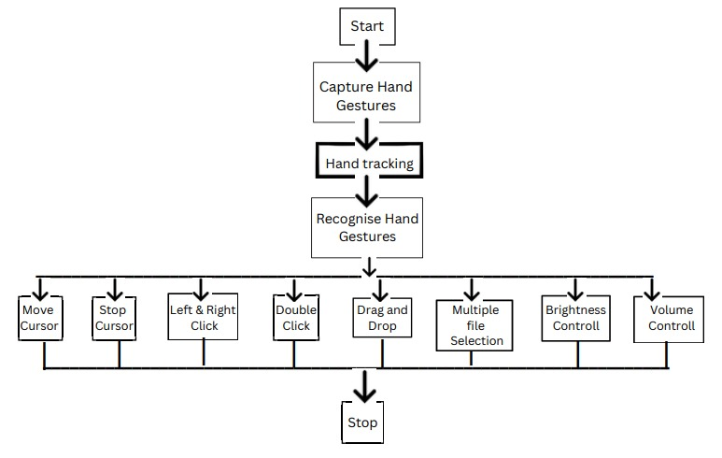
Flow chart of Proposed System

Slide 13
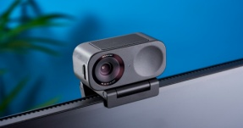
1. Capturing (Input Acquisition)
The system uses a built-in webcam to continuously capture video frames in real-time to check the presence of a hand.
Frames are read using OpenCV (reads images in BGR (Blue-Green-Red) and converted from BGR to RGB (Red-Green-Blue) to ensure compatibility with deep learning models
2. Processing (Preprocessing & Feature Extraction)
OpenCV enhances hand detection by reducing blurriness, and improving image clarity.
MediaPipe Hand Tracking extracts 21 key landmarks from the hand.
ResNet is used for detecting the “No Action” state (idle mouse position).

Slide 14
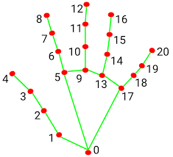
3. Detecting (Gesture Recognition & Mapping)
MediaPipe identifies hand landmarks, including fingertips and knuckles.
The system recognizes gestures such as:
Cursor movement
Left click, Right click, Double click
Volume and brightness control
Drag and drop operations etc..
4. Tracking & Control (Hand Gesture to Mouse Control)
PyAutoGUI translates recognized gestures into mouse actions (cursor movement, clicking, dragging, etc.).
The system continuously updates the cursor position based on hand motion.
Users can interact with the system without a physical mouse, improving accessibility and usability.

Slide 15
Algorithm & Libraries
Algorithm :
ResNet-18, based on the Residual Neural Network (ResNet) architecture, uses skip connections to improve deep learning performance and project trained on the ImageNet dataset.
Libraries :
OpenCV – For real-time video processing
MediaPipe – For hand tracking and gesture detection
PyAutoGUI – For controlling mouse actions
PyTorch – For deep learning-based gesture classification
PyCAW – For volume control
screen_brightness_control – For brightness adjustment

Slide 16
Dataset
We used custom real-time video frame data captured using a webcam.
Pre-trained ImageNet dataset was used for initializing ResNet-18.
Real-time data was processed on-the-fly using OpenCV and MediaPipe for hand landmark extraction.

Slide 17
Implementation
Language Used: Python
Libraries Used: OpenCV, MediaPipe, PyTorch, PyAutoGUI, PyCAW
Steps:
Capture video stream from webcam.
Process each frame using MediaPipe for hand tracking.
Recognize gestures using ResNet model.
Map gestures to cursor actions using PyAutoGUI.

Slide 18
Operations of our Touchless mouse
S. No | Touchless Mouse Operations | Hand Gesture Description | Functionality
1 | No Action | all fingers open (opening hand) | No operation performed
2 | Cursor Movement | Index and middle fingers open, remaining fingers closed | Moves the cursor based on hand movement
3 | Left Click | In the cursor movement pose, the index finger is closed, and only the middle finger open | Performs left click
4 | Right Click | In the cursor movement pose, the middle finger is closed, index finger open | Performs right click
5 | Double Click | In cursor movement pose, both index and middle fingers closed together | Performs double click
6 | Brightness control | Thumb and index fingertips are touched together, remaining fingers closed. | Moving left decreases brightness, and moving right increases brightness
7 | Volume Control | The thumb and index fingertips are touched together, remaining fingers closed. | Moving upwards increases volume, and moving downwards decreases volume­
8 | Drag and Drop | After double-clicking a file, closing all fingers to select the file, moving the closed hand to drag it, and opening all fingers to drop it | Selects and moves files using gestures
9 | Multiple File Selection | Double-click on an empty space in the files area | Selects multiple files

Slide 19
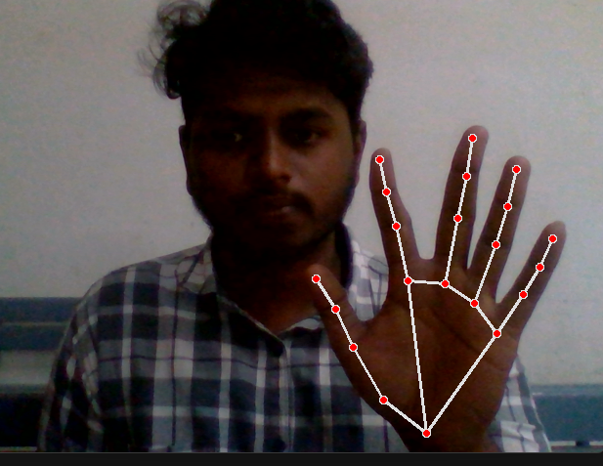
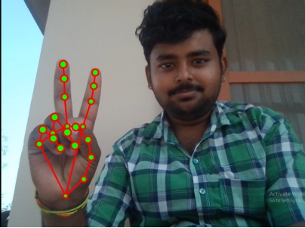
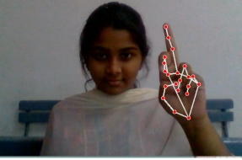
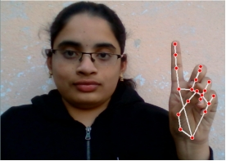
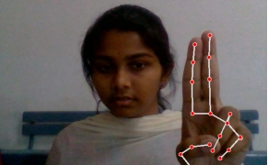
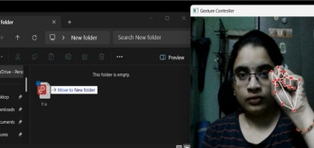
Results
No Action
Mouse moving
Left-Click
Right-Click
Double-Click
Drag & Drop

Slide 20
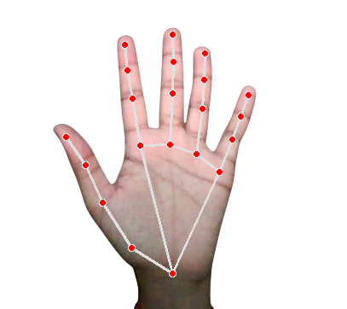

Conclusion
Hands-Free Control – The system enables seamless interaction with a computer using only hand gestures.
Advanced Technology – Utilizes ResNet-18, MediaPipe, OpenCV, and PyAutoGUI for accurate gesture recognition.
No Additional Devices – Eliminates the need for physical devices like gloves or colored markers.
Efficient & User-Friendly – Provides a simple, fast, and intuitive alternative to the traditional mouse.
Practical Applications – Useful in offices, hospitals, and classrooms to reduce physical contact and maintain hygiene.

Slide 21
Future Work
In smart classrooms, presentations can be managed by teachers without touching a mouse or keyboard, ensuring a smoother and more hygienic learning process.
In gaming, a more immersive experience is provided, allowing players to use hand gestures instead of traditional controllers.
System enhancements can be introduced by adding more gestures for undo & redo functions, tab switching, screenshot capturing, and copy-paste operations.
Software optimization for mobile devices, tablets, and smart TVs is planned to expand gesture control beyond standard computer systems.

Slide 22
References
[1] R. Dadlani, S. Dumbre, S. Mishra and A. Tewari, “Eyeball Movement Mouse using Hand Gestures," 2021 International Conference on Technological Advancements and Innovations (ICTAI), Tashkent, Uzbekistan, 2021, pp. 340-345, doi: 10.1109/ICTAI53825.2021.9673251.
[2] A. Kumar Raja, C. Sugandhi, G. Nymish, N. Sai Havish and M. Rashmi, "Face Gesture Based Virtual Mouse Using Mediapipe," 2023 IEEE 8th International Conference for Convergence in Technology (I2CT), Lonavla, India, 2023, pp. 1-6, doi: 10.1109/I2CT57861.2023.10126453.
[3] V. A. Devi, J. E and K. R, "Enhancing User Interaction: Gesture-Enabled Virtual Cursor with Voice Integration," 2024 4th International Conference on Pervasive Computing and Social Networking (ICPCSN), Salem, India, 2024, pp. 279-286, doi: 10.1109/ICPCSN62568.2024.00052.
[4] R. Matlani, R. Dadlani, S. Dumbre, S. Mishra and A. Tewari, "Virtual Mouse using Hand Gestures," 2021 International Conference on Technological Advancements and Innovations (ICTAI), Tashkent, Uzbekistan, 2021, pp. 340-345, doi: 10.1109/ICTAI53825.2021.9673251.

Slide 23
Details of Journal Paper & Conference
Accepted for Publication and Presentation on International Conference on Information and Computer Technologies - (ICICT-2025)

Slide 24
