Slide 1

FarmClick

Slide 2
INCENTIVE:
This application is an attempt to introduce technology to the farmers so that it could aid them to sell their produce,keep tabs on their loans and government policies.
It is aimed to equip the farmer with information preventing them from having to go through mundane process.
This is a full fledged farmer friendly application in which use cases related to problems other than selling produce,loans may also be addressed in the future.

Slide 3
USE CASES:
The application provides the farmers with the details of potential buyers of their produce each time they are willing to sell.
At the end of every cropping season when the farmer is ready with his yield,he needs to travel to nearby market places and talk to market retailers.
This process may turn out to be mundane and sometimes may not be trustworthy as the farmer may be duped and may get underpaid for the produce.
The above mentioned approach may get these farmers in touch with multiple dealers ahead of the harvest.

Slide 4




Slide 5
It also allows the market retailers to register themselves as buyers on the application.
Market retailers may register and get notified about the requests from farmers regarding a deal related to a particular produce.
This in turn may even help the retailers who are in immediate need of produce and are willing to buy the yield.

Slide 6
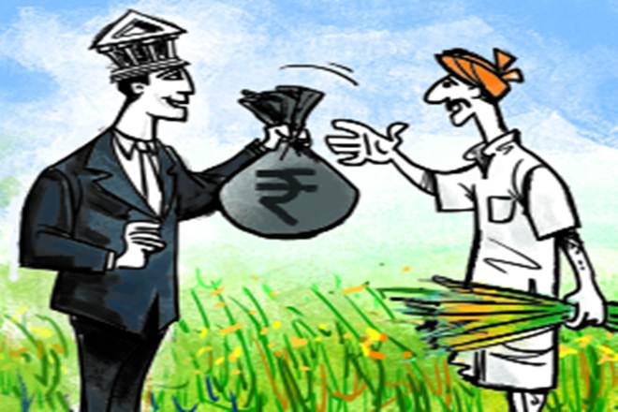

It also provides information regarding financial support from banks and how to keep tabs on the loan and interest.
A very incessant issue in the farmer community is financial aid.

Slide 7
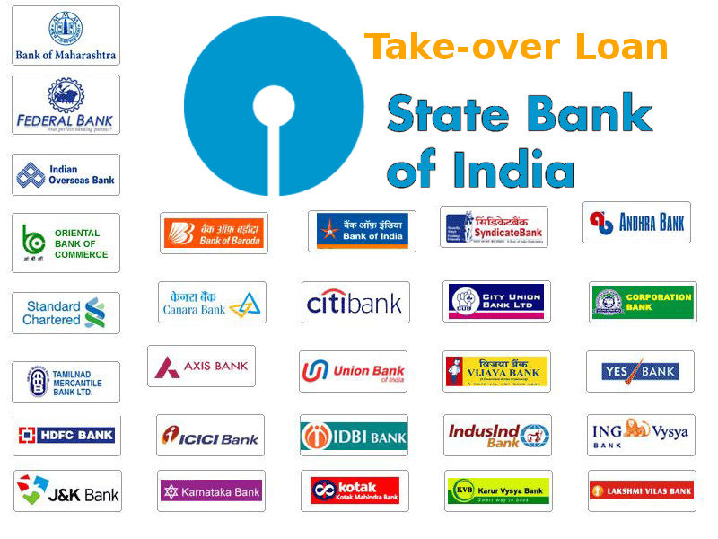
The farmers often prefer to borrow money from the moneylenders and get swindled out of their income under the name of interest.
This particular use case is aimed to equip the farmers with knowledge helping them to comfortably pay off their loans.

Slide 8
Farmers are also provided information regarding the government policies benefiting the farmers.
Many policies are introduced by the government in the favour of the farming community.
These may even go unnoticed by the farmers,so in order to overcome the barrier of unawareness,this use case has been designed.

Slide 9
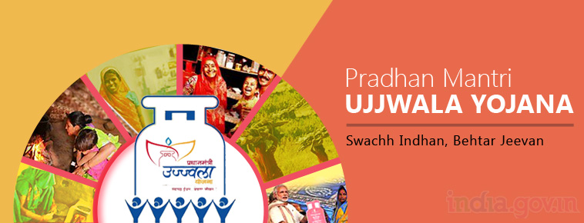

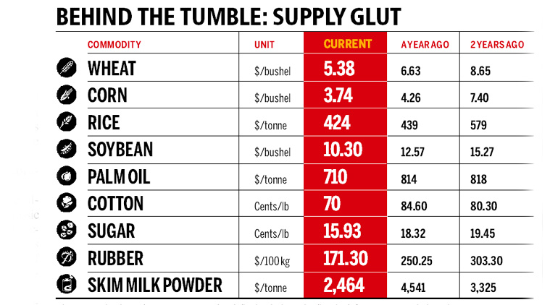

Slide 10
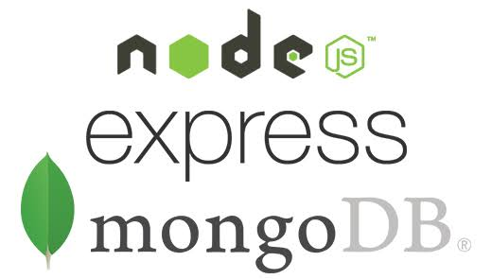
TECH STACK:

Slide 11
Frontend : HTML,CSS,JavaScript
Backend Language:Node.js
Web Application Framework : Express.js
Database Software : MongoDB

