Slide 1

Energy Consumption Analysis

Slide 2
Objective of the Project
Energy is the primary engine of economic growth but also the leading driver of environmental change.
Leveraging authoritative various countries data structured in a MySQL relational database.
We integrate five critical dimensions to model reality:
1. Energy Consumption & Production
2. CO2 Emissions
3. Economic Power (GDP)
4. Demographics (Population)
To visualize the correlation between a nation's wealth and its environmental footprint, identifying trends in global sustainability.

Slide 3
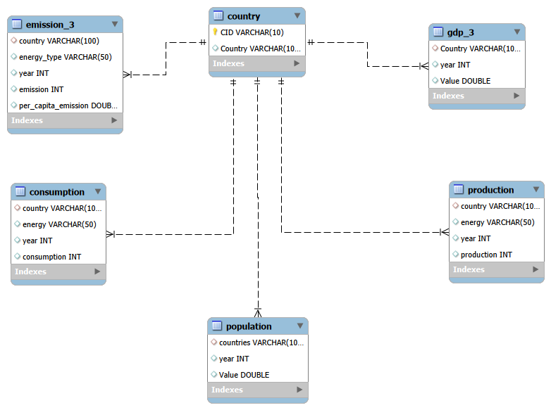
ER Diagram and schema explanation

Slide 4

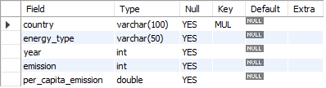

TABLES
COUNTRY TABLE
EMISSION_3 TABLE
POPULATION TABLE

Slide 5



TABLES
PRODUCTION TABLE
GDP TABLE
CONSUMPTION TABLE

Slide 6

Problem statement
While energy consumption is the primary engine of global economic growth, it remains the leading driver of environmental degradation. Stakeholders currently lack an integrated analytical framework to visualize the complex trade-offs between economic power (GDP), population dynamics, and carbon footprints, hindering the identification of critical energy deficits and actionable strategies for global sustainability.

Slide 7
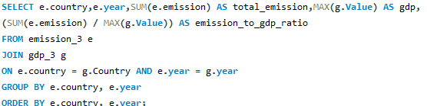
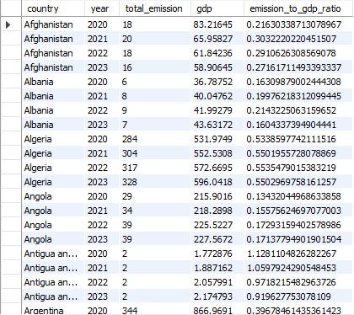
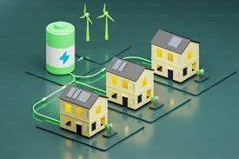
Efficiency & Sustainability
What is the emission-to-GDP ratio for each country over time?

Slide 8
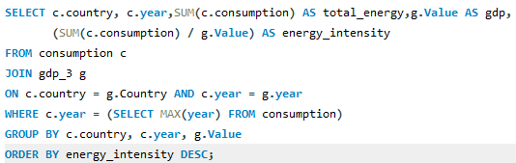
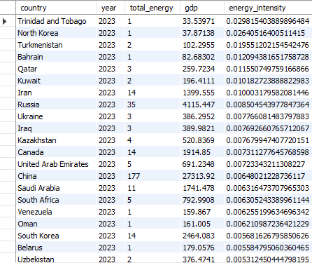
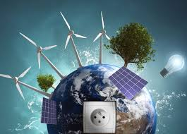
Which countries have the highest energy consumption relative to GDP?

Slide 9
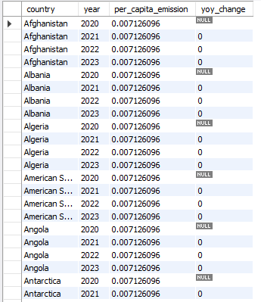
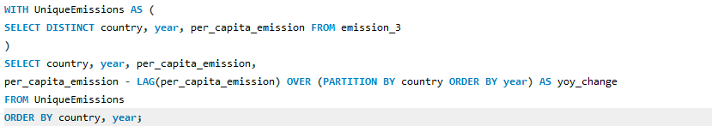
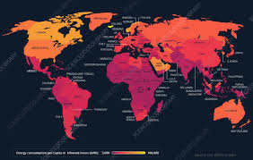
What is the average yearly change in emissions per capita for each country?

Slide 10

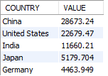

What are the top 5 countries by GDP in the most recent year?

Slide 11
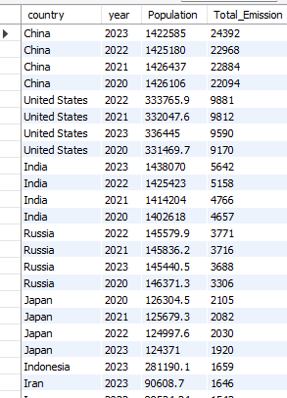
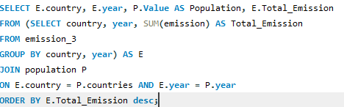

Correlation & Cause"
How has population growth affected total emissions in each country?

Slide 12
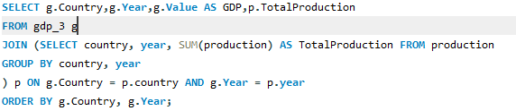
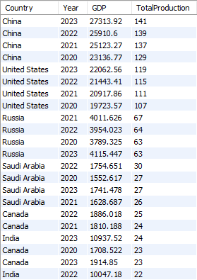
What is the correlation between GDP growth and energy production growth?

Slide 13


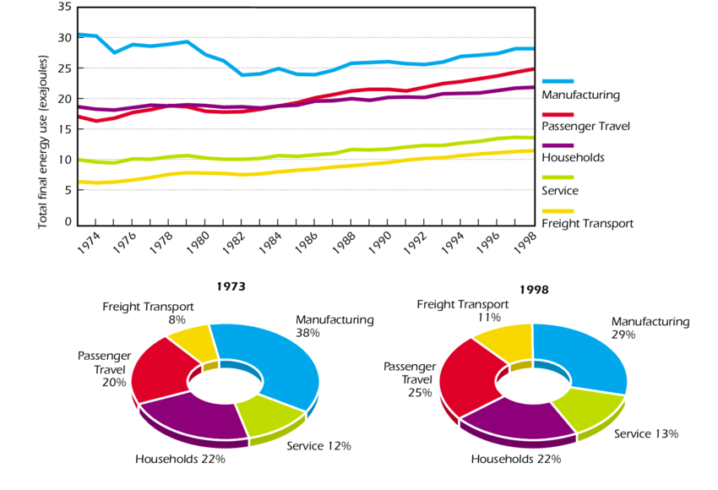
Which energy types contribute most to emissions across all countries?

Slide 14
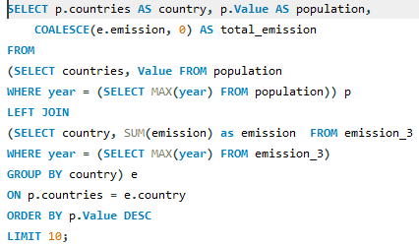
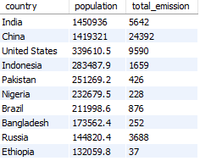
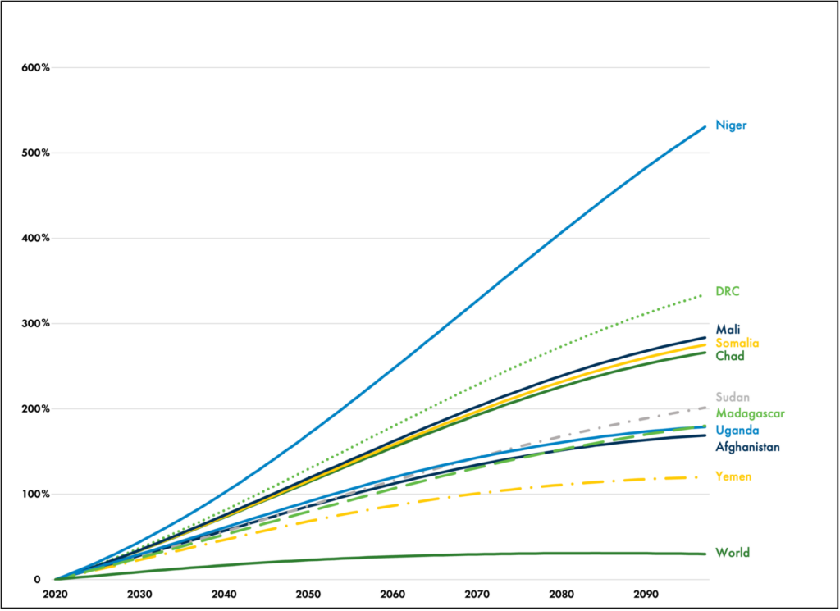
What are the top 10 countries by population and how do their emissions compare?

Slide 15


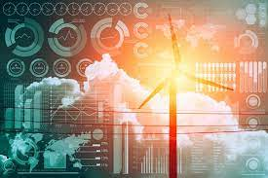
Trend & Forecast
How have global emissions changed year over year?

Slide 16
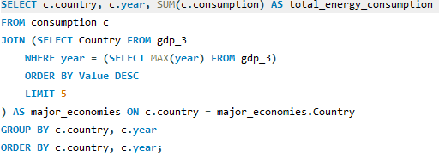
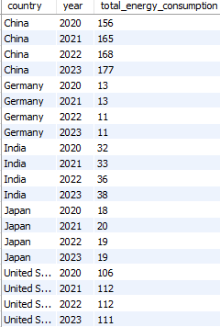
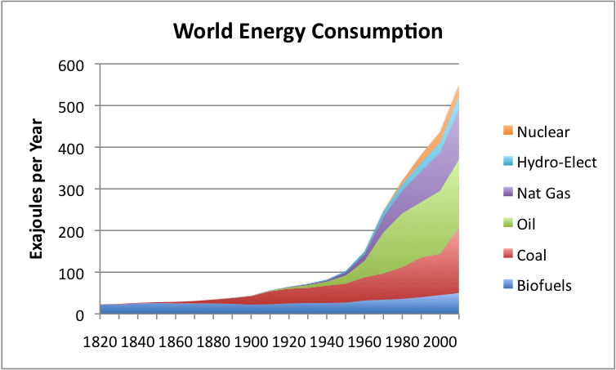
Has energy consumption increased or decreased over the years for major economies?

Slide 17
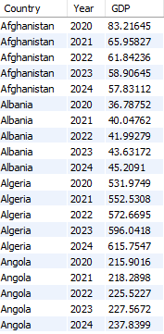

What is the trend in GDP for each country over the given years?

Slide 18
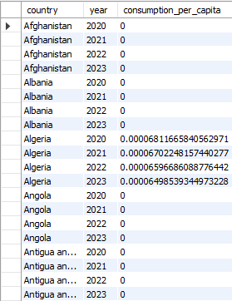
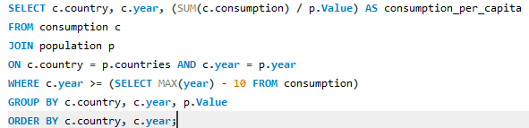
What is the energy consumption per capita for each country over the last decade?

Slide 19
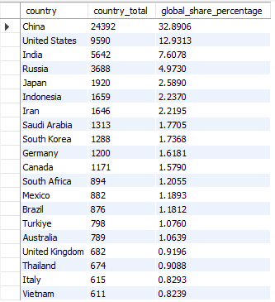
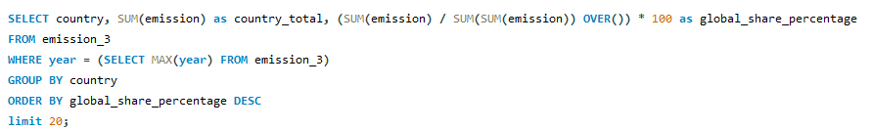
Global Context
What is the global share (%) of emissions by country?

Slide 20
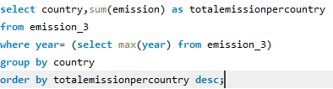
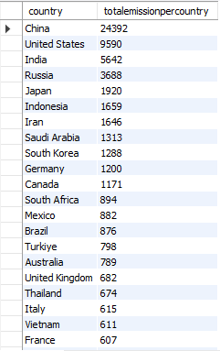

What is the total emission per country for the most recent year available?

Slide 21
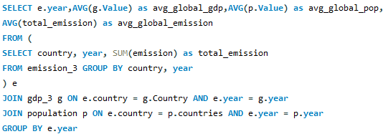
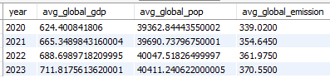
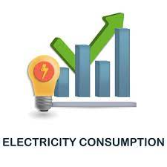
What is the global average GDP , Emission and population by year?

Slide 22
Final business insights and recommendations
The Energy Deficit Trap: Despite high production, major economies like China and India face significant deficits (Consumption > Production), driving a reliance on imports compared to net exporters like Russia.
Dominant Emission Drivers: Coal remains the leading specific contributor to emissions (~64k MMtonnes), proving that heavy industry continues to rely on the most carbon-intensive fuel sources.
The Efficiency Paradox: High GDP does not equal high inefficiency; smaller nations like Trinidad and
Tobago often exhibit far higher energy intensity (wastefulness per dollar of GDP) than economic superpowers.
Global Concentration: The top three nations (China, USA, India) generate over 53% of global emissions, meaning targeted reductions here outweigh total net-zero efforts in dozens of smaller nations.

Slide 23
Conclusion
Unabated Growth: Global emissions persist on an upward trajectory, rising from 67,852 in 2020 to 74,161 in 2023,outpacing current interventions.
Industrial Impact: Population is not the sole driver; despite similar demographics (~1.4B),China emits ~4x more than India (24k vs 5.6k) due to its heavy industrial energy mix.
Economic Decoupling: Data confirms that sustainable growth is possible, as select nations have maintained GDP growth while stabilizing emissions (lowering emission-to-GDP ratios).
The integrated SQL analysis reveals a global economy that is growing wealthier but
increasingly polarized between energy "Net Exporters" and reliant "Net Importers".

Slide 24

THANK YOU

