Slide 1
Text-to-Video of Various PIB Press Releases using Artificial Intelligence / Machine Learning / Generative Adversarial Networks in English and 13 Regional Languages
CSE7101- Capstone Project
Review-1
Batch Number:PSCS_36
Roll Number | Student Name
20221CSE0251 | Thummala Bhargavi
20221CSE0126 | DOODAKULA SAJIDA
20221CSE0417 | PINNAPAREDDY YOGANANDA REDDY
Under the Supervision of,
Dr.Jothish C
Associate Professor
School of Computer Science and Engineering
Presidency University
Name of the Program: Text to Video of various PIB Press Releases
Name of the HoD: Dr . Asif Mohammed
Name of the Program Project Coordinator:Dr . Jayavadivel Ravi
Name of the School Project Coordinators: Dr. Sampath A K , Dr. Geetha A

Slide 2
Problem Statement Number: PSCS_36
Organization: Ministry of Information and Broadcasting
Category (Hardware / Software / Both) :Software
Problem Description: Government press releases are often long, text-heavy, and inaccessible to a wide audience, especially to those with literacy barriers or time constraints. There is no automated, multilingual tool that can transform these documents into engaging video formats with narration and visuals.

Slide 3
Content
Problem Statement
Objectives
Background and Related work for title Selection
Analysis of Problem Statement
Innovation or Novel Contributions
Git-hub Link
Timeline of the Project
References

Slide 4
Content (continuation)..
Problem Description: Press releases from the Press Information Bureau (PIB) are currently available in text form, which may fail to capture user attention due to declining attention spans. The project proposes developing AI-powered software that automatically converts PIB press releases into engaging videos in English and 13 regional languages, integrating copyright-free multimedia, text-to-speech narration, and a review-and-approval workflow.

Slide 5
Objectives:
Automate press release parsing and summarization.
Convert text to multilingual audio narration.
Add relevant images/videos for better engagement.
Provide an easy-to-use web interface for users to upload and generate videos.

Slide 6
Background and Related Work:
AI-based summarization (T5, BART) widely used in news processing.
Text-to-Speech services (Google TTS, Amazon Polly) in commercial apps.
Existing tools lack multilingual + automated video generation for official documents.
GANs and ML models have been applied in news summarization and AI-driven media production.

Slide 7
Innovation or Novel Contributions:
Multilingual Support – Converts press releases into videos in English + 13 Indian languages.
Fully Automated Pipeline – From text → summarization → TTS → video generation without manual steps.
Official Document Optimization – Maintains tone, accuracy, and government compliance standards.
Domain-Specific Summarization – Fine-tuned NLP models for formal and fact-heavy press notes.
Adaptive Voice & Media Retrieval – Matches narration voice to language and tone, fetches relevant images/videos automatically.
Standardized Formatting – Ensures correct emblem placement, fonts, and background music for official use.
Scalable Design – Capable of processing multiple press releases daily in real-time.

Slide 8
Technology Stack Components
1.Frontend: HTML, CSS, JavaScript (Flask templates for approval UI)
2.Backend: Python (Flask framework)
3.AI/ML: Google Cloud Text-to-Speech, NLP keyword extraction, optional GAN for image generation
4.Media Processing: MoviePy, FFmpeg
5.Database/Storage: Local storage or Cloud (S3/GCS) for media pool
6.Integration: Pixabay/Unsplash API for copyright-free images
7.Deployment: Local server / Cloud Run / AWS EC2

Slide 9
Github Link
The Github link provided should have public access permission.
https://github.com/TexttovideoPressReleasesusingAi

Slide 10
Analysis of Problem Statement
Software Requirements:
OS: Windows 10+ / Linux / macOS
Language: Python 3.10+
Libraries: Flask, MoviePy, Requests, pydub, Pillow, FFmpeg, Google Cloud TTS SDK (optional)
Storage: Local or Cloud (S3 / GCS)
Version Control: Git + GitHub
Tools: VS Code, Browser (Chrome/Firefox)

Slide 11
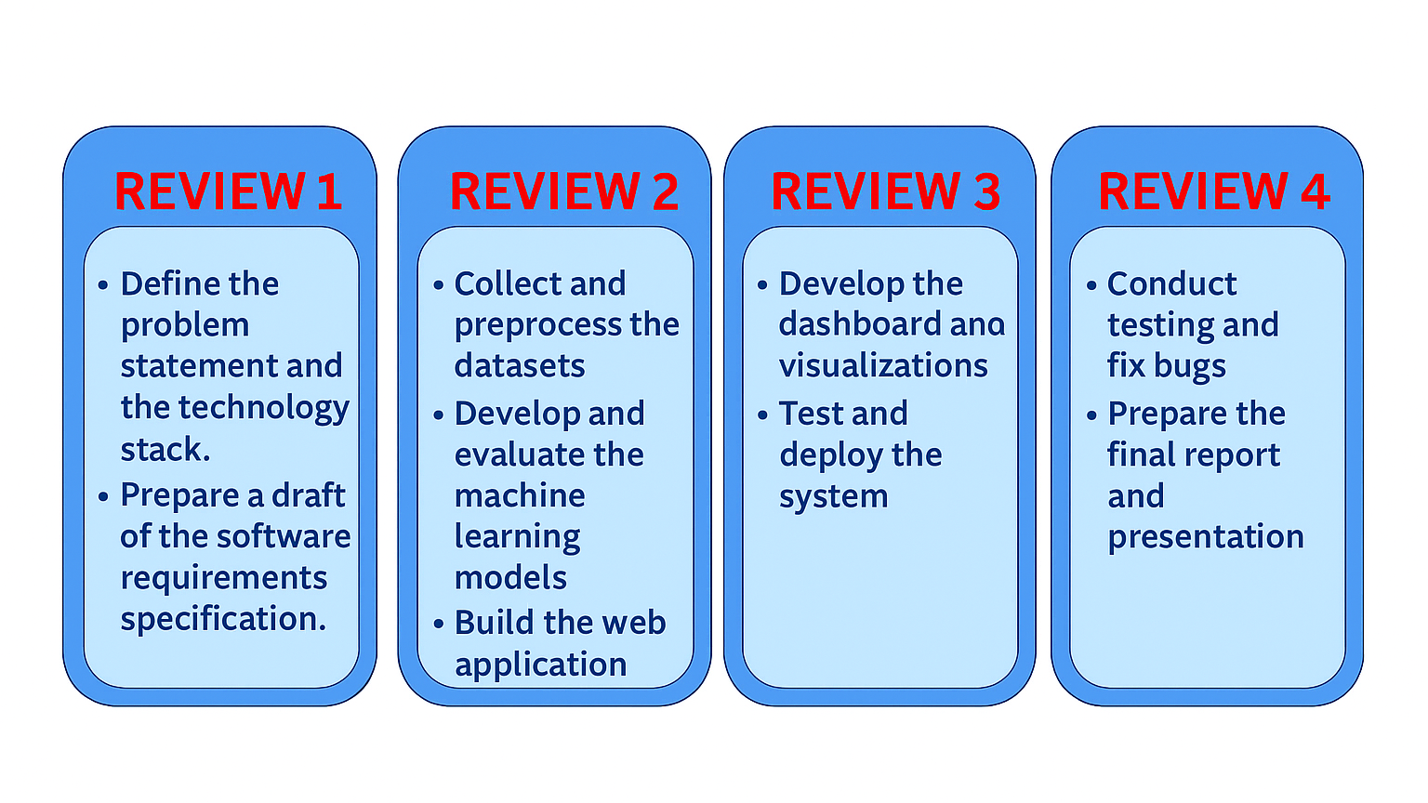
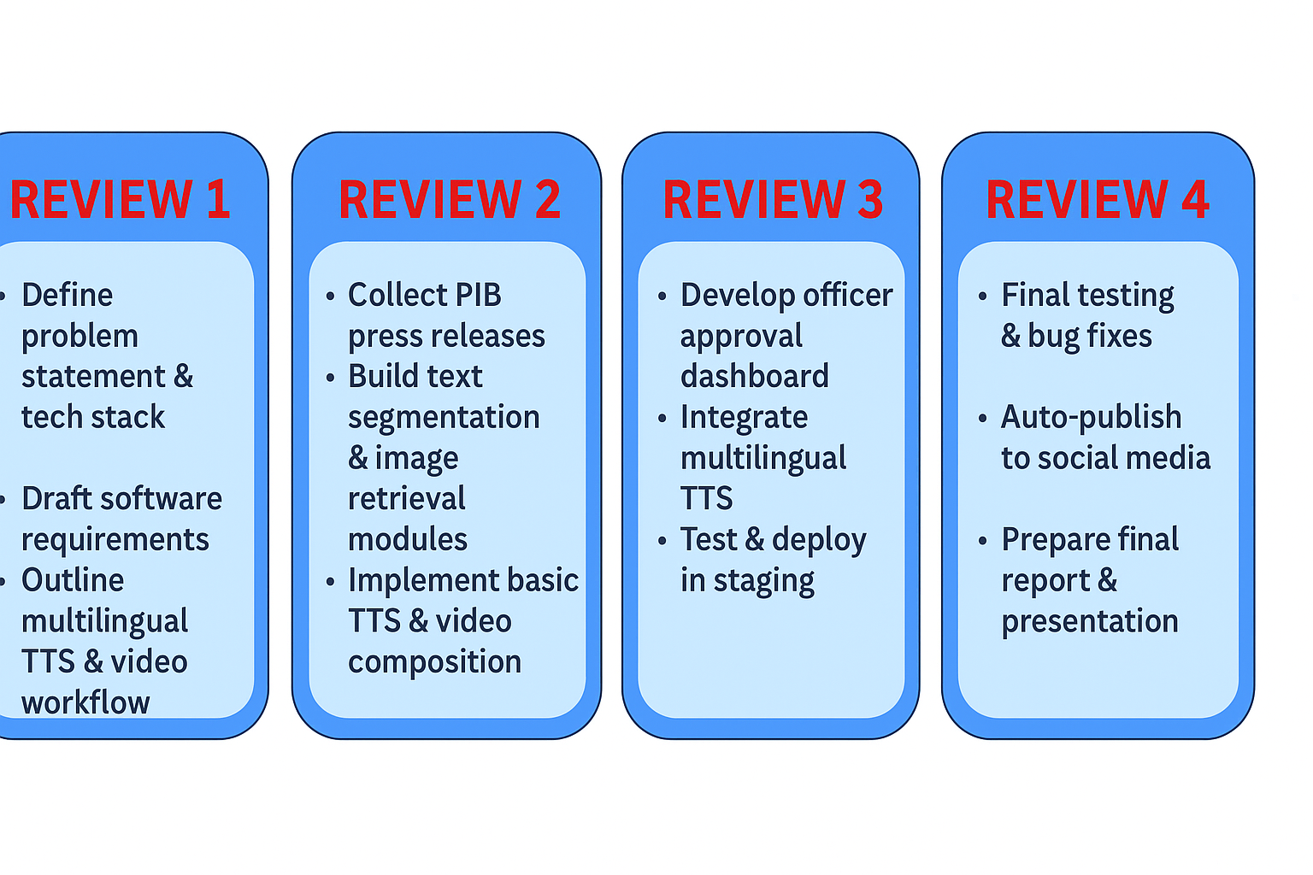
Timeline of the Project (Gantt Chart)

Slide 12
References (IEEE Paper format)
[1] A. Kumar, B. R. Patel, and C. Zhang, “Plant disease identification using convolutional neural networks,” IEEE Access, vol. 9, pp. 34567–34578, Mar. 2021.
[2] J. Smith, “Deep learning in agricultural systems,” IEEE Trans. Neural Netw. Learn. Syst., vol. 32, no. 7, pp. 1234–1245, Jul. 2021.
[3] S. Gupta, P. Roy, “Automated video generation from text using deep learning,” Proc. IEEE Int. Conf. AI & Data Eng., pp. 112–118, Dec. 2022.
[4] Google Cloud, “Text-to-Speech documentation,” Available: cloud.google.com/text-to-speech/docs.
[5] Pixabay, “Pixabay API documentation,” Available: pixabay.com/api/docs/.

Slide 13


