Slide 1
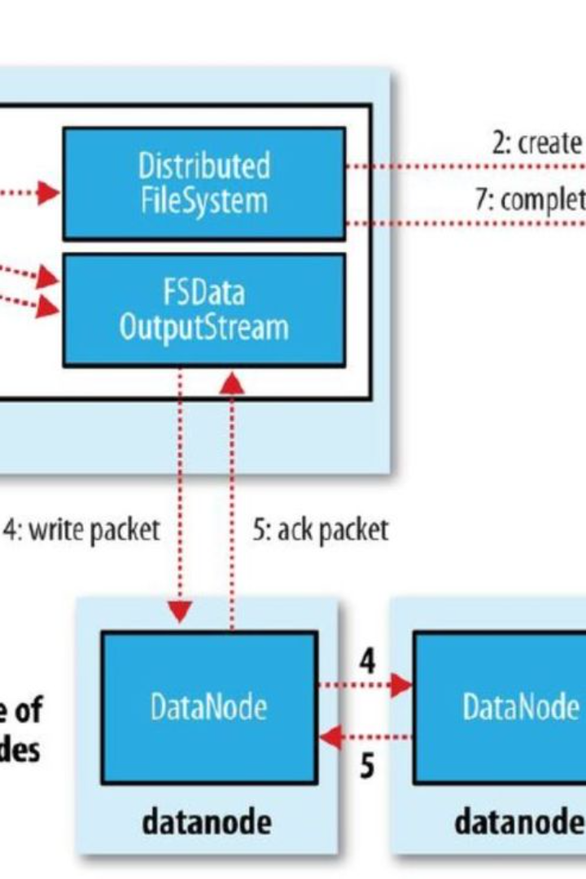

Understanding Hadoop and HDFS
For IT professionals and students venturing into the realm of big data, Hadoop and the Hadoop Distributed File System (HDFS) are foundational technologies. Hadoop has become synonymous with big data processing, thanks to its flexibility, scalability, and fault-tolerant storage system. HDFS, the storage layer of Hadoop, is designed to store vast amounts of data across many machines while maintaining integrity and availability. This series of sections provides in-depth insights into interacting with HDFS, a utility that has become indispensable for storing and managing big data. Mastering the commands presented herein will empower you to work effectively with large-scale data infrastructures.
Ba
by Bhargavi Upadhyay

Slide 2


HDFS Directory Structures
Proper organization of data within HDFS is crucial for efficient data retrieval and management. Like the familiar file systems on UNIX/Linux systems, HDFS allows users to create a hierarchy of directories to systematize data storage.
Create a Directory
Parent Directories
The command 'hadoop fs -mkdir -p /desired/path' creates a new directory within HDFS, along with all necessary parent directories. This mimics the 'mkdir -p' command on Unix/Linux systems for directory creation.
Using the '-p' flag in the context of HDFS ensures that any non-existent parent directories are also created. This avoids errors and streamlines the process of setting up complex directory structures.

Slide 3
Moving Data to HDFS
Transferring data from a local filesystem to HDFS is a standard practice for ingesting data into a Hadoop cluster. The following commands are used to copy files and directories from a local system to HDFS, ensuring data is properly placed for distributed processing.
Single File Transfer
Directory Transfer
The 'hadoop fs -copyFromLocal /local/file.txt /hdfs/path' command transfers an individual file to the designated HDFS location. It's the ideal choice when dealing with a single dataset or file.
When moving directories, 'hadoop fs -copyFromLocal /local/directory /hdfs/path' recursively copies the directory and its contents into HDFS, essential for batch data uploads.

Slide 4
Viewing Files in HDFS
Once data is stored on HDFS, the ability to view and verify contents becomes essential for data management and auditability. HDFS provides commands tailored to this need.
Command
Description
hadoop fs -cat /hdfs/file.txt
Display the content of a single file to the terminal, useful for quickly checking data samples or file integrity.
hadoop fs -ls /hdfs/path
List all items in an HDFS directory, including files and subdirectories, a core command for navigating and inspecting HDFS contents.

Slide 5
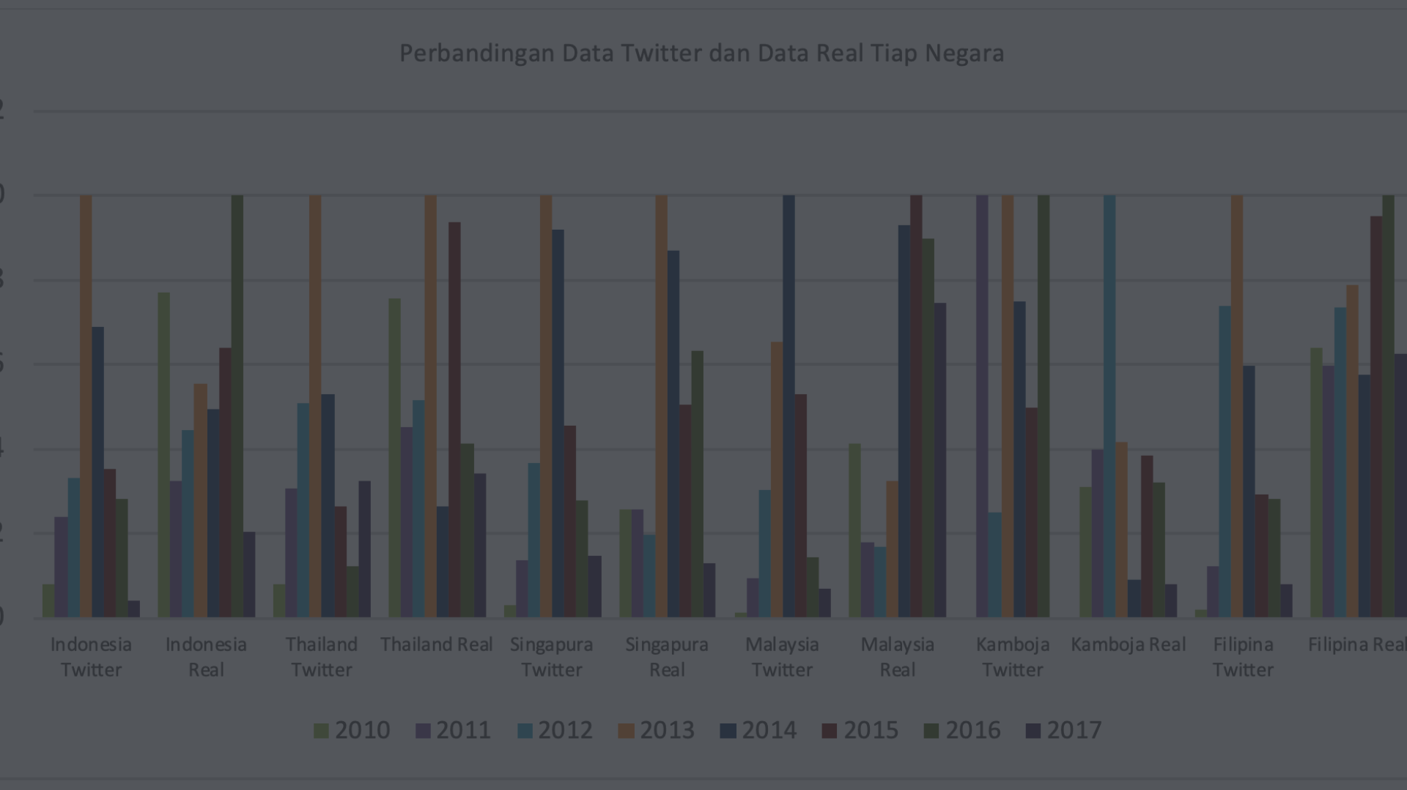
The '-mkdir' Command in Detail
Critical for setting up initial data storage structures in HDFS, the 'mkdir' command is a powerful tool in the Hadoop ecosystem. Here we explore its use and best practices.
1
Create Nested Directories
2
Prevents Errors
3
Flexible and Secure
The inclusion of the '-p' parameter prevents the system from raising errors if the specified parent directories already exist, facilitating script automation.
This command provides a secure method for directory creation, ensuring that user permissions are honored and directory integrity is maintained.
Using 'hadoop fs -mkdir -p /path/to/your/directory' allows for the creation of nested directories in a single command, which is particularly useful when establishing complex directory hierarchies.

Slide 6

Deep Dive: The '-copyFromLocal' Command
Efficient data migration is among the preliminary steps when managing workflows in Hadoop. The '-copyFromLocal' command is designed to streamline the process of moving data from the traditional filesystems to HDFS.
1
File Selection
Identify and select the file from the local filesystem that requires migration to HDFS.
2
Path Designation
Decide upon the destination path within HDFS where the file will reside, ensuring it aligns with your data organization strategy.
3
Execution
Execute the command with the specified paths to transfer the file securely into the Hadoop ecosystem.

Slide 7
Listing Contents with '-ls'
Finding and understanding the composition of directories in HDFS is facilitated by the 'ls' command. It is analogous to its UNIX/Linux counterpart and offers an immediate glimpse into the structure of data within your Hadoop environment.
1
2
Directories
Files
Count of directories within the specified HDFS path.
Number of files residing in the directory, a quick metric of data volume.

Slide 8
Best Practices for HDFS Commands
As with any technology, using HDFS effectively involves adhering to certain best practices that ensure operational efficiency, data security, and system reliability. We will consolidate a few of the critical tips related to using these commands.
Path Verification
Permission Checks
Before executing commands, verify the correctness of the file paths to prevent misplacement of data within HDFS.
Ensure that you have the necessary permissions to execute the commands, especially in multi-user environments.
Automation and Scripts
Data Integrity
Leverage scripts to automate repetitive command sequences, enhancing efficiency and reducing the potential for errors.
Perform regular checks on the data integrity after any major data transfers or manipulations within HDFS.

