Slide 1
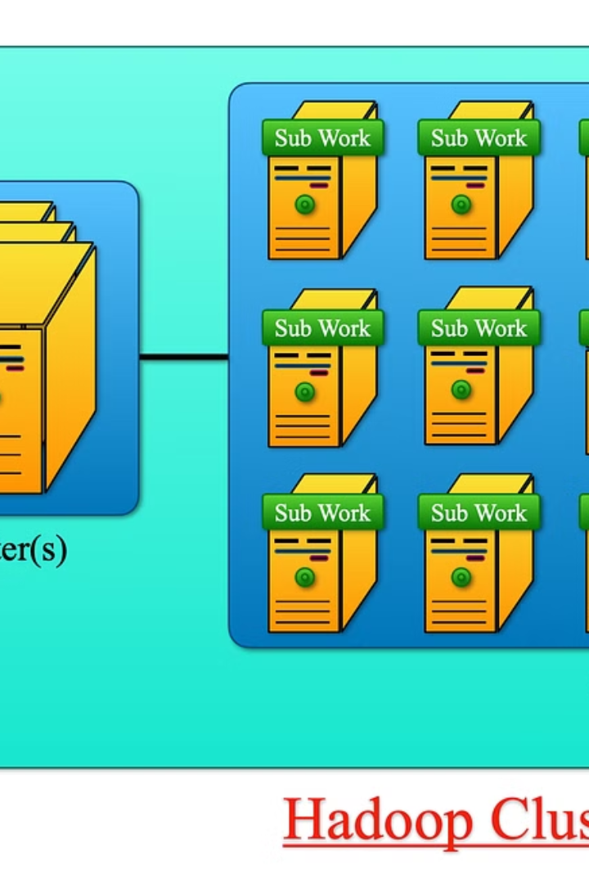

The MapReduce Ecosystem in Hadoop
Welcome to the intricately engineered world of Hadoop's MapReduce framework, where data is not merely processed‒ it's sculpted through the prowess of distributed computing. As software developers and data engineers preparing to embark on the Hadoop journey, sharpening your Java acumen is the cornerstone for orchestrating this symphony of data. In this educational exposition, we peel back the layers to explore the facets of Java that are fundamental in actualizing the full potential of MapReduce within the Hadoop Distributed File System (HDFS). Prepare to delve into the Java concepts that interlace the robust fabric of Hadoop and ensure your data processing is efficient, scalable, and fault-tolerant.
Ba
by Bhargavi Upadhyay

Slide 2
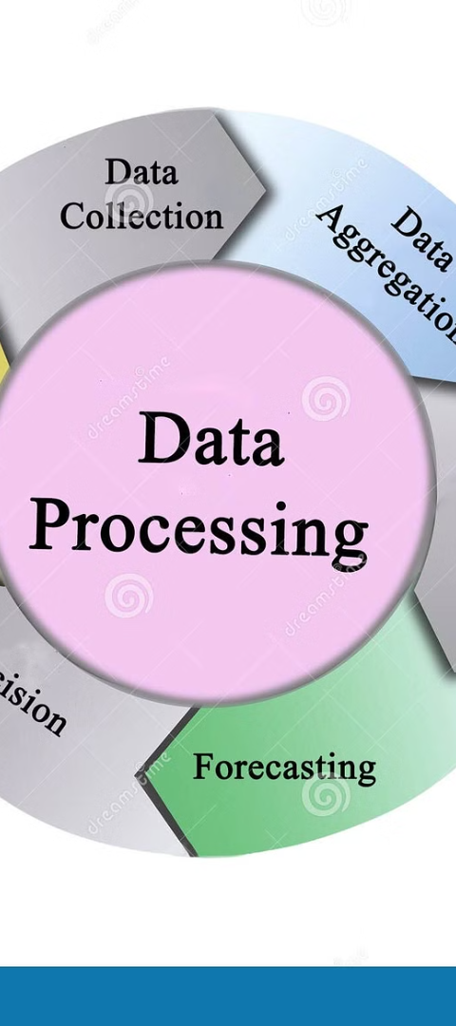
Anatomy of the MapReduce Framework
1
Map Function
Comprehending the Map function is like dissecting the DNA of the MapReduce framework. It's the initial, transformative step where input data is dissected into key-value pairs for detailed examination.
2
Shuffle and Sort
After the mapping, comes the intricate shuffle and sort phase. Here, data from various mappers is intelligently collated and organized, setting the stage for the reduced act that follows.
3
Reduce Function
The Reduce function is akin to piecing together a complex puzzle. It interprets the key-value data sets, merging them into a more coherent and consolidated output that crystallizes the data's essence.

Slide 3

Java: The Heartbeat of Hadoop
1
Syntax Mastery
2
Data Structures Refined
To wield Hadoop's MapReduce effectively, one must first be fluent in the language of Java. Here, the precision of syntax is not just style but substance in crafting robust data solutions.
Data structures are the blueprints providing form to the otherwise unstructured heaps of data. Your adeptness in using them can dramatically alter performance and efficiency.
3
OOP Principles
Object-Oriented Programming (OOP) is the philosophy guiding your Java journey in Hadoop. Understanding the principles of encapsulation, inheritance, and polymorphism is crucial for sophisticated data processing.

Slide 4
Deciphering Input and Output Formats
TextInputFormat
The baseline format accepting raw data in its text-based simplicity, one line at a time.
KeyValueTextInputFormat
A touch more refined, it looks for the tab as a delimiter to separate the keys from the values.
SequenceFileInputFormat
A binary format that's not just efficient but dependable for reading sequences of serialized key-value pairs.
SequenceFileOutputFormat
On the other side, efficiency reigns as well, with this format persisting results back in a compact, sequence-based way.

Slide 5
Serialization within the Hadoop Universe
Why Serialize?
Efficiency in Serialization
Deserialization
Serialization is the alchemy of turning Java objects into a format that can traverse networks, allowing data to be meticulously passed among the nodes within Hadoop's realm.
The counterpart, deserialization, is the essential act of reanimating data back to its original state, ready for the machinations of MapReduce.
Efficient serialization is a delicate balancing act precisely because it underpins performance when data is ferried across Hadoop's vast landscapes.

Slide 6
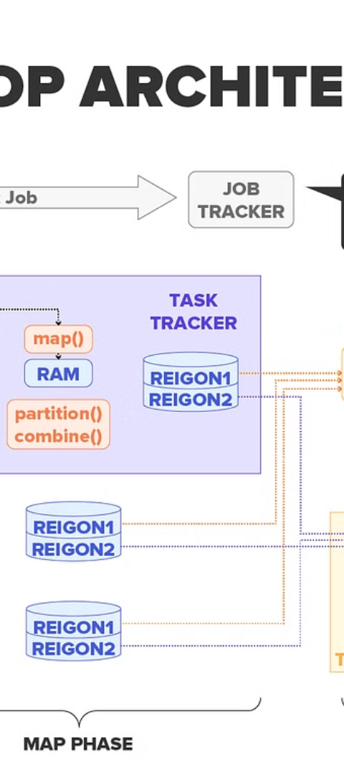



HDFS Architecture: A Foundational Overview
NameNode
At the helm, the NameNode serves as both the librarian and custodian of the cluster, managing the namespace and directing traffic to the right data locations.
DataNode
The hardworking DataNodes are the minions storing and retrieving blocks, while keeping diligent watch over the health of stored data.
Replication
Redundancy is a calculated choice, not an accident. In the world of HDFS, data is replicated across nodes, orchestrating a symphony of reliability and fault tolerance.

Slide 7



Concurrent Processing: The Pulse of MapReduce
Threads
Locks
Synchronization
In Java, threads are the conduits for concurrent execution, allowing multiple processes to unfold in the tapestry of a Hadoop cluster.
Locks are the safeguards, ensuring that while the data dance is underway, integrity is not compromised by conflicting moves.
Synchronization is the rhythm that keeps the concurrent processes in a harmonious flow, preventing disarray in data's ballet.

Slide 8
MapReduce Performance: The Art of Optimization
2x
3x
4x
Combiners
Partitioners
Custom Formats
Functioning as a mini-reducer, a combiner can dramatically reduce the amount of data shuffled across the network, often leading to performance gains.
With a keen partitioner, data is distributed more evenly across reducers, preventing bottlenecks and ensuring scalability.
By tailoring input and output formats, an adept MapReduce maestro can finely tune performance to the unique demands of their data suite.

