Slide 1
XML : eXtensible Markup Language
By
Y.Durga Bhargavi

Slide 2
Introduction
In 1970’s organization were suffering from large amounts of data which could not be shared between the applications
each program used to be in its own formats and those formats had to be changed with new versions of the software.
So IBM has develop a markup language which is used to add structure and formatted information to data

Slide 3
In 1986, the Standard generalized Markup Language was adopted by ISO(International Organization for Standardization)

Slide 4
What is Markup Language?
Set of instructions often called tags, which can be added to text files and file can be processed by application that are used to control structure or presentation of data.
There are different presentation languages Microsoft rich Text Format(RTF) , Adobe Portable Document Format (PDF), and HTML
Each of them have solution for displaying information but all have same limitation
They describe how data looks but give no information about what it is.

Slide 5
XML is used to describe the structure of a document not the way it is presented.
XML is recommendation of the World Wide Web consortium(W3C)
Two areas where XML appears
Structuring data for storage where Relational database is inappropriate
Structuring data for presentation on web pages.

Slide 6
If the system/application is handling small quantities of data they start creating thrie own data formats

Slide 7
Basic XML
<? xml version="1.0" ?> // processing instruction tells application how to handle XML
<recipes>
<category type="loaf">
<name> Basic Farmhouse </name>
<ingredient></ingredient>
<cooking>
<time></time>
<setting> </setting>
</cooking>
<serves> </serves>
<instructions></instructions>
</category>
</recipes>

Slide 8
Save the page with .xml extension
Open the file in any of the browsers
Output will be:

Slide 9
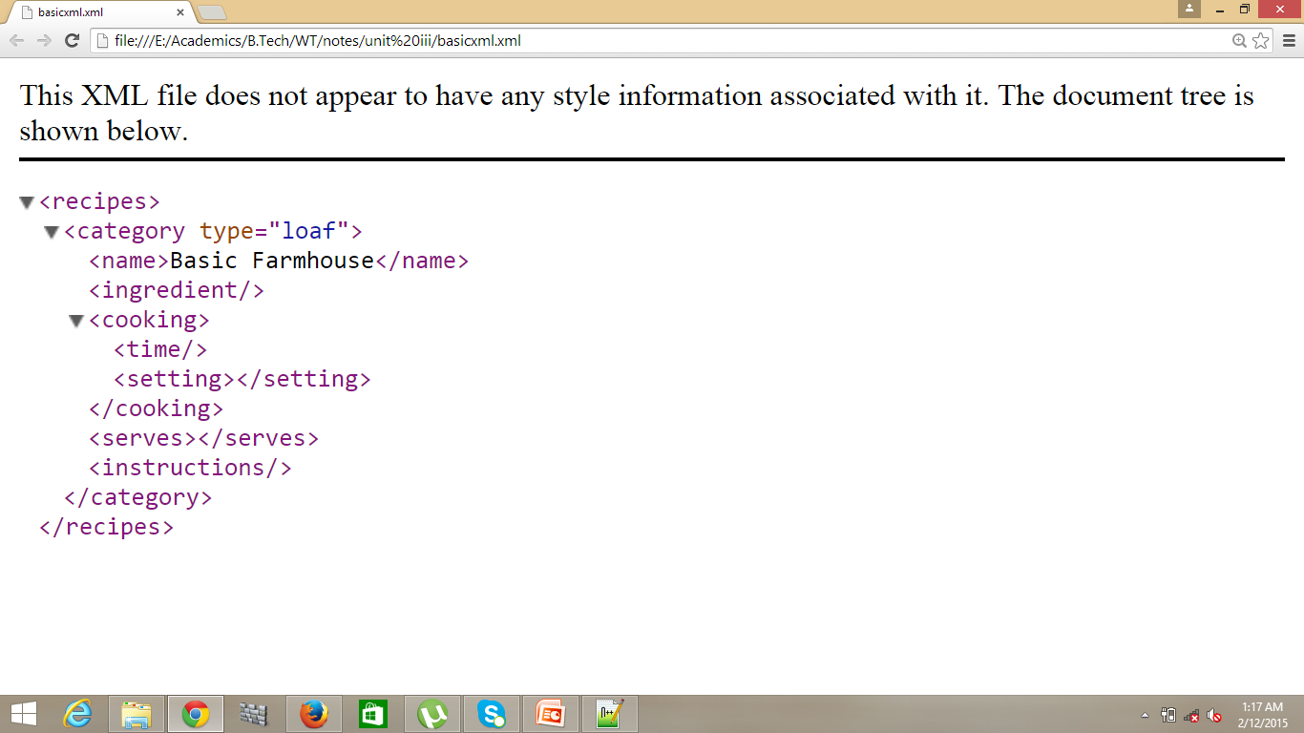

Slide 10
XML Document
XML document has 3 things
Elements
Control information
Entities

Slide 11
1.XML elements
Most of the XML document is element markup
Elements are surrounded by tags
Each document has root element
Each element in turn has no. of sections which are enclosed with in tags.

Slide 12
1.1 Nesting Tags
Nesting tags : MUST BE NESTED PROPERLY
Closed in reverse of the order in which they are opened
Eg: <category type="loaf">
<name> Basic Farmhouse </name>
<ingredient></ingredient>
<cooking>
<time></time>
<setting> </setting>
</cooking>
<serves> </serves>
<instructions></instructions>
</category>

Slide 13
1.2 Case Sensitive
Can use mixed upper-case and lower-case letters inside the markup
XML is case-sensitive
Use lower-case for your mark up

Slide 14
1.3 Empty Tags
Elements usually have content
Eg: previously a empty <ingredient> </ingredient> has no sense in including it.
But it may be empty though if you are formatting data retrieved from database or entered by user
In output it shows
<ingredient/>

Slide 15
1.4 Attributes
Attributes simply describe the properties of elements
<ingredient amount=“300” unit=“ml”> Sugar
</ingredient>

Slide 16
2 .Control Information
There are 3 control information
Comments
<! Any comments -->
Processing instructions
PI is used to control applications
<?xml version=“1.0”> → instruction tells the application that the data in the file follows rules of XML version 1.0
Document type declarations
It is associated with DTD (Document type definition)
DTD is held in separate file such that it can be used in multiple documents
Can also include external DTD

Slide 17
3. Entities
XML document may have one or more entities
Entity is a thing which can be used as the as a part of the document.
Eg: entity is like image or an encrypted signature which you use it frequently
Rather than creating some XML each time signature can be used

Slide 18
Document Type Definition (DTD)
Writing XML is only half story
XML neither has a meaning nor context without a grammar against which can be validated.
The grammar is called DTD.

Slide 19
Example of DTD
<?xml version="1.0"?>
<!DOCTYPE Cookbook SYSTEM "recipe.dtd"> <!-- file type is cookbook which uses dtd which is stored in file called recipe.dtd , the dtd which u develop yourself is or develop by you is denoted by SYSTEM else for internationally agreed dtd for PUBLIC-->
<!ELEMENT cookbook (category+)> <!--root node and parent node -->
<!ELEMENT category (recipe+)> <!-- parent node and children -->
<!ATTLIST category type CDATA #REQUIRED> <!-- attribute list parent node attribute type and its datatype -->
<!ELEMENT recipe (name, ingredient+, cooking+, serves?, instructions*)>
<!ELEMENT name (#PCDATA)>
<!ELEMENT ingredient (qty, item)>
<!ELEMENT qty (#PCDATA)>
<!ATTLIST qty amount CDATA #REQUIRED unit CDATA "g">
<!ELEMENT item (#PCDATA)>

Slide 20
Cntd.. Example
<!ELEMENT cooking (time*,gas*, electric*)>
<!ELEMENT time (#PCDATA)>
<!ATTLIST time unit CDATA "minutes">
<!ELEMENT gas (#PCDATA)>
<!ELEMENT electric (#PCDATA)>
<!ELEMENT instructions (ins*)>
<!ELEMENT ins (#PCDATA)>

Slide 21
Cntd..DTD
Dtd is replaced inside a single DOCTYPE tag and is surrounded by square brackets [..]
Eg: <!DOCTYPE recipe [
<!ELEMENT cookbook (category +)
<!--all the elements of dtd-->
]>

Slide 22
Elements
XML document is composed of number of elements
Each elements is made up of the other elements
Some elements in the document can have attributes
First node of XML document is called a root node. It contains other nodes too.
Each XML document must have exactly one root node

Slide 23
Cntd..Elements
Eg : <!ELEMENT cookbook (category+)
All elements are declared in the above format
The element tag starts with exclamatory mark and word ELEMENT in upper-case.
The followed by name of the element
In case container node has a comma-separator list of sub-elements are added.
Each sub-elements can also be associated with a control character indicating how often it appears

Slide 24
Cntd..Elements
Example
<!ELEMENT recipe (name, ingredient+, cooking+, serves?, instructions*)>
The name appears just once, atleast one ingredient, and one cooking element, only a single serves element is allowed and many instructions

Slide 25
DTD Elements with control Repetition
Symbol | Example | Meaning
Asterix | Item* | Item appears 0 or more times
Comma | (item1, item2, item3) | Separates items in a sequence in th order in which they appear
None | Item | Item appears exactly once
Parentheses | (item1, item2) | Encloses a group of items
Pipe | (item1 | item2) | Separates a set of alternatives. Only one may appear
Plus | Item+ | Alteast once
Question mark | Item? | Iteam appears once or not at all

Slide 26
Cntd..Elements
<!ELEMENT name (#PCDATA)>
Parentheses contain the data type of the element
Data type must be preceded by a # symbol
Elements have 2 data types
CDATA: plain text character data (which is not passed through the engine of XML parser.
PCDATA: parsed character data which may have XML markup and is handled by parser
NOTE: Default data type for element is PCDATA

Slide 27
Attributes
These are very important and usefull when you are handling complexities
Elements need hold more than one piece of information
Eg: <qty amount=“435” unit=“ml”> warm water</qty>

Slide 28
Cntd..Attributes
Associated element declaration is an ATTLIST which may contain
The name of element
The name of each attribute
Data type of attribute
Any value which will be used as default
Control information about the element
Eg: <!ATTLIST qty amount CDATA #REQUIRED
unit CDATA “g”>

Slide 29
Entities
Markup elements contain complex data
These elements are called entities
Entity as container with some form of content
The content may be included in XML file
An internal file
An external file
Attributes, elements, or entities may or may not be parsed

Slide 30
Internal Entities
These are used to create small pieces data which you want to repeatedly use throughout your schema
Eg: <!ENTITY POS “pinch of salt”>
Which can be used in instruction as follows
<item> Finally ass the &POS; </item>
When an entity is included the name is preceded ampersand and followed by semicolon;

Slide 31
External Entities
Data can be included in your XML as an external entity
<!ENTITY myimage SYSTEM “xyz.png” NDATA PNG>
NDATA → notation data

Slide 32
Namespaces
<staff>
<name> </name>
<dept>
<name> school of CSE </name>
</dept>
<room> 2334</room>
</staff>
NOTE : two elements called name but represent different things
In that cases you go namespaces

Slide 33
Cntd.. Namespaces
Namespace is included in xml same as dtd
<?xml version=“1.0”>
<!DOCTYPE Recipies SYSTEM “recipe.dtd”>
<!xml:namespaces ns=http://URL//namespaces/breads prefix=“bread”>
<!xml:namespaces ns=http://URL//namespaces/meats prefix=“lamb”>

Slide 34
Cntd .. Namespaces
<recipe>
<category>
<bread:name> basic loaf </bread:name>
</category>
<category>
<lamb:name> basic loaf </lamb:name>
</category>
</recipe>

