Slide 1
PHP: The Basics

Slide 2
What is it?
PHP is a scripting language commonly used on web servers.
  Stands for “PHP: Hypertext Preprocessor”
  Open source
  Embedded code
  -- C like language
  Multiple operating systems/web servers
Source-code not visible by client
  ‘View Source’ in browsers does not display the PHP code

Slide 3
What can it do?
Dynamic generation of web-page content
Database interaction
Processing of user supplied data
Email
File handling
Text processing
Network interaction
And more…

Slide 4
Fundamentals
PHP is embedded within xhtml pages within the tags: <?php … ?>
The short version of these tags can also be used: <? … ?>
Each line of PHP is terminated, like MySQL, with a semi-colon.

Slide 5
Hello World!
<html>
<head>
<title>PHP Test</title>
</head>
<body>
<?php echo ‘<p>Hello World!</p>’; ?>
</body>
</html>
Notes:
Using your favoured text editor (e.g. Notepad) create the file on the slide…
Save it in your web space as hello.php and navigate to the file via your web browser
You should see
Hello World!
On the page…
If that has worked replace all with phpinfo(); and run again…
You should now see a page with lots of information about the PHP installation – this will become useful later!
NOT XHTML (NO DOCTYPE SETTING ETC) TO SAVE SPACE ON PAGE…

Slide 6
Preparing to code with PHP

Slide 7
Literals..
All strings must be enclosed in single or double quotes: ‘Hello’ or “Hello”.
Numbers are not in enclosed in quotes: 1 or 45 or 34.564
Booleans (true/flase) can be written directly as true or false.

Slide 8
Comments
// This is a comment
# This is also a comment
/* This is a comment
that is spread over
multiple lines */
Do not nest multi-line comments
// recommended over #

Slide 9
Comments
<?php
// this is a comment
echo ‘Hello World!’;
/* another
multi-line comment */
?>

Slide 10
Two Ways
You can embed sections of php inside html:
Or you can call html from php:
<BODY>
<P>
<?php $myvar = "Hello World!";
echo $myvar;
</BODY>
<?php
echo "<html><head><title>Howdy</title>
…
?>

Slide 11
Displaying Data
There are two language constructs available to display data: print() and echo().
They can be used with or without brackets.
Note that the data ‘displayed’ by PHP is actually parsed by your browser as HTML. View source to see actual output.

Slide 12
Displaying data
<?php
echo ‘Hello World!<br />’;
echo(‘Hello World!<br />’);
print ‘Hello World!<br />’;
print(‘Hello World!<br />’);
?>

Slide 13
Variables: What are they?
When we work in PHP, we often need a labelled place to store a value (be it a string, number, whatever) so we can use it in multiple places in our script.
These labelled ‘places’ are called
VARIABLES

Slide 14
Variables in PHP
PHP variables must begin with a “$” sign
Case-sensitive ($Foo != $foo != $fOo)
Global and locally-scoped variables
  Global variables can be used anywhere
  Local variables restricted to a function or class
Certain variable names reserved by PHP
  Form variables ($_POST, $_GET)
  Server variables ($_SERVER)
  Etc.

Slide 15
Variables: Naming
$ followed by variable name
Case sensitive
  $variable differs from $Variable
  Stick to lower-case to be sure!
Name must started with a letter or an underscore
  Followed by any number of letters, numbers and underscores

Slide 16
Variables: example
<?php
$name = ‘Phil’;
$age = 23;
echo $name;
echo ’ is ‘;
echo $age;
// Phil is 23
?>
Notes:
Demo the fact that the variable can be changed..
$name = ‘Phil’;
$age = 23;
$name = ‘Ed’;
echo $name;
echo ’ is ‘;
echo $age;
// Ed is 23

Slide 17
Variable usage
<?php
$foo = 25; // Numerical variable
$bar = “Hello”; // String variable
$foo = ($foo * 7); // Multiplies foo by 7
$bar = ($bar * 7); // value of //bar=0expression
?>

Slide 18
Constants
Constants (unchangeable variables) can also be defined.
Each constant is given a name (note no preceding dollar is applied here).
By convention, constant names are usually in UPPERCASE.
Notes:
A constant is an identifier for a single value…
Cannot be changed during execution (or undefined)
Same naming convention as a standard variable (just no $)
Are global (can be accessed anywhere – within functions, etc.)
There are many predefined constants (see www.php.net for the long list!)
Core constants
Set in the PHP core…
Mostly to do with error tracking and also core items like version, install directories, etc.
Standard constants
Loads more!
Extension constants
These are set by extensions if they are loaded
See individual extension descriptions for details

Slide 19
Constants
<?php
define(‘NAME’,‘Phil’);
define(‘AGE’,23);
echo NAME;
echo ’ is ‘;
echo AGE;
// Phil is 23
?>

Slide 20
“ or ‘ ?
There is a difference between strings written in single and double quotes.
In a double-quoted string any variable names are expanded to their values.
In a single-quoted string, no variable expansion takes place.

Slide 21
“ or ‘ ?
<?php
$name = ‘Phil’;
$age = 23;
echo “$name is $age”;
// Phil is 23
?>
Notes:
Demo the fact that the variable can be changed..
$name = ‘Phil’;
$age = 23;
$name = ‘Ed’;
echo $name;
echo ’ is ‘;
echo $age;
// Ed is 23

Slide 22
“ or ‘ ?
<?php
$name = ‘Phil’;
$age = 23;
echo ‘$name is $age’;
// $name is $age
?>
Notes:
Demo the fact that the variable can be changed..
$name = ‘Phil’;
$age = 23;
$name = ‘Ed’;
echo $name;
echo ’ is ‘;
echo $age;
// Ed is 23

Slide 23
Data types
Integer
Double
String

Slide 24
$a = 56;
$b=65.98;
$c=“cse ”;

Slide 25
Converting variables to different data types
Settype
  settype(variabl-name,”datatype”);
  settype($testString,”double”);
(datatype)variable-name
  $data = “98.6 degrees”;
  Print(“value is after casting” .(double)$data . “Value as interger” . (integer)$data);

Slide 26


Slide 27
Operators
Math Operators
String Concatenate operator
Increment and Decrement operators
Assignment Operator

Slide 28
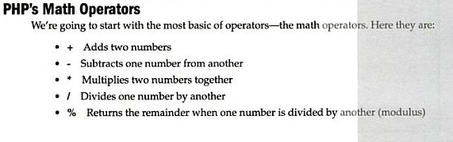

Slide 29
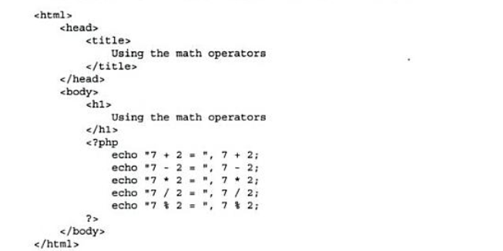
Examples of math operators

Slide 30
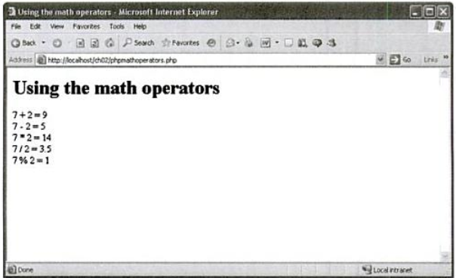
output

Slide 31
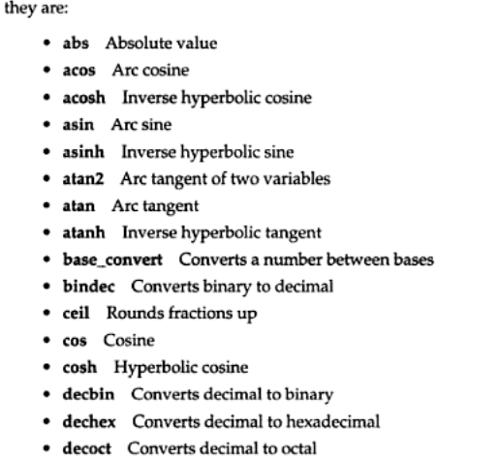
Built-in math operators

Slide 32
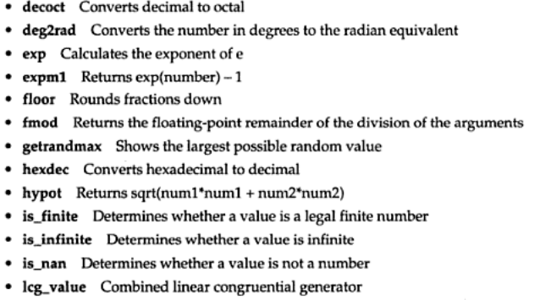

Slide 33
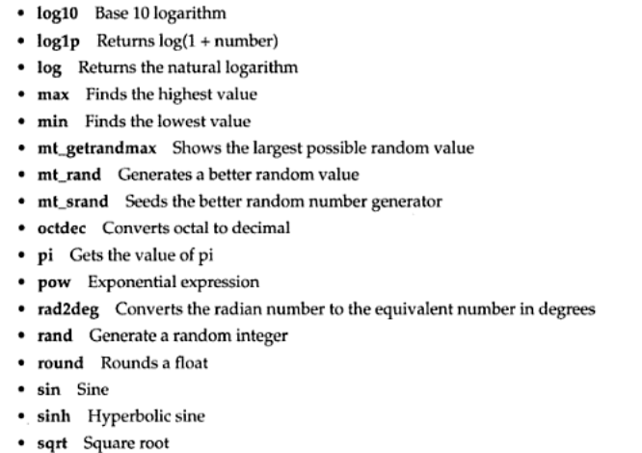

Slide 34
example
<?php
$xy=pow(2,5);
echo "xy = $xy";
echo "pow(2,3)=",pow(2,3), "<br>";
$flo=floor(3.23144);
print (" floor(3.23144) = $flo <br>");
$a=4;
echo sqrt($a++);
?>

Slide 35
PHP String Concatenation (.) operator
echo $a;
Output : No worries
<?
$a = “No”;
$a .= “worries”;
?>

Slide 36
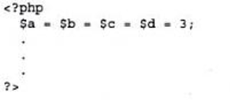
Assignment Operator

Slide 37

Increment and Decrement Operators

Slide 38
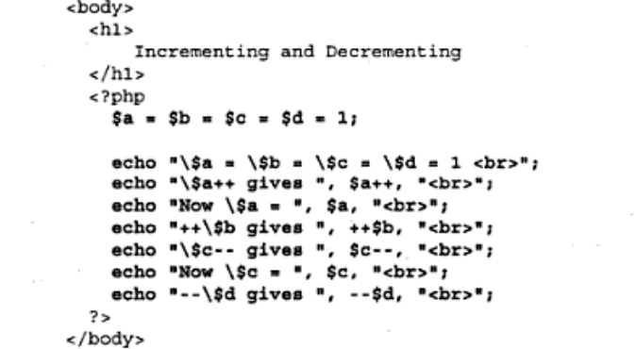
Example

Slide 39
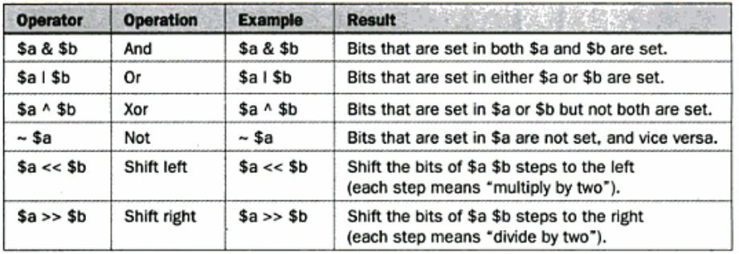
Bitwise Opertors

Slide 40
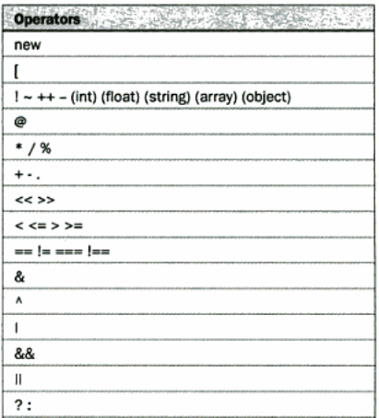
Operator Precedence

Slide 41
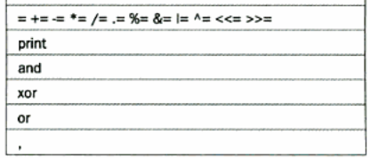

Slide 42
Flow Controls

Slide 43
String functions

Slide 44
Arrays

Slide 45
functions

Slide 46
Expressions

Slide 47
