Slide 1
Multi-Dimensional Arrays
A multi-dimensional array each element in the main array can also be an array. And
each element in the sub-array can be an array, and so on.
Values in the multi-dimensional array are accessed using multiple index.

Slide 2
Example
In this example we create a two dimensional array to store marks of three students in three subjects −
This example is an array, you can create numeric array in the same fashion.

Slide 3
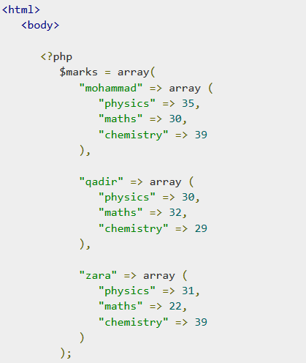

Slide 4
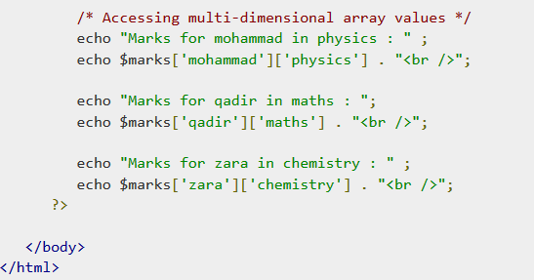

Slide 5
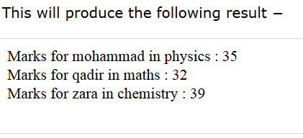

Slide 6
Regular Expressions
Regular expressions are nothing more than a sequence or pattern of characters itself.
They provide the foundation for pattern-matching functionality.
Using regular expression you can search a particular string inside a another string, you can replace one string by another string and you can split a string into many chunks.

Slide 7
PHP offers functions specific to two sets of regular expression functions, each corresponding to a certain type of regular expression. You can use any of them based on your comfort.
  POSIX Regular Expressions
  PERL Style Regular Expressions

Slide 8
POSIX Regular Expressions
Portable Operating System Interface (POSIX) extended regular expressions
The structure of a POSIX regular expression is similar to that of a typical arithmetic expression: various elements (operators) are combined to form more complex expressions.
The simplest regular expression is one that matches a single character, such as g, inside strings such as g, haggle, or bag.

Slide 9
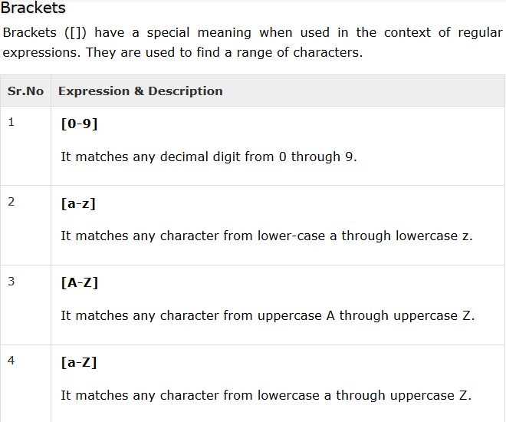
concepts being used in POSIX regular expression

Slide 10
you could also use the range [0-3] to match any decimal digit ranging from 0 through 3,
or
the range [b-v] to match any lowercase character ranging from b through v.

Slide 11
Quantifiers
The frequency or position of bracketed character sequences and single characters can be denoted by a special character.
Each special character having a specific connotation. The +, *, ?, {int. range}, and $ flags all follow a character sequence.

Slide 12
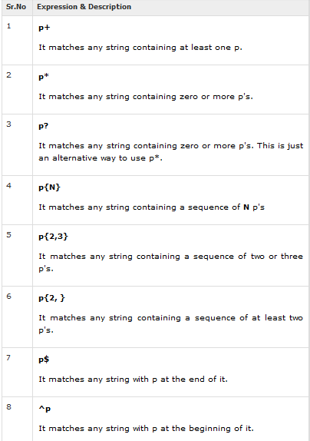

Slide 13
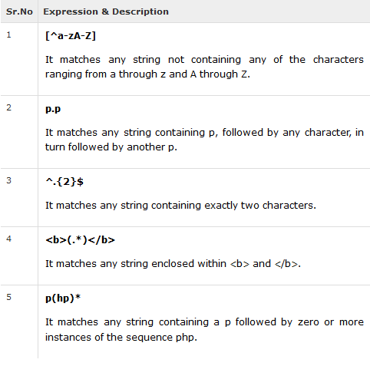
Examples

Slide 14
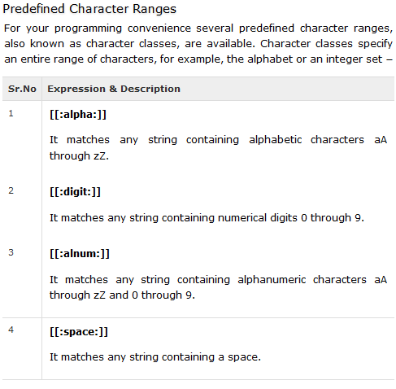
Predefined Character ranges

Slide 15
PHP's Regexp POSIX Functions
PHP currently offers seven functions for searching strings using POSIX-style regular expressions

Slide 16
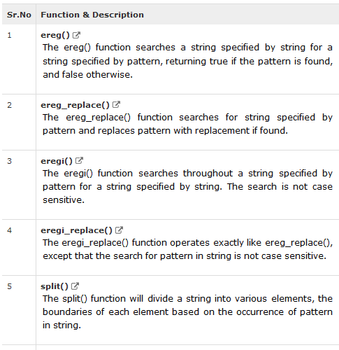

Slide 17
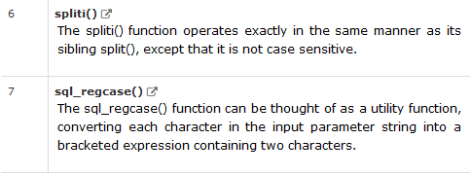

Slide 18
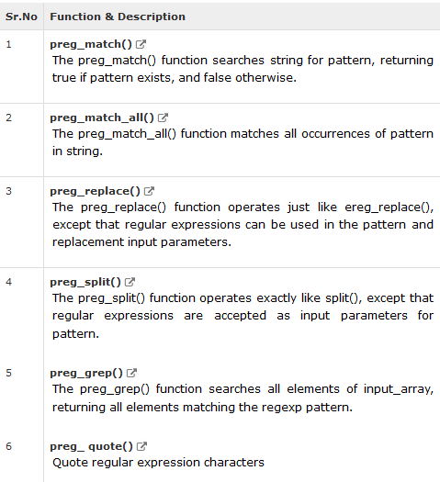
PERL Style Regular Expressions

Slide 19
Meta characters
A meta character is simply an alphabetical character preceded by a backslash that acts to give the combination a special meaning.
For instance, you can search for large money sums using the '\d' meta character: /([\d]+)000/, Here \d will search for any string of numerical character.

Slide 20
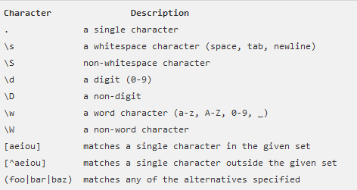

Slide 21
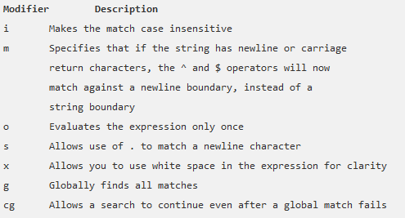
Modifiers
can make your work with regexps much easier, like case sensitivity, searching in multiple lines etc.

Slide 22
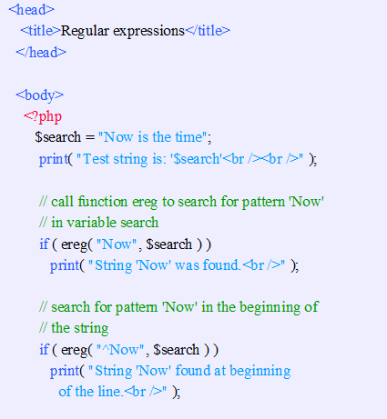
Example

Slide 23
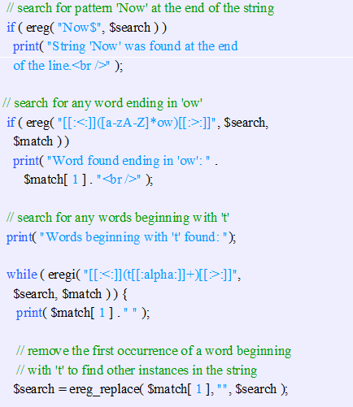



Slide 24
Functions

Slide 25
What Is Function ?
In PHP we have two type of functions :
  User-defined Function.
  Built-in Function.
User-defined Function : is the function created by user .
Built-in Function : is the function created by PHP , and ready to use.
The real power of PHP comes from its functions.
We just talk about user defined function in this chapter

Slide 26
User-Defined Function
User-defined function is just a name we give to a block of code that can be executed whenever we need it.
A function will be executed by a call to the function.
You may call a function from anywhere within a page.
A function will be executed by a call to the function.
PHP function guidelines:
  Give the function a name that reflects what the function does
  The function name can start with a letter or underscore (not a number)

Slide 27
Create a PHP Function
Begins with keyword function and then the space and then the name of the function then parentheses”()” and then code block “{}”
function functionName()
{
//code to be executed;
}

Slide 28
Create a PHP Function
We want our function to print each time it's called,
<?php
  function myfunction()
  {
  echo “This is the first function to me ";
  }
?>
Note: Your function name can start with a letter or underscore "_", but not a number!

Slide 29
Parameters Functions
To add more functionality to a function, we can add parameters. A parameter is just like a variable.
Parameters are specified after the function name, inside the parentheses.
<?php
  function myfunction($par1, $par2 ,……..)
  {
  echo “This is the first function with parameters to me ";
  }
?>

Slide 30
Parameters Functions
<?php
function myname($firstName)
{
echo “my name is ". $firstName ;
}
?>

Slide 31
Parameters Functions – Call
<?php
  function myname($firstName)
  {
  echo “my name is ". $firstName . "!<br />";
  }
  myname(“kalid");
  myname("Ahmed");
  myname(“laith");
  myname(“muneer");
?>

Slide 32
Parameters Functions - Call
<?php
  function myname($firstName, $lastName)
  {
  echo "Hello there ". $firstName ." ". $lastName ."!<br />";
  }
  myname(“Kalid", “Ali");
  myname("Ahmed", “Samer");
  myname(“Wael", “Fadi");
  myname(“Muneer", " Masadeh");
?>

Slide 33
Parameters Functions - Call
<?php
function writeName($fname,$punctuation)
{
echo $fname . " Refsnes" . $punctuation . "<br />";
}
echo "My name is ";
writeName(“muneer ",".");
echo "<br>My family's name is ";
writeName(" Masadeh ",“,");
echo “<br>I am Dr in ";
writeName(“CS Department ",“!");
?>

Slide 34
Function Returning Values
In addition to being able to pass functions information, you can also have
them return a value. However, a function can only return one thing, although
that thing can be any integer, float, array, string, etc. that you choose!
How does it return a value though? Well, when the function is used and
finishes executing, it sort of changes from being a function name into being
a value. To capture this value you can set a variable equal to the function.
Something like:
$myVar = somefunction();
Let's demonstrate this returning of a value by using a simple function that
returns the sum of two integers.

Slide 35
Functions Returning Values – Example
<?php
  function mySum($numX, $numY)
  {
  return ($numX + $numY);
  }
  $myNumber = 0;
  echo "Before call function, myNumber = ". $myNumber ."<br />";
  // Store the result of mySum in $myNumber
  $myNumber = mySum(3, 4);
  echo "After call function, myNumber = " . $myNumber ."<br />";
?>

Slide 36
Function Returning Values – Example
<?php
  function factorial($number)
  {
  $ temp = 0;
  if($number <= 1)
  return 1;
  $temp = $number * factorial($number - 1);
  return $temp;
  }
  $ number = 4;
  if ($number < 0)
  echo "That is not a positive integer.\n";
  else
  echo $number . " factorial is: " . factorial($number);
  ?>

Slide 37
Function Returning Values – Example
<?php
$n = 10;
echo " The sum is “. sum($n) ;
function sum($a)
{
if ( $n <= 0 )
return 0;
else
return ($n + sum($n-1));
}
?>

Slide 38
PHP Variable Scopes
The scope of a variable is the part of the script where the variable can be referenced/used.
PHP has four different variable scopes:
  local
  global
  static
  parameter

Slide 39
Local Scope
A variable declared within a PHP function is local and can only be accessed within that function:
<?php
$x=5; // global scope
function myTest()
{
echo $x; // local scope
}
myTest();
?>

Slide 40
Local Scope
The script above will not produce any output because the echo statement refers to the local scope variable $x, which has not been assigned a value within this scope.
You can have local variables with the same name in different functions, because local variables are only recognized by the function in which they are declared.
Local variables are deleted as soon as the function is completed.

Slide 41
Global Scope
A variable that is defined outside of any function, has a global scope.
Global variables can be accessed from any part of the script, EXCEPT from within a function.
To access a global variable from within a function, use the global keyword:

Slide 42
Global Scope
A variable that is defined outside of any function, has a global scope.
Global variables can be accessed from any part of the script, EXCEPT from within a function.
To access a global variable from within a function, use the global keyword:

Slide 43
Global Scope
<?php
$x=5; // global scope
$y=10; // global scope
function myTest()
{
global $x,$y;
$y=$x+$y;
}
myTest();
echo $y; // outputs 15
?>

Slide 44
Global Scope
PHP also stores all global variables in an array called $GLOBALS[index]. The index holds the name of the variable. This array is also accessible from within functions and can be used to update global variables directly.
The example above can be rewritten like this:

Slide 45
Global Scope
<?php
$x=5;
$y=10;
function myTest()
{
$GLOBALS['y']=$GLOBALS['x']+$GLOBALS['y'];
}
myTest();
echo $y;
?>

Slide 46
Static Scope
When a function is completed, all of its variables are normally deleted. However, sometimes you want a local variable to not be deleted.
To do this, use the static keyword when you first declare the variable:

Slide 47
Static Scope
<?php
function myTest()
{
static $x=0;
echo $x;
$x++;
}
myTest();
myTest();
myTest();
?>

Slide 48
Static Scope
Then, each time the function is called, that variable will still have the information it contained from the last time the function was called.
Note: The variable is still local to the function.

Slide 49
Parameter Scope
A parameter is a local variable whose value is passed to the function by the calling code.
Parameters are declared in a parameter list as part of the function declaration:
<?php
function myTest($x)
{
echo $x;
}
myTest(5);
?>

Slide 50
Passing Variable to a function
You can pass a variable by Value to a function so the function can’t modify the variable.
You can pass a variable by Reference to a function so the function can modify the variable.

Slide 51
Passing Variable By Value
<?php
  $numX = 1;
  function byvalue ($numX)
  {
  $numX = $numX + 1;
  }
  byvalue ($numX);
  echo “the change after send data by value = ". $numX ."<br />";
?>

Slide 52
Passing Variable By Reference
<?php
function byreference (&$numX)
{
$numX = $numX + 1;
}
byvalue ($numX);
echo “the change after send data by Reference = ". $numX ."<br />";
?>

Slide 53
Passing Variable By Reference
<?php
function foo(&$var)
{
$var++;
}
$a=5;
echo foo($a); // $a is 6 here
?>

Slide 54
Passing Variable By Reference
<?php
function foo(&$var)
{
$var++;
return $var;
}
function &bar()
{
$a = 5;
return $a;
}
echo foo(bar());
?>

Slide 55
Passing Variable By Reference
<?php
$string = 'string';
function change($str) {
$str = 'str';
}
change(&$string);
echo $string;
?>

Slide 56
Example Chapter

Slide 57
Example
<?php
main();
function main()
{
$num1 = 10; $num2 = -6; $num3 = 2; $num4 = 1;
$op = "-";
echo "<ol>";
echo "<li> Expression is : $num1 $op $num2 $op $num3 $op $num4 = ".cal($num1, $num2, $num3, $num4,$op)."</li>";
echo "<li> Max number between ( $num1 , $num2, $num3 , $num4 ) = ".maxs($num1, $num2, $num3, $num4)."</li>";

Slide 58
Example
echo "<li> Min number between( $num1 , $num2, $num3 , $num4 ) = ".mins($num1, $num2, $num3, $num4)."</li>";
echo "<li>Positive numbers between( $num1 , $num2, $num3 , $num4 ) </li>";
posi($num1, $num2, $num3, $num4);
echo "<br>";
echo "<li> Negative numbers between( $num1 , $num2, $num3 , $num4 ) </li>";
nega($num1, $num2, $num3, $num4);
echo "</ol>";
}

Slide 59
Example
function cal($num1 , $num2, $num3 , $num4,$op )
{
switch($op)
{
case "+": return ($num1 + $num2+ $num3 + $num4 ); break;
case "*": return ($num1 * $num2 * $num3 * $num4 ); break;
case "/": return ($num1 / $num2 / $num3 / $num4 ); break;
default : return ($num1 - $num2 - $num3 - $num4 ); break;
}
}

Slide 60
Example
function maxs($num1, $num2, $num3, $num4)
{
$max1 = $num1;
if ($num2 > $max1) {
$max1 = $num2;
}
if ($num3 > $max1) {
$max1 = $num3;
}
if ($num4 > $max1) {
$max1 = $num4;
}
return $max1; /* max is the largest value */
}

Slide 61
Example
function mins($num1, $num2, $num3, $num4)
{
$min1 = $num1;
if ($num2 < $min1) {
$min1 = $num2;
}
if ($num3 < $min1) {
$min1 = $num3;
}
if ($num4 < $min1) {
$min1 = $num4;
}
return $min1; /* max is the largest value */
}

Slide 62
Example
function posi($num1, $num2, $num3, $num4)
{
echo "<ol type='i'>";
$count = 0;
if($num1 > 0)
{
echo "<li>The $num1 is positive numbers </li>";
$count++;
}
if($num2 > 0)
{
echo "<li>The $num2 is positive numbers </li>";
$count++;
}

Slide 63
Example
if($num3 > 0)
{
echo "<li>The $num3 is positive numbers </li>";
$count++;
}
if($num4 > 0)
{
echo "<li>The $num4 is positive numbers </li>";
$count++;
}
echo "<li>The Total positive numbers is $count</li>";
echo "</ol>";
}

Slide 64
Example
function nega($num1, $num2, $num3, $num4)
{
$count = 0;
echo "<ol type='i'>";
if($num1 < 0)
{
echo "<li>The $num1 is negative numbers </li>";
$count++;
}
if($num2 < 0)
{
echo "<li>The $num2 is negative numbers </li>";
$count++;
}

Slide 65
Example
if($num3 < 0)
{
echo "<li>The $num3 is negative numbers </li>";
$count++;
}
if($num4 < 0)
{
echo "<li>The $num4 is negative numbers </li>";
$count++;
}
echo "<li>The Total negative numbers is $count</li>";
echo "</ol>";
}
?>
Notes:
<?php
main();
function main()
{
$num1 = 10; $num2 = -6; $num3 = 2; $num4 = 1;
$op = "-";
echo "<ol>";
echo "<li> Expression is : $num1 $op $num2 $op $num3 $op $num4 = ".cal($num1, $num2, $num3, $num4,$op)."</li>";
echo "<li> Max number between ( $num1 , $num2, $num3 , $num4 ) = ".maxs($num1, $num2, $num3, $num4)."</li>";
echo "<li> Min number between( $num1 , $num2, $num3 , $num4 ) = ".mins($num1, $num2, $num3, $num4)."</li>";
echo "<li>Positive numbers between( $num1 , $num2, $num3 , $num4 ) </li>";
posi($num1, $num2, $num3, $num4);
echo "<br>";
echo "<li> Negative numbers between( $num1 , $num2, $num3 , $num4 ) </li>";
nega($num1, $num2, $num3, $num4);
echo "</ol>";
}
function cal($num1 , $num2, $num3 , $num4,$op )
{
switch($op)
{
case "+":
return ($num1 + $num2+ $num3 + $num4 );
break;
case "*":
return ($num1 * $num2 * $num3 * $num4 );
break;
case "/":
return ($num1 / $num2 / $num3 / $num4 );
break;
default :
return ($num1 - $num2 - $num3 - $num4 );
break;
}
}
function maxs($num1, $num2, $num3, $num4)
{
$max1 = $num1;
if ($num2 > $max1) {
$max1 = $num2;
}
if ($num3 > $max1) {
$max1 = $num3;
}
if ($num4 > $max1) {
$max1 = $num4;
}
return $max1; /* max is the largest value */
}
function mins($num1, $num2, $num3, $num4)
{
$min1 = $num1;
if ($num2 < $min1) {
$min1 = $num2;
}
if ($num3 < $min1) {
$min1 = $num3;
}
if ($num4 < $min1) {
$min1 = $num4;
}
return $min1; /* max is the largest value */
}
function posi($num1, $num2, $num3, $num4)
{
echo "<ol type='i'>";
$count = 0;
if($num1 > 0)
{
echo "<li>The $num1 is positive numbers </li>";
$count++;
}
if($num2 > 0)
{
echo "<li>The $num2 is positive numbers </li>";
$count++;
}
if($num3 > 0)
{
echo "<li>The $num3 is positive numbers </li>";
$count++;
}
if($num4 > 0)
{
echo "<li>The $num4 is positive numbers </li>";
$count++;
}
echo "<li>The Total positive numbers is $count</li>";
echo "</ol>";
}
function nega($num1, $num2, $num3, $num4)
{
$count = 0;
echo "<ol type='i'>";
if($num1 < 0)
{
echo "<li>The $num1 is negative numbers </li>";
$count++;
}
if($num2 < 0)
{
echo "<li>The $num2 is negative numbers </li>";
$count++;
}
if($num3 < 0)
{
echo "<li>The $num3 is negative numbers </li>";
$count++;
}
if($num4 < 0)
{
echo "<li>The $num4 is negative numbers </li>";
$count++;
}
echo "<li>The Total negative numbers is $count</li>";
echo "</ol>";
}
?>

Slide 68
Forms
(Getting data from users)

Slide 69
Forms: how they work
We need to know..
How forms work.
How to write forms in XHTML.
How to access the data in PHP.

Slide 70


How forms work
User requests a particular URL
XHTML Page supplied with Form
User fills in form and submits.
Another URL is requested and the
Form data is sent to this page either in
URL or as a separate piece of data.
User
Web Server
XHTML Response

Slide 71
XHTML Form
The form is enclosed in form tags..
<form action=“path/to/submit/page”
method=“get”>
<!–- form contents -->
</form>

Slide 72
Form tags
action=“…” is the page that the form should submit its data to.
method=“…” is the method by which the form data is submitted. The option are either get or post. If the method is get the data is passed in the url string, if the method is post it is passed as a separate file.

Slide 73
Form fields: text input
Use a text input within form tags for a single line freeform text input.
<label for=“fn">First Name</label>
<input type="text"
name="firstname"
id=“fn"
size="20"/>

Slide 74
Form tags
name=“…” is the name of the field. You will use this name in PHP to access the data.
id=“…” is label reference string – this should be the same as that referenced in the <label> tag.
size=“…” is the length of the displayed text box (number of characters).

Slide 75
Form fields: password input
Use a starred text input for passwords.
<label for=“pw">Password</label>
<input type=“password"
name=“passwd"
id=“pw"
size="20"/>

Slide 76
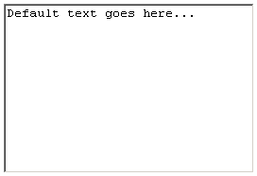
Form fields: text input
If you need more than 1 line to enter data, use a textarea.
<label for="desc">Description</label>
<textarea name=“description”
id=“desc“
rows=“10” cols=“30”>
Default text goes here…
</textarea>

Slide 77
Form fields: text area
name=“…” is the name of the field. You will use this name in PHP to access the data.
id=“…” is label reference string – this should be the same as that referenced in the <label> tag.
rows=“…” cols=“..” is the size of the displayed text box.

Slide 78
Form fields: drop down
<label for="tn">Where do you live?</label>
<select name="town" id="tn">
<option value="swindon">Swindon</option>
<option value="london”
selected="selected">London</option>
<option value=“bristol">Bristol</option>
</select>

Slide 79
Form fields: drop down
name=“…” is the name of the field.
id=“…” is label reference string.
<option value=“…” is the actual data sent back to PHP if the option is selected.
<option>…</option> is the value displayed to the user.
selected=“selected” this option is selected by default.

Slide 80
Form fields: radio buttons
<input type="radio"
name="age"
id="u30“
checked=“checked”
value="Under30" />
<label for="u30">Under 30</label>
<br />
<input type="radio"
name="age"
id="thirty40"
value="30to40" />
<label for="thirty40">30 to 40</label>

Slide 81
Form fields: radio buttons
name=“…” is the name of the field. All radio boxes with the same name are grouped with only one selectable at a time.
id=“…” is label reference string.
value=“…” is the actual data sent back to PHP if the option is selected.
checked=“checked” this option is selected by default.

Slide 82
Form fields: check boxes
What colours do you like?<br />
<input type="checkbox"
name="colour[]"
id="r"
checked="checked"
value="red" />
<label for="r">Red</label>
<br />
<input type="checkbox"
name="colour[]"
id="b"
value="blue" />
<label for="b">Blue</label>

Slide 83
Form fields: check boxes
name=“…” is the name of the field. Multiple checkboxes can be selected, so if the button are given the same name, they will overwrite previous values. The exception is if the name is given with square brackets – an array is returned to PHP.
id=“…” is label reference string.
value=“…” is the actual data sent back to PHP if the option is selected.
checked=“checked” this option is selected by default.

Slide 84
Submit button..
A submit button for the form can be created with the code:
<input type="submit"
name="submit"
value="Submit" />

Slide 85
Fieldset
In XHTML 1.0, all inputs must be grouped within the form into fieldsets. These represent logical divisions through larger forms. For short forms, all inputs are contained in a single fieldset.
<form>
<fieldset>
<input … />
<input … />
</fieldset>
<fieldset>
<input … />
<input … />
</fieldset>
</form>

Slide 86
In PHP…
The form variables are available to PHP in the page to which they have been submitted.
The variables are available in two superglobal arrays created by PHP called $_POST and $_GET.

Slide 87
Access data
Access submitted data in the relevant array for the submission type, using the input name as a key.
<form action=“path/to/submit/page”
method=“get”>
<input type=“text” name=“email”>
</form>
$email = $_GET[‘email’];

Slide 88
A warning..
NEVER TRUST USER INPUT
Always check what has been input.
Validation can be undertaken using Regular expressions or in-built PHP functions.

Slide 89
A useful tip..
I find that storing the validated data in a different array to the original useful.
I often name this array ‘clean’ or something similarly intuitive.
I then *only* work with the data in $clean, and never refer to $_POST/$_GET again.

Slide 90
Example
$clean = array();
if (ctype_alnum($_POST['username']))
{
$clean['username'] = $_POST['username'];
}

Slide 91
Filter example
$clean = array();
if (ctype_alnum($_POST['username']))
{
$clean['username'] = $_POST['username'];
}
$clean = array();
Initialise an array to store filtered data.

Slide 92
Filter example
$clean = array();
if (ctype_alnum($_POST['username']))
{
$clean['username'] = $_POST['username'];
}
if (ctype_alnum($_POST['username']))
Inspect username to make sure that it is alphanumeric.

Slide 93
Filter example
$clean = array();
if (ctype_alnum($_POST['username']))
{
$clean['username'] = $_POST['username'];
}
$clean['username'] = $_POST['username'];
If it is, store it in the array.

Slide 94
Is it submitted?
We also need to check before accessing data to see if the data is submitted, use isset() function.
if (isset($_POST[‘username’])) {
// perform validation
}

