Slide 1
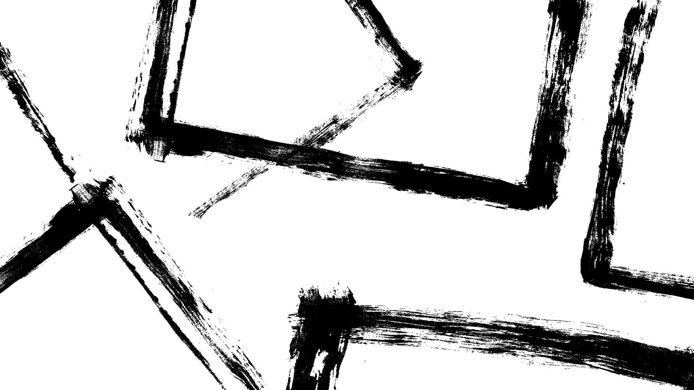
HYBRID DATASTRUCTURES
TERNARY SEARCH TRIE

Slide 2
GROUP : ALGOHOLICS
TEAM MEMBERS :
Abhisheakraj O – CB.EN.U4CSE21402
Nithin G - CB.EN.U4CSE21443
S Amruthiyu - CB.EN.U4CSE21449
Srutija B - CB.EN.U4CSE21460
T Bhargavi - CB.EN.U4CSE21462

Slide 3
Introduction
Hybrid data structures combine the strengths of multiple data structures to efficiently solve complex problems. They strike a balance between time and space complexity, offering versatile and optimized solutions. The objective of a project involving hybrid data structures is to design and implement a tailored solution that optimizes performance while minimizing drawbacks. Practical applications include computer graphics, gaming, and database systems.
Analyzing the time and space complexity of hybrid data structures is crucial for evaluating their efficiency. This involves evaluating worst-case, average-case, and best-case time complexities for important operations like insertion, deletion, search, and traversal. Space complexity analysis helps determine the memory requirements of the hybrid structure. Through comprehensive analysis, valuable insights are gained to optimize the structure's performance for efficiently solving complex problems.

Slide 4

Overview of TST
The Ternary Search Trie (TST) is a hybrid data structure combining trie and binary search tree characteristics. It efficiently stores and searches strings by leveraging the strengths of both structures. Each node represents a character, with three branches per node for efficient searching and insertion. It also includes links for ordered traversal. The TST excels in string-based operations like prefix searching and wildcard matching. By combining data structures, the TST achieves a balance between time and space complexity, making it powerful for versatile and efficient data storage and retrieval. It handles large datasets efficiently and is effective for complex problem-solving. Overall, the TST is a powerful tool for various applications.

Slide 5
IMPLEMENTATION

Slide 6
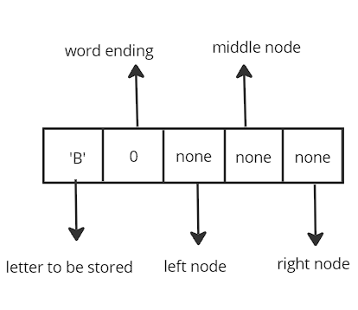
Node Definition
The TST is composed of nodes, each representing a character and containing pointers to its left, middle, and right child nodes. Additionally, each node may store a value associated with the character if it represents the end of a key.

Slide 7
INSERTION
K
Start at the root of the TST.

Slide 8
Compare the current character of the key you want to insert with the character at the current node.
If the current character is smaller, go to the left child of the current node.
If the current character is larger, go to the right child of the current node.
If the current character is equal, move to the middle child of the current node and proceed to the next character of the key.
K
I

Slide 9
K
Repeat steps 2-5 until you reach a null node.
Create new nodes for the remaining characters of the key and link them appropriately to the TST.
Set the value of the last node in the key to the desired value or data associated with the key.
I
w

Slide 10
K
I
w
I

Slide 11
K
I
w
I

Slide 12
K
I
w
I
F

Slide 13
K
I
w
I
F
R

Slide 14
K
I
w
I
F
R
U

Slide 15
K
I
w
I
F
R
U
I

Slide 16
K
I
w
I
F
R
U
I
T

Slide 17
K
A
I
w
I
F
R
U
I
T

Slide 18
K
A
I
P
w
I
F
R
U
I
T

Slide 19
K
A
I
P
w
P
I
F
R
U
I
T

Slide 20
K
A
I
P
w
P
I
L
F
R
U
I
T

Slide 21
K
A
I
P
w
P
I
L
F
E
R
U
I
T

Slide 22
K
DELETION
A
I
Start at the root of the TST.
Compare the current character of the key you want to delete with the character at the current node.
If the current character is smaller, go to the left child of the current node.
If the current character is larger, go to the right child of the current node.
If the current character is equal, move to the middle child of the current node and proceed to the next character of the key.
Repeat steps 2-5 until you reach the end of the key or a null node.
If you reach the end of the key and the current node has a value associated with it, mark the value as deleted (e.g., set it to None).
If the current node has no value and is a leaf node (no children), delete the node and backtrack to the parent.
If the current node has no value but has children, continue traversing the TST.
During the backtrack, if any node has no value and no children, delete the node and update the appropriate link in the parent node.
Repeat steps 2-10 until the end of the key is reached or a null node is encountered.
P
w
P
I
L
F
E
R
U
I
T

Slide 23
K
A
I
Delete apple
P
w
P
I
L
F
E
R
U
I
T

Slide 24
K
A
I
P
w
P
I
L
F
E
R
U
I
T

Slide 25
K
A
I
P
w
P
I
L
F
E
R
U
I
T

Slide 26
K
A
I
P
w
P
I
L
F
E
R
U
I
T

Slide 27
K
A
I
P
w
P
I
L
F
E
R
U
I
T

Slide 28
K
A
I
P
w
P
I
L
F
E
R
U
I
T

Slide 29
K
A
I
P
w
P
I
L
F
R
U
I
T

Slide 30
K
A
I
P
w
P
I
F
R
U
I
T

Slide 31
K
A
I
P
w
I
F
R
U
I
T

Slide 32
K
A
I
w
I
F
R
U
I
T

Slide 33
K
I
w
I
F
R
U
I
T

Slide 34
K
SEARCH
A
I
Start at the root of the TST.
Compare the current character of the key you want to search with the character at the current node.
If the current character is smaller, go to the left child of the current node.
If the current character is larger, go to the right child of the current node.
If the current character is equal, move to the middle child of the current node and proceed to the next character of the key.
Repeat steps 2-5 until you reach the end of the key or a null node.
If you reach the end of the key and the current node has a value associated with it, return the value as the search result.
If the current node has no value or the end of the key is reached but the current node is null, the key is not present in the TST.
P
w
P
I
L
F
E
R
U
I
T

Slide 35
K
SEARCH
A
I
Search for kiwi
-found k
P
w
P
I
L
F
E
R
U
I
T

Slide 36
K
SEARCH
A
I
Search for kiwi
Found i
P
w
P
I
L
F
E
R
U
I
T

Slide 37
K
SEARCH
A
I
Search for kiwi
Found w
P
w
P
I
L
F
E
R
U
I
T

Slide 38
K
SEARCH
A
I
Search for kiwi
Found I and I is endofword
Hence found kiwi
P
w
P
I
L
F
E
R
U
I
T

Slide 39
Advantages of TST
Efficient String Operations
Ordered Traversal
Efficient search and insertion
Compact representation
Simple Design

Slide 40
Disadvantages of TST
Memory overhead
Slower search times
Not suitable for all applications
Complexity in Implementation
Limited to String-Based Data

Slide 41
Practical Applications
Spell checking and autocompletion
Information retrieval and text indexing
Auto-suggest and predictive text
Symbol table management in compilers
DNA Sequence Analysis

Slide 42
Performance Analysis
Time Complexity of key operations in TST
Space Complexity of TST

Slide 43
Time Complexity
Insertion: O(log n), where n is the number of nodes in the TST. The time complexity is influenced by the length of the key and the structure of the tree. In the average case, TST provides efficient insertion.
Searching: O(log n) on average. The time complexity depends on the length of the key and the tree structure. The search process involves comparing characters and traversing the tree until the end of the key is reached or a null node is encountered.
Deletion: O(log n) on average. Deleting a key involves comparing characters, traversing the tree to locate the key, and adjusting pointers. The time complexity remains logarithmic due to the structure of the TST.

Slide 44
Space Complexity
The space complexity of a Ternary Search Trie (TST) primarily depends on the number of nodes and the amount of data stored in each node. In general, the space complexity of a TST is proportional to the total number of characters in the keys inserted. The TST has a memory overhead compared to other data structures like arrays or hash tables because each character is represented by an individual node.
The actual space complexity can vary based on implementation details, such as whether the TST uses balanced trees or compression techniques. Balancing techniques can help optimize space usage by ensuring a more balanced distribution of nodes. Compression techniques, such as path compression, can reduce the number of nodes and save space by merging common prefixes.

Slide 45

Comparing TST with BST and Tries
Efficiency: TSTs are efficient for certain operations, such as prefix-based searches, autocompletion, or spell checking, due to their trie-like structure.
01
Memory Utilization: TSTs generally have higher memory utilization and overhead compared to BSTs due to the individual nodes for each character.
02
Time Complexity: TSTs offer efficient time complexity for insertion, searching, and deletion operations with an average complexity of O(log n), where n is the number of nodes. BSTs also provide similar time complexity for these operations.
03

Slide 46

Experimental Evaluation
The experimental setup for measuring the performance of the Ternary Search Tree (TST) involves analyzing the time taken for insertion, search, and deletion operations on the TST
During the experiments, the time taken for each operation (insertion, search, and deletion) is measured for each word in the dataset.
The results obtained from the experiments can be visualized by plotting the time complexity analysis using the matplotlib.pyplot library. The graph shows the performance of the TST for insertion, search, and deletion operations, with the number of words on the x-axis and the time taken in seconds on the y-axis. This provides insights into the efficiency and scalability of the TST for different operations.

Slide 47
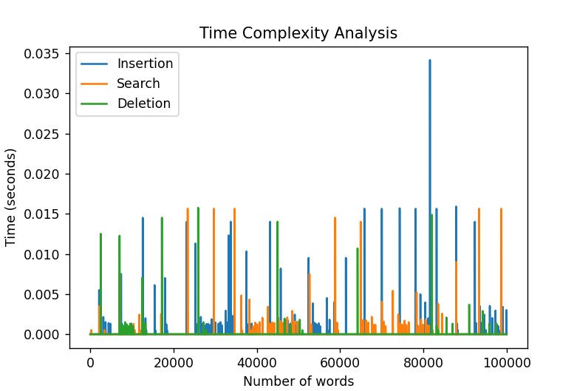

Slide 48
Discussion
Practicality: The TST is a versatile data structure that can handle a wide range of applications involving string data
Effectiveness: The TST offers efficient operations for key operations such as insertion, searching, and deletion
Limited to string data: The TST is specifically designed for string data and is less suitable for applications that require general data storage or operations
Memory overhead: The TST has a higher memory overhead compared to other data structures due to the individual nodes representing characters
Compression techniques: One potential improvement is the implementation of compression techniques to reduce the memory overhead of the TST
Overall, the TST is a powerful and versatile data structure with a wide range of applications

Slide 49
CONCLUSION
The project aimed to analyze the performance and efficiency of the Ternary Search Tree (TST) data structure. A TST is a specialized tree structure used for efficient storage and retrieval of strings. The implementation of the TST involved insertion, search, and deletion operations.
To evaluate the performance, the code generated a list of random words and measured the time taken for insertion, search, and deletion operations at different word counts. The time complexity analysis was visualized using a line graph.

Slide 50

THANK YOU

