Slide 1


Slide 2
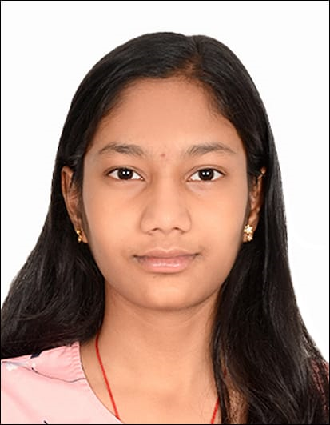

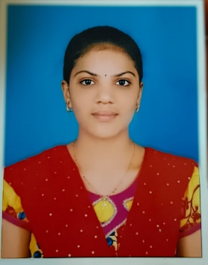
Team details
TEAM NAME: WARRIORS
Alapati Hema Latha (Team Leader) College: Vel Tech Rangarajan Dr. Sagunthala R&D Institute of Science and Technology Stream: B.Tech CSE Year of graduation:2026 ^{Photo} : |  | Marthala Bhargavi College:Vel Tech Rangarajan Dr. Sagunthala R&D Institute of Science and Technology Stream: B.Tech CSE Year of graduation:2026

Slide 3
Problem Statement
Problem Statement
AI BASED SENSOR FOR MARINE LIFE PROTECTION
Tidal energy is a renewable energy that harnesses the power of ocean tides to generate electricity. It is an eco-friendly energy resource since it doesn’t release any greenhouse gases. In fact, it has greater efficiency than solar or wind energy. There is scope to generate this energy on a large scale but there are many hindrances like frozen sea, low or weak tides, straight shore lines. Apart from this there is an ecological disturbance in marine life. In our project, we will develop a chemical discharger which will release ‘DISTURBANCES CUES’ a signal(chemicals) which marine animal will detect and will stay away from the tidal plant. This device can be put into the water body where the tidal plant is setup. This project is an attempt to understand the response mechanism of aquatic life and also solve one of the major issues hindering the setup of tidal plant. It also aims to conserve and sustainably use the oceans, seas and marine resources for sustainable development.

Slide 4
Proposed solution
A tidal energy works via a turbine works like a wind turbine, with blades rotating 12-to-18 times a minute depending on tide strength. The turbine is connected to a gearbox that turns a generator, creating electricity. Consecutively, with the help of SONAR SENSORS we will keep an eye on the marine animals’ safety. The sensor will detect the presence of fishes within a range of 11 metres. It will direct this signal to the Chemical Discharger through the Relay Module. The chemicals used in the discharger are either Cephalopod Ink or Disturbances Cues. The chemical used might be subject to its availability, eco-friendliness and synthesising cost. Thus, the chemical is released which alerts the fish about the danger and hence save their lives. Also we have used Keil C and Arduino IDE to program our sensors.

Slide 5
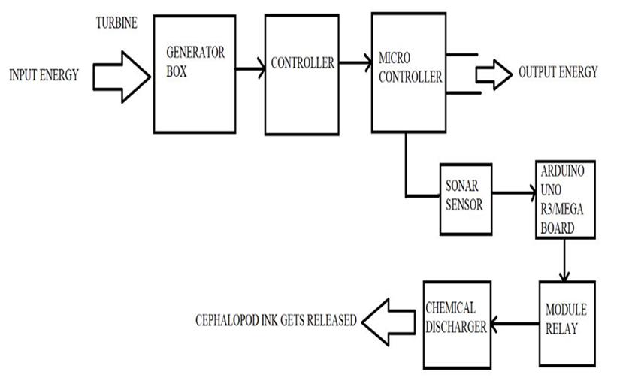
Block Diagram
The below diagram represents the working mechanism of the model:
Fig. 1 Block Diagram
The output energy of the tidal plant.
The SONAR sensor detects the fish and it sends the signal to the Chemical Discharger via the Relay Module.
The Chemical Discharger releases the Cephalopod Ink.

Slide 6
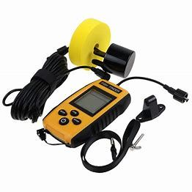
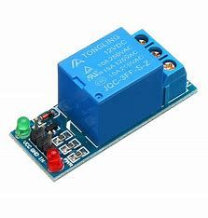
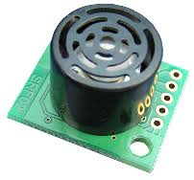
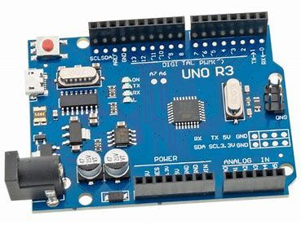
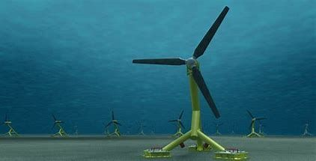
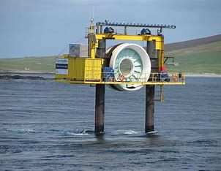
How does your innovation accelerate change with the power of Technology?
Hardware Details
Fig.2 Sonar Sensor Fig. 3 Ultrasonic Sensor Fig. 4 12V Relay Module
Fig. 5 Arduino UNO Microcontroller Fig. 6 Tidal Turbine Fig. 7 Tidal Generator

Slide 7


How does your innovation accelerate change with the power of Technology?
Acceleration in Innovation with the power of Technology
Our project aims in two goals , firstly, to protect the life under water(Marine life) as well as the growth in sustainable energy which is also one of the G20 goals in India. Our innovation which uses both AI techniques as well as sensor methodology can prove to be helpful by providing deeper insights about the life underwater. With the help of technology, we are saving the precious lives of the aquatic species as well as progressing in the field of energy development. Arduino IDE and Keil C are the primary programming languages used in our project. The functions of the sensors are programmed into it so as to work out unmanned. The below picture represents the programming languages used in our sensors:
Fig. 8 Arduino IDE Software Fig. 9 Keil C Programming Language

Slide 8
How is your solution different/unique from other solutions in market
Sonar Sensors are currently used for fish detection in the ocean. These sensors detect the fish at various ranges and depths. In our project, we are going to send the Chemical Discharger the signal to release out the chemical when the sensor captures any fish within the range of 11 metres. Cephalopod Ink or Squid ink will act as the chemical which alerts the fish about the danger. It is observed that when squid ink is released around the fish , they alert danger and release a signal “Disturbance Cues” which alerts the other surrounding fishes. We can also synthesise artificial squid ink or any other chemical to which fish response system is the same. Our chemical discharger plays the vital role in our project as the chemical is stored in it which needs to be ejected out time to time.
PATENT FILED: No
Do you have a working model/prototype: No
If not, will you be able to show working prototype during finale. Yes

Slide 9
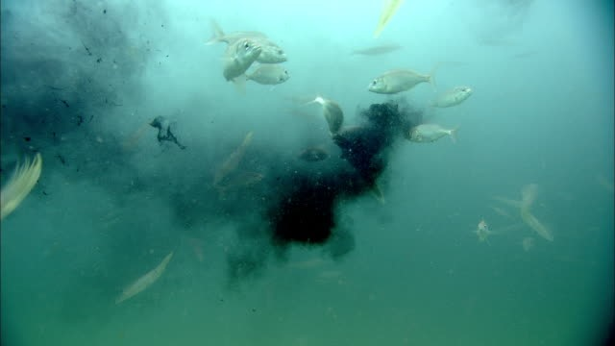
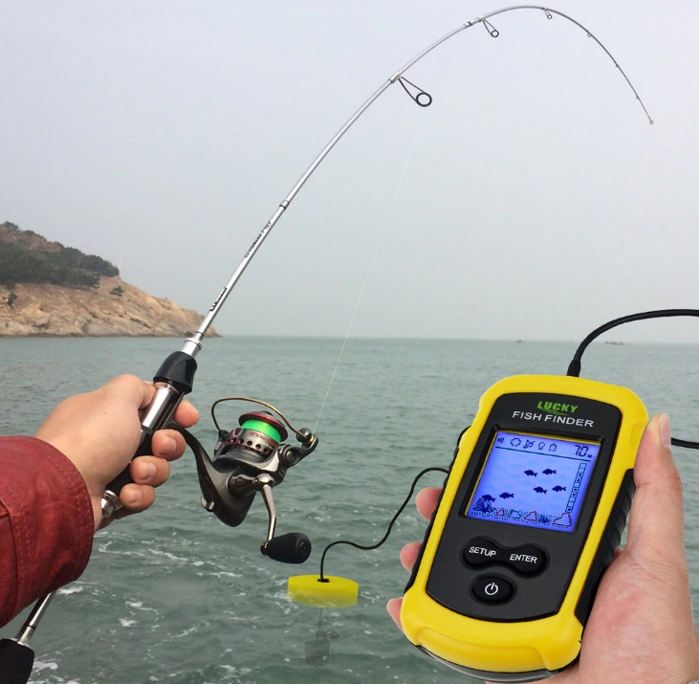
Any testimonials received?
Our project model is under progress and will be completed before the Finals.
Fig. 10 Fish response to Cephalopod ink Fig.11 Sonar Sensor detecting the fish

Slide 10


Thank you!

