Slide 1
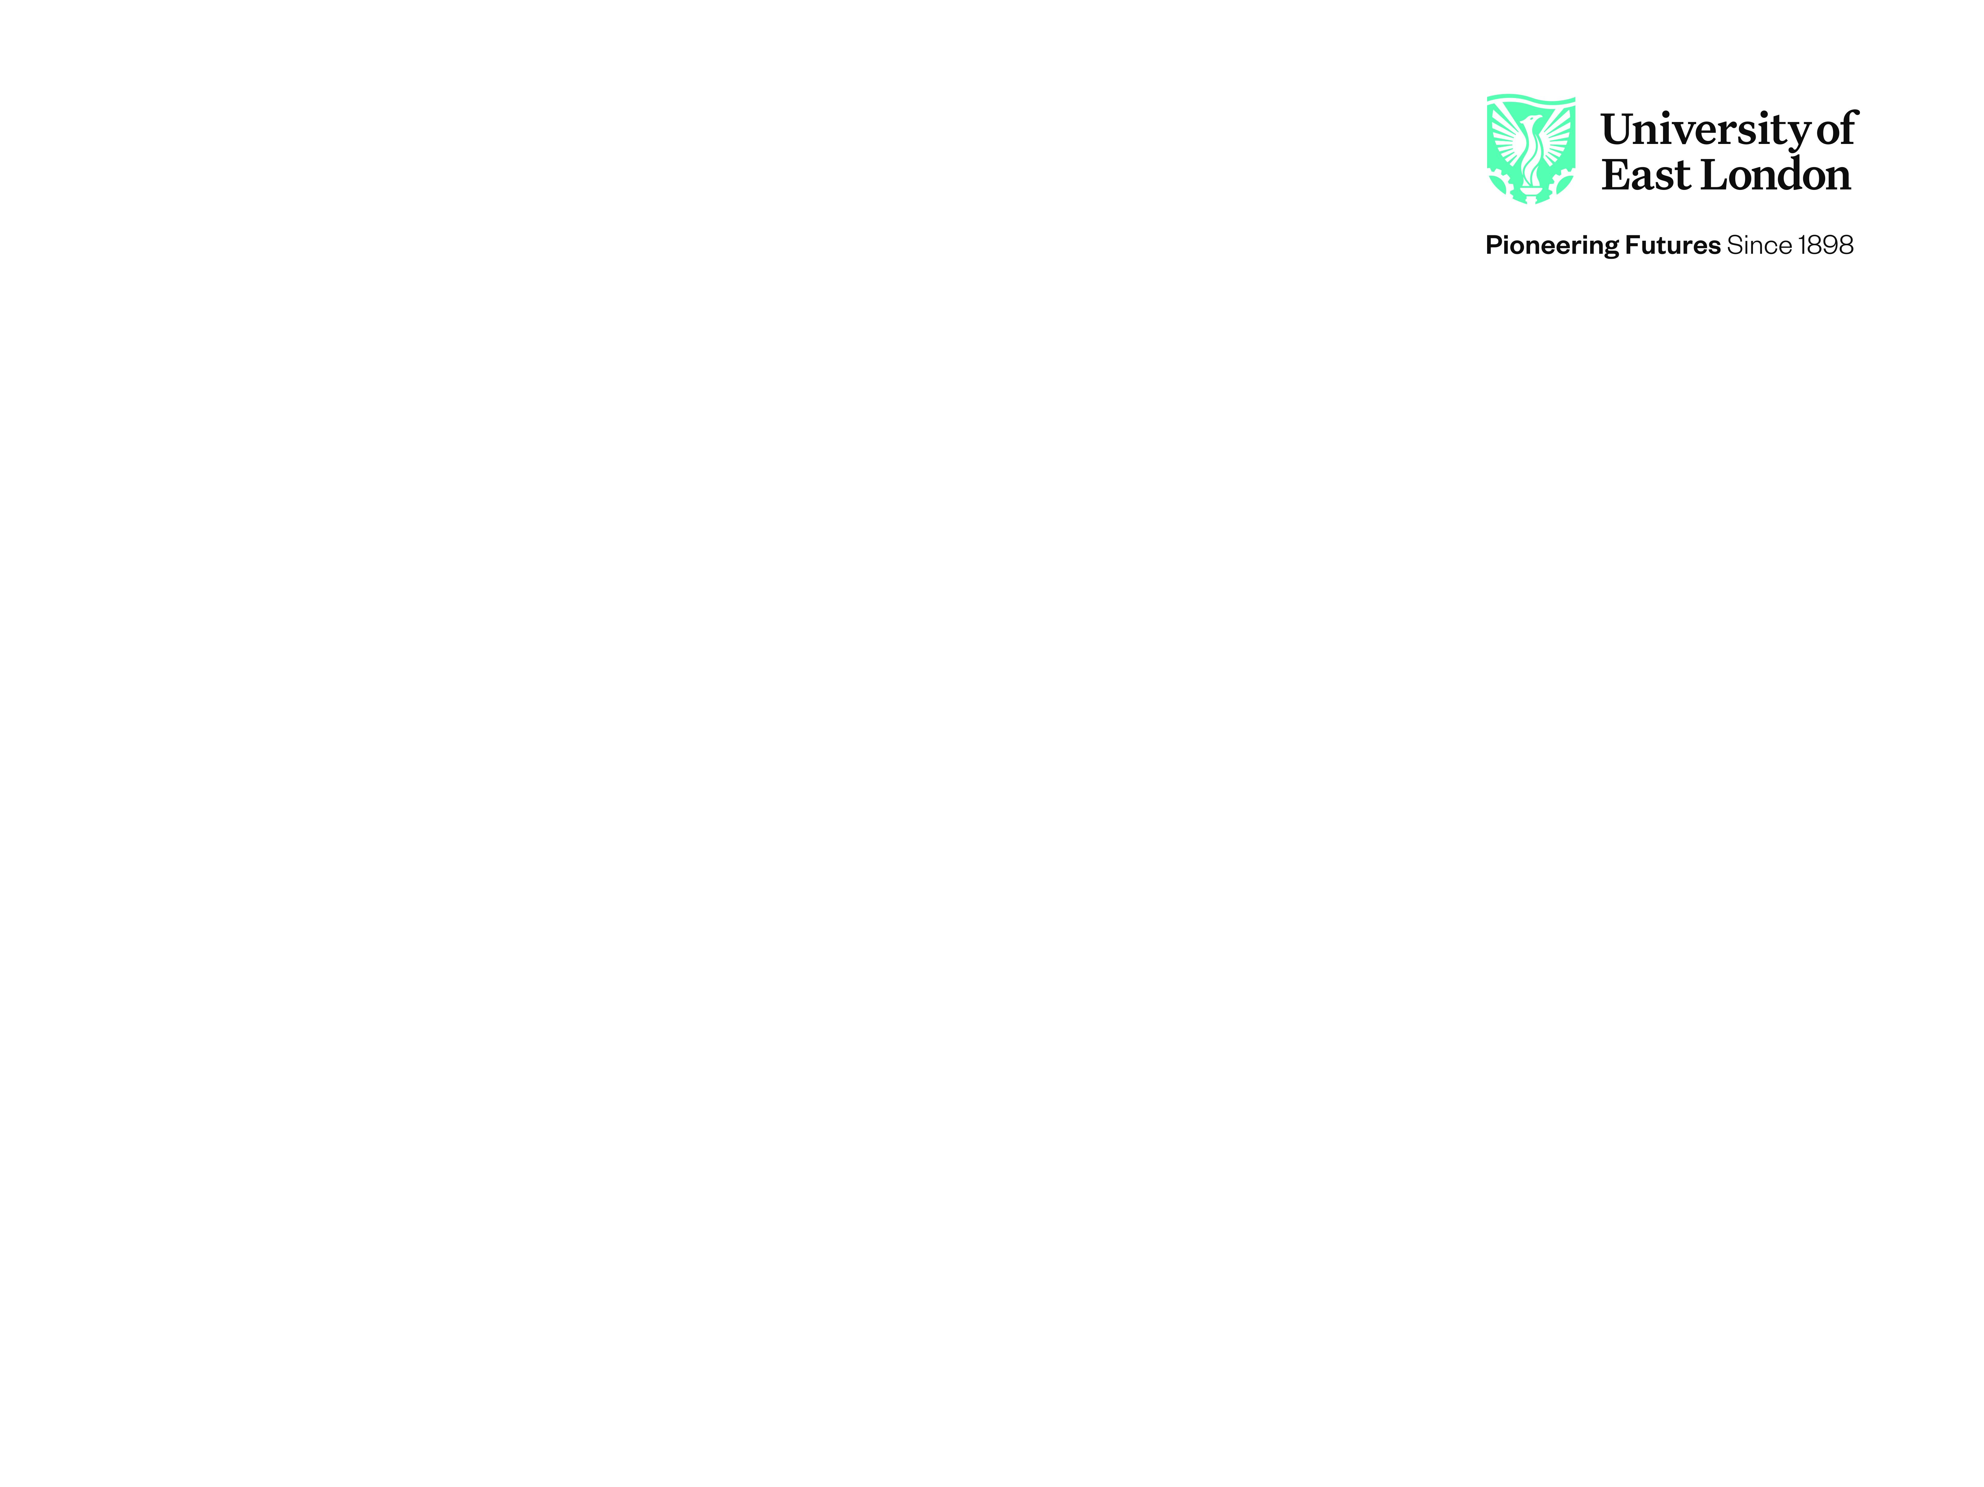
CN7023 – Artificial Intelligence & Machine Vision
Project Topic: Multi-View Mammography Classification and Explainable Diagnosis Using CBIS-DDSM
Name: Bala Bhargavi Godari
ID: 4004419
Email: u4004419@uel.ac.uk

Slide 2
Dataset Description
Dataset Name | CBIS-DDSM: Breast Cancer Image Dataset
Dataset Link | CBIS-DDSM: Breast Cancer Image Dataset
Dataset Size | 6.3 GB
Image Dimensions | 512 x 512 x 3 normalized RGB Image Tensors
Number of Classes | 3
Number of Images per Class | Class 1 | Class 2 | Class 3
 | 4257 | 4119 | 1757
Notes: This Kaggle release mixes full Mammograms, Lesion crops and ROI masks under overlapping metadata tags, so every file path was re-validated against the images actually on disk rather than trusted from the CSVs, Splits are performed by patient_id where noted, to stop the CC and MLO views of the same patient leaking across Training/validation/Test.

Slide 3
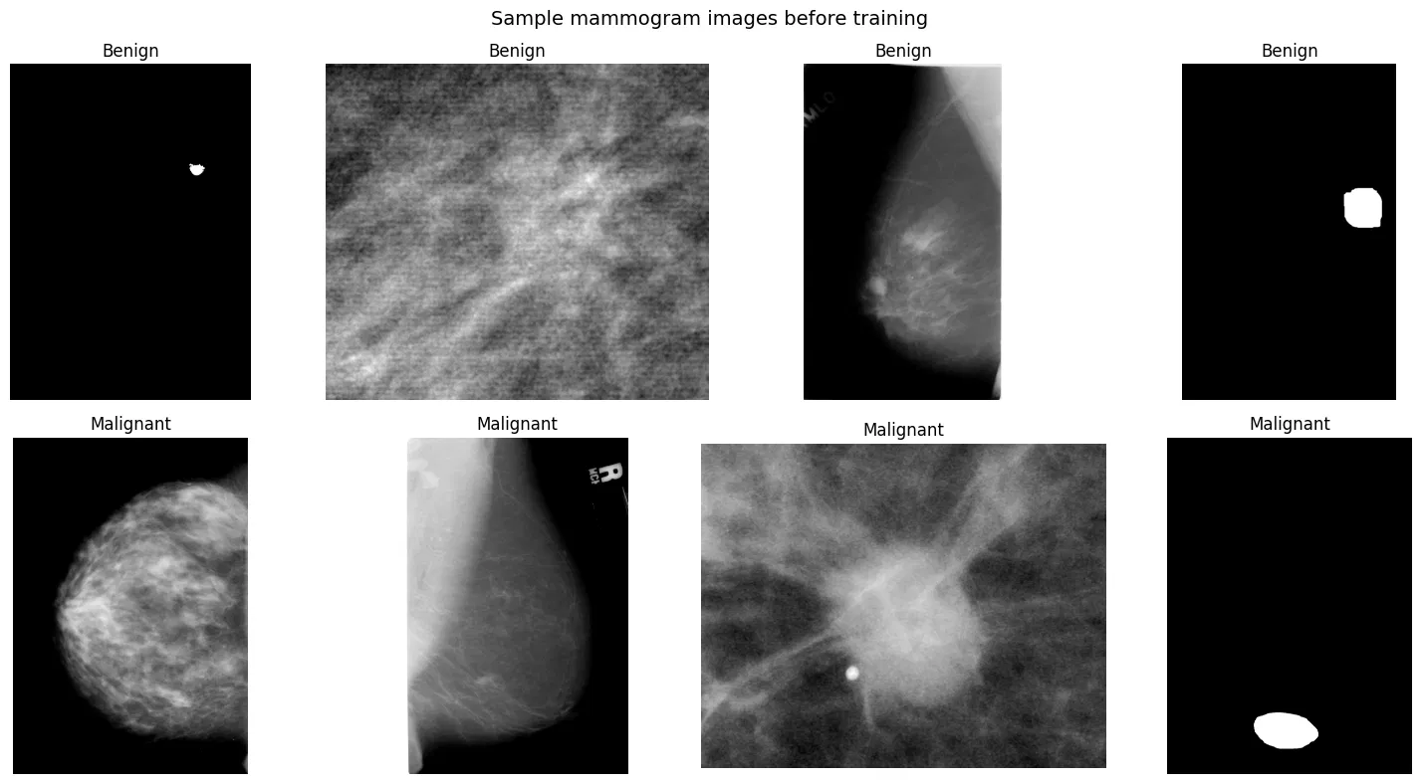
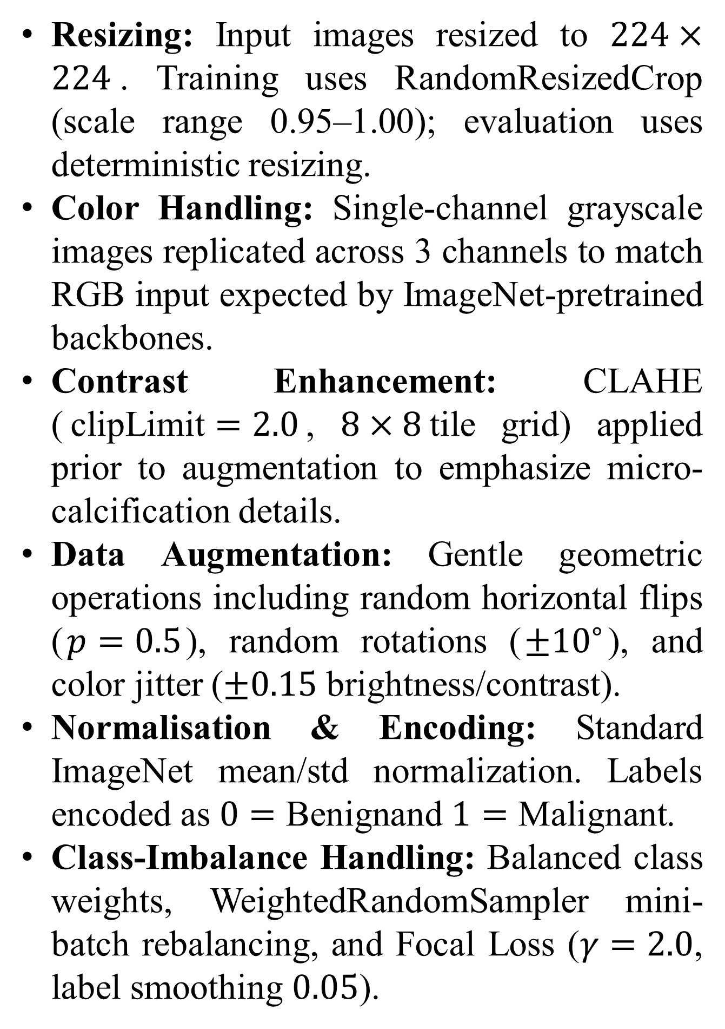
Data Pre-processing & Encoding
Resizing: Input images resized to $224×224$. Training uses RandomResizedCrop (scale range 0.95–1.00); evaluation uses deterministic resizing.
Color Handling: Single-channel grayscale images replicated across 3 channels to match RGB input expected by ImageNet-pretrained backbones.
Contrast Enhancement: CLAHE ($\text{clipLimit}=2.0$, $8×8$tile grid) applied prior to augmentation to emphasize micro-calcification details.
Data Augmentation: Gentle geometric operations including random horizontal flips ($p=0.5$), random rotations ($±{10}^{∘}$), and color jitter ($±0.15$ brightness/contrast).
Normalisation & Encoding: Standard ImageNet mean/std normalization. Labels encoded as $0=\text{Benign}$and $1=\text{Malignant}$.
Class-Imbalance Handling: Balanced class weights, WeightedRandomSampler mini-batch rebalancing, and Focal Loss ($γ=2.0$, label smoothing $0.05$).

Slide 4
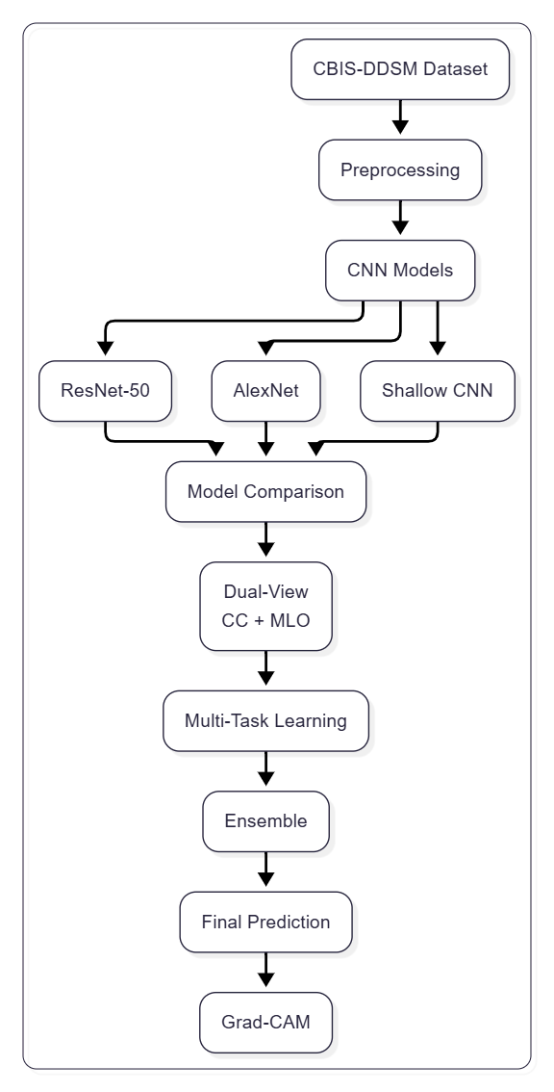
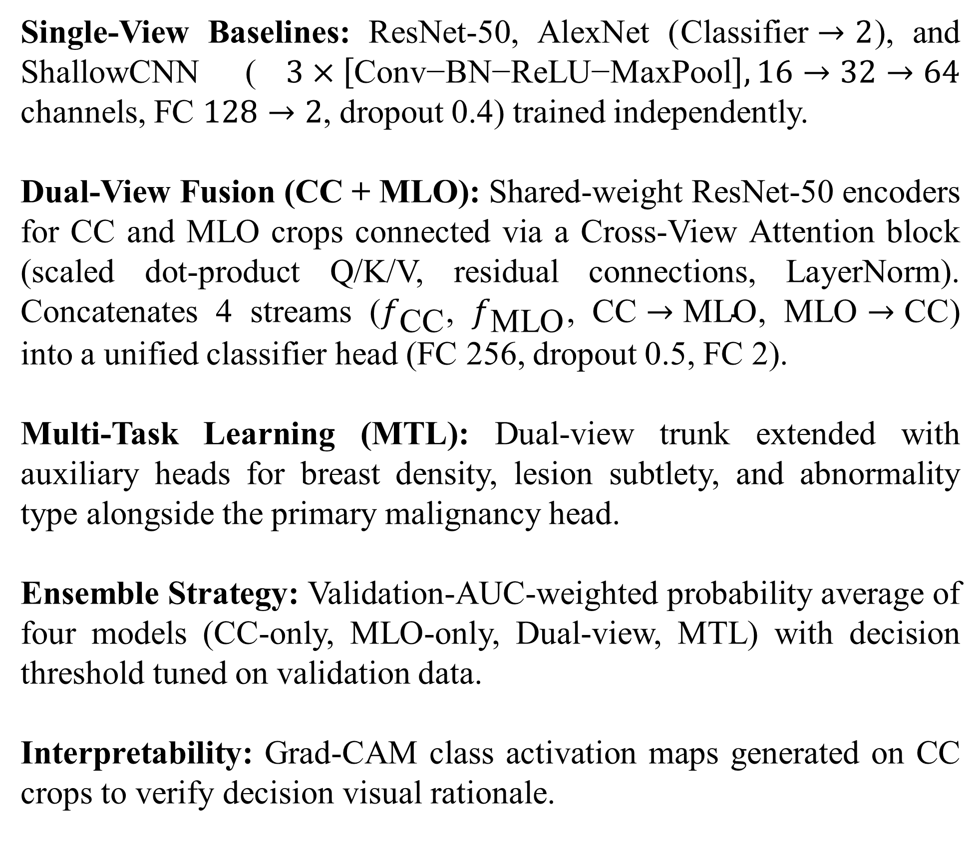
Network Architecture & Learning Algorithm
Single-View Baselines: ResNet-50, AlexNet ($\text{Classifier}→2$), and ShallowCNN ($3×\left[\text{Conv−BN−ReLU−MaxPool}\right],16→32→64$ channels, FC $128→2$, dropout 0.4) trained independently.
Dual-View Fusion (CC + MLO): Shared-weight ResNet-50 encoders for CC and MLO crops connected via a Cross-View Attention block (scaled dot-product Q/K/V, residual connections, LayerNorm). Concatenates 4 streams ($f_{\text{CC}}$, $f_{\text{MLO}}$, $\text{CC}→\text{MLO}$, $\text{MLO}→\text{CC}$) into a unified classifier head (FC 256, dropout 0.5, FC 2).
Multi-Task Learning (MTL): Dual-view trunk extended with auxiliary heads for breast density, lesion subtlety, and abnormality type alongside the primary malignancy head.
Ensemble Strategy: Validation-AUC-weighted probability average of four models (CC-only, MLO-only, Dual-view, MTL) with decision threshold tuned on validation data.
Interpretability: Grad-CAM class activation maps generated on CC crops to verify decision visual rationale.

Slide 5
Network Training Options
 | Shallow CNN | AlexNet | ResNet-50 (single-view) | Dual-view (B) / MTL (C)
Optimizer | SGD, momentum 0.9 + cosine annealing | SGD, momentum 0.9, wd 1e-4 (best of 4, below) | AdamW, wd 1e-4 | AdamW, wd 1e-4 (2-phase unfreeze)
Learning rate | 1e-3 | 1e-4 | 1e-4 | 1e-4
Batch size | 32 | 32 | 48 | 48
Dropout | 0.4 | 0.5 (torchvision default) | — | 0.5 (fusion head)
Epochs | 25 (early-stopped @ 7, patience 5) | 15 | 20 | Phase 1: 2 (head warm-up) Phase 2: ≤30, patience 8
Loss function | Weighted cross-entropy | Weighted cross-entropy | Focal loss (γ=2.0, label smoothing 0.05) | Focal (B); malignancy + 0.20 density + 0.20 subtlety + 0.12 type (C)
Other | Mixed precision (AMP) | Optimizer sweep: SGD / SGDM / Adam / RMSProp | WeightedRandomSampler, horizontal-flip TTA, 5-fold patient bagging | Backbone frozen → gradual unfreeze (layer2–4), 5-fold patient bagging

Slide 6
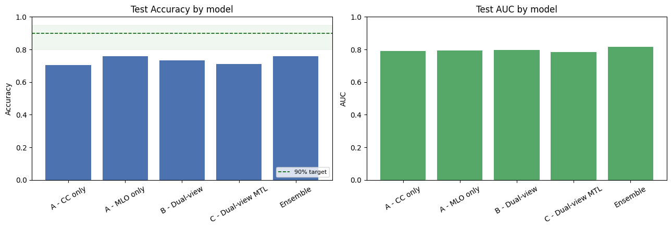
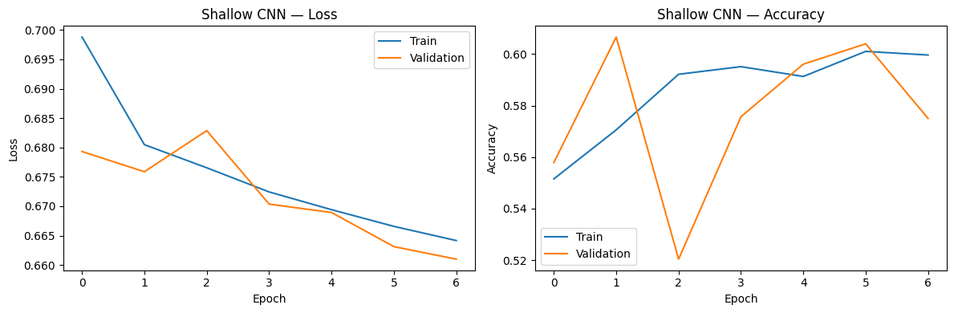
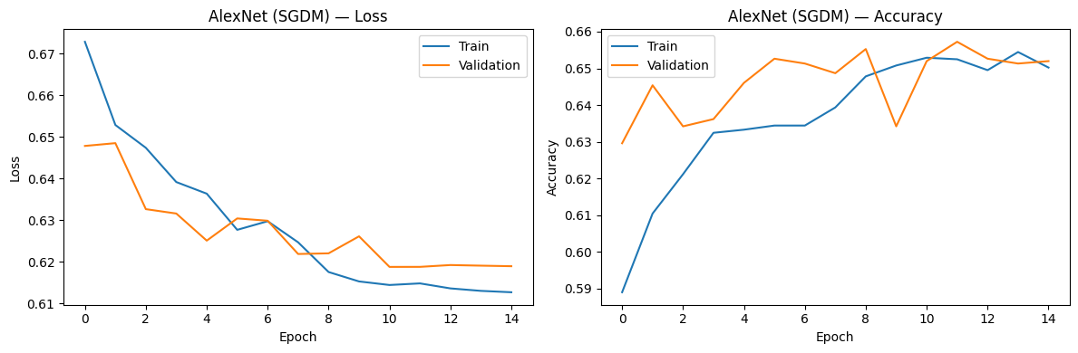
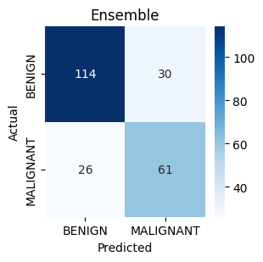
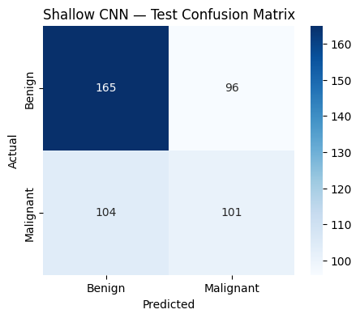
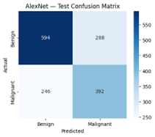
Results

Slide 7
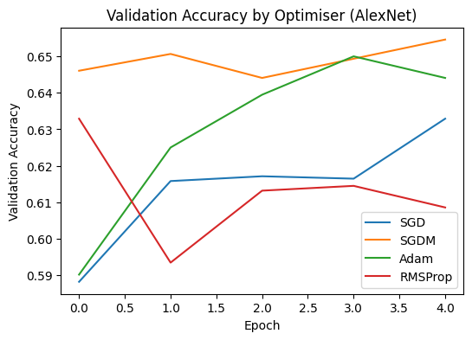
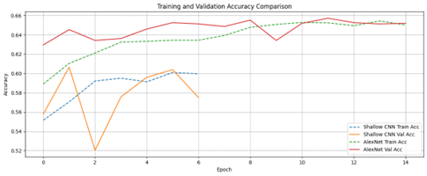
Comparative Analysis
Single-view backbone comparison (whole-image pipeline, 15-epoch budget)
Dual-view / multi-task / ensemble comparison
(curated abnormality-crop pipeline, 5-fold bagging)
Model | Accuracy | F1 (Malignant)
Shallow CNN | 59.1% | 0.49
AlexNet — SGD | n/a (val 63.3%) | —
AlexNet — SGDM (best) | 64.9% | 0.59
AlexNet — Adam | n/a (val 64.4%) | —
AlexNet — RMSProp | n/a (val 60.9%) | —
Model | AUC | Acc. | Prec. | Sens. | Spec. | F1
A – CC only | 0.790 | 0.706 | 0.584 | 0.759 | 0.674 | 0.660
A – MLO only | 0.794 | 0.758 | 0.660 | 0.736 | 0.771 | 0.696
B – Dual-view | 0.796 | 0.732 | 0.634 | 0.678 | 0.764 | 0.656
C – Dual-view MTL | 0.785 | 0.710 | 0.647 | 0.506 | 0.833 | 0.568
Ensemble | 0.818 | 0.758 | 0.670 | 0.701 | 0.792 | 0.685

Slide 8
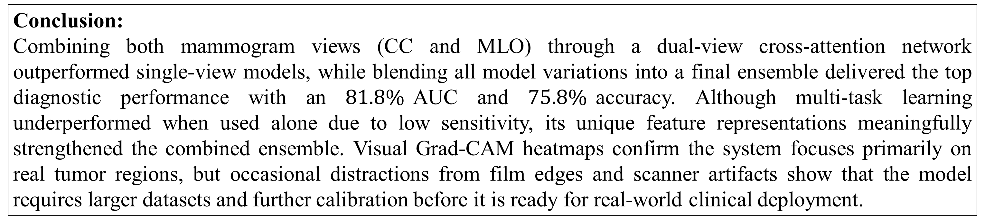
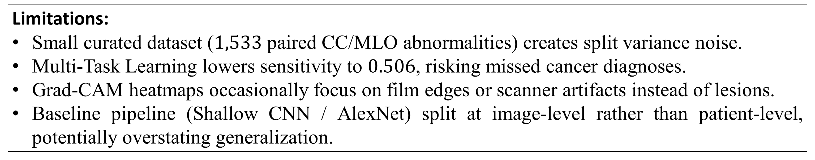
Limitations, Future Work & Conclusion
Limitations:
Small curated dataset ($1,533$ paired CC/MLO abnormalities) creates split variance noise.
Multi-Task Learning lowers sensitivity to $0.506$, risking missed cancer diagnoses.
Grad-CAM heatmaps occasionally focus on film edges or scanner artifacts instead of lesions.
Baseline pipeline (Shallow CNN / AlexNet) split at image-level rather than patient-level, potentially overstating generalization.
Future Work:
Expand training pool to 3,199 full single-image crops or external datasets.
Re-balance auxiliary loss weights in MTL to protect sensitivity.
Apply self-supervised pretraining directly on mammography images instead of ImageNet.
Conduct external multi-site validation and uncertainty calibration.
Conclusion:
Combining both mammogram views (CC and MLO) through a dual-view cross-attention network outperformed single-view models, while blending all model variations into a final ensemble delivered the top diagnostic performance with an $81.8\%$AUC and $75.8\%$accuracy. Although multi-task learning underperformed when used alone due to low sensitivity, its unique feature representations meaningfully strengthened the combined ensemble. Visual Grad-CAM heatmaps confirm the system focuses primarily on real tumor regions, but occasional distractions from film edges and scanner artifacts show that the model requires larger datasets and further calibration before it is ready for real-world clinical deployment.

Slide 9
References
Lee, R.S., Gimenez, F., Hoogi, A., Miyake, K.K., Gorovoy, M. and Rubin, D.L. (2017) 'A curated mammography data set for use in computer-aided detection and diagnosis research', Scientific Data, 4, 170177. Available at: https://doi.org/10.1038/sdata.2017.177 (Accessed: 20 August 2026).
He, K., Zhang, X., Ren, S. and Sun, J. (2016) 'Deep residual learning for image recognition', in Proceedings of the IEEE Conference on Computer Vision and Pattern Recognition (CVPR). Las Vegas: IEEE, pp. 770–778.
Krizhevsky, A., Sutskever, I. and Hinton, G.E. (2012) 'ImageNet classification with deep convolutional neural networks', in Advances in Neural Information Processing Systems, 25, pp. 1097–1105.
Selvaraju, R.R., Cogswell, M., Das, A., Vedantam, R., Parikh, D. and Batra, D. (2017) 'Grad-CAM: visual explanations from deep networks via gradient-based localization', in Proceedings of the IEEE International Conference on Computer Vision (ICCV). Venice: IEEE, pp. 618–626.
Lin, T-Y., Goyal, P., Girshick, R., He, K. and Dollár, P. (2017) 'Focal loss for dense object detection', in Proceedings of the IEEE International Conference on Computer Vision (ICCV). Venice: IEEE, pp. 2980–2988.
Zuiderveld, K. (1994) 'Contrast limited adaptive histogram equalization', in Graphics Gems IV. San Diego: Academic Press Professional, pp. 474–485.

