Slide 1

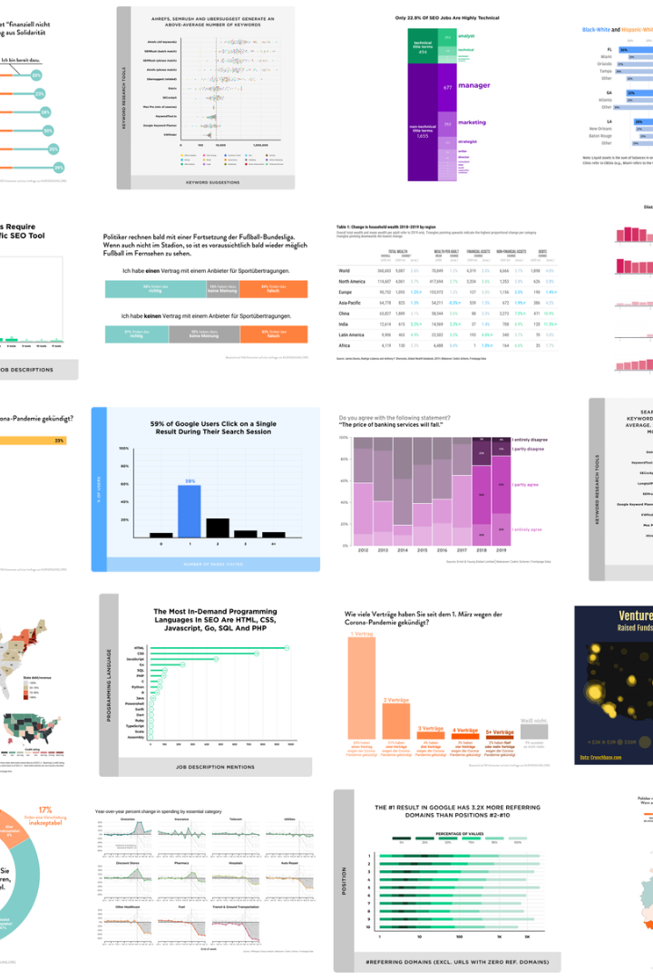
Machine Learning Analysis of Insurance Charges and Customer Segmentation
This project aims to dissect the factors influencing insurance charges through machine learning, providing a granular understanding of customer demographics and behavior.
-Bhargavi Dwivedi

Slide 2
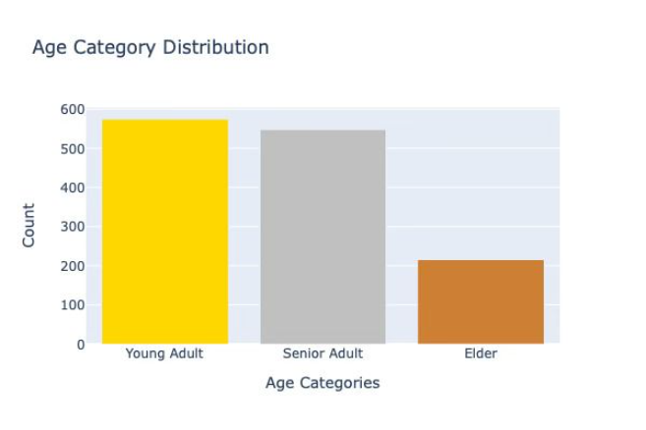
Age Analysis
Turning Age into Categorical Variables:
Young Adult: from 18 - 35
Senior Adult: from 36 - 55
Elder: 56 or older
Share of each Category: Young Adults (42.9%), Senior Adults (41%) and Elder (16.1%)

Slide 3
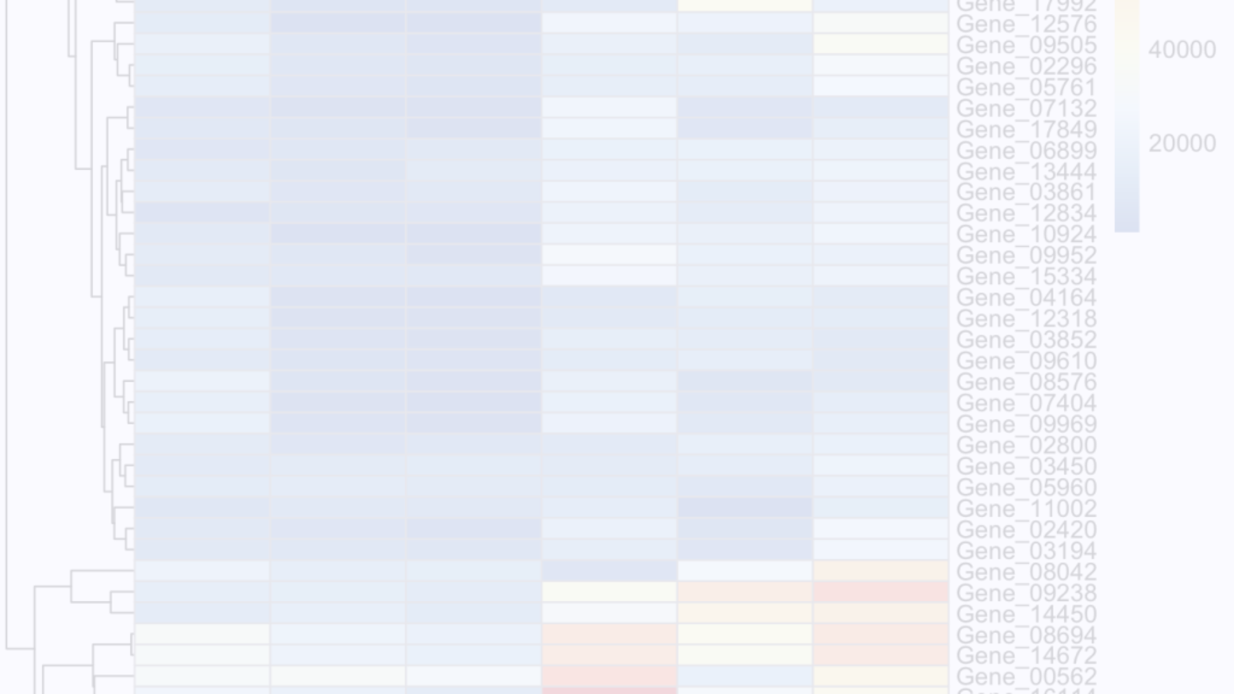



Heatmap Analysis
New Categorical Label
Weight Status vs. Charges
A new categorical label, "weightcategory," was introduced in the data analysis. This label was derived from individuals' Body Mass Index (BMI) values, and individuals were classified into four distinct health conditions: Underweight, Normal Weight, Overweight, and Obese.
It is observed that, among overweight individuals, there are two distinct groups that receive significantly higher charges compared to the remaining overweight population. Similarly, within the obese category, a similar pattern is identified, where one subgroup incurs notably higher charges compared to the other subgroup.

Slide 4
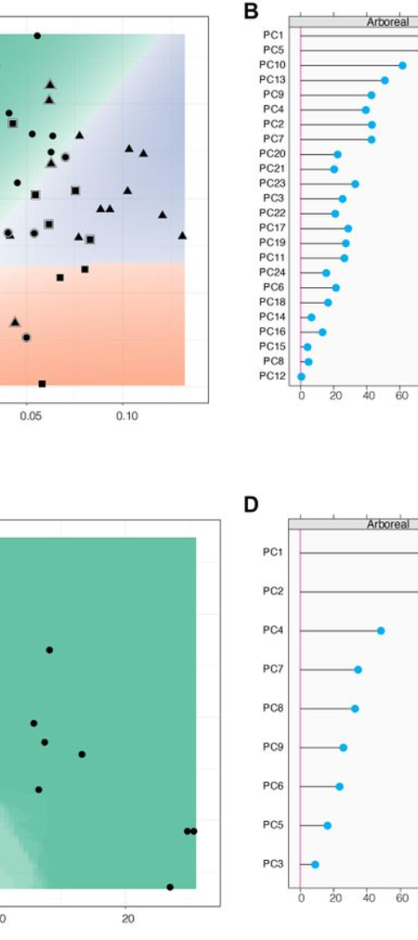
KNearest Neighbors (KNN) Algorithm
1
Model's Performance
2
Impact of Smoking
As indicated by a Mean Absolute Error (MAE) of 3791.84, a Mean Squared Error (MSE) of 33733255.78, and an R-squared value of 0.78, the KNN algorithm suggests a substantial predictive capacity.
KNN can be instrumental in discerning the impact of smoking on insurance charges, a question of particular interest to insurers.

Slide 5
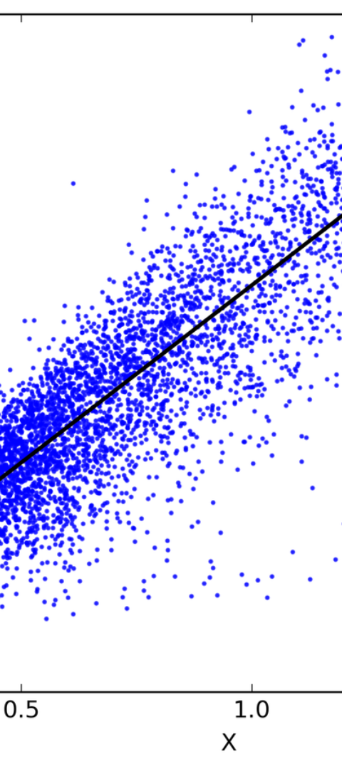
Linear Regression Analysis
1
Results
Results indicative of a moderate level of accuracy were obtained. Insurance charges were estimated using encoded predictive features, namely 'weight category', 'age category', and 'smoker status'.
2
Model's Performance
An R-squared value of 0.74 was reported, suggesting that around 74% of the variance in insurance charges was accounted for by the model's inputs.
3
Residual Plot
The spread of residuals revealed potential model inadequacies, such as possible non-linearity or heteroscedasticity.

Slide 6
Decision Tree Regressor Analysis
Model's Performance
Feature Space Segmentation
The Mean Absolute Error (MAE) recorded stands at 2842.64, which suggests that on average, the model's predictions deviate from the actual charges by this amount.
The decision tree's architecture allows it to naturally capture the non-linear relationships and interactions between features, which linear models may not handle as effectively.

Slide 7
Comparative Analysis
1
Advancing to Predictive Analytics
Two regression techniques were compared: Linear Regression and Decision Tree Regression.
Model Comparison
2
The Decision Tree Regressor, with a commendable R-squared value of 0.84748, outperformed its linear counterpart, signifying its higher efficacy in modeling the nonlinear patterns present in the data.

Slide 8
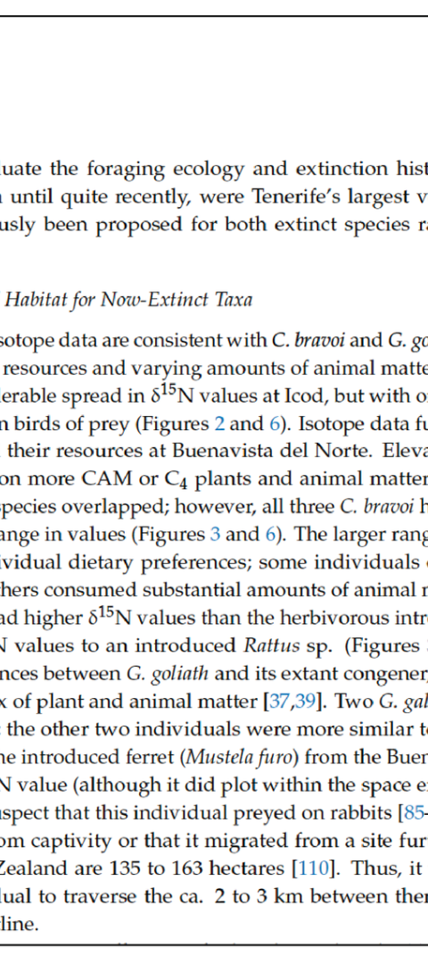
Conclusion
1
Insights
2
Potential for Refinement
This comparative analysis not only affirmed the utility of machine learning in predicting and understanding insurance charges but also illuminated the path for future inquiries.
These results underscored the decision tree's capability to dissect the data's intricacies, offering a nuanced and granular understanding of the determinants affecting insurance premiums.

Slide 9
Thank you

