Slide 1
SMART CLASSROOM AND TIME TABLE SCHEDULER
CSE7101- University Project
Review-5
Batch Number : CSE_35
Under the Supervision of,
Ms. Shaik Salma Begum
Assistant Professor
School of Computer Science and Engineering
Presidency University
Roll Number | Student Name
20221CSE0517 | Bhargavi K
20221CSE0516 | Bhargavi N
20221CSE0452 | Rahul K M
Name of the Program: B.Tech
Name of the HoD: Dr. Asif Mohamed H B
Name of the Program Project Coordinator: Dr. Jayavadivel Ravi
Name of the School Project Coordinators: Dr. Sampath A K .

Slide 2
Problem Statement Number: SIH25028
Organization: Government of Jharkhand (SIH 2025 Official Problem Statements) .
Category (Hardware / Software / Both) : Software
Problem Description:
The problem focuses on creating a Smart Classroom & Timetable Scheduler for educational institutions. Currently prepared timetables leading to class conflicts, Difficult Subjects are not placed during attention hours, uneven faculty workload, and underutilized classrooms.
The system should automatically generate optimized, Attention-aware and clash-free schedules based on faculty availability, room capacity, and student batches.
It should handle dynamic constraints like elective combinations and sudden unavailability of staff or classrooms.
The solution must improve resource utilization and reduce administrative effort. An intelligent, Attention-aware and faculty workload- balance scheduling system will ensure fairness for teachers and smooth academic operations.

Slide 3
Content
Problem Statement
Objectives
Background and Related work for title Selection
Analysis of Problem Statement
Innovation or Novel Contributions
Git-hub Link
Timeline of the Project
References

Slide 4
Content (continuation)..
Problem Statement: Many educational institutions face persistent challenges in classroom allocation and timetable management due to increasing student strength, limited infrastructure, and complex academic requirements. The lack of an automated and intelligent scheduling mechanism leads to timetable clashes, inefficient classroom utilization, unbalanced faculty workload, attention hours are ignored/given to easy subjects and excessive manual effort. This results in academic disruptions, faculty overload, and reduced overall efficiency in institutional operations.
Key Gap: Most institutions rely on manual scheduling or basic tools that lack data-driven optimization and conflict resolution capabilities.
Objectives
To collect and organize academic data related to classrooms, faculty, courses, and time slots.
To categorize scheduling requirements department-wise, faculty-wise, classroom-wise, and time-slot wise.
To develop an automated and intelligent Attention-aware and Faculty Workload-Balanced timetable generation system.
To optimize classroom utilization, focusing on attention hours, reduce faculty overload and avoid scheduling conflicts.
To support academic administrators with efficient and flexible scheduling decisions.

Slide 5
Background and Related Work
Background: Educational institutions traditionally rely on manual or semi-automated methods for classroom allocation and timetable preparation. As student strength, courses, and faculty increase, these approaches become inefficient, time-consuming, and error-prone.
Existing systems often fail to handle:
Classroom capacity constraints an
Faculty overload and Attention hours are wrongly used
Faculty availability conflicts
Dynamic changes in schedules
Related Work: Some institutions use basic timetable software or spreadsheets, which:
Lack intelligent optimization
Do not adapt to real-time constraints
Offer minimal analytics and flexibility

Slide 6
Technology Stack Components
1. Data Collection & Processing
Python – Data validation and preprocessing
JSON / CSV – Structured input data formats
Pandas – To read CSV files and to generate tabular format for timetables
2. Timetable Scheduling Logic
CP-SAT – Constraint Programming - Satisfiability
BACKTRACKING – backtracking if all constraints are not satisfied
3. Streamlit
To maintain frontend and backend as a single centralized unit.
To visualize interactive dashboard and to retrieve the outputs.
4. Platforms
Google colab/ VS Code – To implement the logic to build a system.
Stream lit – Interactive dashboard to get the optimized timetables.
5. Hosting & Deployment
GitHub – Source Code Management and project collaboration

Slide 7
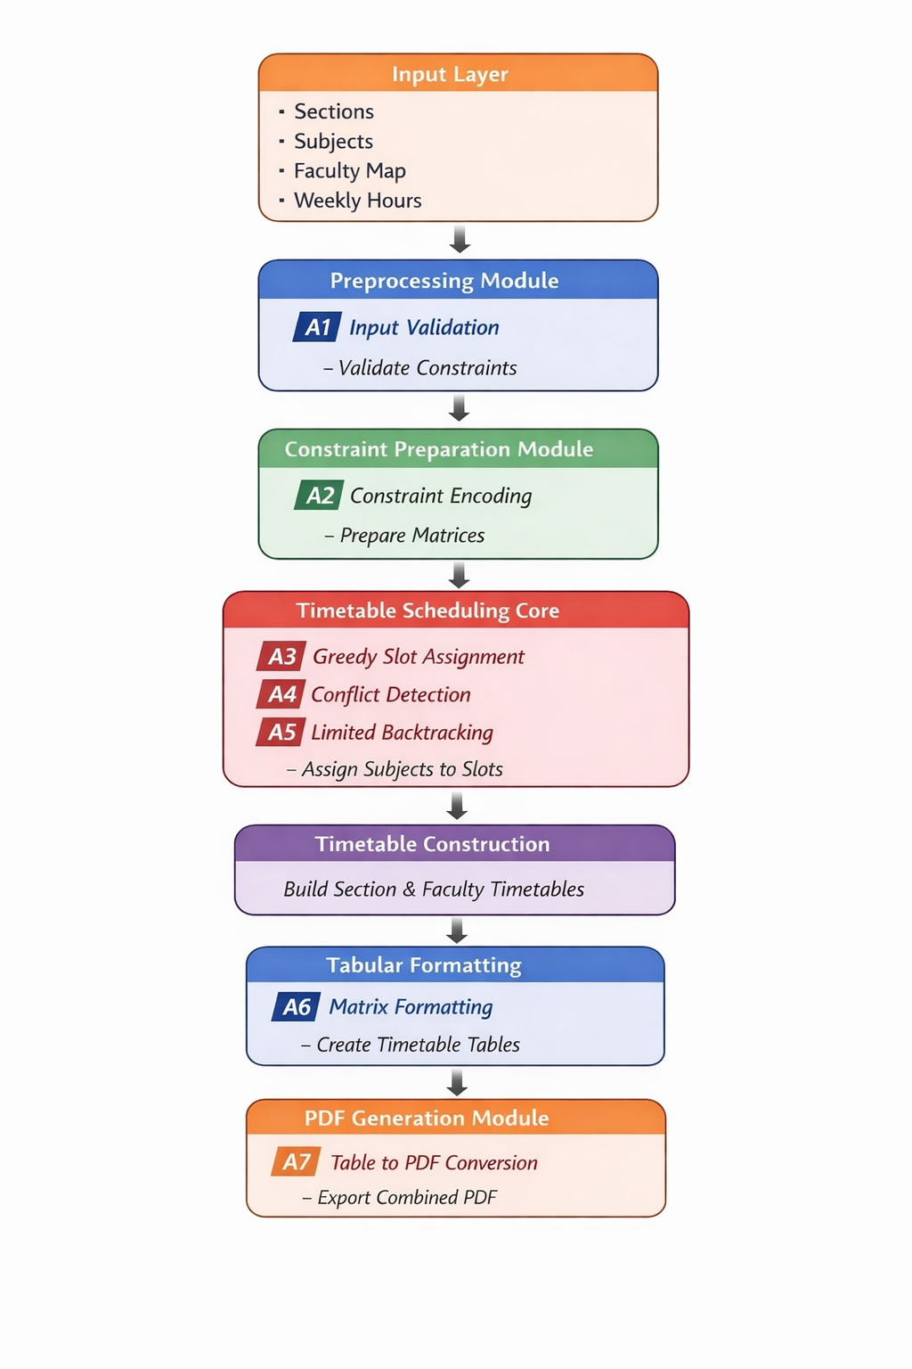
Architecture Diagram

Slide 8
Github Link
The Github link provided should have public access permission.
GitHub Link:
https://github.com/Bhargavi872004/CSE_35_SmartClassRoomAndTimeTableScheduler

Slide 9
Requirements
Software Requirements
Operating System:
Windows 10 or later
Programming Language:
Python 3.9 or higher
Libraries & Frameworks:
NumPy – Numerical and logical operations
Pandas – Data handling and preprocessing
Stream lit:
To maintain frontend and backend as a single centralized unit.
To visualize interactive dashboard and to retrieve the outputs.
IDE / Tools:
Google Colab / Visual Studio Code – Code and Logic Implementation
Microsoft Excel – Initial data entry and validation

Slide 10
Analysis of Problem Statement
Manual classroom allocation and timetable preparation become increasingly complex as the number of courses, faculty members, classrooms, and time slots increases.
The absence of an automated scheduling system leads to frequent timetable clashes, inefficient use of classroom resources, and increased administrative workload.
Hard Subjects are not placed in attentive slots, required teaching hours are not satisfied and Faculty workloads are unbalanced.
Faculty availability constraints and classroom capacity limitations are often not handled systematically, resulting in academic disruptions.
These challenges highlight the need for a reliable, software-based scheduling solution that can manage constraints efficiently and generate optimized timetables.

Slide 11

Timeline of the Project (Gantt Chart)
WEEK-8
Phase | Week 1 | Week 2 | Week 3 | Week 4 | Week 5 | Week 6 | Week 7 | Week 8
Requirement Analysis & Data Collection | ✓ | ✓
Data Preparation & Validation |  | ✓ | ✓
Scheduling Logic Design |  |  | ✓ | ✓
Backend Development |  |  |  | ✓ | ✓
Frontend / UI Development |  |  |  |  | ✓ | ✓
Testing & Optimization |  |  |  |  |  | ✓ | ✓
Documentation & Final Review |  |  |  |  |  |  | ✓ | ✓

Slide 12
References (IEEE Paper format)
[1] A. Verma and S. Iyer, “Automated timetable generation using constraint-based scheduling,” IEEE Access, vol. 11, pp. 38745–38756, 2023.
[2] R. Kumar, P. Singh, and M. Joshi, “Smart classroom management systems: Design and implementation,” IEEE Transactions on Education, vol. 65, no. 4, pp. 512–520, Aug. 2022.
[3] S. Gupta and N. Mehta, “Optimization techniques for classroom allocation and faculty scheduling,” IEEE Access, vol. 10, pp. 74821–74832, 2022.
[4] J. Fernandes, P. Silva, and R. Costa, “A comparative study of university course timetabling approaches,” in Proc. IEEE International Conference on Learning Technologies, pp. 45–52, 2019.
[5] M. Hassan and L. Chen, “Constraint satisfaction methods for automated course timetabling,” IEEE Transactions on Systems, Man, and Cybernetics: Systems, vol. 50, no. 6, pp. 2145–2154, June 2020.
[6] T. Nguyen and H. Pham, “Efficient classroom utilization using automated scheduling algorithms,” IEEE Access, vol. 9, pp. 90112–90121, 2021.
[7] A. Choudhury and P. Banerjee, “Design of scalable timetable management systems for universities,” in Proc. IEEE International Conference on Advances in Computing, Communication and Control, pp. 119–124, 2020.

Slide 13
Literature Review
Ref. No. | Authors | Title | Publication | Year
[1] | A. Verma, S. Iyer | Automated timetable generation using constraint-based scheduling | IEEE Access | 2023
[2] | R. Kumar, P. Singh, M. Joshi | Smart classroom management systems: Design and implementation | IEEE Transactions on Education | 2022
[3] | S. Gupta, N. Mehta | Optimization techniques for classroom allocation and faculty scheduling | IEEE Access | 2022
[4] | J. Fernandes, P. Silva, R. Costa | A comparative study of university course timetabling approaches | Proc. IEEE Int. Conf. on Learning Technologies | 2019
[5] | M. Hassan, L. Chen | Constraint satisfaction methods for automated course timetabling | IEEE Trans. on Systems, Man, and Cybernetics: Systems | 2020
[6] | T. Nguyen, H. Pham | Efficient classroom utilization using automated scheduling algorithms | IEEE Access | 2021
[7] | A. Choudhury, P. Banerjee | Design of scalable timetable management systems for universities | Proc. IEEE Int. Conf. on Advances in Computing, Communication and Control | 2020

Slide 14


