Slide 1
Timeseries analysis and forecasting - using SMART meter Energy data
Kingston University
K2175468
Kameswari Naga Bhargavi Kalaparty

Slide 2
Motivation and Objective
Introduction to energy meters is expected to bring significant shift in energy landscape with data being its fuel.
Leveraging this valuable data for the future is of paramount importance.
This presentation serves as an educational resource focused on forecasting and analyzing energy meter data.

Slide 3

Methodology
Data understanding and pre-processing.
Exploratory data analysis
Statistical tests and analysis
Visualizations for further analysis on data
Model Exploration and performance analysis
Forecasting
Result Discussion and Conclusion

Slide 4
Exploratory Data Analysis
Data Stamp: Mean, String Parse: strp
Generated months using relativedelta and filtered similar months
Null Values: isnull().sum()
Decimal Value Roundoff: round(decimals=0)
Negative Values: Filtered the non positives by <=0 and put them in a data frame
Date time formatting and Indexing: to_datetime and set_index
Time Resampling using down sampling: groupby(df.index).mean()

Slide 5
Statistical tests- Stationarity
ADF – Augmented Dickey Fuller Test: adfuller(X) function has 2 components adf[0] and adf[1] , Runs on Hypothesis.
KPSS (Kwiatkowski-Phillips-Schmidt-Shin) Test- kpss() function has 2 components kpss_result[0] and kpss_result[1] , Runs on Hypothesis (opp. to ADF).
PP Test – ADF test but with constant and linear time trend. Similar to ADF but regression='ct'

Slide 6
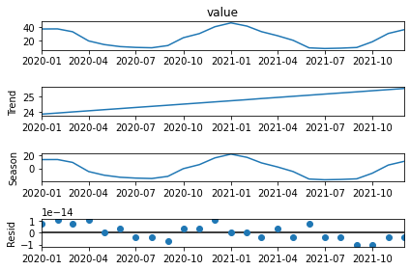
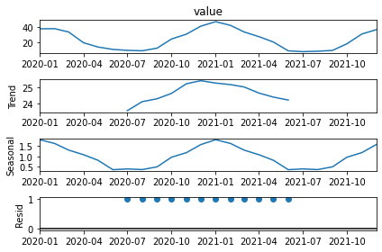
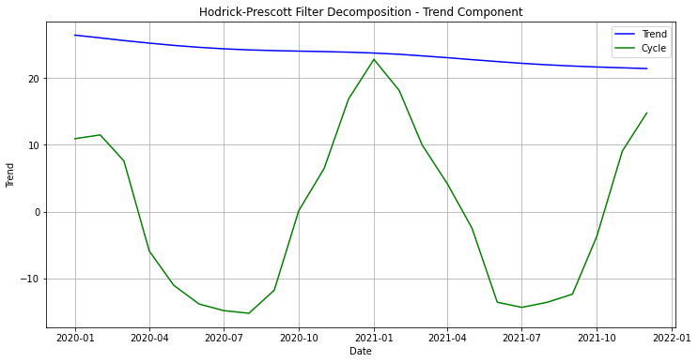
Statistical Analysis- Seasonal Decompose
Additive Seasonal Decompose: Trend, Seasonal and residual- STL()
Hodrick-Prescott Filter Decomposition- Cyclic and Trend- hpfilter()
Multiplicative Seasonal Decompose – seasonal_decompose(model='multiplicative')

Slide 7
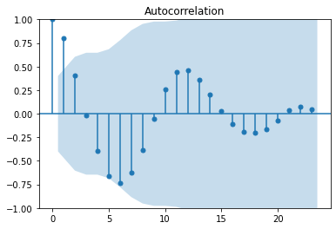
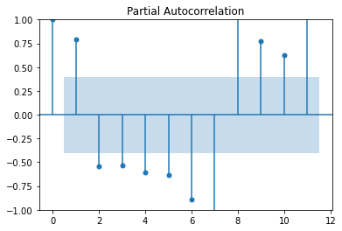
Correlation Plots- ACF and PACF
Auto Correlation Plot shows the correlation between lagged and original timeseries.
Partial auto correlation does the same but between the residuals.
plotacf() plotpacf()

Slide 8
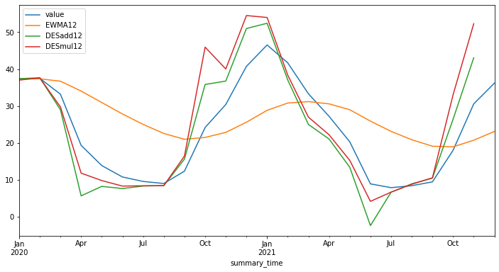
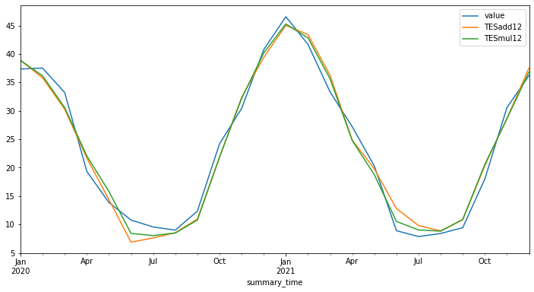
Exponential Smoothening
Statistical methods used to reduce the noise in data
EWMA: Assigns exponentially decreasing weights to past observations, with the most recent data points receiving the highest weight.
Double Exponential Smoothening: Smoothens data using trend component
Triple Exponential Smoothening: Smoothens data using trend and seasonality component

Slide 9
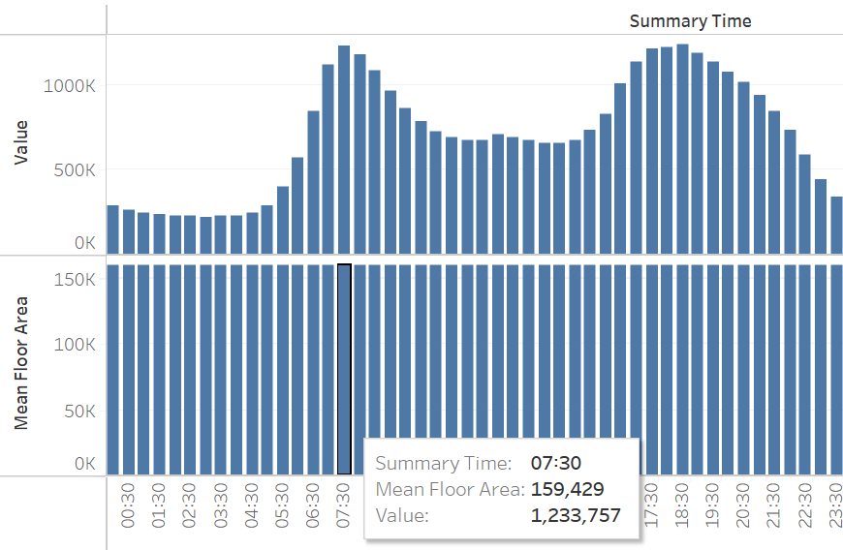
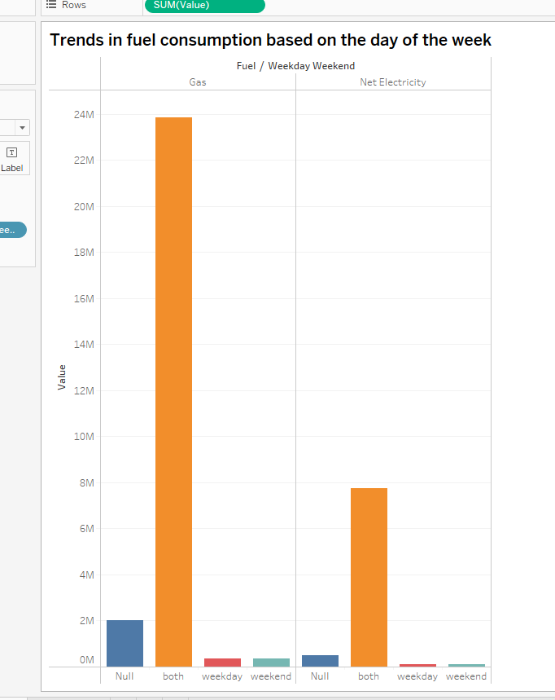
Visualizations
Fuel consumption across different time periods- In 2020 peak at 7 AM and 7:30 PM
In 2021 7:30 AM and 6:30 PM
Trends in fuel consumption based on the day of the week- gas consumption is the highest over both weekends and weekends when compared to electricity consumption.

Slide 10
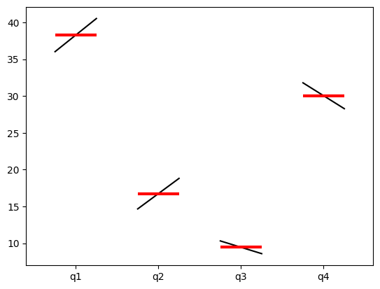
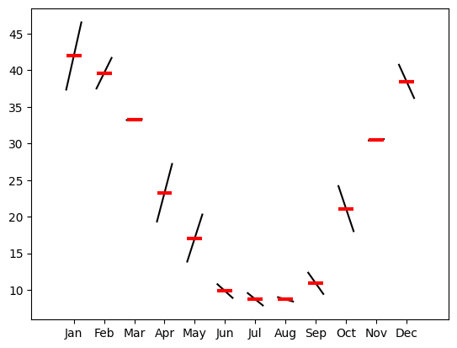
Exposing Seasonality with Month and Quarter Plots

Slide 11
Granger Causality Test
Causality: If one variable effects the value of other in multivariate timeseries. Runs on Hypothesis and P-values.
grangercausalitytests(maxlags=5)
Need to have at least one value less than or equal to 0.05 at any lag.
mean_hdd and mean_temp

Slide 12
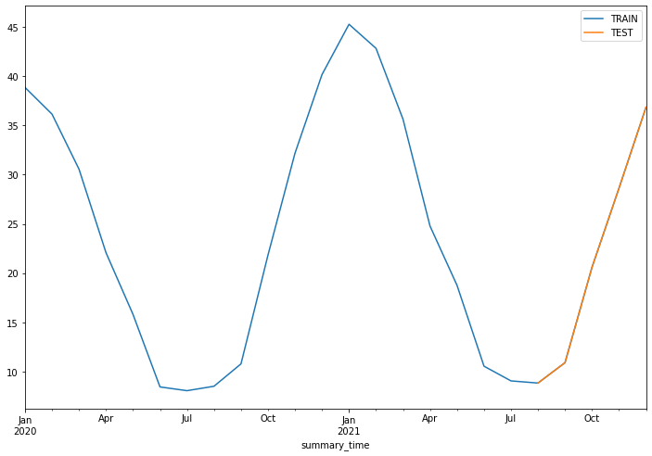
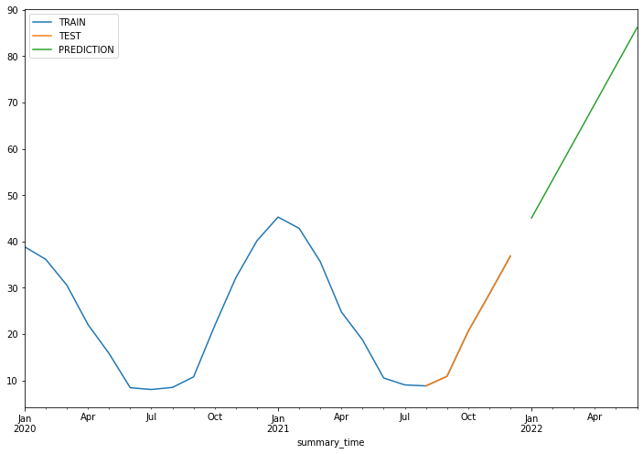
Models :
Plot 1: Train and Test Data
Plot 2: Train Test and Prediction data
Holt-Winters: Used Exponential Data
ExponentialSmoothing()
Only Trend no Seasonal component

Slide 13
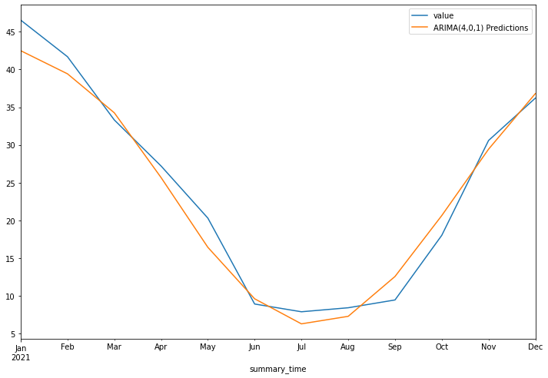
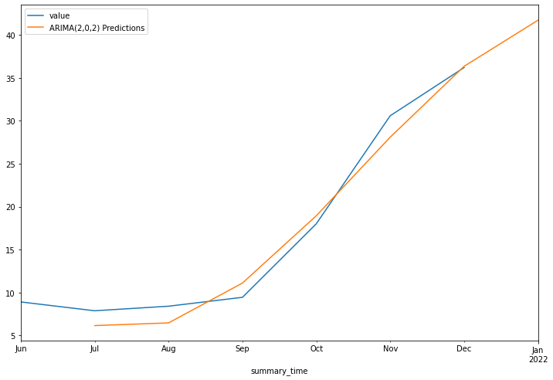
Model- Arima
Grid Search- Choosing Hyperparameters- auto_arima() and correlation plots.
When seasonal=False
SARIMAX(4,0,1)
seasonal=True
SARIMAX(2,0,2)
Tried ARIMA first and backtested

Slide 14
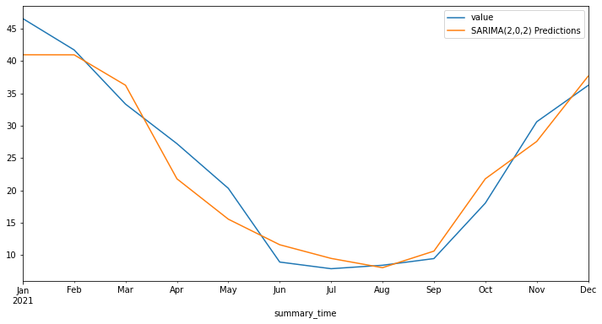
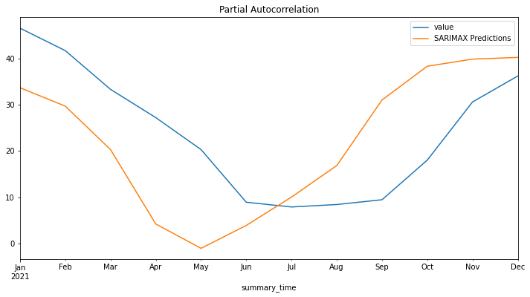
Model-SARIMA
SARIMAX(train['value'],order=(2,0,2),seasonal_order=(2, 0, 1, 12))
Exogenous Variable: exog=train['mean_temp']

Slide 15
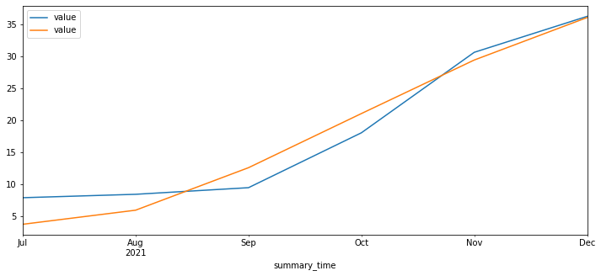
Varma- Multivariate
VARMA(2,2) using Auto Arima
VARMAX(train[['value','mean_temp']], order=(2, 2), trend='c')

Slide 16
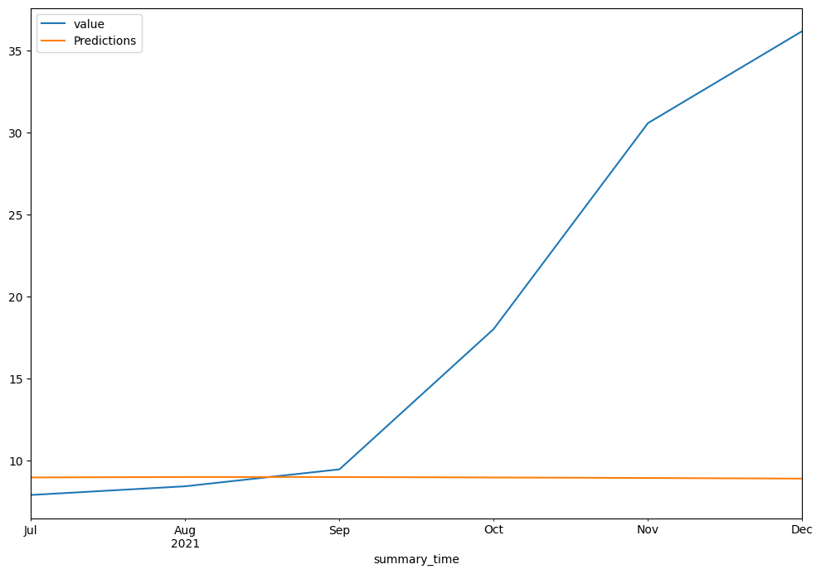
RNN-LSTM
Used Standard Scaler to scale the data.
Advantage: Memory of Long Sequences
Cell State
Forget Gate
Input Gate
Output Gate
Vanilla LSTM
Stacked LSTM
Bidirectional LSTM

Slide 17
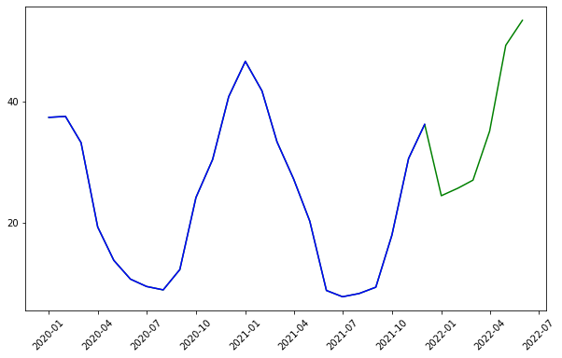
Linear Regression and Garch- Multivariate
Linear regression is used for modeling the relationship between a dependent variable and one or more independent variables, while GARCH is used for modeling and forecasting volatility.
OLS is used to fit linear equation to set of data points in such a way to minimizes the sum of the squared differences between the observed and predicted values.
The GARCH model helps you forecast the conditional variance of the dependent variable, which represents the volatility.

Slide 18
Result Discussion
Model | AIC | Error | RMSE | MAPE
ARIMA (2,0,2) | 102 | 38 | 6.2 | 12
ARIMA(4,0,1) | 78 | 5 | 2 | 11
SARIMA (2,0,2)*(2,0,2,12) | 91 | 3 | 10 | 14
SARIMA (2,0,1)*(2,0,2,12) | 89 | 3 | 10 | 13.9
SARIMAX | 84 | 197* | 14 | 70
VARMA (2) | 166 | 5 | 2 | 84
VARMA (3) | 217 | 10 | 3.3 | 84.9
LR with GARCH | 120 |  | 17.3 | 130

Slide 19
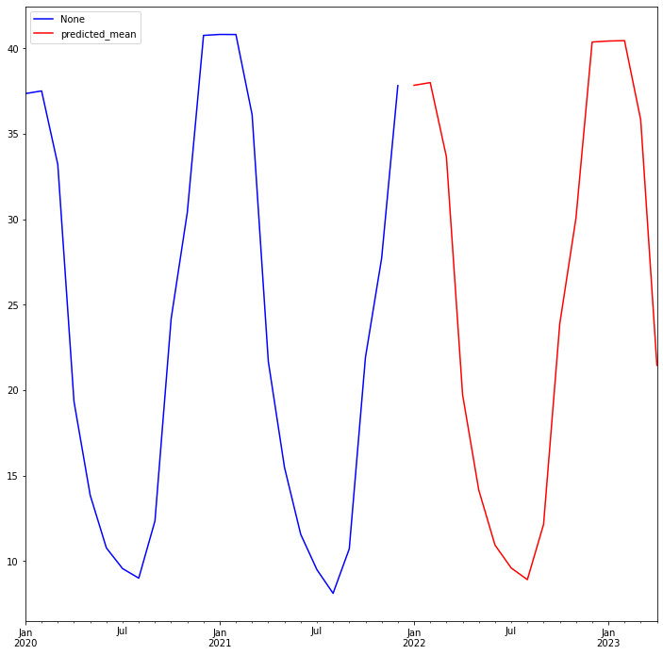
Forecasting- SARIMA (2,0,2)*(2,0,1,12)
Plot
Values
Date | Energy consumption in KWh
2023-01-01 | 40
2023-02-01 | 40
2023-03-01 | 35
2023-04-01 | 21

Slide 20
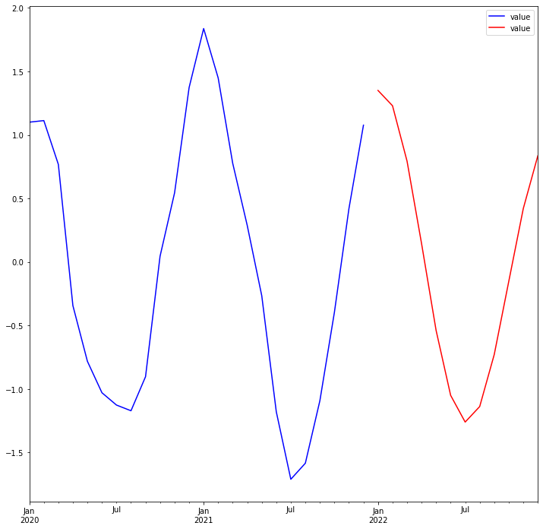
Forecasting- VARMA (2,2) 3 variable
Plot
Values
Date | Energy consumption in KWh | Mean Temperature | Mean HDD
01-01-2023 | 35 | 6 | 8
01-02-2023 | 31 | 7 | 6
01-03-2023 | 25 | 9 | 5
01-04-2023 | 19 | 11 | 4
01-05-2023 | 14 | 13 | 3
01-06-2023 | 11 | 14 | 2

Slide 21
Conclusion
The best performing model in consideration with AIC and errors is the ARIMA without seasonality, however our data has clear seasonality hence the next best is the SARIMA (2,0,2)*(2,0,1,12).
Considering multivariate nature of data, according to Granger and OLS(Ordinary Least Squares) best causality for energy is with mean_hdd. Next best is mean_temp and the best model is VARMA.

Slide 22

Q & A

