Slide 1

Partnership Kickoff
Insert Cus Logo
MM.DD.YYYY
Presenter Name
Title, Company

Slide 2
01
Introductions
02
Goal Alignment
03
Implementation Roadmap
04
Implementation Scope
05
Action Items

Slide 3
Welcome to Amplitude
00

Slide 4
The Amplitude Implementation Team
I N T R O D U C T I O N S & G O A L A L I G N M E N T
Name
ACCOUNT EXECUTIVE
email@amplitude.com
Name
TECHNICAL SUCCESS MANAGER
email@amplitude.com
Name
CUSTOMER SUCCESS ARCHITECT
email@amplitude.com
Ongoing commercial resource.
Focused on making sure you are getting value from your investment.
Advisor during implementation and Long-term business contact.
Product Analytics Expert and Advisor.
Focused on ensuring Amplitude is aligned with your goals.
Monitors platform adoption and offers change management strategies.
Technical contact during Implementation.
Focused on making your Implementation successful.
Offers expertise in data governance, analytics best practices, and taxonomy design.

Slide 5
The Amplitude Implementation Team
USE WITH PSP
I N T R O D U C T I O N S & G O A L A L I G N M E N T
Name
ACCOUNT EXECUTIVE
email@amplitude.com
Name
TECHNICAL SUCCESS MANAGER
email@amplitude.com
Name
CUSTOMER SUCCESS ARCHITECT
email@amplitude.com
Ongoing commercial resource.
Focused on making sure you are getting value from your investment.
Advisor during implementation and Long-term business contact.
Product Analytics Expert and Advisor.
Focused on ensuring Amplitude is aligned with your goals.
Monitors platform adoption and offers change management strategies.
Long-term technical contact during and post-Implementation.
Helping you achieve your long-term goals by maintaining a strong data foundation.
Offers expertise in data governance, analytics best practices, and taxonomy design.

Slide 6
Two Phases of your Amplitude Journey
USE FOR ENTERPRISE, NO PSP
I N T R O D U C T I O N S & G O A L A L I G N M E N T
PHASE ONE
PHASE
TWO
IMPLEMENTATION
ONGOING SUCCESS
Implementation
Technical Success Manager [main POC]
Customer Success Architect
Account Executive
Ongoing Success
Technical Success Manager [main POC]
Account Executive
ON DEMAND RESOURCES: PLATFORM SUPPORT TEAM + KNOWLEDGE BASE
Notes:
TALK TRACK
Before we introduce ourselves and our roles in more detail - I’d like to quickly define the two phases you’ll experience throughout your relationship with Amplitude.
Implementation is the first phase of your relationship with Amplitude, we’ll get into the details on this call, but you can think of this as your Amplitude Implementation.
After you complete Implementation, you’ll be in the Ongoing Success Planning Phase. You have access to several resources throughout your entire relationship with us, but we’ve highlighted them for you here.

Slide 7
Two Phases of your Amplitude Journey
USE FOR PSP
I N T R O D U C T I O N S & G O A L A L I G N M E N T
PHASE ONE
PHASE
TWO
IMPLEMENTATION
ONGOING SUCCESS
Implementation
Technical Success Manager [main POC]
Customer Success Architect
Account Executive
Ongoing Success
Technical Success Manager [main POC]
Customer Success Architect
Account Executive
ON DEMAND RESOURCES: PLATFORM SUPPORT TEAM + KNOWLEDGE BASE
Notes:
TALK TRACK
Before we introduce ourselves and our roles in more detail - I’d like to quickly define the two phases you’ll experience throughout your relationship with Amplitude.
Implementation is the first phase of your relationship with Amplitude, we’ll get into the details on this call, but you can think of this as your Amplitude Implementation.
After you complete Implementation, you’ll be in the Ongoing Success Planning Phase. You have access to several resources throughout your entire relationship with us, but we’ve highlighted them for you here.

Slide 8





On Demand Resources
Amplitude Support
95% CSAT 2024
FOR EVERYONE ELSE
Introducing Global Agent
Available directly in the product - Global Agent allows you to type a question, and we'll share a chart with the answer you need. Learn more here!
I N T R O D U C T I O N S & G O A L A L I G N M E N T
E-Mail
Enterprise: 1 day SLA
Growth: 1-2 day SLA
24x5 availability: SF, Amsterdam, Singapore
Submit tickets via
  support.amplitude.com
  Help (?) in the product
Help Center
Best practices and overviews on Amplitude main charts and key features
Amplitude 101 & 201 information
Available at help.amplitude.com
Status Page
Subscribe to our status page at
status.amplitude.com
Alerts on known, widespread issues
Community
Place for users to connect, find solutions, and network
Amplitude 201 & 301 information
Available at community.amplitude.com
Subscribe to Product Updates
Academy
Getting Started resources and other courses - earn a badge!
Live training classes for anyone
Video library

Slide 9






On Demand Resources
Amplitude Support
95% CSAT 2024
FOR EVERYONE ELSE
Introducing Global Agent
Available directly in the product - Global Agent allows you to type a question, and we'll share a chart with the answer you need. Learn more here!
I N T R O D U C T I O N S & G O A L A L I G N M E N T
Technical Support
Enterprise: 1 day SLA
Growth: 2 day SLA
24x5 availability: SF, Amsterdam, Singapore
Submit tickets via
  support.amplitude.com
  Help (?) in the product
Documentation
Overviews on Amplitude platform, main charts, and key features
Technical documentation on SDKs, APIs, integrations, and data ingestion
Best practices and FAQs
Available at https://amplitude.com/docs
Academy
Educational resources to get started or level up your Amplitude usage
Product certifications and live group trainings
Available at https://academy.amplitude.com/
Help Center(s)
One-stop landing page for Amplitude self-serve resources available at https://gethelp.amplitude.com/hc/en-us
In-App Help Center available under “?” icon in the Amplitude product
  Submit feature requests via Give Feedback form
Status Page
Follow for proactive updates on known Amplitude-wide issues
Click on "Subscribe to Updates" to be alerted on critical issues
Available at https://status.amplitude.com
Community
Place for users to connect, find solutions, and network
Amplitude 201 & 301 information
Available as a Web Forum via https://community.amplitude.com/ or as Slack via https://bit.ly/cohort-community
Subscribe to Product Updates
Notes:
TALK TRACK (SUPPORT / BELINDA CHIU)
Revise to update what’s additive to general support

Slide 10
Customer Introductions
00

Slide 11
[Customer] Amplitude Leads
Executive Sponsor should attend the kickoff call.
Flag to PS leads if attendance is a challenge.
I N T R O D U C T I O N S & G O A L A L I G N M E N T
Reminder: Send the core group the Customer Welcome Kit on Amplitude Academy.
Click here for messaging ideas.
Name
EXECUTIVE ADVOCATE
Name
PROJECT LEAD
Name
TECHNICAL LEAD
Name
BUSINESS LEAD
Overall sponsor & budget owner of the Amplitude partnership
Attends executive business reviews
Responsible for the overall management of the Amplitude instance
Amplitude’s main point of contact
Responsible for instrumentation and accuracy of data
Owns the technical implementation timeline
Early power-user of Amplitude
Responsible for driving adoption and value

Slide 12
Goal Alignment
Optional, use as needed if use cases are available
INTRODUCTION & GOAL ALIGNMENT
Information should be included in the Sales <> PS handoff. Please fill out as much as possible before the KOC and use the KOC to validate.
Challenges | Critical Business Use Case | KPIs
example High drop-off before value moment, unclear entry paths | example Onboarding Optimization | example Time-to-first-value, Activation rate, Drop-off rate

Slide 13
Implementation Roadmap
00

Slide 14


Our vision is to help you move 100x faster
SENSE
SENSE
SENSE
BUILD
DECIDE
BUILD
DECIDE
LEARN
DECIDE
LEARN
LEARN
ACT
Where most customers are
Trusted data, insights & actions
Proactive growth loops with AI
100s of clicks
3 business months
47 clicks
40 human hours
3 sentence prompt
5 human minutes
Notes:
This slide is our north star. On the left is where most teams are today — hundreds of clicks, months of effort to get to insights. The middle represents what Amplitude already enables: a trusted, structured feedback loop across Sense, Learn, Decide, and Build. The right is where we're heading with agents: a 3-sentence prompt, 5 minutes, and proactive AI-driven growth loops. The goal isn't just faster analysis — it's shifting your team's time away from manual, low-judgment work toward high-context strategy and decision-making.

Slide 15
Learning a Framework for Continuous Instrumentation
I M P L E M E N T A T I O N & S U C C E S S A P P R O A C H
Implementation
The Amplitude implementation team will partner with you to understand your product priorities and teach you the framework to get trusted data into the platform.
Events and Properties
Instrument the top ~30 prioritized events that relate to your questions
Business Goals
What are your business goals?
Amplitude Agents
Ongoing
Our thoughtful instrumentation framework learned during implementation allows your teams to continuously align on metrics and instrument the events that matter to your business as priorities evolve leveraging a foundation of data governance
Business Questions
Prioritize the questions you want to answer for those KPIs
KPIs and Metrics
What are the KPIs that Amplitude can help influence?
Notes:
TALK TRACK
During the implementation phase, we take a more hands on approach to teach your teams our framework to instrumentation through regular cadence meetings. We’ll help you identify the events that are critical to your Use Case and Key User Flows, and how to instrument them using a consistent taxonomy. We’ll review the taxonomy in detail and provide suggestions on how best to implement it when thinking about your long term goals.
After the implementation phase wraps up, the framework your teams learned can be reused as your team continues to release new features and instrument more of the product as your business needs evolve. You’ll be equipped with the tools to lead your teams through bringing new data into Amplitude.
Your leveraged framework will also have resulted in lessons learned that should be used in ongoing maintenance efforts to your Amplitude data. A governing process that maintains Amplitude data integrity is at the foundation of ongoing success with Amplitude.

Slide 16
Implementation roadmap: Core Analytics
Delete if not applicable
Week 0
Week 1-2
Week 3-4
Week 5-8
Week 9-10
Week 11-14
Alignment
Discovery
Technical scoping
Instrumentation
Prod launch
Enablement
and rollout
Project kickoff
Confirm legal approval on AI functionality
Confirm timeline
Confirm lead roles and responsibilities*
Align on data sources and methods
 |  | Design Event Taxonomy
Send data to production and
set up AI context
Analytics
Confirm and EB sign off on Analytics use cases
Design event taxonomy
Data Governance Workshop
Foundational training for Analytics
and AI
AI admin walkthrough
Send data to development
Customer product walkthrough
Align on instrumentation approach
AI dashboards and set up Global Agent
Validate test data
Technical walkthrough
*ENG owners
Notes:
Use for one blade/product implementations

Slide 17
Implementation roadmap: 3 products
Delete if not applicable
Week 0
Week 1-2
Week 3-4
Week 5-8
Week 9-10
Week 11-14
Alignment
Discovery
Technical scoping
Instrumentation
Prod launch
Enablement
and rollout
Analytics
 |  | Design Event Taxonomy
 |  |  |  | Send Replays to Production Send Replays to Production Send Replays to Production | Send Replays to Production
 | Confirm G&S Use Cases | Guide Building Overview
Project kickoff
Confirm legal approval on AI functionality
Confirm AMPL priority and timeline
Confirm lead roles and responsibilities*
Align on data sources and destinations
Review architecture map
Confirm and EB sign off on Analytics use cases
Design event taxonomy
Data Governance Workshop
Send data to production and
set up AI context
Foundational training for Analytics and AI
AI admin walkthrough
Send data to development
Customer product walkthrough
Align on instrumentation approach
AI dashboards and set up Global Agent
Validate test data
Technical walkthrough for Analytics and Session Replay
Session Replay
Confirm privacy and sampling settings
Send Replays to development and validate masking settings
Send Replays to production
Foundational training for Session Replay
Set up SR Agent
Guides and Surveys
Confirm and sign off on G&S use cases
Technical walkthrough
Data Governance Workshop
QA and launch Guide/Survey on production
Review Guide metrics
Install G&S SDK on dev and prod
Design Guide theme(s)
Guide building overview
Foundational training for G&S
Validate Guide or Survey on dev
*ENG owners

Slide 18
Implementation roadmap: 3 products
IMPLEMENTATION SCOPE
Delete if not applicable
Week 0
Week 1-2
Week 3-4
Week 5-8
Week 9-10
Week 11-14
Alignment
Discovery
Technical scoping
Instrumentation
Prod launch
Enablement
and rollout
 |  | Design Event Taxonomy
 | Confirm G&S Use Cases | Guide Building Overview
 |  |  | Install G&S SDK on Dev & Prod
Design event taxonomy
Data Governance Workshop
Send data to production and
set up AI context
Analytics
Project kickoff
Confirm legal approval on AI functionality
Confirm AMPL priority and timeline
Confirm lead roles and responsibilities*
Align on data sources and destinations
Review architecture map
Confirm and EB sign off on Analytics use cases
Foundational training for Analytics and AI
AI admin walkthrough
Send data to development
Customer product walkthrough
Align on instrumentation approach
AI dashboards and set up Global Agent
Technical walkthrough for Analytics
Validate test data
Guides and Surveys
Confirm and sign off on G&S use cases
Technical walkthrough
Data Governance Workshop
QA and launch Guide/Survey on production
Review Guide metrics
Install G&S SDK on dev and prod
Design Guide theme(s)
Guide building overview
Foundational training for G&S
Validate Guide or Survey on dev
Web Experiment
Confirm and sign off on Experiment design
Technical & Visual Editor walkthrough
Data Governance Workshop
Launch A/B test
Foundational training for Web Experiment
Install Exp SDK on dev and prod
Experiment Intro Workshop
Review A/B Test Results and decide
Configure Experiment and validate
*ENG owners

Slide 19
Implementation roadmap: 4 products
Delete if not applicable
Week 0
Week 1-2
Week 3-4
Week 5-8
Week 9-10
Week 11-14
Alignment
Discovery
Technical scoping
Instrumentation
Prod launch
Enablement
and rollout
Analytics
 |  | Design Event Taxonomy
 |  |  |  | Send Replays to Production Send Replays to Production Send Replays to Production | Send Replays to Production
 | Confirm G&S Use Cases | Guide Building Overview
 |  |  | Install G&S SDK on Dev & Prod
Project kickoff
Confirm legal approval on AI functionality
Confirm AMPL priority and timeline
Confirm lead roles and responsibilities*
Align on data sources and destinations
Review architecture map
Confirm and EB sign off on Analytics use cases
Design event taxonomy
Data Governance Workshop
Send data to production and
set up AI context
Foundational training for Analytics and AI
AI admin walkthrough
Send data to development
Customer product walkthrough
Align on instrumentation approach
AI dashboards and set up Global Agent
Validate test data
Technical walkthrough for Analytics and Session Replay
Session Replay
Confirm privacy and sampling settings
Send Replays to development and validate masking settings
Send Replays to production
Foundational training for Session Replay
Set up SR Agent
Guides and Surveys
Confirm and sign off on G&S use cases
Technical walkthrough
Data Governance Workshop
QA and launch Guide/Survey on production
Review Guide metrics
Install G&S SDK on dev and prod
Design Guide theme(s)
Guide building overview
Foundational training for G&S
Validate Guide or Survey on dev
Web Experiment
Confirm and sign off on Experiment design
Technical & Visual Editor walkthrough
Data Governance Workshop
Launch A/B test
Foundational training for Web Experiment
Install Exp SDK on dev and prod
Experiment Intro Workshop
Review A/B Test Results and decide
Configure Experiment and validate
*ENG owners

Slide 20
Implementation Scope
00

Slide 21


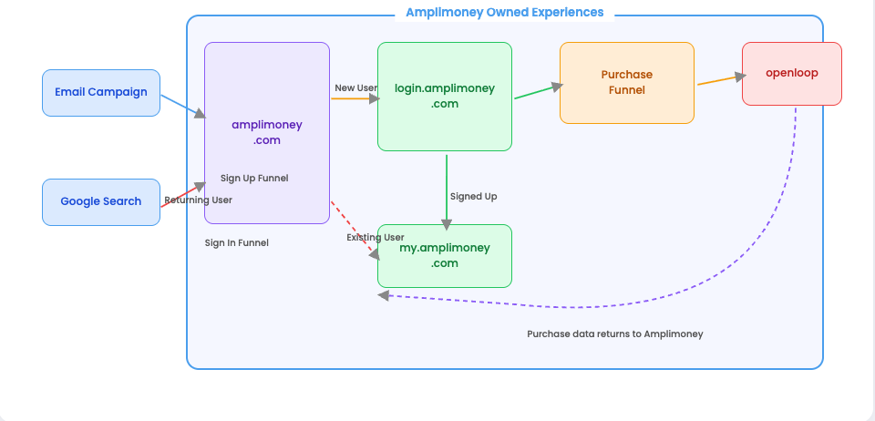
Business Use Cases to Architecture Alignment
Replace with architecture diagram from sales
Example ONLY - DO NOT USE
Remove if diagram is not provided
I M P L E M E N T A T I O N S C O P E
© 2025 Amplitude Inc. Confidential. All Rights Reserved.

Slide 22


Data Sources & Destinations
How data flows into and out of Amplitude: *What is in scope for Amplitude Professional Services to support during this implementation phase*
SOURCES
Ingestion Method
DESTINATIONS
Export Method
Example:
Client Web Data
Amplitude Browser SDK
CDP & Marketing Tools
Segment · Braze · HubSpot

Slide 23
Project Roles & Responsibilities
Fill out if Implementation Partner is involved
I M P L E M E N T A T I O N S C O P E
 | Amplitude | [Implementation Partner]
Project Management/Updates for [Customer Name] | - | Owner
Use Case Discovery and Requirements Gathering | - | Owner
Event Taxonomy Design | - | Owner
Instrumentation and Data Ingestion | - | -
Data Audit and Validation | - | Owner
Dashboarding | - | Owner
End User Training | Owner | -
Notes:
THE PURPOSE OF THIS SLIDE IS TO HELP DEFINE ROLES & RESPONSIBILITIES WHEN AN IMPLEMENTATION PARTNER IS INVOLVED.
IF MULTIPLE PARTNERS INVOLVED PLEASE ADD ADDITIONAL COLUMN PER ADDITIONAL PARTNER

Slide 24
Project Planning - Priorities
I M P L E M E N T A T I O N S C O P E
01
Your Products & Teams
02
Amplitude Products
03
Engineering Resources
Customer Product Priority
What We'll Enable Together
Technical Resourcing Plan
"Walk us through the products or teams you're thinking about for this implementation. What's driving that order?"
"Are there Amplitude products beyond Analytics that feel urgent to your team right now?"
"Will the same engineering team implement all products, or do different products involve different teams?"
Analytics + Global Agent
1st Priority
Product / Team A
Same eng team across all?
1st Priority
Confirm
Session Replay + SR Agent
+
Product / Team B
Different teams per product?
2nd Priority
Confirm
Guides & Surveys
+
Product / Team C
Sprint / release cycle?
3rd Priority
Confirm
Experiment
+

Slide 25
[Customer] Implementation Plan & Checklist
**For customers with complete prod data be sure to customize the time window. Suggestion is 1 week from kickoff for align, +1-2 weeks for Instrument, and +1 week for go-live.
I M P L E M E N T A T I O N S C O P E
Scoping
Instrumentation
Rollout
Align on use cases
Align on instrumentation approach
Complete Taxonomy
Conduct technical walkthroughs
Send in Dev Data
QA dev data
Conduct Data Governance
Promote to Prod
Launch Reports
Launch Global Agent
Conduct Training
Roll out Amplitude
Activities
What is the priority of teams and products?
Who will share and approve use cases?
Which teams will be completing ENG work?
Who will own completing the taxonomy?
Who will sign off on data requirements?
Who will validate data in Amplitude?
What is the dev sprint / release cycle?
Who will validate initial key reporting?
Who will validate the Global Context?
Who will be part of the initial trainings?
Are there any upcoming launches or dates to target?
Considerations
Target Date: XX
Target Date: XX
Target Date: XX
Target Date: XX
Target Date: XX
2 weeks
2 weeks
4 weeks
2 weeks
2 weeks

Slide 26
Potential Risks or Delays
I M P L E M E N T A T I O N S C O P E
 | Known Risks | Potential Impact
1 | E.g. engineering resource availability, cookie policy updates, product not live, privacy/security controls (i.e. GDPR) etc.
2
3
Notes:
TALK TRACK
Are there any potential risks or delays the team should be aware of that could delay the expected timeline?
Some examples are:
Needing a security review
Limited engineering resources

Slide 27

Action Items
Notes:
Let's close with clear next steps so everyone leaves the call knowing who owns what.

Slide 28
What to Expect After Today
Action Items
[CUSTOMER] Product Walkthrough(s) & Key Use Case Alignment
[Customer] to prepare a 20 minute demo of your product. Focus on key user flows in the product
We will determine top use cases & align on the KPI scope for implementation
  (To be scheduled over the next week)
  Required attendee(s): Project Lead, Business Lead *optional* Technical Lead
Engineering Overview
Amplitude covers Technical/ENG focused areas: Data ingestion methods and taxonomy best practice-
  Required attendee(s): Technical Lead, Project Lead
Scheduling of Recurring Implementation Meeting
Amplitude will send out availability following this meeting
Notes:
Use this slide to close the meeting with concrete ownership.
The recommended starting action items are:
decide on admin-only vs. org-wide for the initial rollout (recommendation: admin only until context is in place)
have the customer gather initial AI business context to upload into their priority project
connect the Slack integration for agents
jointly select the top 1-2 projects for taxonomy enrichment
identify the top dashboards to configure for the Dashboard Agent
and set up a shared Slack channel as the feedback hub for the rollout.
Adjust owners and details based on what was discussed in the meeting.

Slide 29

Thank you

Slide 30
Appendix

Slide 31

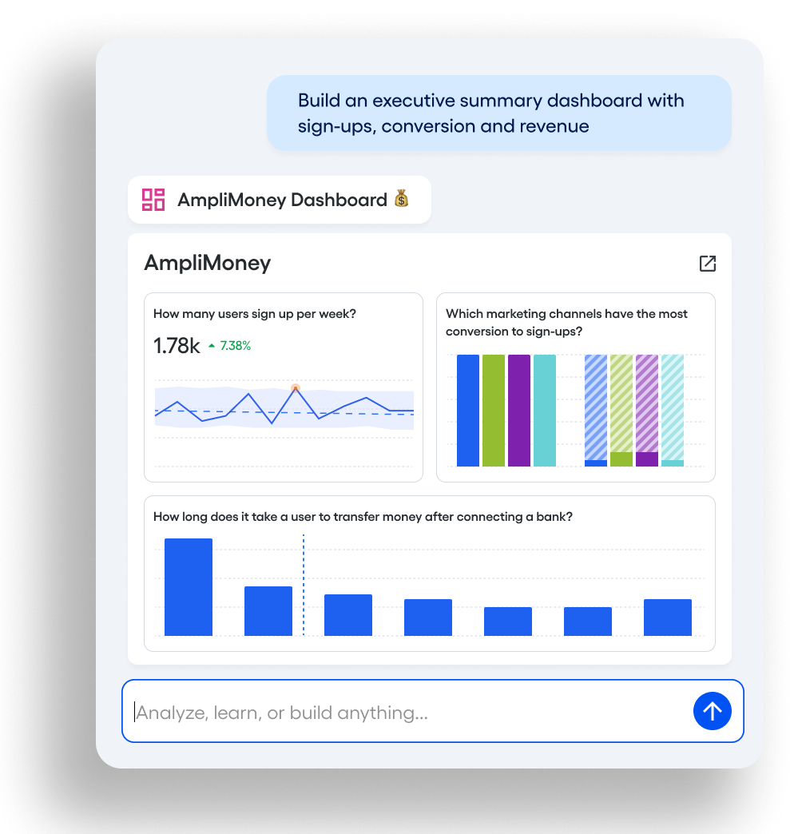



Global Agent
What is it?
An in-product AI analyst that analyzes your questions and more—instantly and in context.
Go beyond generic chatbots
Ask anything, get answers instantly
Understand what’s really happening
Take actions with confidence
Notes:
Global Agent is an in-product AI analyst that analyzes your questions and more—instantly and in context.
It’s grounded in the way product and growth teams actually work: events, funnels, cohorts, experiments, and session replay.
And it’s built for outcomes: after you get the ‘why,’ you can create cohorts, launch in-product experiences, or start an experiment while the context is fresh.
Core use cases to anchor the conversation:
Automate deep research: Turn messy data into clear answers in seconds. Global Agent runs deep, automated diagnostics to uncover not just what changed, but why—connecting trends, anomalies, and user behaviors into a narrative you can act on.
Unlock the full story: See the full story behind every metric. Global Agent combines Amplitude’s quantitative data with semantic search across unstructured feedback, from tickets, surveys, and more, to explain why your numbers are moving, not just how.
Build beautiful artifacts: Go from question to artifact without starting from scratch. Global Agent generates charts, dashboards, notebooks and even PRD drafts directly from your prompts, so you can move from insight to alignment in a single workflow.
Govern data at scale: Keep analysis consistent and trustworthy as your organization scales. Global Agent can identify instrumentation issues, recommend metadata improvements, and suggest new instrumentation -- all while respecting permissions and privacy.
💡 Sales instruction: Share the launch demo prominently featuring Global Agent.

Slide 32

Global Agent has been tested on over 50+ data taxonomies,
making it superhuman in both speed & accuracy:
CAPABILITY
HUMAN SCORE
GLOBAL AGENT SCORE
Creating charts
70%
~3.5 minutes
76%
~15 seconds
Creating cohorts
61%
~4 minutes
70%
~10 seconds
Root cause analysis
40%
~days/weeks
68%
~3 minutes
Understanding data
43%
85%
Site navigation & search
78%
95%
Notes:
The hardest work in analytics isn’t pulling a chart—it’s accurately answering why a metric moved.
We tested Global Agent across 50+ data taxonomies to validate performance across a number of analyses and tasks
One metric really stood out: its ability to do root-cause analysis, which can take considerable time and require technical expertise. Global Agent can do this quickly with accuracy: connecting trends, segments, funnels, journeys, experiments, and session replay into a coherent explanation.
When the diagnosis is right, teams can act immediately: activate the right cohort, launch the right in-product experience, or run an experiment to validate the fix—and measure impact end-to-end.
Our ultimate goal for Global Agent is trust at enterprise scale. Because it’s grounded in your behavioral data and consistent with what your analysts would conclude it performs reliably and accuracy is always improving.
Sales Instruction: If they more questions about measuring and understanding our performance, share the Task Based Evaluation blog (published at 6:55 am PST on Tuesday, February 17).

Slide 33
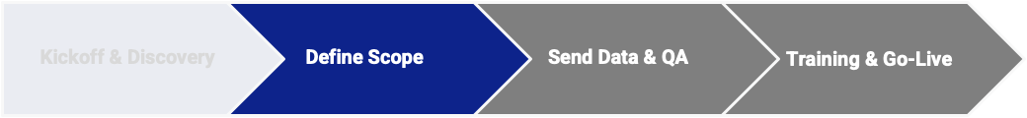
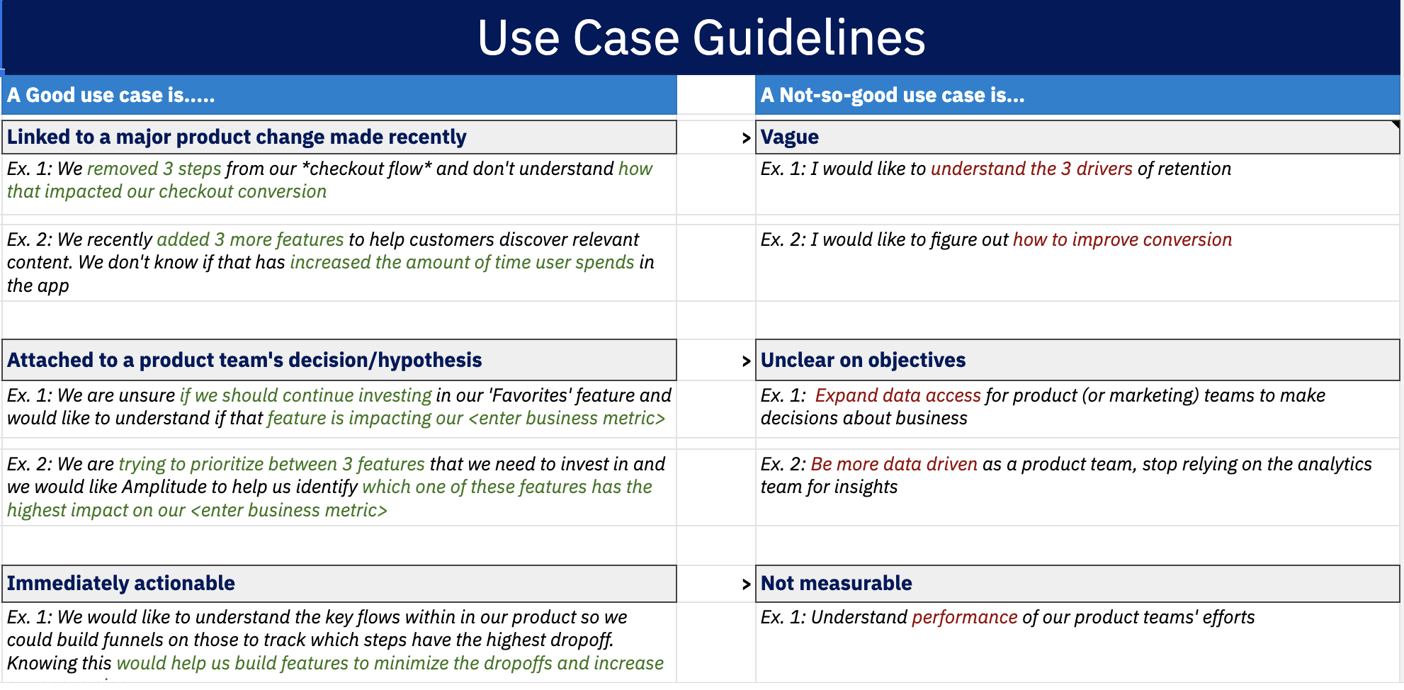
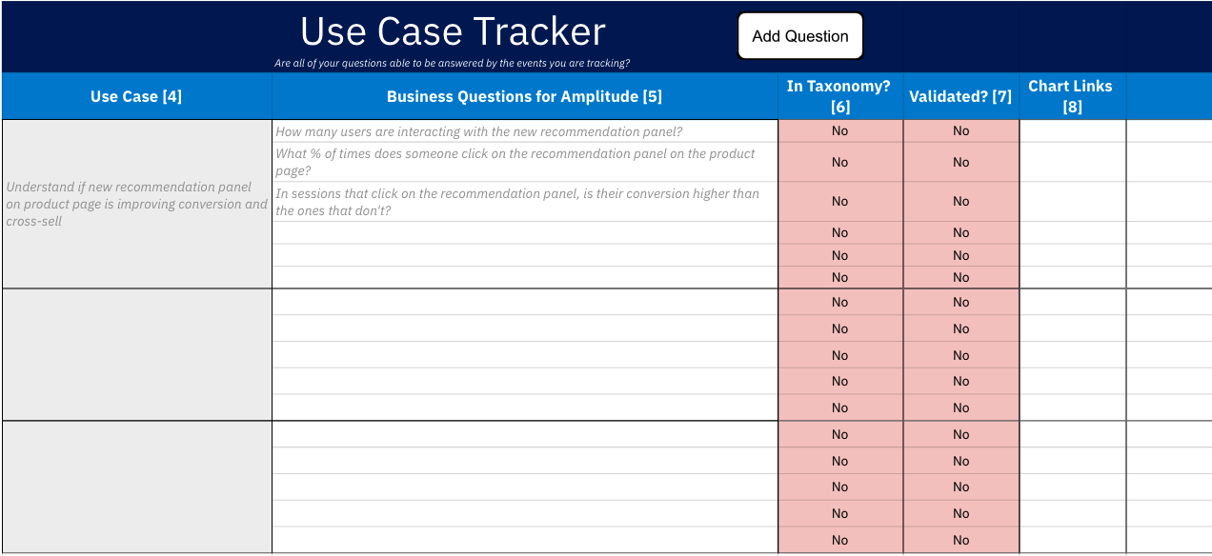
KEY ALIGN PHASE ACTIVITIES
Use Case Alignment
Estimated Duration: 1-2 meetings; 1 -3 hours
Description
The team presents Amplitude with their product's key user flows to identify 2-3 Amplitude use cases and 10-15 supporting business questions for implementation phase scope.
Desired Outcomes
Our implementation team has solid understanding of your business and short-term product analytics goal
Determine 2-3 use cases & 10-15 supporting business questions to validate by end of implementation phase
[Customer’s name] Participants
Business Lead**, Engineering Lead, Project Lead**
** required
Notes:
TALK TRACK
One of the first steps after today’s kickoff will be to conduct a use case alignment meeting where your team will provide a walkthrough of your product to help us identify 2-3 initial Amplitude use cases and 10-15 supporting business questions. We’ll want to ensure we have the correct audience for this as well.
The use cases and business questions we define will serve as primary implementation scope for us to validate with Amplitude charts in launch phase. We’ll help you ensure they’re tied to business goals/kpi, feasible, and are measurable.

Slide 34
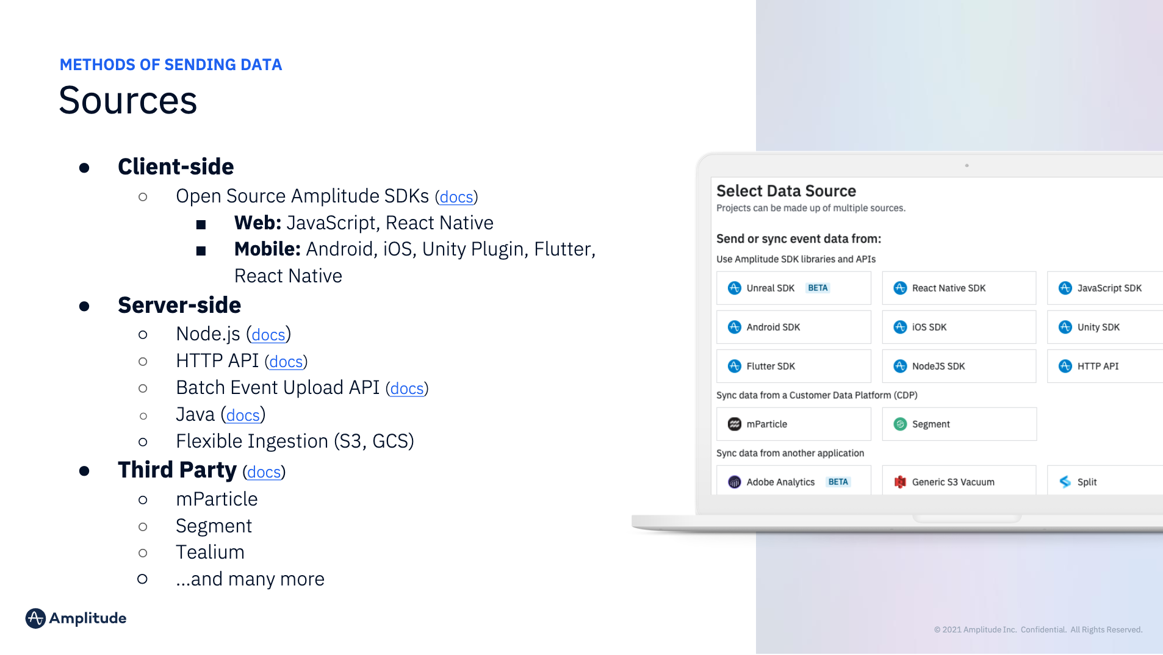
KEY ALIGN PHASE ACTIVITIES
Engineering Kickoff
Estimated Duration: 1 hr meeting
Description
Our team assesses your overall instrumentation readiness and covers technical and engineering focused areas, including best practices related to your implementation.
Desired Outcomes
Align on your method(s) of sending/receiving data with Amplitude and the relevant data sources and destinations
Overview of Amplitude Schema, Session Tracking, and Data Management Platform
Discuss your User Identification strategy
[Customer’s name] Participants
Engineering Lead**, Project Lead, Business Lead(s) (optional)
** required
Notes:
TALK TRACK
In addition to understanding key use cases, we’ll want to ensure we understand your ingestion method and other technical requirements with your data as it relates to Amplitude, including aligning on your user identification strategy.

Slide 35



SDK
Remove slides if customer is not using auto-capture
AUTOCAPTURE
1
Customize or Delete callout box for customer presentations
Key Callouts
Autocapture requires the use of Amplitude SDKs.
If using Segment, you can combine Autocapture data with Segment data in our UI by identifying the user.
If using Warehouse native, these events would need to be in a separate project.
On iOS, these were available as “Default Event Tracking” starting 1.0.0 and above.
On Android, these were available as “Default Event Tracking” starting 1.10.1.
Browser SDK
Version 2.10 and above
Sessions
Page Views
Form Starts/Submissions
File Downloads
Clicks/Interactions + Visual Labeling
Amplitude User Props
Marketing Attribution
iOS Swift SDK
Version 1.8.0 and above
Android Kotlin SDK
Version 1.17.0 and above
Sessions
Screen Views
Application Interactions
Amplitude User Props
Notes:
Migrating on older versions to autocapture - iOS and Android

Slide 36
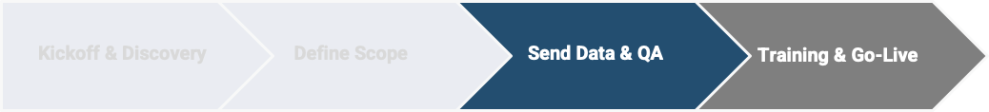
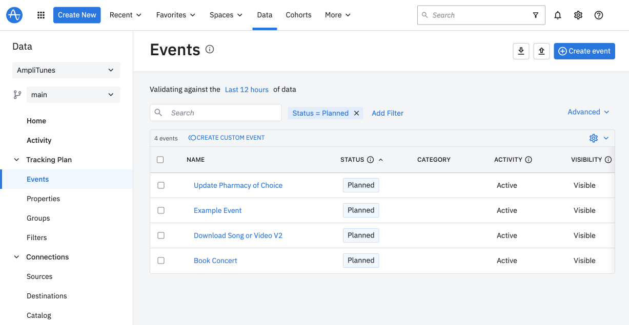
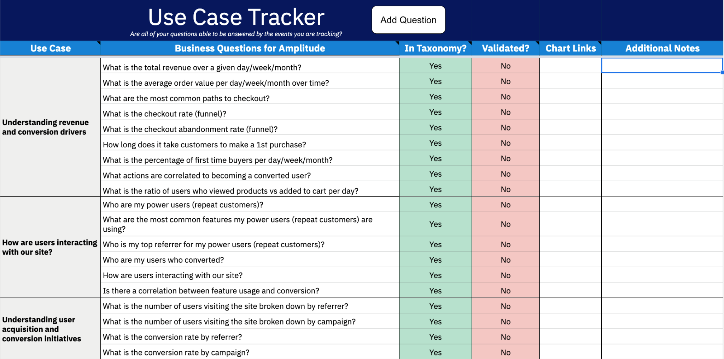
KEY INSTRUMENTATION PHASE ACTIVITIES
Taxonomy Planning & QA
Estimated Duration: 1-2 weeks; Weekly Sync(s) or Standalone
Description
We conduct an interactive working session(s) w/ walkthrough of our Data Management platform and help you prioritize taxonomy planning based on events and priorities defined as implementation phase scope.
Desired Outcomes
Create example events & properties within taxonomy template in Data Management platform or implementation workbook
Standardization of taxonomy events and syntax
Validate taxonomy will answer the implementation scope (use cases/business questions)
Amplitude team completes taxonomy audit
[Customer’s name] Participants
Engineering Lead**, Project Lead, Developer Resources (optional), Business Lead (strongly encouraged)
** required
Notes:
TALK TRACK
Next, either through a weekly sync or working session, we’ll be sure to give you best practices to your taxonomy and data planning to send to Amplitude. Feel free to send our team any existing documentation related to this after today’s call in preparation of our next touchpoint.

Slide 37
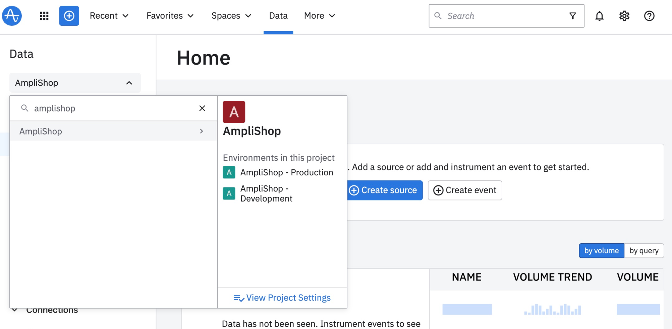
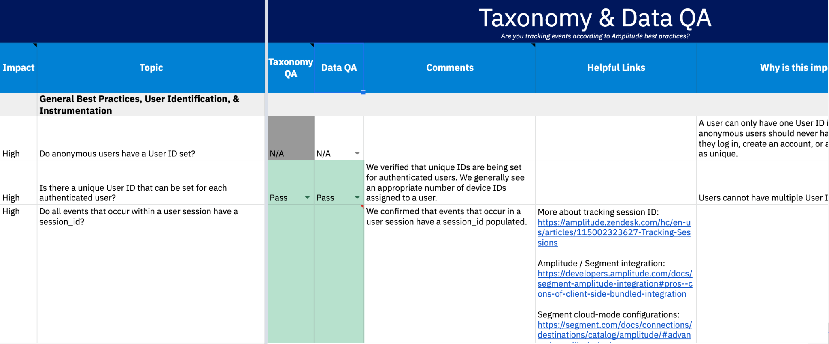
KEY INSTRUMENTATION PHASE ACTIVITIES
Send Dev & Prod Data with QA
Estimated Duration: 2-4 weeks; Support via Weekly Sync(s) or Standalone
Description
[Customer’s name] team sends initial data to recommended development project, followed by Amplitude team’s audit and recommendation to promote to production project.
Desired Outcomes
[Customer Name] team understands how to use Data Management platform features and User Look-Up
Amplitude team completes Data audit
Initial data in development project meets expectations for promotion to production project
[customer’s name] Participants
Engineering Lead**, Developer Resources (optional), Project Lead
** required
Notes:
TALK TRACK
Now that we have use cases tied to business outcomes and successfully planned taxonomy data, you’ll begin sending data to a dev project in Amplitude for an initial QA and then once ready, we’ll promote to sending data to production project. We’ll walk your team through best methods to do so using our Data Management platform.

Slide 38
Only include if customer purchased SR
KEY INSTRUMENTATION PHASE ACTIVITIES
Implement Session Replay
Estimated Duration: 1-2 weeks; Support via Weekly Sync(s) or Standalone
Description
[Customer’s name] team implements Session Replay in Production environment and validates that key events in sessions are captured.
Desired Outcomes
[Customer Name] team understands how to find and review replayable sessions in Amplitude.
Amplitude team validates Session Replay implementation.
Ingestion Monitor reports successful metrics.
[customer’s name] Participants
Engineering Lead**, Developer Resources (optional), Project Lead
** required
Notes:
TALK TRACK
Now that we have use cases tied to business outcomes and successfully planned taxonomy data, you’ll begin sending data to a dev project in Amplitude for an initial QA and then once ready, we’ll promote to sending data to production project. We’ll walk your team through best methods to do so using our Data Management platform.

Slide 39
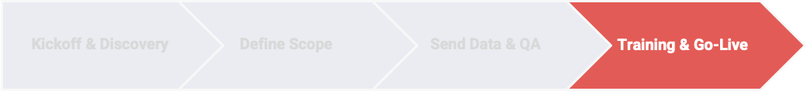
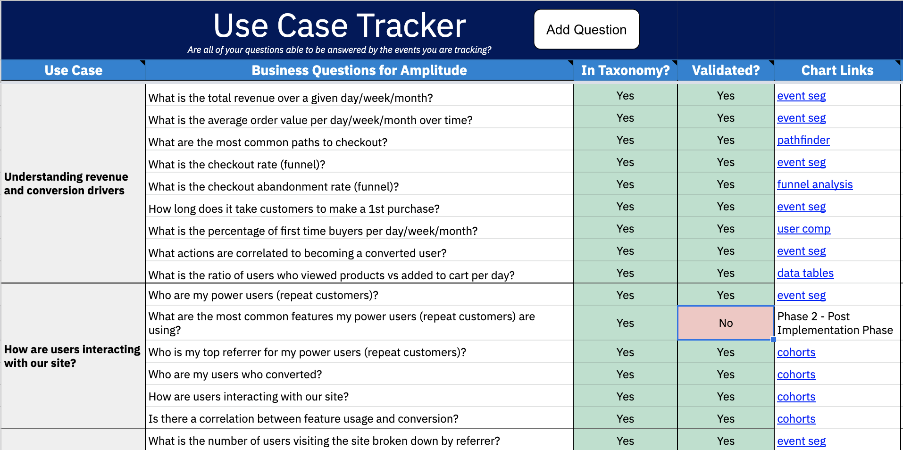
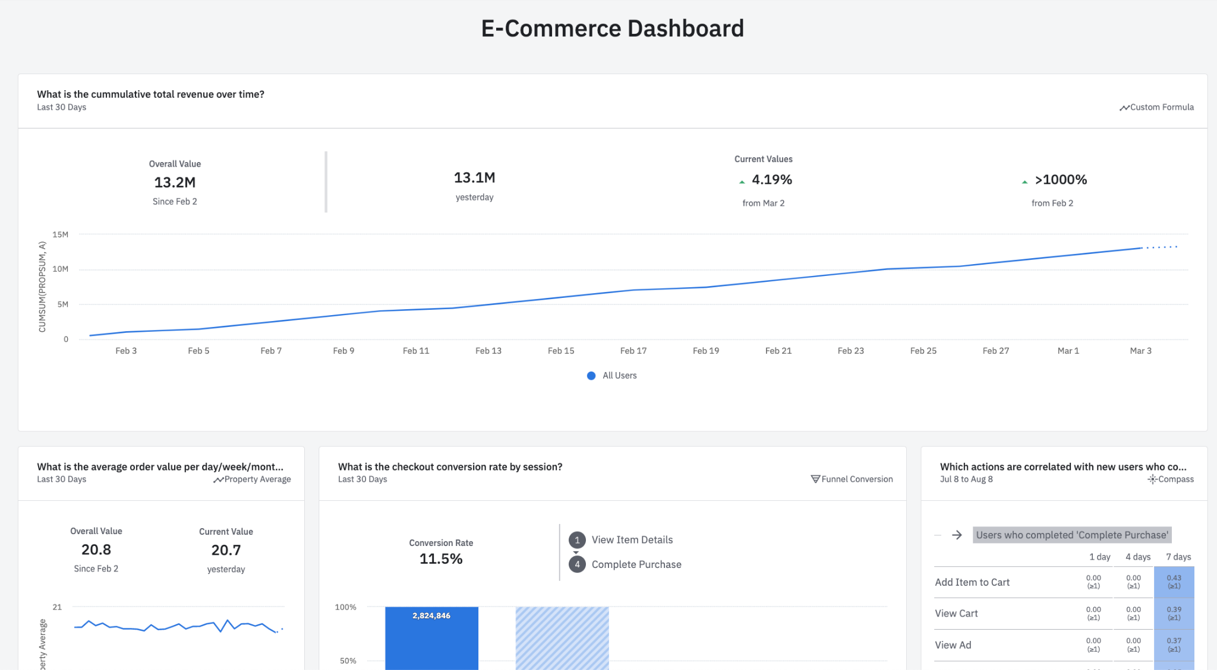
KEY LAUNCH PHASE ACTIVITIES
Dashboarding Use Cases
Estimated Duration: 1-2 meetings; Weekly Sync(s) or Standalone
Description
With interactive session(s), we build Amplitude charts with you to validate your production data to your use cases and supporting business questions and jumpstart the teams usage in Amplitude.
Desired Outcomes
Provide brief Amplitude 101 to help familiarizing w/ Amplitude
Confirm data answers defined implementation phase scope
Establish dashboard and/or charts to your high value insights with links to use cases
Understanding of your relevant Add-Ons
[customer’s name] Participants
Business Lead(s)**, Engineering Lead, Project Lead
** required
Notes:
TALK TRACK
With production data in Amplitude, our team will have a working session or multiple if needed to help your implementation team understand how to build Amplitude charts that can now answer the use cases & business questions defined during the align phase.

Slide 40




KEY LAUNCH PHASE ACTIVITIES
Remaining Launch Activities
Launch Planning
Foundational Training
Implementation Readout
Data Governance Workshop
We’ll discuss objectives of remaining launch phase activities and initiate training planning including training audience.
We deliver a 2-hr training course to your early Amplitude users covering foundational areas within Amplitude.
Completes implementation support and we highlight your accomplishments and discuss support resources post go-live.
We provide best practices on data governance with your Amplitude data based on current and/or governance plans.
OUTCOMES
Identify Training Audience
Schedule Training
Introduce your Amplitude Trainer
OUTCOMES
Introduce event-based analytics
Walkthrough UI navigation + key chart types
Participants create live Amplitude charts
OUTCOMES
Highlight successes and remaining efforts
CSAT Survey participants
Intro Account Team
OUTCOMES
Share our Data Governance best practices
Learn your current data governance process
Identity Data Governance roles
Notes:
TALK TRACK
When we approach the end of our implementation phase, we’ll want to ensure we set your team up for success with the tools and guidance to continue growing in your Amplitude journey with self serve analytics. We’ll talk about these activities in more detail as we progress through implementation phase, including the exciting Amplitude launch with your Platform Foundational training w/ early Amplitude users.

Slide 41







Data Governance Framework Foundations
I M P L E M E N T A T I O N & S U C C E S S A P P R O A C H
Education
Instrument
Maintenance
Initial Implementation
Ongoing
Assign data governor and supporting roles
Define a style guide
Build a data dictionary in Amplitude Data or where it makes sense
Govern your Data directly in Amplitude
Create an ongoing instrumentation plan
Maintenance of your Amplitude Data
Follow your ongoing instrumentation plan
Notes:
TALK TRACK
While the implementation phase does focus on accelerating your time to value with insights from Amplitude Analytics and instrumenting data with best practices. It’s just as important to ensure there are scalable practices in place during and post implementation.
Amplitude adopts the following 3 pillars of data governance, (1) Education, (2) Instrument and (3) Maintenance and we believe there are best practices in applying them.
During initial implementation, there are beginning steps we encourage you take which are most relevant based on your organization and/or team’s data maturity.
Our goal is that following your initial implementation, your team is comfortable with defining and setting up a solid system to support your data governance framework to ensure ongoing integrity and trust of your Amplitude data.
We’ve included a checklist in the Appendix to help you in assessing your data governance readiness before implementation starts

Slide 42


Project Visibility and Collaboration Resources
I M P L E M E N T A T I O N & S U C C E S S A P P R O A C H
We leverage two primary resources with your project team to track your overall implementation and increase collaboration with your project stakeholders.
Project Management Tool
Implementation Workbook
Allows visibility to tasks and timelines with our customers
Easily shareable resource guide between project teams
Notes:
TALK TRACK
During implementation, we understand the importance of providing stakeholders and project team members the necessary resources for successful implementation. We leverage Mavenlink, a professional services automation tool that supports our Amplitude implementation teams with powerful resource management and overall project management.
We’ll look to confirm a weekly cadence call with you to discuss overall health, tracking to go live milestone, current project risks/issues and any other relevant topics tracked in Mavenlink.
In addition to Mavenlink, we'll share an implementation workbook with you that contains the implementation plan checklist, and several resources to guide the process. We’ll use this to document progress and accomplishments as we make through the next few weeks. If for any reason there becomes any issues with access to google sheets, we’ll be able to share via another format.

Slide 43
Implementation Workbook with Best Practices
I M P L E M E N T A T I O N & S U C C E S S A P P R O A C H
Our extensive experience has allowed us to deliver a repeatable successful roadmap to Go-Live by understanding key activities relevant to you and your business objectives.
Implementation Checklist
Power User Identification
Implementation Use Cases
Taxonomy Structure
Taxonomy & Data QA
Resources
Summary of activities and checklist managed in workbook and Mavenlink to ensure go-live criteria is met.
Identifies key end users from customer to leverage for testing and future training.
Provides best practices to document 10-15 key use cases w/ supporting questions for current scope determining charts.
Template for customers to input taxonomy data and includes best practice guide for most optimal instrumentation.
Our Amplitude experts have defined criteria to have successful launch and provide feedback to help your team be successful.
Descriptions
Notes:
TALK TRACK
As mentioned, we’ll be using an implementation workbook via google sheets to offer several resources to help guide your team through a successful implementation. With your input and direction, this workbook is where key details to instrumentation is documented for sharing across both teams, such as use cases, taxonomy audits, and Amplitude charts once data is successfully sent to Amplitude. Our extensive experience has allowed us to identify key areas within our Align, Instrument, and Launch phases where we can offer support to customers through easy templates and guides. We understand that every customers’ journey with Amplitude may look different; however, the areas called out here are critical exit criteria for launch.
Question for customer: Do we anticipate any concerns with using the google sheets as the source for this documentation.
Feedback from 11/10 review - We should consider updating the workbook to remove the due dates since it conflict with messaging mavenlink being source from tracking versus implementation workbook

Slide 44
Data Governance Framework Foundations
I M P L E M E N T A T I O N & S U C C E S S A P P R O A C H
Education
Instrument
Maintenance
Initial Implementation
Ongoing
Assign data governor and supporting roles
Define a style guide
Build a data dictionary in Amplitude Data or where it makes sense
Govern your Data directly in Amplitude
Create an ongoing instrumentation plan
Maintenance of your Amplitude Data
Follow your ongoing instrumentation plan
Notes:
TALK TRACK
While the implementation phase does focus on accelerating your time to value with insights from Amplitude Analytics and instrumenting data with best practices. It’s just as important to ensure there are scalable practices in place during and post implementation.
Amplitude adopts the following 3 pillars of data governance, (1) Education, (2) Instrument and (3) Maintenance and we believe there are best practices in applying them.
During initial implementation, there are beginning steps we encourage you take which are most relevant based on your organization and/or team’s data maturity.
Our goal is that following your initial implementation, your team is comfortable with defining and setting up a solid system to support your data governance framework to ensure ongoing integrity and trust of your Amplitude data.
We’ve included a checklist in the Appendix to help you in assessing your data governance readiness before implementation starts

Slide 45
Implementation Overview &
Best Practices
Notes:
TALK TRACK
Thanks for sharing information with us about your team and your goals, as we continue our relationship, please feel encouraged to keep us up to speed on anything happening with your team whether it be from a larger organizational goal or something that specifically relates to Amplitude - this information helps us partner with you on an ongoing basis as your business evolves.
If applicable
Next, I’ll pass it over to [ENGAGEMENT MANAGER OR S/A] to provide a more granular view into what you can expect in the coming weeks.

Slide 46
Industry Implementation Guides
OPTIONAL
I M P L E M E N T A T I O N & S U C C E S S A P P R O A C H
We offer an industry-specific implementation guides that drives successful adoption by tailoring to industry specific challenges and common best practices with business use cases and taxonomy.
Guides found here
Industry Implementation Guide
1. Industry Case Studies
______________________________________________
______________________________________________
2. Implementation Process Details
______________________________________________
______________________________________________
3. Industry Recommended Use Cases & Business questions
______________________________________________
______________________________________________
4. Industry Recommended Taxonomy
______________________________________________
______________________________________________
5. Standard Dashboard
______________________________________________
______________________________________________
Notes:
TALK TRACK
We’ve worked with customers from many industries over the years through hundreds of implementations. This has shown us the trends and common needs and challenges customers have based on specific industries. Our industry-specific implementation guides are what helps differentiate us here at Amplitude and may allow for quicker implementation. We plan to share more around this and how we can best see this in our upcoming Product Walkthrough/Use Case alignment and Engineering kick-off calls.

