Slide 1
IMPLEMENTING AMPLITUDE EXPERIMENT TECHNICAL TRACK: EXPERIMENT SDK IMPLEMENTATION EXERCISE
Instructions
As instructed, I worked through the MemoMinder Experiment SDK exercise (the sample app itself is not publicly accessible, so it was rebuilt to spec) and took a screenshot at each of the following milestones:
• 1.2 Analytics API key replaced in index.html (2 instances)
• 1.5 Live Events showing 3+ Memo Interacted events
• 2.1 Client-side deployment created
• 2.3a/b Variants (add / create) with JSON payloads
• 2.3c/d Allocation (All Users, 50/50, 100% rollout) + primary metric
• 2.6 Evaluation API returning key + payload
• 2.7 Assignment event received in User Profiles
• 3.1/3.2 Experiment SDK script tags + deployment key in code
• 3.3 setLabel() using start() / variant()
• 4.2 App showing the assigned button label
• 4.4 Assignment, Exposure and Memo Interacted events on one user
• 4.5 Different button label in a second browser context
• 4.6 Activity tab totals (exposures / assignments)

Slide 2
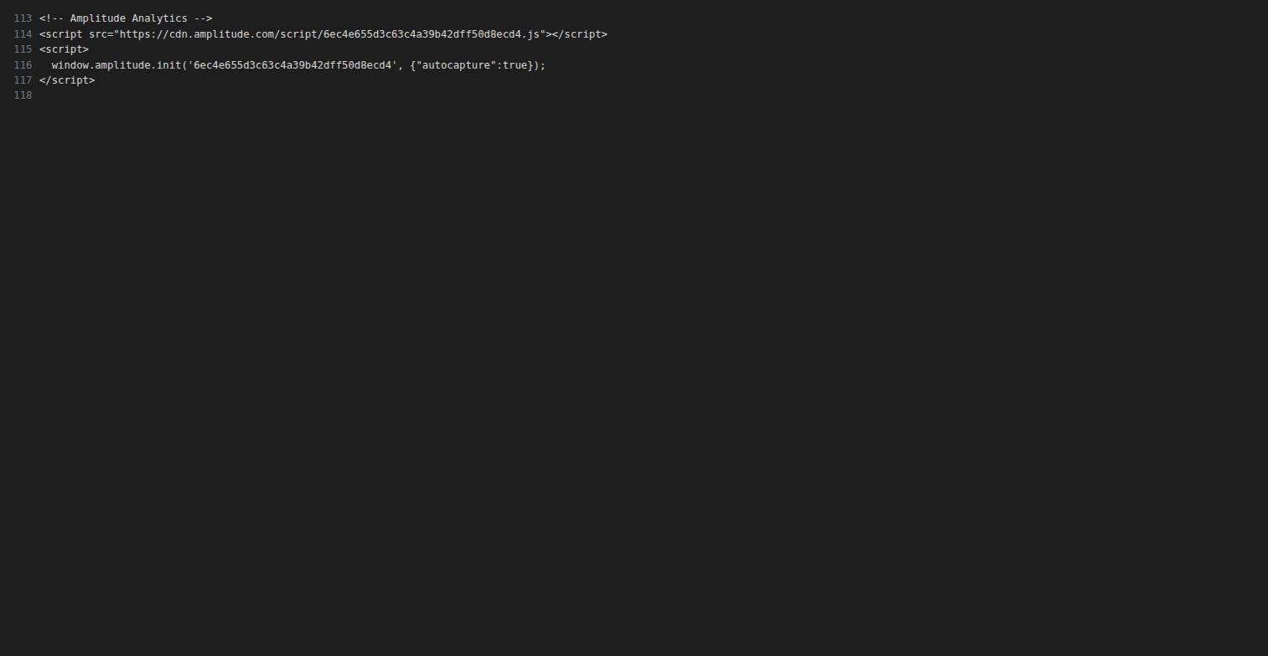
IMPLEMENTING AMPLITUDE EXPERIMENT TECHNICAL TRACK: EXPERIMENT SDK IMPLEMENTATION EXERCISE
Screenshot 1: Analytics API key in code (step 1.2)
index.html, lines 113-117:
window.amplitude.init('6ec4e655d3c63c4a39b42dff50d8ecd4', ...)
Both AMPLITUDE_API_KEY placeholders replaced with the real Analytics API key for the MemoMinder project (source: memominder-web).

Slide 3
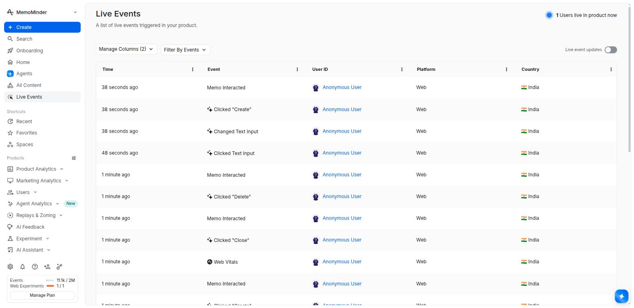
IMPLEMENTING AMPLITUDE EXPERIMENT TECHNICAL TRACK: EXPERIMENT SDK IMPLEMENTATION EXERCISE
Screenshot 2: Live Events - Memo Interacted (step 1.5)
Live Events feed showing multiple Memo Interacted events (create / close / delete), well over the minimum of 3, arriving in real time from the running app.

Slide 4
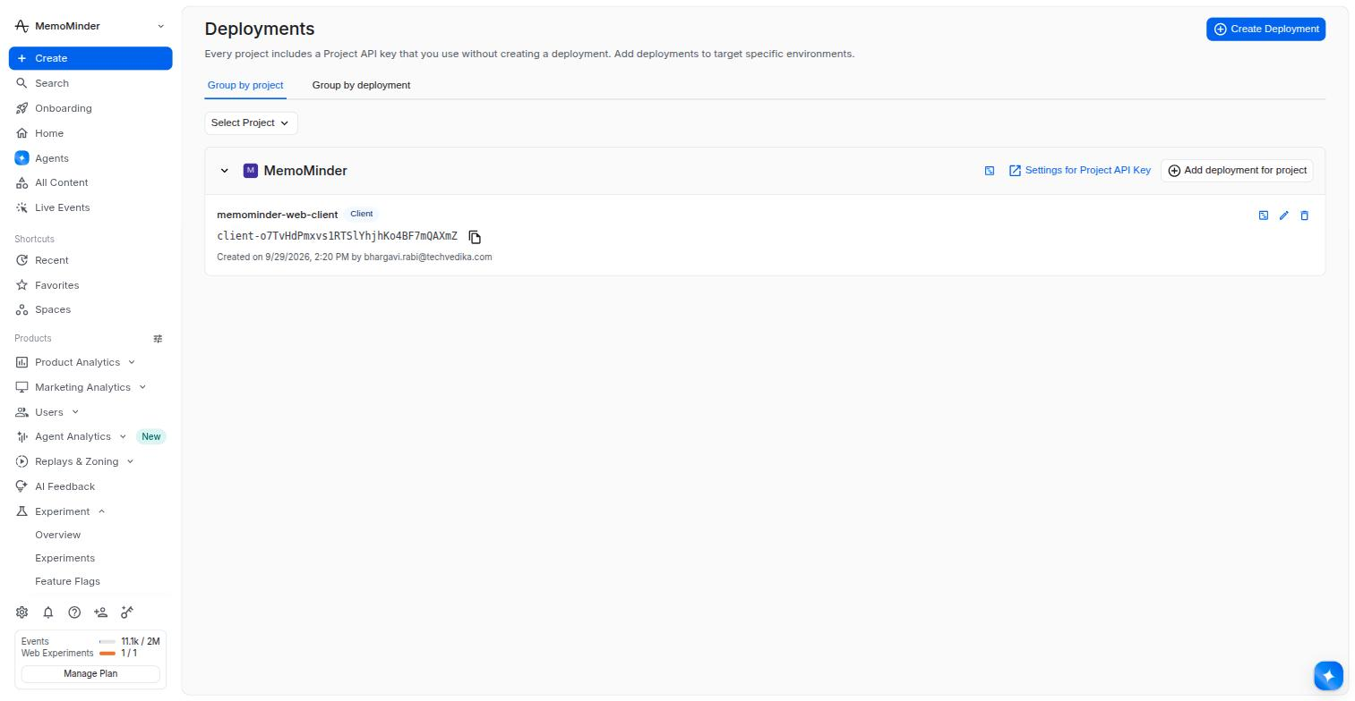
IMPLEMENTING AMPLITUDE EXPERIMENT TECHNICAL TRACK: EXPERIMENT SDK IMPLEMENTATION EXERCISE
Screenshot 3: Client-side deployment (step 2.1)
Deployment `memominder-web-client` (Client) created under the MemoMinder project, associated with the Analytics project.

Slide 5
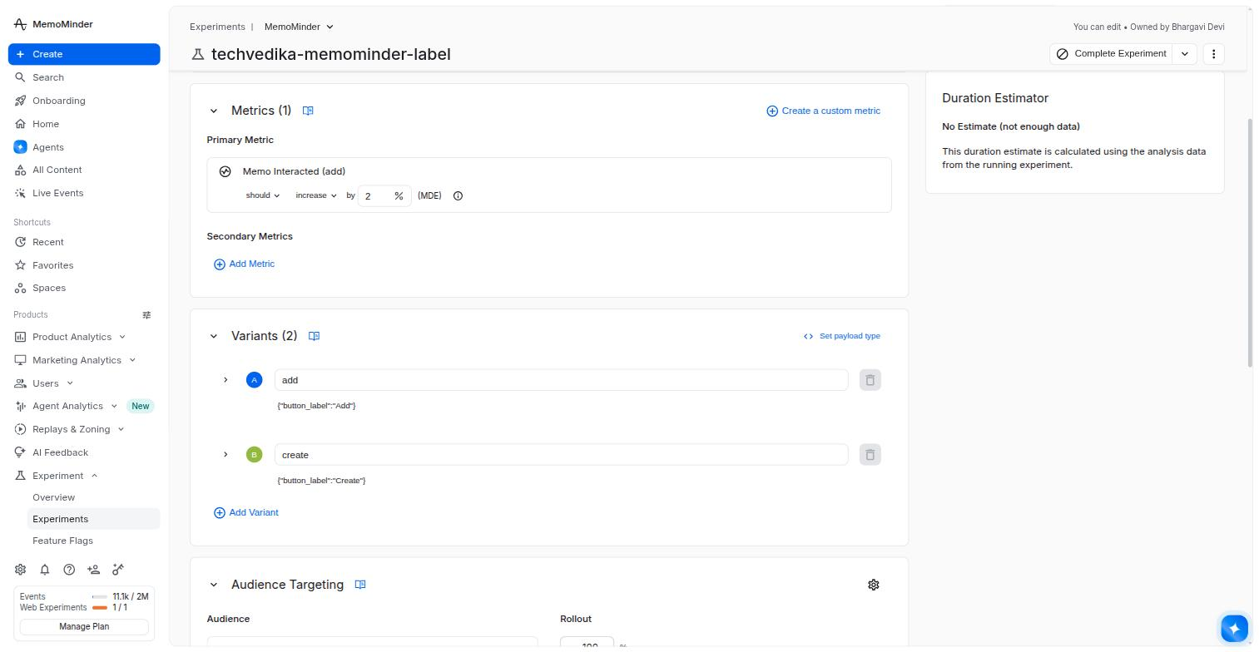
IMPLEMENTING AMPLITUDE EXPERIMENT TECHNICAL TRACK: EXPERIMENT SDK IMPLEMENTATION EXERCISE
Screenshot 4: Variants + payloads (step 2.3a/b)
Two variants:
add` -> {"button_label":"Add"}
create` -> {"button_label":"Create"}
Primary metric (Memo Interacted, add) also visible above.

Slide 6
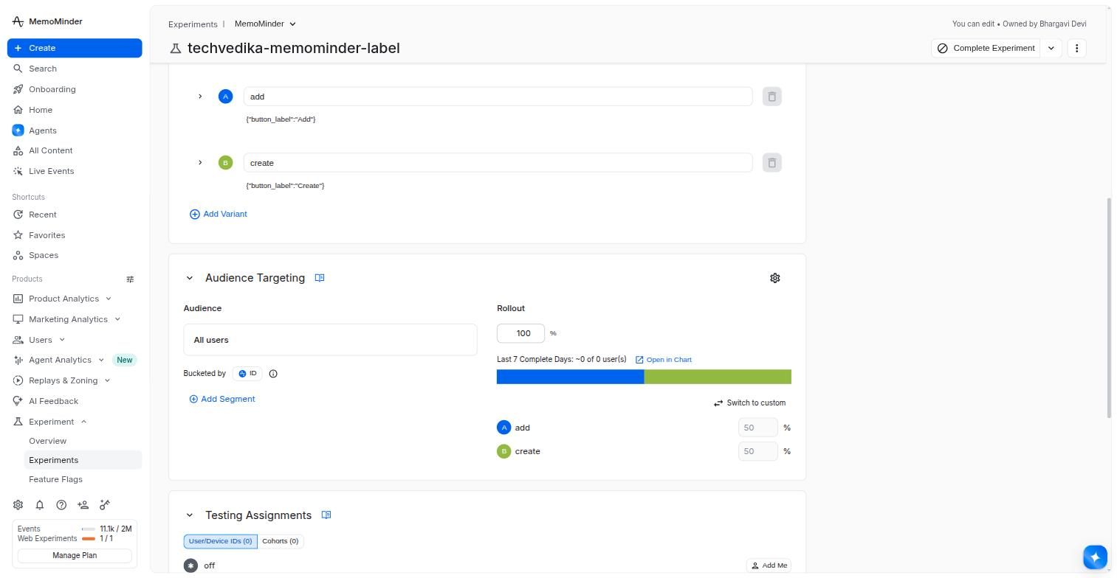
IMPLEMENTING AMPLITUDE EXPERIMENT TECHNICAL TRACK: EXPERIMENT SDK IMPLEMENTATION EXERCISE
Screenshot 5: Allocation + primary metric (step 2.3c/d)
Audience: All Users
Bucketed by: Amplitude ID
Allocation: 50 / 50
Rollout: 100%
Primary metric: Event Totals, Memo Interacted where action = add.

Slide 7
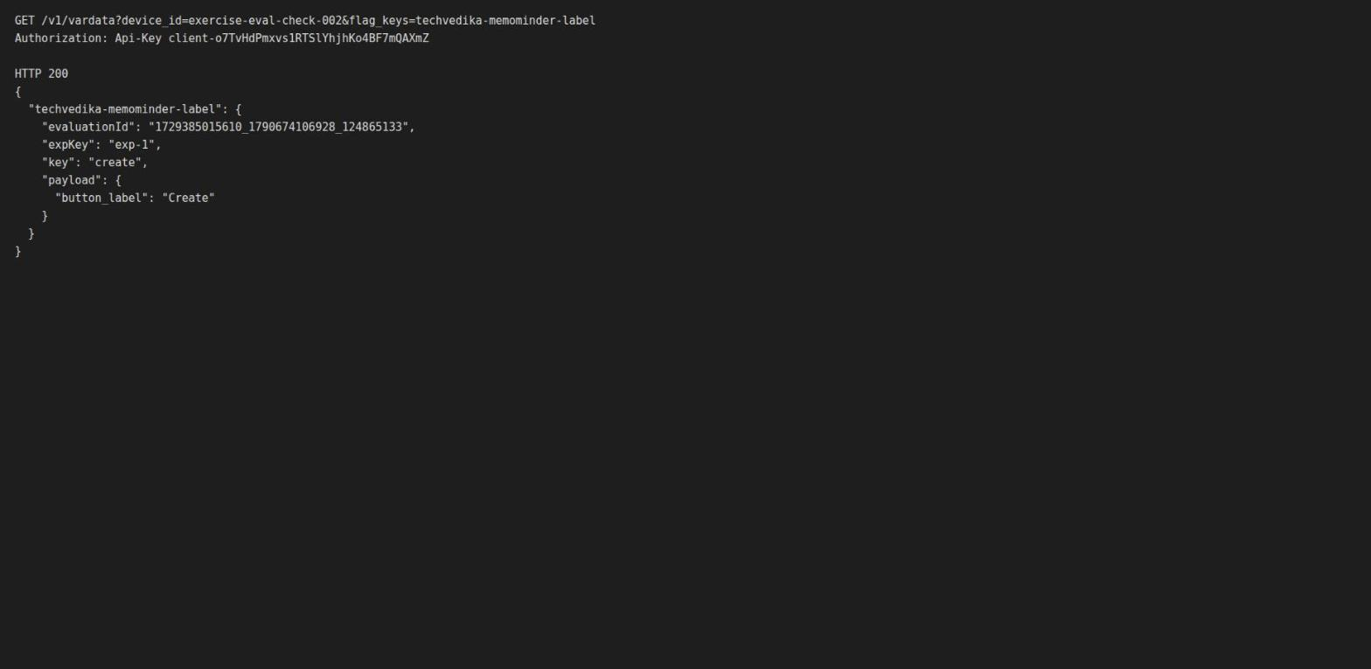
IMPLEMENTING AMPLITUDE EXPERIMENT TECHNICAL TRACK: EXPERIMENT SDK IMPLEMENTATION EXERCISE
Screenshot 6: Evaluation API (step 2.6)
GET /v1/vardata with the deployment key returns HTTP 200 with both a variant `key` and its `payload` for a fresh device id, confirming the experiment is ready to assign users.

Slide 8
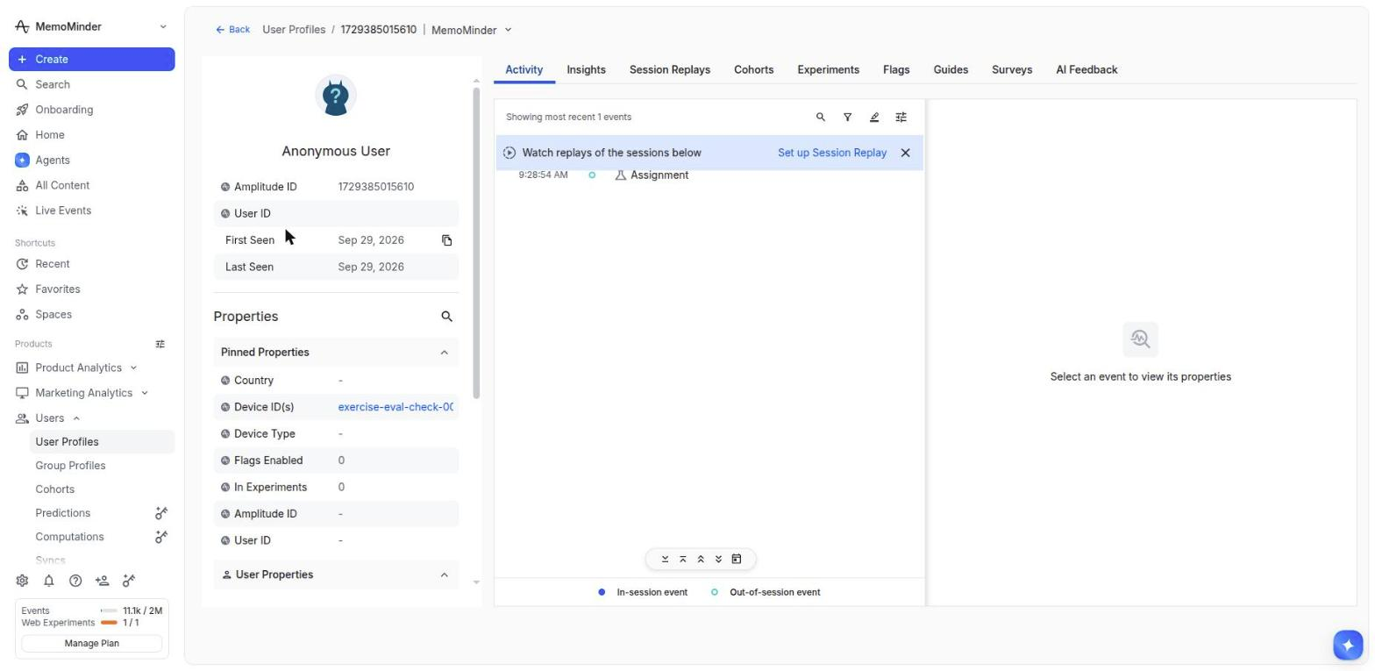
IMPLEMENTING AMPLITUDE EXPERIMENT TECHNICAL TRACK: EXPERIMENT SDK IMPLEMENTATION EXERCISE
Screenshot 7: Assignment event received (step 2.7)
User Profile for the Evaluation API test device shows an Assignment event, confirming assignments are logged back to the Analytics project.

Slide 9
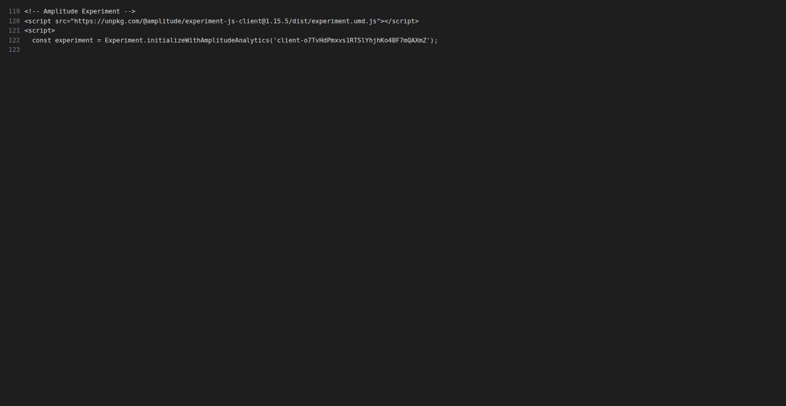
IMPLEMENTING AMPLITUDE EXPERIMENT TECHNICAL TRACK: EXPERIMENT SDK IMPLEMENTATION EXERCISE
Screenshot 8: Experiment SDK + deployment key (step 3.1/3.2)
index.html, lines 119-122: Experiment JS SDK script tag (`experiment-js-client@1.15.5`) and DEPLOYMENT_KEY replaced with the real client deployment key.

Slide 10
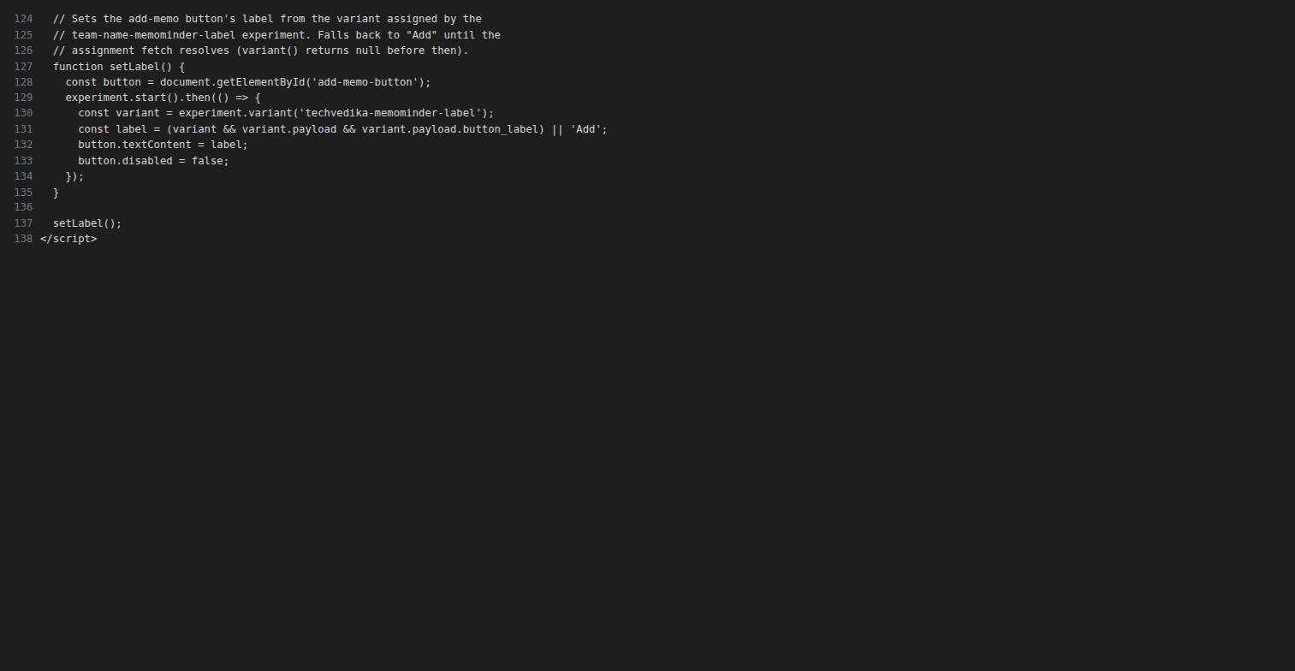
IMPLEMENTING AMPLITUDE EXPERIMENT TECHNICAL TRACK: EXPERIMENT SDK IMPLEMENTATION EXERCISE
Screenshot 9: setLabel() implementation (step 3.3)
setLabel() calls `experiment.start()`, then reads `experiment.variant('techvedika-memominder-label')` and applies its payload's button_label to the Add/Create button.

Slide 11
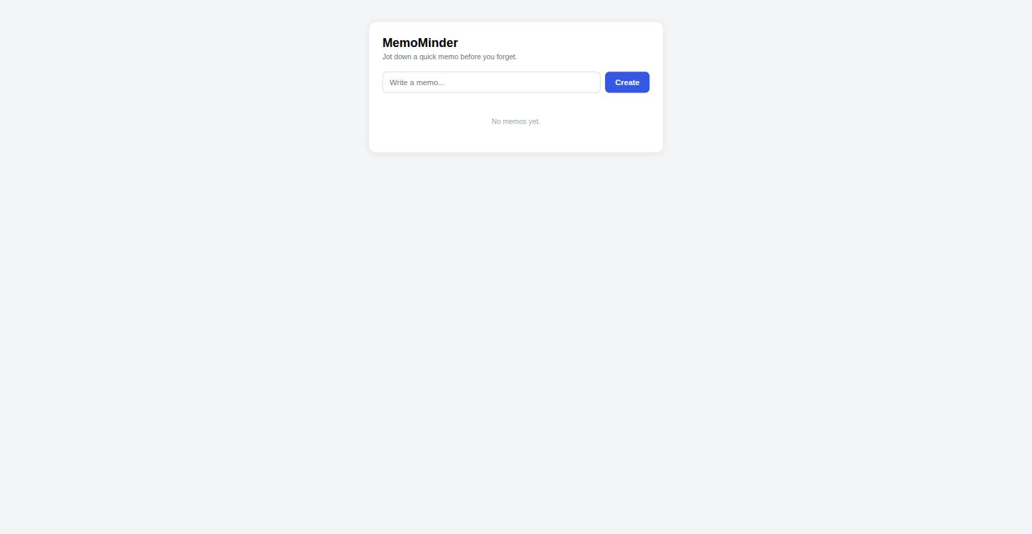
IMPLEMENTING AMPLITUDE EXPERIMENT TECHNICAL TRACK: EXPERIMENT SDK IMPLEMENTATION EXERCISE
Screenshot 10: Button shows assigned label (step 4.2)
MemoMinder app loaded against the live deployment - the button is enabled and labeled from the assigned variant's payload (shown here: "Create").

Slide 12
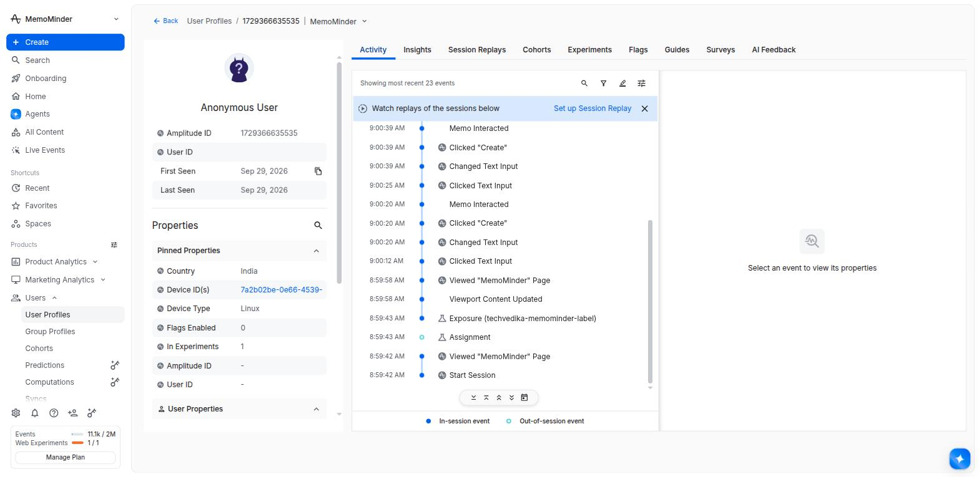
IMPLEMENTING AMPLITUDE EXPERIMENT TECHNICAL TRACK: EXPERIMENT SDK IMPLEMENTATION EXERCISE
Screenshot 11: Assignment, Exposure, Memo Interacted (step 4.4)
Same real user's event stream, in order: Assignment -> Exposure (techvedika-memominder-label) -> Memo Interacted (multiple, from create/close/delete actions).

Slide 13
IMPLEMENTING AMPLITUDE EXPERIMENT TECHNICAL TRACK: EXPERIMENT SDK IMPLEMENTATION EXERCISE
Screenshot 12: Different label in a second context (step 4.5)
[ Insert your incognito-window screenshot here ]
MANUAL STEP - not yet captured.
Clearing cookies, localStorage, sessionStorage and IndexedDB and forcing hard reloads kept returning the identical device id and the same "create" variant, which points to a deterministic device-id fallback on this machine that automation can't get around.
Please open a real Incognito window yourself, refresh a few times, and drop a screenshot here once you see "Add" instead of "Create".

Slide 14
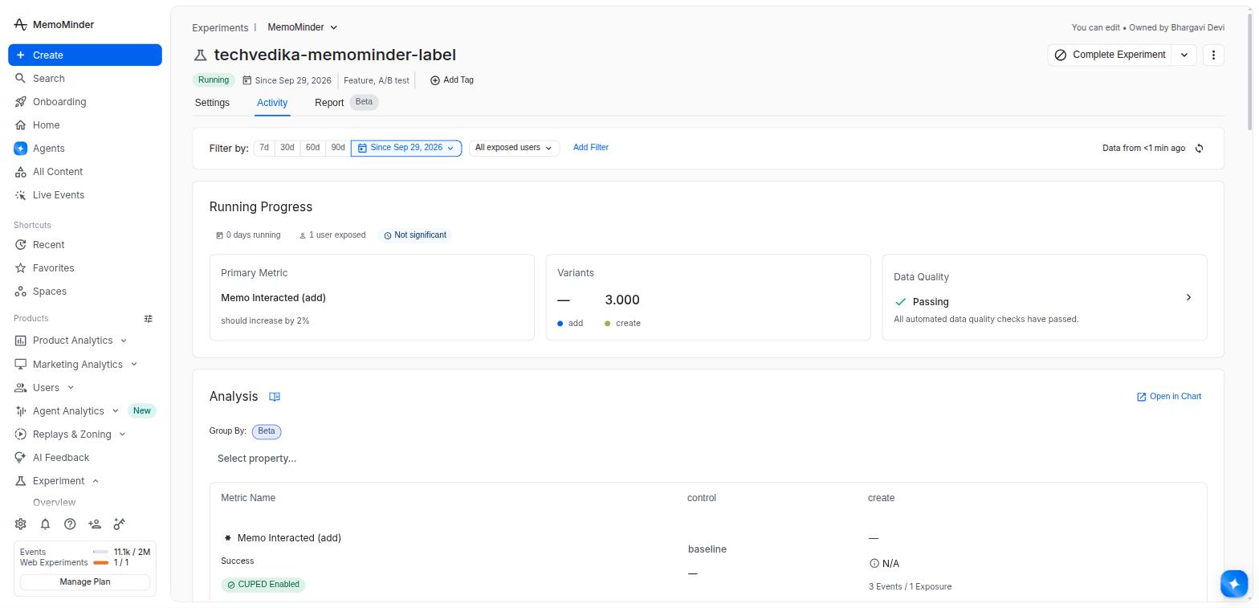
IMPLEMENTING AMPLITUDE EXPERIMENT TECHNICAL TRACK: EXPERIMENT SDK IMPLEMENTATION EXERCISE
Screenshot 13: Activity tab totals (step 4.6)
Experiment Activity tab: 1 user exposed, primary metric wired up, "create" variant showing 3 events / 1 exposure, data quality checks passing.

