Slide 1
Instructions
IMPLEMENTING AMPLITUDE ANALYTICS TECHNICAL TRACK: SDK IMPLEMENTATION EXERCISE
As you work through the Battleboat exercise instructions, take a screenshot at each of the following milestones and insert them in the following slides provided.
Install Amplitude with Autocapture
Initialize game event
Select Ship event with event property
Rotate Ship event with event property
Place Ship event with event property
Start Game event with event property
Shoot Ship event with event property
Sink opponent ship event with event property
Example of any one of these user properties: Total Games Played, Total Games Won, or Total Games Lost
Game End event with event property
With Game End event , open the Amplitude instance and show the event with the user properties.

Slide 2
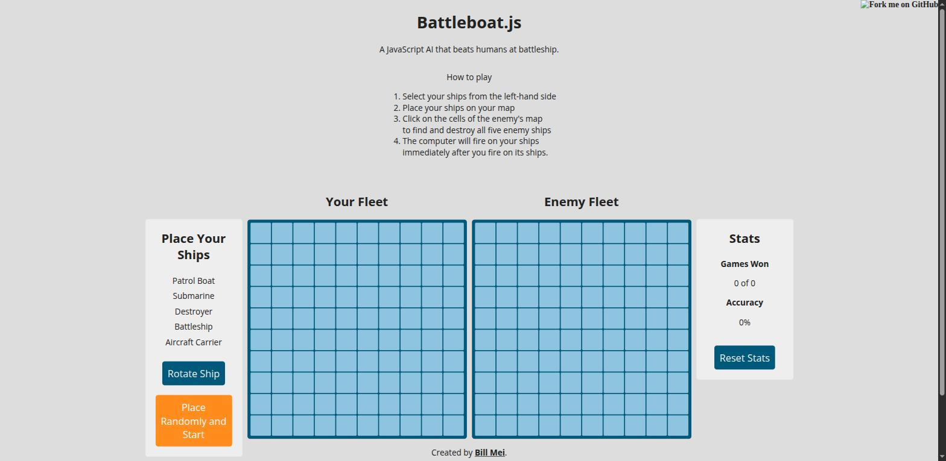
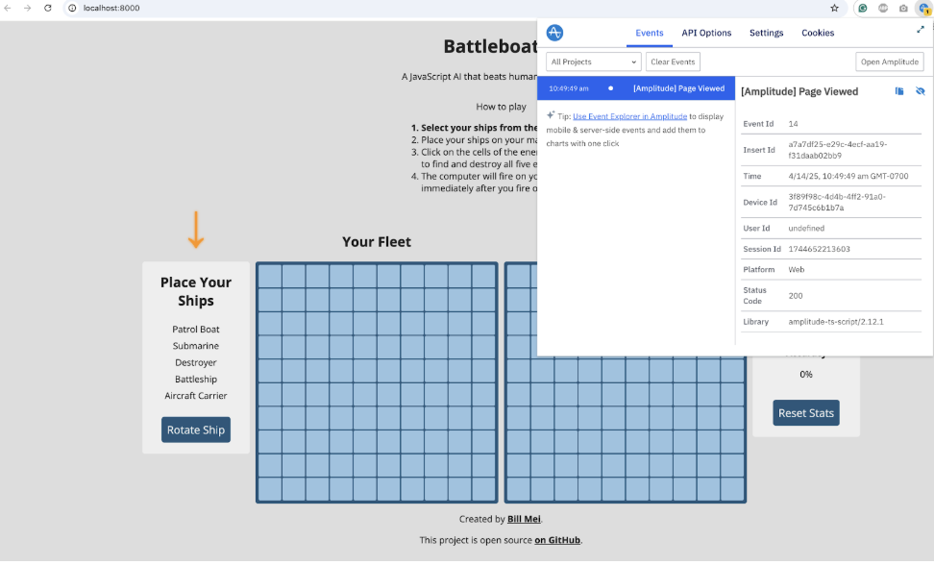
Screenshot 1: Install Amplitude with Autocapture
IMPLEMENTING AMPLITUDE ANALYTICS TECHNICAL TRACK: SDK IMPLEMENTATION EXERCISE
Verified via live network requests:
GET sr-client-cfg.amplitude.com/config/<key> -> 200
POST api2.amplitude.com/2/httpapi -> 200
index.html snippet:
amplitude.init('e0ee0b71af...', {autocapture:true})

Slide 3
Screenshot 2: Initialize game event
IMPLEMENTING AMPLITUDE ANALYTICS TECHNICAL TRACK: SDK IMPLEMENTATION EXERCISE
battleboat.js - Game() constructor:
amplitude.track('Initialize Game');
Fires unconditionally on every page load/refresh,
right after this.init(). Confirmed via the
httpapi POST captured on load.

Slide 4

Screenshot 3: Select Ship event with event property
IMPLEMENTING AMPLITUDE ANALYTICS TECHNICAL TRACK: SDK IMPLEMENTATION EXERCISE
Console-captured event:
track: {"name":"Select Ship",
"props":{"ship":"patrolboat"}}

Slide 5
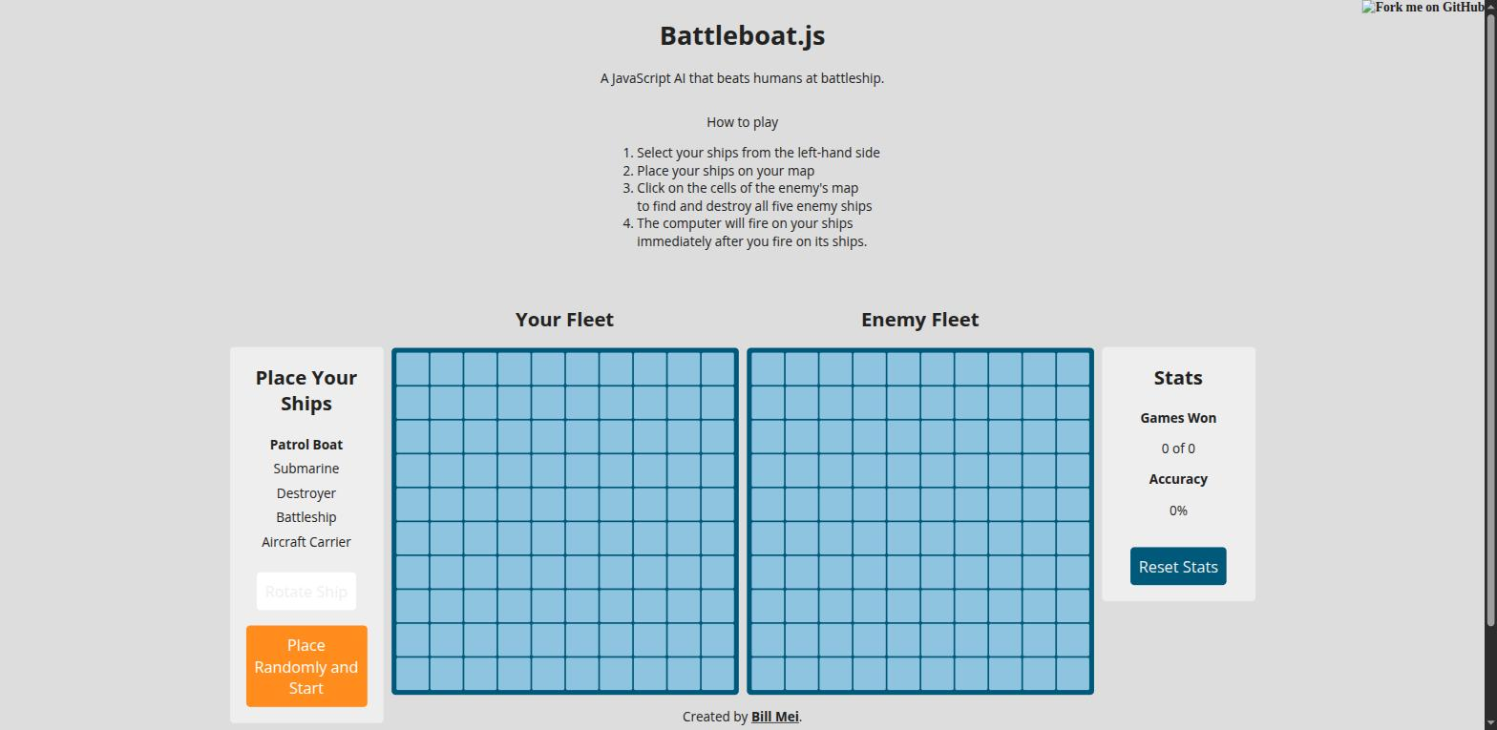
Screenshot 4: Rotate ship event with event property
IMPLEMENTING AMPLITUDE ANALYTICS TECHNICAL TRACK: SDK IMPLEMENTATION EXERCISE
Console-captured event:
track: {"name":"Rotate Ship",
"props":{"ship":"patrolboat",
"direction":"horizontal"}}

Slide 6
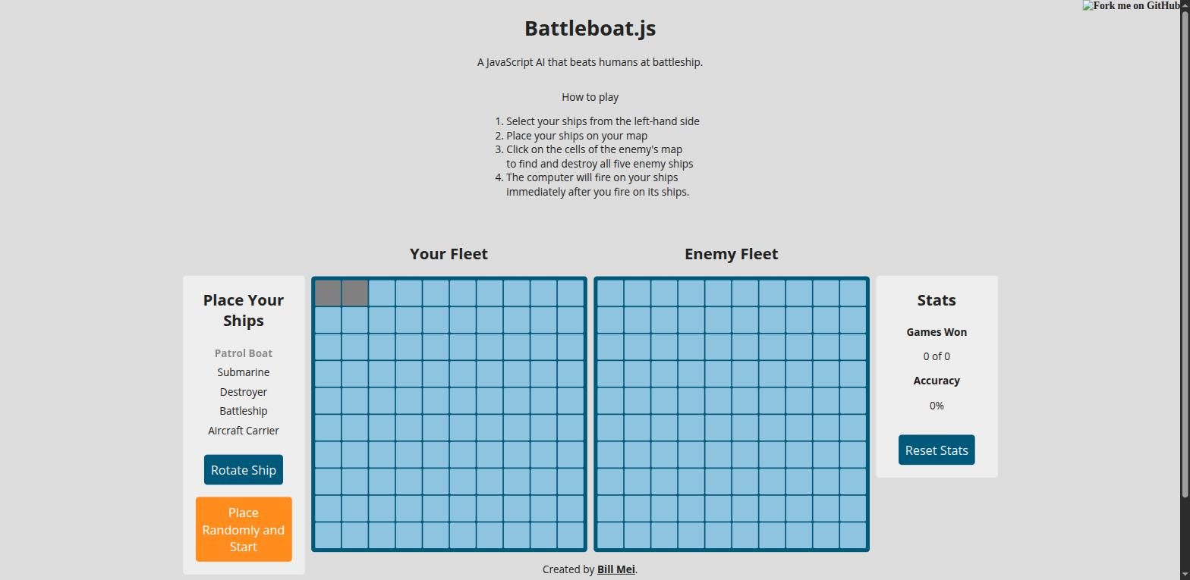
Screenshot 5: Place ship event with event property
IMPLEMENTING AMPLITUDE ANALYTICS TECHNICAL TRACK: SDK IMPLEMENTATION EXERCISE
Console-captured event:
track: {"name":"Place Ship",
"props":{"ship":"patrolboat",
"success":true,"direction":"horizontal"}}

Slide 7
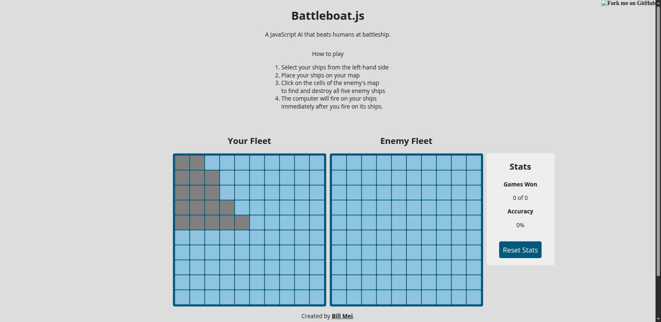
Screenshot 6: Start game event with event property
IMPLEMENTING AMPLITUDE ANALYTICS TECHNICAL TRACK: SDK IMPLEMENTATION EXERCISE
Console-captured event:
track: {"name":"Start Game",
"props":{"allShipsPlaced":true}}

Slide 8
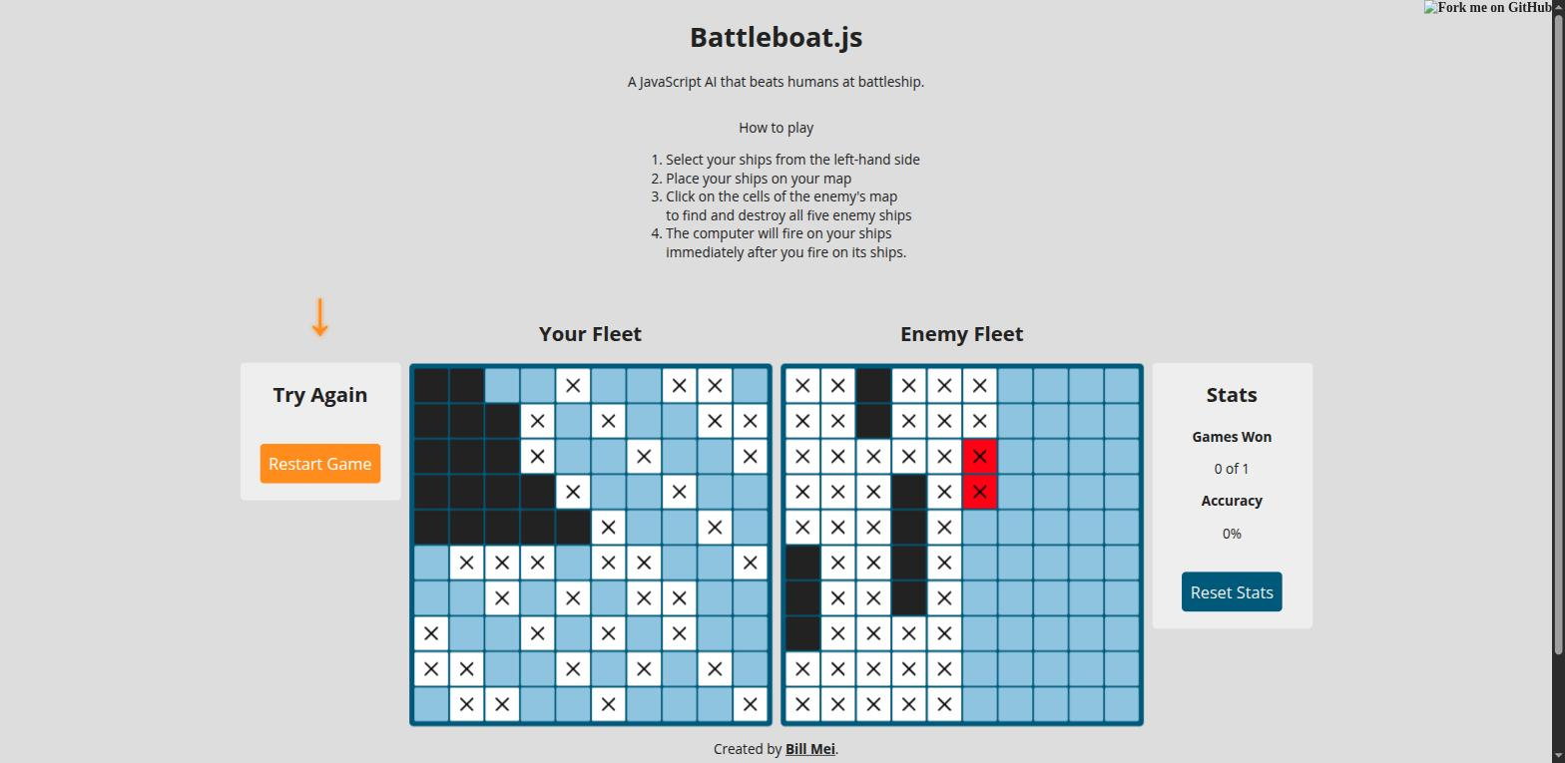
Screenshot 7: Shoot ship event with event property
IMPLEMENTING AMPLITUDE ANALYTICS TECHNICAL TRACK: SDK IMPLEMENTATION EXERCISE
Board after a full playthrough (X = shot cell,
red = most recent hit). Example console event:
track: {"name":"Shoot Ship",
"props":{"x":5,"y":0,"hit":true,"miss":false}}

Slide 9
Screenshot 8: Sink opponent ship event…
IMPLEMENTING AMPLITUDE ANALYTICS TECHNICAL TRACK: SDK IMPLEMENTATION EXERCISE
Dark cells = sunk enemy ships. Console events:
track: {"name":"Sink Opponent Ship",
"props":{"ship":"submarine","shipLength":3}}
track: {"name":"Sink Opponent Ship",
"props":{"ship":"patrolboat","shipLength":2}}
track: {"name":"Sink Opponent Ship",
"props":{"ship":"battleship","shipLength":4}}

Slide 10
Screenshot 9: Game end event with event property
IMPLEMENTING AMPLITUDE ANALYTICS TECHNICAL TRACK: SDK IMPLEMENTATION EXERCISE
"Try Again" sidebar = checkIfWon() detected a loss.
Console-captured event:
track: {"name":"Game End",
"props":{"result":"loss","shotsTaken":54}}

Slide 11
Screenshot 10: Total Games Played, Total Games Won, or Total Games Lost
IMPLEMENTING AMPLITUDE ANALYTICS TECHNICAL TRACK: SDK IMPLEMENTATION EXERCISE
Identify call fired right before Game End,
so the properties attach to that event:
identify: {"$add":{"Total Games Played":1,
"Total Games Lost":1}}
(Win path uses the same pattern with
'Total Games Won' instead - see checkIfWon())

