Slide 1

Leaf Classification using Machine Learning and Image Processing
Presented by
Bhargavi Reddy Suvala

Slide 2


Project Overview
This project focuses on developing a robust machine learning model to classify different leaf species using image processing and
deep learning techniques. By analyzing features
such as shape, color, texture, and vein structure,
the model aims to recognize and differentiate
among various types of leaves.
The project explores three models:
Convolutional Neural Networks (CNN) for deep
learning, and Support Vector Machine (SVM) and
Random Forest (RF) for traditional machine
learning. The system is built using a dataset of
RGB leaf images and is designed to serve as a
real-time identification tool in environmental,
botanical, and agricultural domains.
Notes:
The goal of my project is to develop a model that can accurately classify different leaf species using their images. . I used a dataset of RGB images and analyzed key features like shape, color, texture, and vein patterns. I used three models:
Convolutional Neural Network (CNN) for deep learning
Support Vector Machine (SVM)
Random Forest (RF)
This system can help real-time identification of leaves for environmental, agricultural, and botanical applications.**"

Slide 3
CNN Architecture
In this CNN model is custom-built with three convolutional blocks, each followed by Batch Normalization, LeakyReLU activation, MaxPooling, and Dropout layers to prevent overfitting. The feature extractor is followed by a fully connected (dense) classifier, which outputs predictions across multiple leaf species. We used CrossEntropyLoss as the loss function and optimized using Adam Optimizer with a learning rate of 0.001. Input images were resized to 64x64 RGB, and the final classifier outputs predictions for 40 classes.
Notes:
I used three convolutional layers to extract deep visual features, with Batch Normalization and LeakyReLU to stabilize and enhance learning. MaxPooling layers help reduce spatial dimensions, and Dropout prevents overfitting. After feature extraction, the model flattens the output and passes it through fully connected layers to classify among 40 leaf classes. We trained the model using Cross Entropy Loss and optimized with the Adam optimizer with a learning rate of 0.001. Input images were resized to 64x64 RGB format.”

Slide 4
Dataset & Preprocessing
Dataset Source: Custom leaf images in RGB format Number of Classes: 40 different leaf species Data Split: 70% Train, 15% Validation, 15% Test Preprocessing Techniques: • Resizing to 64x64 pixels • Data Augmentation (Rotation, Horizontal Flip, Color Jitter) • Normalization using ImageNet mean and std Transformation Libraries: torchvision.transforms
Notes:
I worked with a dataset consisting of RGB leaf images from 40 species.
I split the data: 70% for training, 15% for validation, and 15% for testing. I before said resized every image to 64x64 pixels to standardize the input size. Preprocessing included resizing images, adding data augmentation (rotation, flipping, color changes), and normalization using ImageNet statistics. This improves model generalization.”

Slide 5
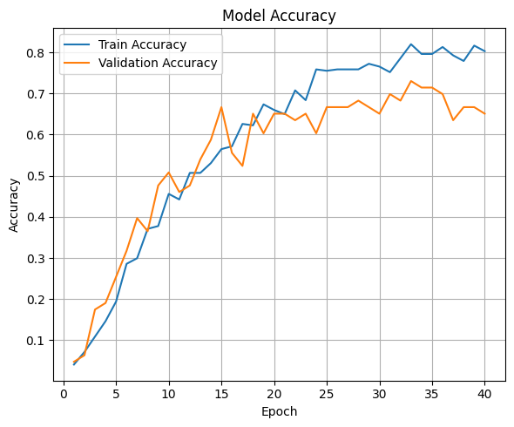
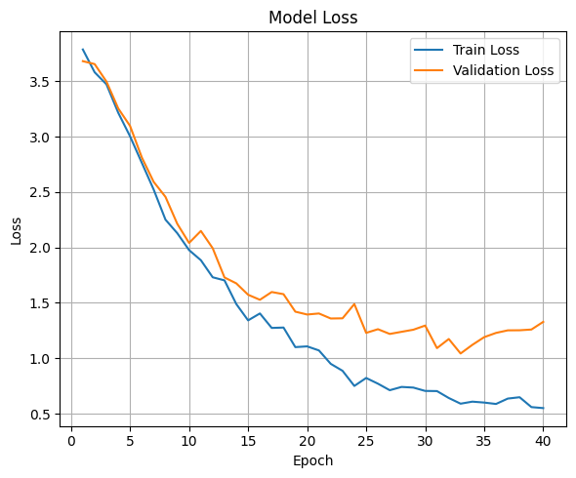
Model Accuracy & Model Loss
Training Accuracy vs Validation Accuracy && Training Loss vs Validation Loss
Notes:
This slide showcases how well my CNN model is learning to classify leaf species by tracking accuracy over time.
We see a steady rise in training accuracy as the model learns from the data. The validation accuracy also improves significantly, reaching a plateau that reflects consistent performance on unseen data.
This gap between training and validation accuracy is small, which indicates the model is not overfitting and generalizes reasonably well to new images.
Loss
This slide visualizes the learning process of our Convolutional Neural Network. We monitored loss values during each training epoch to evaluate model performance.
As you can see, the training loss continuously decreases, indicating that the model is learning from the training data. The validation loss also decreases initially and then stabilizes, which shows the model is generalizing well without significant overfitting.
We used Cross-Entropy Loss as the loss function, which is common in multi-class classification problems. The optimizer used was Adam, chosen for its adaptive learning capability, making it efficient in handling noisy gradients.
(if someone asks):
Loss Function: nn.CrossEntropyLoss()
Optimizer: torch.optim.Adam(lr=0.001)
Epochs: 50

Slide 6
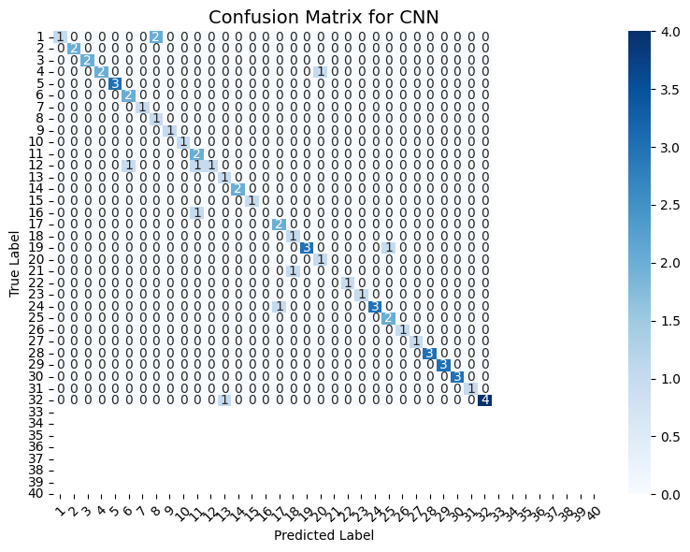
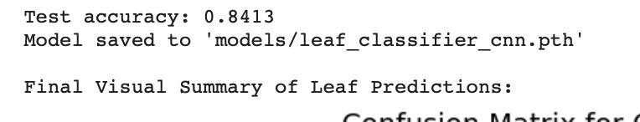
Test Evaluation & Confusion Matrix (CNN)
This slide presents the final evaluation of our CNN model using the test dataset. The model achieved a test
accuracy of 84.13%, which confirms strong
generalization to completely unseen leaf
images.
Notes:
Where the model is correctly predicting species (along the diagonal).
Where it confuses similar-looking species (off-diagonal cells).

Slide 7
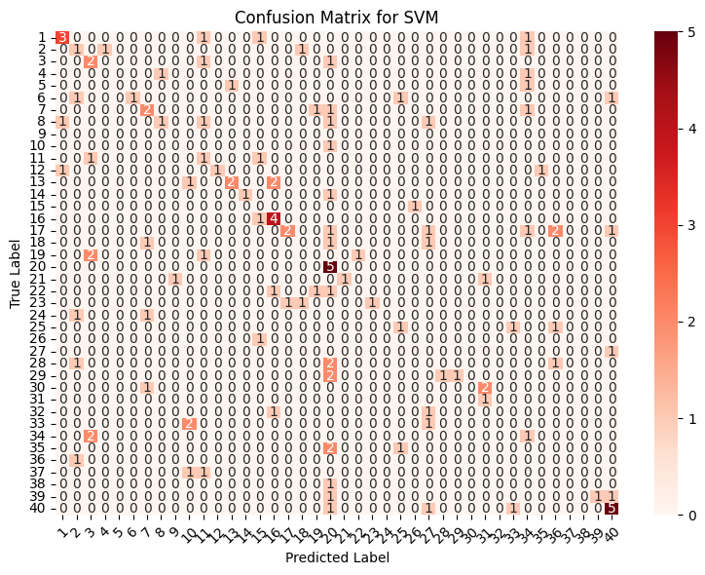
Confusion Matrix – SVM Performance
Model: Support Vector Machine (SVM) using
SGDClassifier with linear kernel.
Purpose: This confusion matrix shows how
well the SVM model classified the leaf
species.
Interpretation:
Each row represents actual labels.
Each column represents predicted labels.
Diagonal cells show correct predictions.
Off-diagonal cells indicate misclassifications.
Notes:
This slide illustrates the classification performance of the SVM model.”
“The diagonal elements in red indicate the number of correctly predicted leaf species.”
“We observe that while the model performs decently, there are a A lot misclassifications shown by the off-diagonal elements.”
If they ask Why We Used SGDClassifier (Stochastic Gradient Descent) for SVM:
We chose SGDClassifier as our SVM implementation because it is optimized for high-dimensional data like images. It's faster, more scalable, and provides flexibility in loss functions and regularization. This made it ideal for our real-time leaf classification project where training speed and resource usage matter.”
Scalability for Large Datasets
SGDClassifier is highly efficient for large-scale datasets like images because it updates the model incrementally, one sample at a time.
Traditional SVM (sklearn.svm.SVC) becomes computationally expensive with large datasets.
Speed & Memory Efficiency
Unlike kernel-based SVMs, SGDClassifier does not need to compute or store the full kernel matrix.
It’s faster and less memory-intensive, which is ideal for image classification tasks.
Flexibility
You can switch between different objectives easily (hinge loss for SVM, log loss for logistic regression).
In our case, we used loss='hinge', which replicates the behavior of a linear SVM.
Real-time / Online Learning
It supports online learning, meaning it can be retrained with new data batches—useful in real-world applications like plant monitoring.
Regularization Control: SGDClassifier offers fine-grained control over L1/L2 regularization, helping to avoid overfitting.

Slide 8
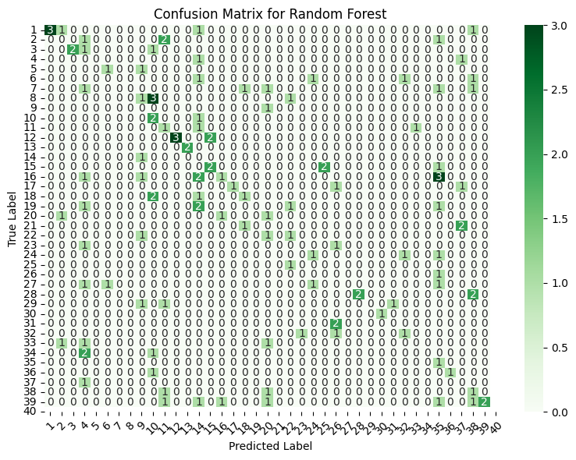
Confusion Matrix – Random Forest
This confusion matrix displays the
performance of the Random Forest model
on the test dataset.
Each row represents the true class, while
each column shows the predicted class.
The diagonal cells show correctly classified
samples for each leaf species.
Off-diagonal cells indicate misclassifications,
revealing which classes the model confuses.
Notes:
This is the confusion matrix for our Random Forest model. As you can see, the majority of predictions lie on the diagonal, which indicates strong performance and accurate predictions for most classes. As well more misclassifications exist, but overall, Random Forest handles class separation effectively."

Slide 9
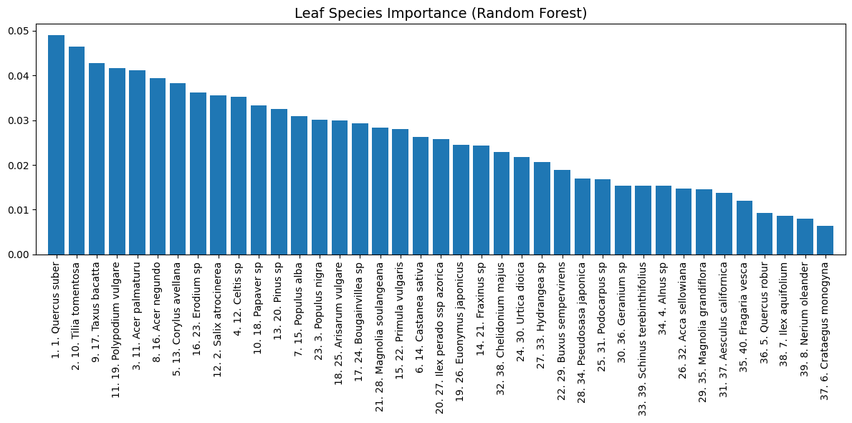
Leaf Species Importance – Random Forest
To highlight which leaf species are most influential in the Random Forest model’s classification process.
To interpret the model: Which species had the most impact based on their learned features after LDA transformation.
Notes:
This plot represents the relative importance of different leaf species as determined by the Random Forest model. The model assigns higher importance to species that have more distinctive and recognizable features after dimensionality reduction using LDA. These species played a key role in helping the Random Forest classifier make accurate predictions. This type of interpretability is useful for understanding which leaves are easier to classify and which might need better feature engineering or more data.”
How LDA Works:
Finds linear combinations of features (like shape, color, etc.)
Projects the data into a new space where:
Similar species are grouped together
Different species are pushed farther apart
This helps classification models (like Random Forest or SVM) perform better with simplified and more meaningful data.
If they ask why not in CNN &SVM

Slide 10
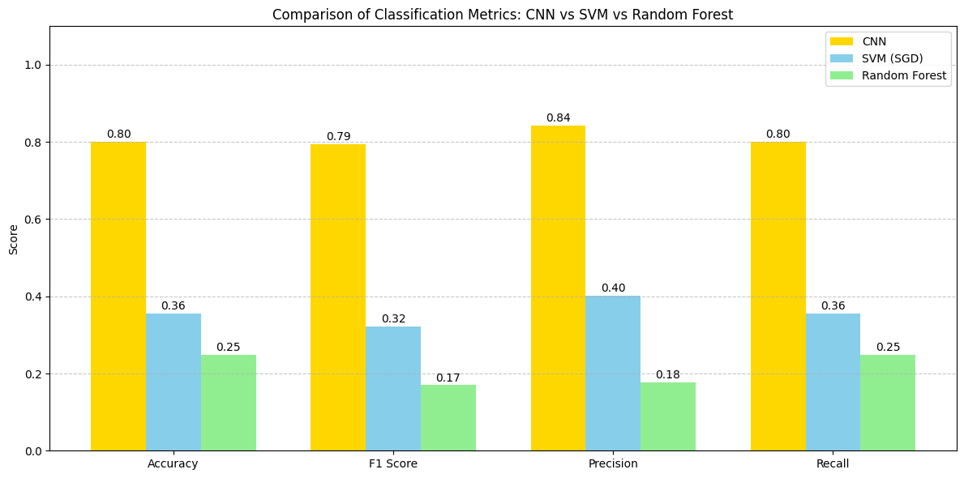
Model Comparison: Confusion Matrices
Notes:
Model | Confusion Matrix Observation | Accuracy | Best Use Case
CNN | Most predictions lie on the diagonal. ✅ Highest (based on your metrics output) | | Complex feature learning
Some scattered misclassifications, but overall From raw images
very accurate.
Performs well across all classes. |
SVM (SGD) | More scattered predictions.
Struggles with some classes. | ❌ Lowest | Good for baseline linear classification
Few classes have consistent misclassification.
Random Forest | Most values concentrated on diagonal.
Slightly more off-diagonal values than CNN. | ⚠️ Moderate | Useful when features (color, shape)
Performs better than RF, but slightly behind CNN. are extracted

Slide 11
Conclusion
Among all models, CNN achieved the highest accuracy and overall performance, making it the best choice for leaf species classification, while SVM helped in understanding feature importance.

