Slide 1
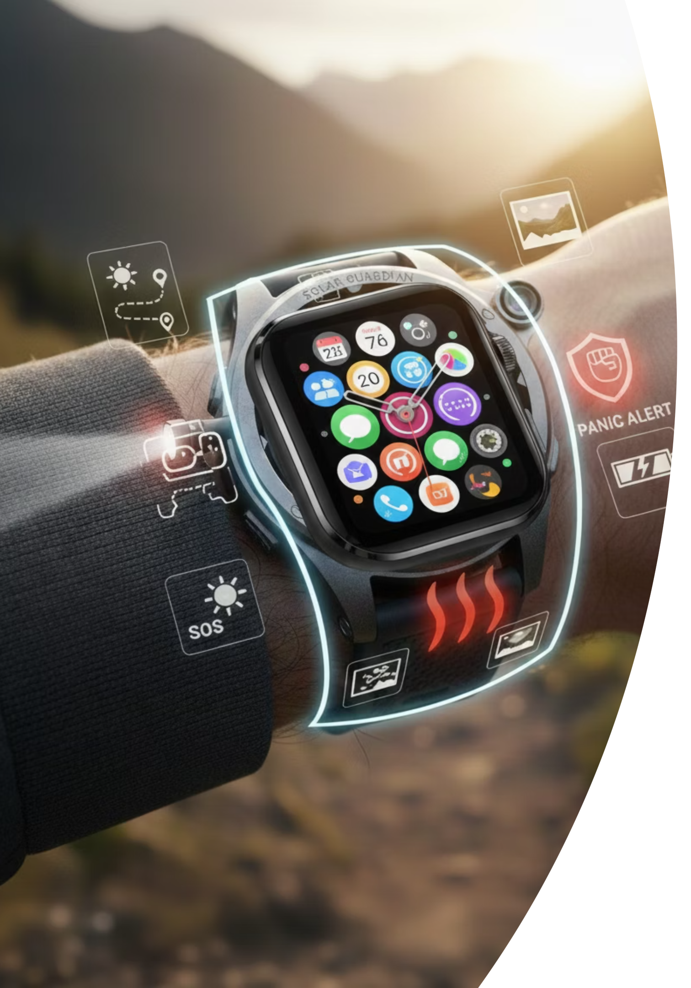

Guardian Band
An advanced safety and health smartwatch designed to protect and empower women, children, and senior citizens through intelligent monitoring and real-time emergency response.

Slide 2

Overview
Redefining Personal Safety & Health Monitoring
Comprehensive Protection
Medical-Grade Tracking
Combines personal safety features with continuous health monitoring for complete peace of mind.
Monitors blood pressure, heart rate, oxygen levels, and other vital health parameters in real-time.
Self-Sustaining Power
Privacy-First Design
Harvests energy from body heat and pulse, supplemented by solar charging for extended battery life.
End-to-end encryption ensures your data remains secure and under your control at all times.

Slide 3

Our Vision & Mission
Vision
Mission Objectives
To build a self-sustaining smart wearable that seamlessly integrates safety and health technology, providing real-time protection for vulnerable populations through intelligent monitoring and instant emergency response.
Reduce emergency response time by 70% through instant alerts
Enable continuous medical-grade health tracking
Achieve 85% energy independence through harvesting
Ensure intuitive usage for ages 8 to 85+
Provide robust data privacy and user control

Slide 4
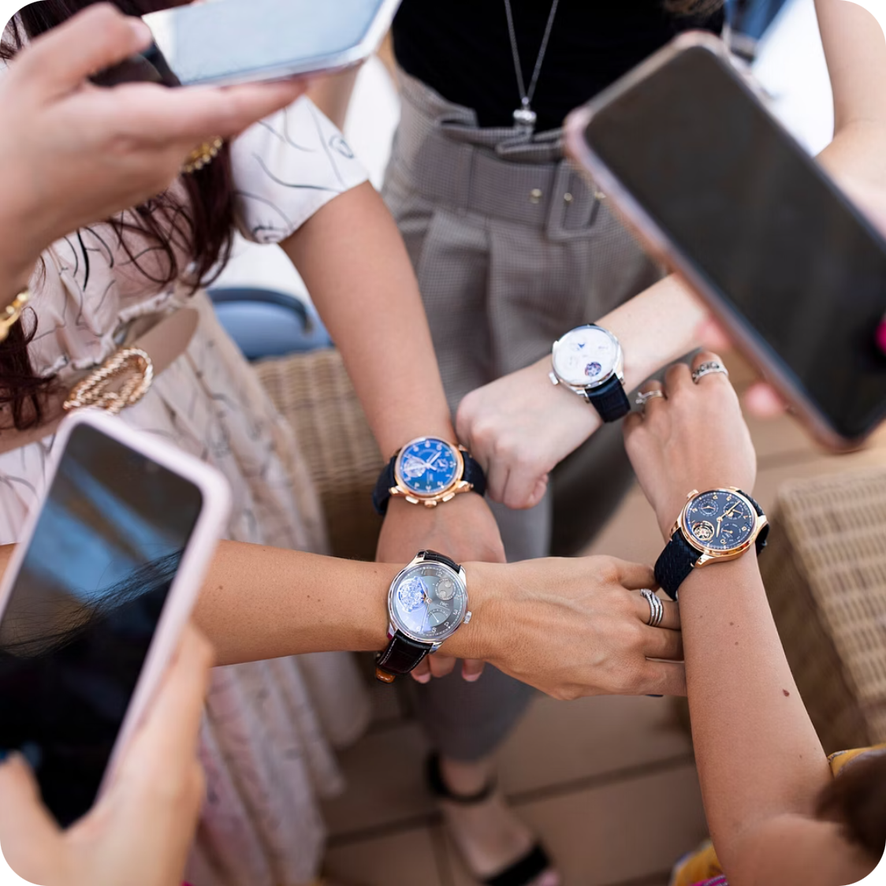
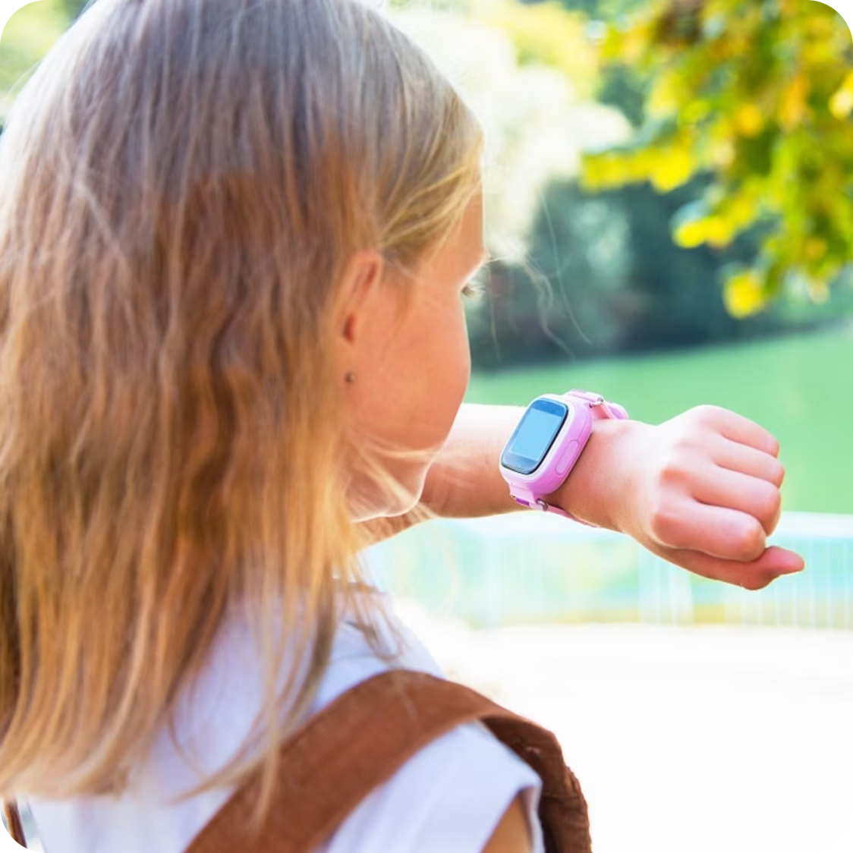
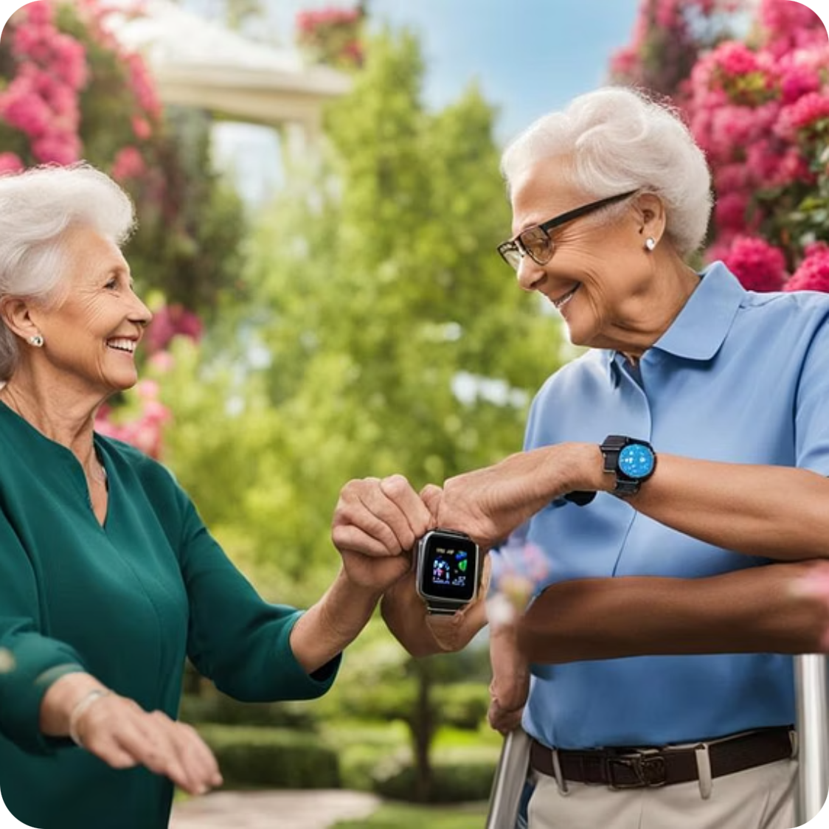
Who Benefits from Guardian Band
Women
Children
Senior Citizens
Personal safety protection, emergency SOS alerts, and discreet panic features for everyday security and peace of mind.
Parental tracking, geofencing alerts, and instant emergency contact for school safety and outdoor activities.
Fall detection, health monitoring, and automatic emergency alerts for independent living with family support.
Secondary users include family members, caregivers, healthcare providers for remote monitoring, and institutions such as schools and senior care facilities.

Slide 5
Advanced Safety Features
1
2
Intelligent Fall Detection
SOS Emergency System
6-axis motion sensors powered by AI distinguish real falls from normal movements. Auto alert system activates with a 30-second cancel option to prevent false alarms.
Dedicated physical SOS button with triple-press and voice activation. Silent alert mode ensures discreet emergency calls in dangerous situations.
3
4
Gesture-Based Panic Alert
GPS Location Tracking
Activate emergency response through simple wrist gestures. Instantly sends alerts to trusted contacts and connects to emergency services automatically.
Dual-band GPS with global satellite support and indoor tracking using WiFi and Bluetooth. Live location sharing during emergencies with geofencing capabilities.

Slide 6

Context-Aware Emergency Response
Intelligent Photo Capture
A discreet 5MP wide-angle camera automatically captures contextual photos during SOS activation, providing crucial visual information to emergency responders and trusted contacts.
Auto photo capture during emergency alerts
End-to-end encrypted image sharing
LED privacy indicator for transparency
Manual disable option for complete control
Location history tracking and geofencing ensure caregivers can monitor movement patterns and receive alerts when users enter or leave designated safe zones.

Slide 7





Comprehensive Health Monitoring
Heart Monitoring
Blood Pressure
Real-time heart rate and heart rate variability analysis for cardiovascular health insights.
Continuous BP tracking using optical sensors with calibration-free, medical-grade accuracy and alerts for abnormal trends.
Blood Oxygen
SpO2 monitoring tracks oxygen saturation levels for respiratory health assessment.
Sleep & Stress
Detailed sleep quality analysis and stress level monitoring for holistic wellness tracking.
Body Temperature
Continuous body temperature sensing helps detect fever and health anomalies early.

Slide 8

Revolutionary Power System
Body Heat Harvesting
Kinetic Energy Capture
Thermoelectric generators convert your body's natural warmth into electrical energy for continuous operation.
Harvests energy from wrist pulse and natural arm movements throughout your daily activities.
Solar Charging Layer
Transparent solar cells provide supplementary power from ambient and direct sunlight exposure.
Smart Power Management
Up to 7 Days
350mAh lithium-polymer battery
Battery life with typical usage patterns and energy harvesting enabled.
Ultra-low power processor optimisation
Intelligent power allocation system

Slide 9





Seamless Connectivity Architecture
Cellular Network
Bluetooth 5.2
4G LTE Cat-M1 and NB-IoT support ensures reliable emergency communication anywhere.
Seamless pairing with mobile devices for data sync and enhanced functionality.
WiFi Connectivity
NFC Integration
Fast data synchronisation and indoor location tracking capabilities.
Emergency medical information sharing with first responders instantly.
Software Foundation: Built on FreeRTOS for stable real-time performance with an integrated AI engine for safety and health analysis. Complete ecosystem includes mobile apps for users and families, plus web dashboards for caregivers and institutions.

Slide 10


Guardian Band: Protection Powered by Innovation
70%
85%
7
24/7
Faster Response
Energy Independent
Days Battery Life
Health Monitoring
Emergency response time reduction
Power from harvesting technology
Extended operation time
Continuous vital signs tracking
Guardian Band represents the future of personal safety and health monitoring—combining cutting-edge technology with intuitive design to protect and empower vulnerable populations. With medical-grade health tracking, intelligent emergency response, and sustainable energy harvesting, Guardian Band delivers comprehensive protection in a discreet, user-friendly wearable.

