Slide 1
JAVA APPLICATION PROJECT
ATM Transaction
Management System
Using Java
An educational ATM simulation for balances, deposits, withdrawals, PIN verification, and transaction records.
GROUP 11
Team Members:
2620080037- Datla Harshith Varma
2620030138- Vemulapally Bhargav Krishna
2620040017- Prathigadapa Aditya

Slide 2
ABSTRACT/OVERVIEW
The ATM Transaction Management System using Java is a simple software application designed to perform basic banking operations. It allows users to check their account balance, deposit money, withdraw money, and view transaction history. The system uses PIN verification to provide basic security and helps manage transactions accurately.
This project demonstrates various Java programming concepts, including primitive and non-primitive data types, loops, conditional statements, arrays, and methods. It also includes advanced concepts such as recursion, method overloading, method overriding, constructors, inheritance, and exception handling. String handling is performed using String, StringBuilder, and String Buffer. File handling helps store transaction records, while collections, lambda expressions, and streams help manage transaction data.
The main objective of this project is to understand how Java concepts are used in a real-world application. It provides practical programming experience and can be improved in the future by adding database connectivity, a graphical user interface, and enhanced security features.
2

Slide 3
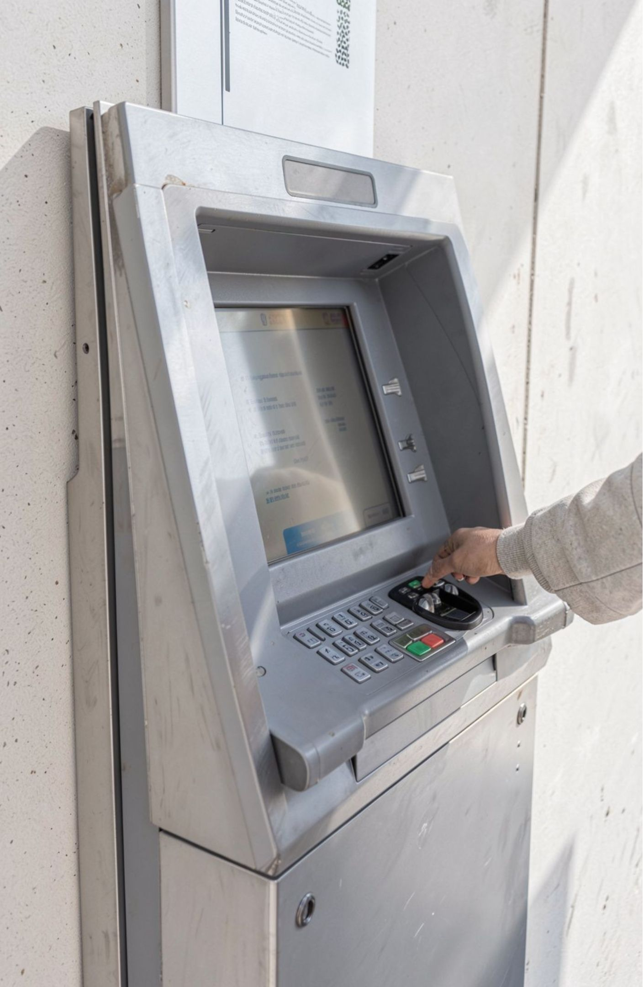
PROBLEM STATEMENT
Managing ATM transactions manually can lead to errors, take more time, and make transaction records difficult to maintain. Therefore, a simple and efficient ATM Transaction Management System is needed to perform banking operations such as PIN verification, balance checking, deposits, withdrawals, and transaction history using Java programming.
Solution
The Java-based ATM system allows users to securely verify their PIN, check balances, deposit money, and withdraw money. It maintains transaction history, validates user inputs, and uses Java programming concepts to manage transactions accurately and efficiently.
History: Maintain transaction history so users can review previous activity.
ATM flow: PIN verification → menu → transaction validation → updated balance/history.
3

Slide 4
03 · DATA MODEL
Data types give every ATM value the right shape
Type | Example | ATM use
int | 3 | PIN attempts or counts
byte | 2 | Menu option
double | 250.75 | Balance and amounts
boolean | true | Login status
char | 'A' | A single character
long · float · short | Numeric values | Larger, decimal, or smaller numeric values
String | "Welcome" | Names and messages
array · class · object | double[] | Transaction records, accounts, and ATM operations
4

Slide 5
04 · CONTROL FLOW
Loops and conditions keep the menu under control
for: process transaction records.
while: repeat actions while a condition remains true.
do-while: show the ATM menu until the user exits.
if / if-else / else-if: verify the PIN, check sufficient balance, and select menu options.
Nested if: validate multiple conditions before completing a transaction.
ATM menu → condition remains true → repeat actions
PIN verification
Withdrawal validation
if (enteredPin == pin) {
loggedIn = true;
}
if (amount > 0 && amount <= balance) {
balance -= amount;
}
5

Slide 6
JAVA ARRAYS IN THE ATM
Arrays Used In ATM Transactions
Index | Transaction amount | Meaning
0 | 120.50 | First deposit
1 | 45.00 | Cash withdrawal
2 | 300.75 | Second deposit
double[] transactions = {120.50, 45.00, 300.75};
int count = transactions.length;
System.out.println("Transaction history:");
for (int i = 0; i < count; i++) {
System.out.println("Index " + i + ": $" + transactions[i]);
}
Count = transactions.length = 3
Each index stores one amount, so a loop can show the full history in order.
6
Notes:
An array holds a fixed number of values of one type. Here each index is one ATM transaction. The for loop runs from 0 to length minus one and prints each amount.

Slide 7
Methods used in Atm Transaction
In an ATM system, methods perform operations such as checking balance, depositing money, and withdrawing money. They improve code reusability, readability, and organization.
void checkBalance() {
System.out.println("Balance: Rs. 5000");
}
void deposit(double amount) {
if (amount > 0) {
balance += amount;
System.out.println("Deposit successful");
}
}
7

Slide 8
06 · OBJECT-ORIENTED FEATURES
Object-oriented features make the ATM easier to extend
Constructors, inheritance, and overriding
Overloading
Initialize BankAccount, SavingsAccount, and CurrentAccount. Account subclasses customize displayAccountType().
deposit(double amount) and deposit(double amount, String description).
Exceptions
Recursion
Use try-catch for invalid input and transaction errors, including InputMismatchException.
Demonstrate a limited retry example; loops are better for the ATM menu.
8

Slide 9
How Object-Oriented Programming Powers the ATM
BankAccount account = new BankAccount();
account.balance = 5000;
System.out.println(account.balance);
Object-oriented programming (OOP) models each part of the ATM as an object that holds its own data and actions.
BANK ACCOUNT
▼ extended by
Encapsulation: the balance and PIN are private; only deposit() and withdraw() change them.
Inheritance: Savings Account and CurrentAccount reuse the code in BankAccount.
Polymorphism: each account type gives its own monthly fee rule.
Abstraction: the ATM calls simple actions without knowing the internal details.
SAVINGS ACCOUNT
9
Notes:
OOP keeps the ATM easy to extend: new account types inherit BankAccount and only override what differs.

Slide 10
Strings
A String stores text such as the account holder's name, account number stored as text, or a transaction message. A String is immutable, meaning its content cannot be changed after creation.
String name = "Mythri";
String message = "Welcome to ATM";
System.out.println(message);
Types are
String Builder
String Buffer
10

Slide 11
String Builder
String Buffer
StringBuilder is used to build or modify text efficiently. It is useful when an ATM needs to add multiple transaction details to a history message. It is not thread-safe.
Syntax:
StringBuffer is similar to StringBuilder, but its methods are synchronized, making it suitable when multiple threads share and modify the same buffer
Syntax:
StringBuilder history = new StringBuilder();
history.append("Deposit: Rs. 500\n");
history.append("Withdrawal: Rs. 200\n");
System.out.println(history);
StringBuffer history = new StringBuffer();
history.append("Deposit: Rs. 1000\n");
history.append("Balance: Rs. 5000\n");
System.out.println(history);
11

Slide 12
Collections, Lambda, and Streams in the ATM
1. ArrayList stores transaction records
2. A lambda processes each record
3. Streams filter and total deposits
An ArrayList keeps the ATM's transactions in order.
A lambda is a short inline function. Here it prints each transaction.
This stream keeps deposits above 100 and adds them up.
List<Double> deposits = new ArrayList<>();
deposits.add(500.0);
deposits.add(120.0);
deposits.add(60.0);
deposits.forEach(amount ->
System.out.println("Deposit: " + amount));
double total = deposits.stream()
.filter(amount -> amount > 100)
.mapToDouble(Double::doubleValue)
.sum();
12

Slide 13
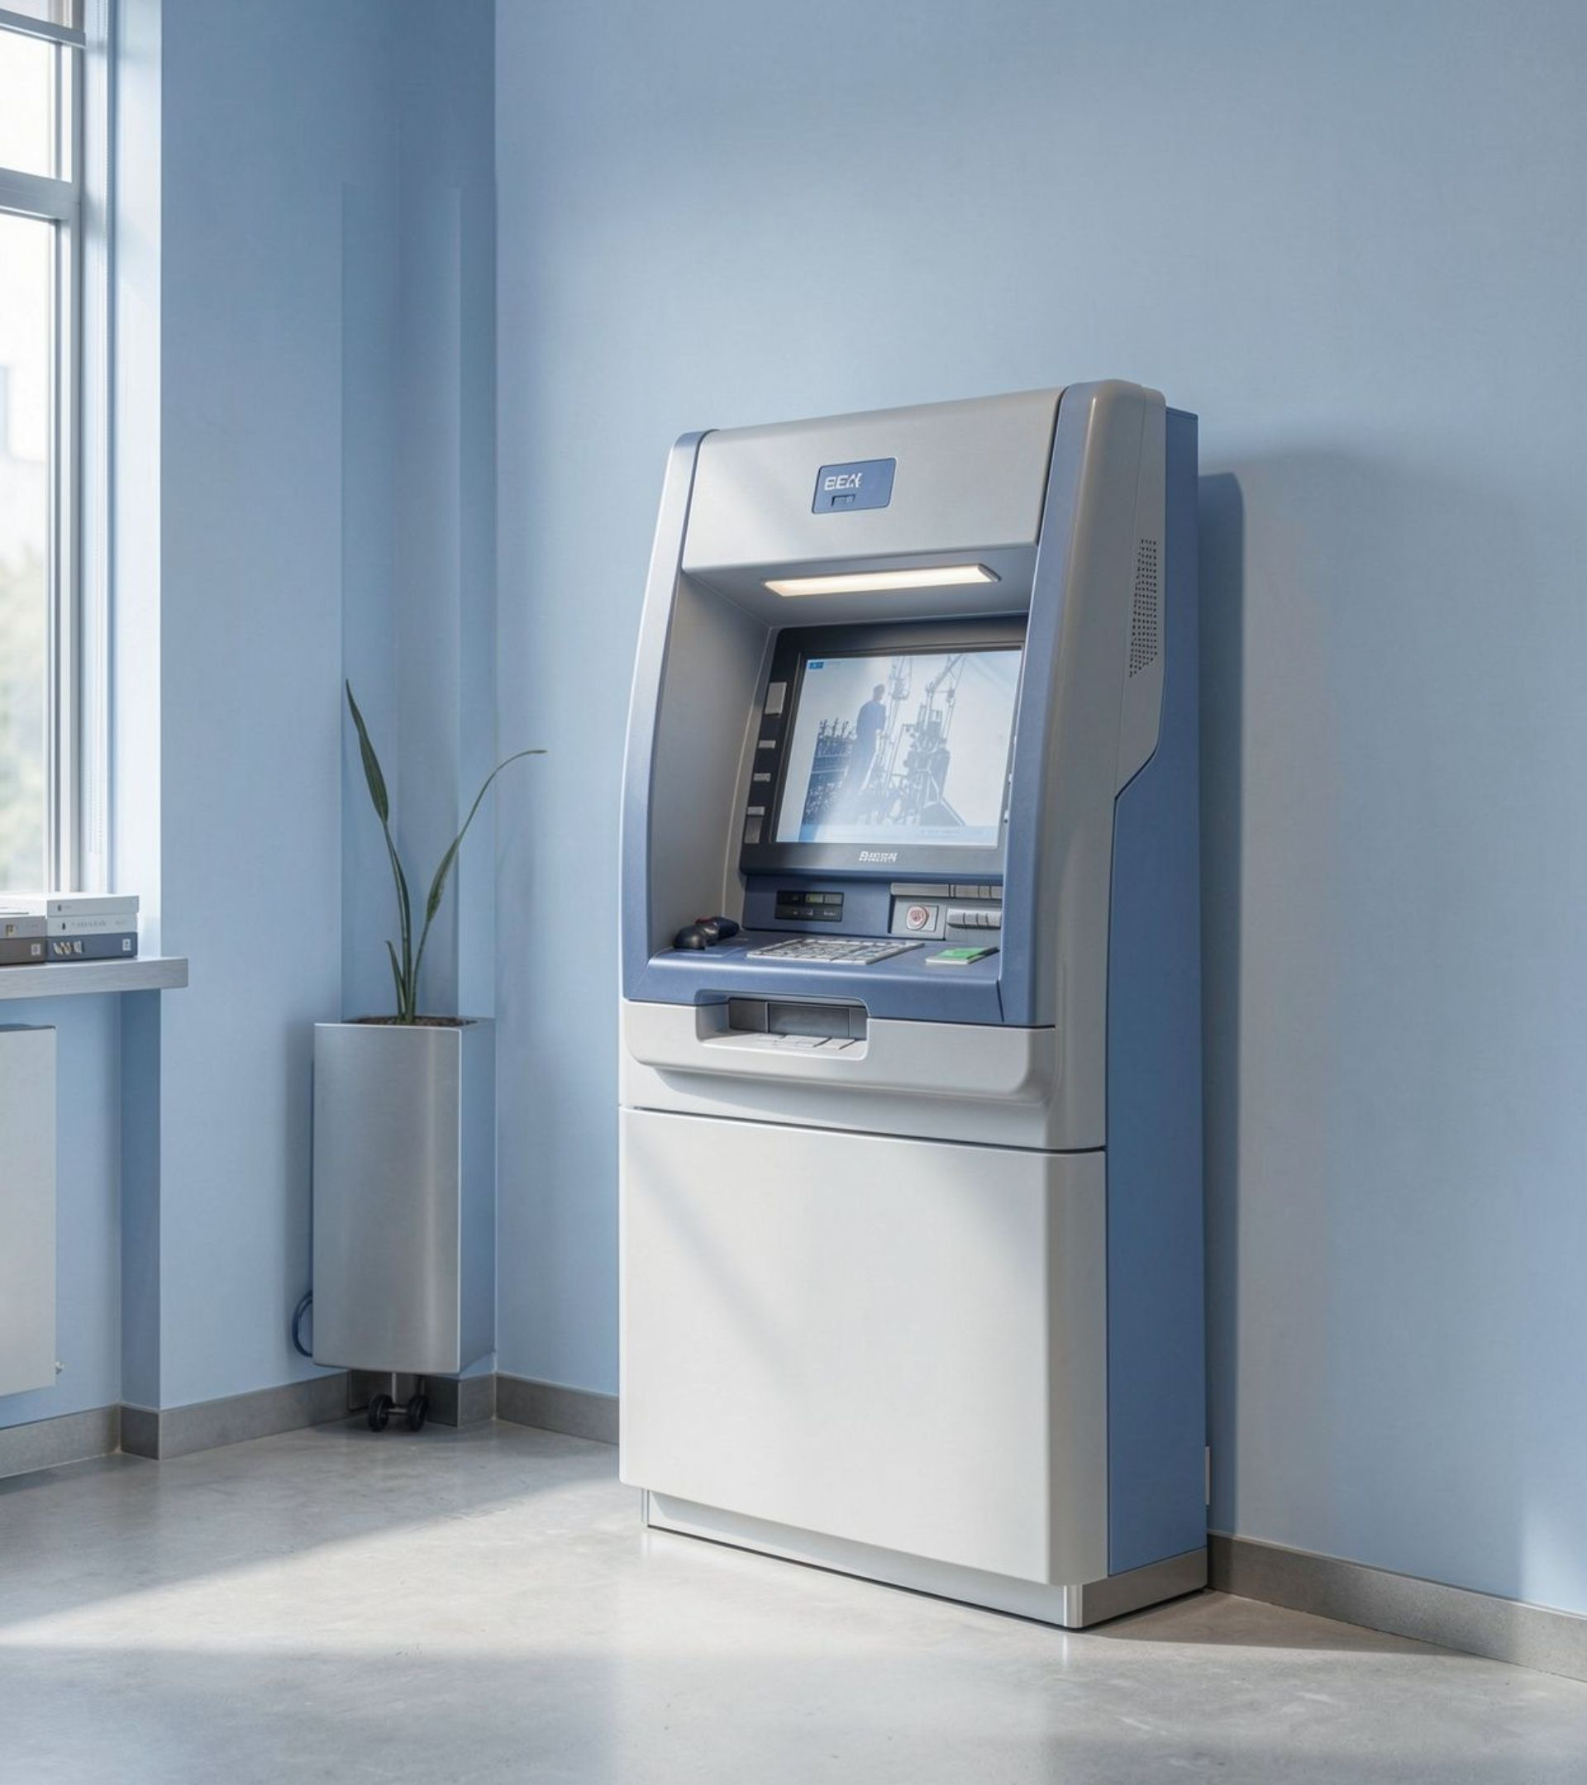
Conclusion
The Java ATM system shows how methods, arrays, object-oriented design, exceptions, collections, and file handling organize secure transaction workflows.
It gives practical Java experience and a solid base to grow with a database, a GUI, and stronger authentication.
14

Slide 14
GIT HUB LINK
https://github.com/Bhargavkrishna-003/JAVA-
13

Slide 15
Thank you
Validate
Organize
Manage
Input and account behavior.
Arrays, methods, inheritance, and exceptions.
Collections and file handling.
From Group 6

