Slide 1
PaperReady | Designed by Bhargav
Can You Indian Premier League
Can You Indian Premier League | May 07, 2026

Slide 2

Introduction to the Indian Premier League
1 / 3
▸ Established in 2008, IPL revolutionized Twenty20 cricket
▸ Comprises 8 teams representing 6 Indian cities and 2 international teams
▸ Annual tournament held during March/April, lasting 4 months
▸ IPL's format: 20 overs per side, 4 innings, and a playoff system
▸ IPL's impact: Boosted cricket's popularity in India and globally
▸ Key statistics: Over 3 billion IPL viewers worldwide
PaperReady | Designed by Bhargav | Phi-3 Mini (Microsoft)

Slide 3
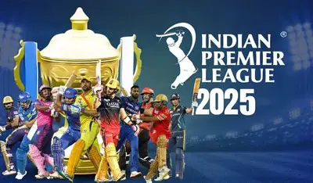
IPL's Structure and Competition Format
2 / 3
▸ Round-robin stage: 6 teams play each other twice, 10 matches per team
▸ Top 4 teams advance to the playoffs
▸ Playoff structure: Semi-finals, Final, and Third/Fifth place playoffs
▸ Prize money: IPL champions receive $21 million, runner-up $14 million, etc.
▸ IPL's unique features: Auction system, franchise model, and IPL Super Sunday
PaperReady | Designed by Bhargav | Phi-3 Mini (Microsoft)

Slide 4
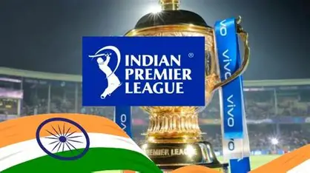
IPL's Impact on Indian Cricket and Beyond
3 / 3
▸ IPL's contribution: Increased domestic cricket participation, improved infrastructure
▸ IPL's global influence: Boosted international cricket tours and collaborations
▸ Notable IPL achievements: Highest ever IPL match attendance, record-breaking IPL auction
▸ IPL's role in popularizing Indian cricket players: Virat Kohli, MS Dhoni, and others
▸ IPL's economic impact: Generated over $1 billion annually, creating jobs and revenue
PaperReady | Designed by Bhargav | Phi-3 Mini (Microsoft)

