Slide 1
PaperReady | Designed by Bhargav
Good Or The Topic Convoolutional Neural Networks
Good Or The Topic Convoolutional Neural Networks | April 27, 2026

Slide 2
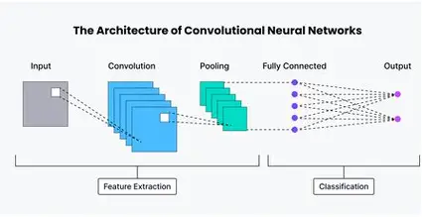
Introduction to Convolutional Neural Networks
1 / 3
▸ Definition: Convolutional Neural Networks (CNNs) are a class of deep neural networks, primarily used for image processing and computer vision tasks.
▸ History: CNNs were inspired by the organization of the animal visual cortex and have evolved significantly since their inception in the 1980s.
▸ Key Components:
▸ Convolutional Layers: Apply filters to the input data to create feature maps.
▸ Pooling Layers: Reduce the spatial dimensions of the feature maps.
▸ Fully Connected Layers: Classify the image based on the learned features.
▸ Advantages:
▸ Efficiency: CNNs require fewer parameters than fully-connected networks, making them computationally efficient.
▸ Feature Learning: Automatically learn hierarchical feature representations, reducing the need for manual feature engineering.
PaperReady | Designed by Bhargav | Phi-3 Mini (Microsoft)

Slide 3
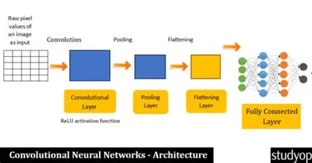
CNN Architecture and Working
2 / 3
▸ Input Layer: The initial layer where the raw pixel data is fed into the network.
▸ Convolutional Layer: Applies filters to the input data, creating feature maps.
▸ Formula: Output = Activation(Convolution(Input) * Weights) + Bias
▸ Pooling Layer: Reduces the spatial dimensions of the feature maps, typically using max pooling.
▸ Fully Connected Layer: Uses the learned features to classify the image.
▸ Backpropagation: The process of adjusting the network's weights based on the error between predicted and actual outputs.
▸ Training: CNNs are trained using labeled datasets, optimizing the weights through gradient descent.
PaperReady | Designed by Bhargav | Phi-3 Mini (Microsoft)

Slide 4
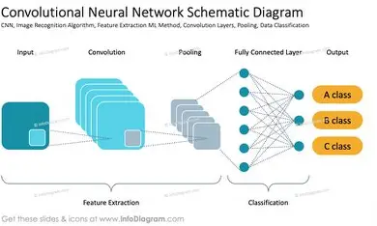
Uses of Convolutional Neural Networks
3 / 3
▸ Image Classification: CNNs are widely used for classifying images into predefined categories.
▸ Object Detection: CNNs can detect and localize multiple objects within an image.
▸ Image Segmentation: CNNs can segment images into different regions, useful for medical imaging and autonomous vehicles.
▸ Natural Language Processing (NLP): CNNs can be applied to NLP tasks, such as sentiment analysis and text classification.
▸ Medical Imaging: CNNs are used for analyzing medical images, aiding in disease diagnosis and prognosis.
▸ Autonomous Vehicles: CNNs play a crucial role in enabling self-driving cars, helping them perceive and understand their surrrances.
PaperReady | Designed by Bhargav | Phi-3 Mini (Microsoft)

