Slide 1
Employee Management System
-a ppt by bhargav

Slide 2
Table of Contents
1. Introduction
2. System Requirements
3. System Architecture
4. Features
5. Technical Specifications
6. Database Design
7. User Interface
8. Installation and Setup
9. Future Enhancements
10. Execution Screenshots
11. Conclusion

Slide 3
Introduction
- Overview of the Employee Management System (EMS)
- Main functionalities: adding, viewing, updating, and deleting employee records
- User authentication

Slide 4
System Requirements
Hardware Requirements:
- Standard PC or laptop
Software Requirements:
- Java Development Kit (JDK) 8 or higher
- Eclipse IDE
- MySQL Database
- JDBC Driver for MySQL

Slide 5
System Architecture
Overview:
- Desktop application architecture with Swing for the user interface and JDBC for database connectivity
Components:
- Frontend: Java Swing
- Backend: JDBC for database interaction
- Database: MySQL
Data Flow:
- User interacts with the Swing frontend
- Requests processed by Java backend
- Backend communicates with MySQL database for CRUD operations
- Frontend updates UI based on backend responses

Slide 6
Features
Employee Management:
- Add, view, update, delete employee records
Authentication:
- Login with username and password

Slide 7
Technical Specifications
Frontend (Java Swing):
- Swing components for UI design
- Event-driven programming model
Backend (Java JDBC):
- JDBC API for database connectivity
- Prepared statements for SQL queries
Database (MySQL):
-Tables:
- users: username, password
- employees: id, name, email, position, department, salary, date_hired

Slide 8
Database Design
Tables:
Users:
- username (Primary Key)
- password
Employees:
- id (Primary Key)
- name
- email
- position
- department
- salary
- date_hired

Slide 9
User Interface
Screens:
- Login Frame: Fields for username and password, login button
- Main Dashboard: Buttons for adding, removing, viewing/updating employees, and generating reports
- Add Employee Frame: Fields for employee details and add button
- Remove Employee Frame: Field for employee ID and remove button
- Report Frame: Chart displaying employee count by department

Slide 10
Installation and Setup
Steps:
- Download and install Eclipse IDE
- Clone the Java project repository
- Import the project into Eclipse
- Set up MySQL database and import the schema
- Update database credentials in the Java code
- Compile and run the LoginFrame.java file in Eclipse

Slide 11
Future Enhancements
- Implement encrypted storage for passwords
- Add search functionality for employee records
- Enhance the UI with more detailed employee data views
- Integrate role-based access control

Slide 12
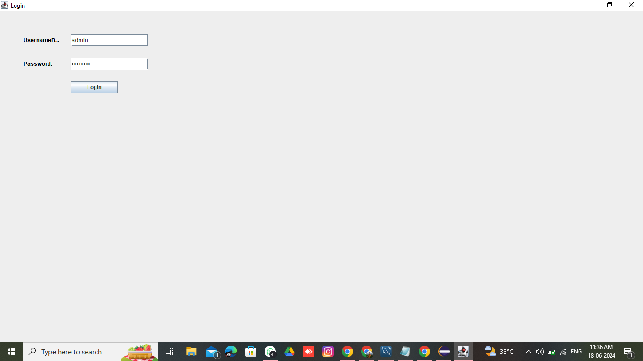
Execution Screenshots
- User Authentication

Slide 13
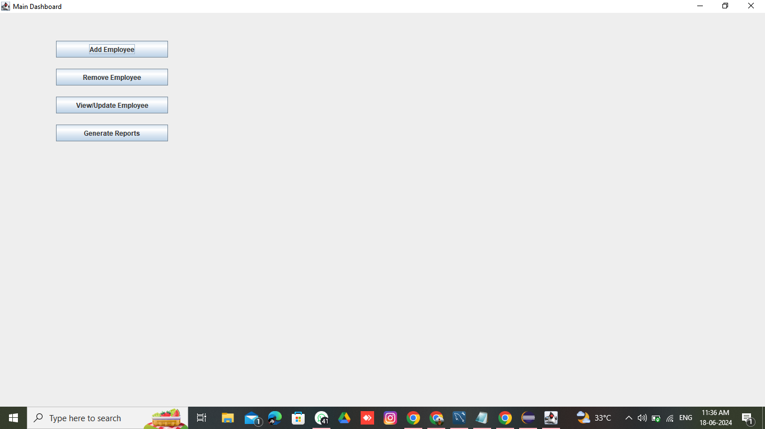
- Main Dashboard

Slide 14
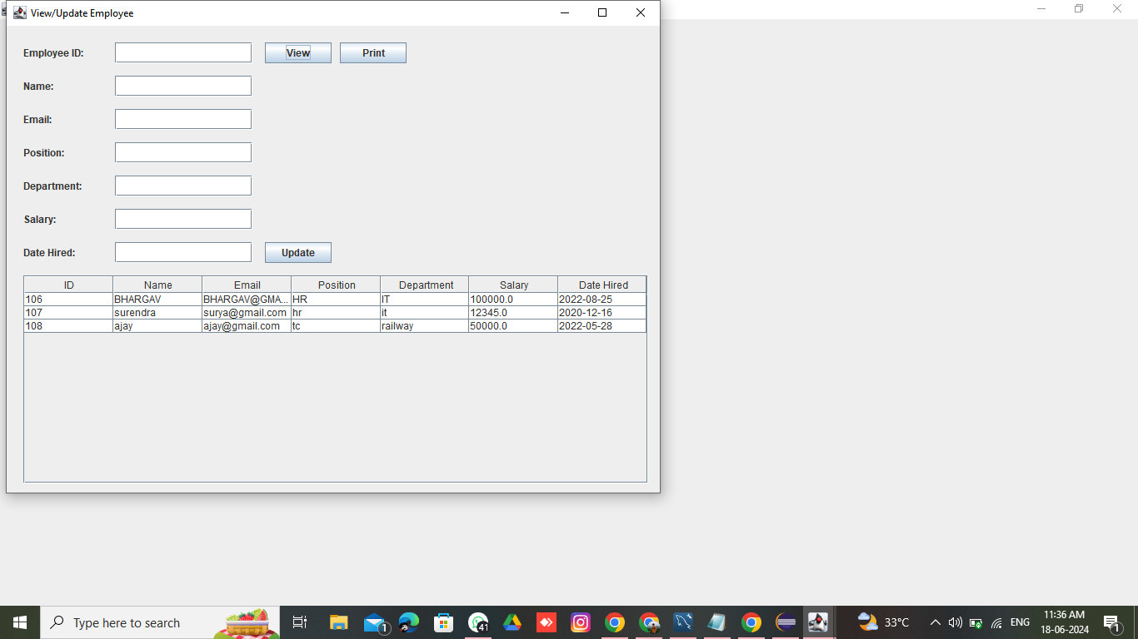
- Add Employee

Slide 15

- Update Employee

Slide 16
- View Employee

Slide 17
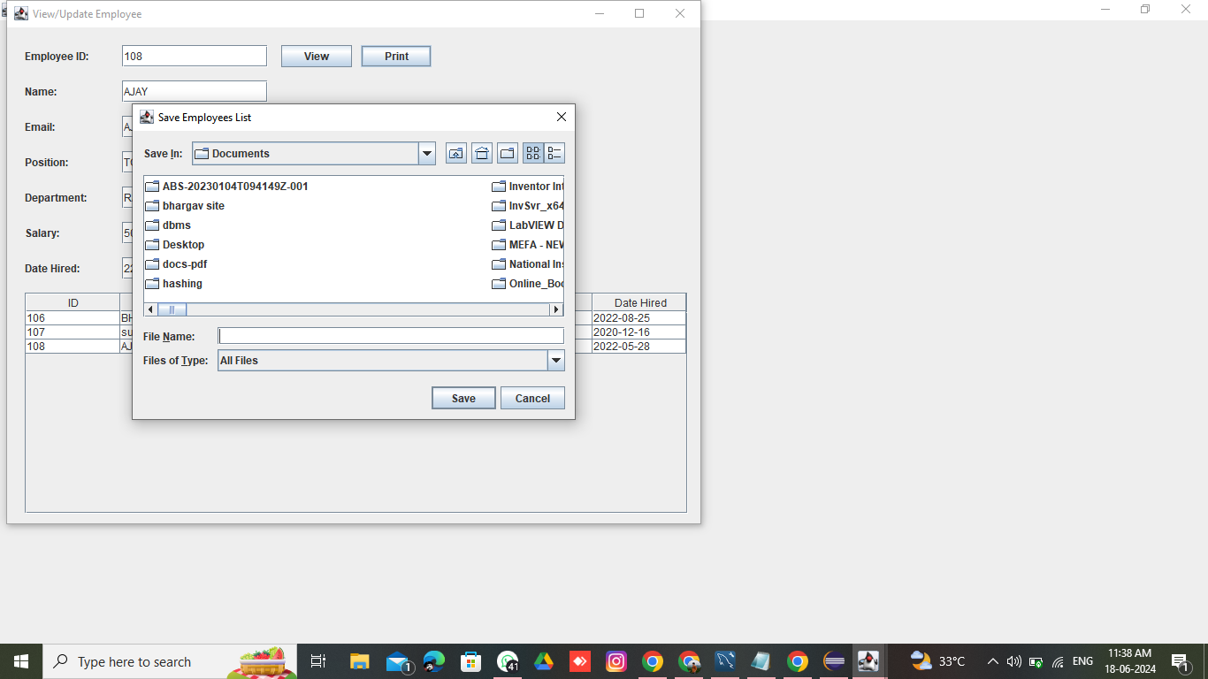
- Saving Files in Different Formats

Slide 18
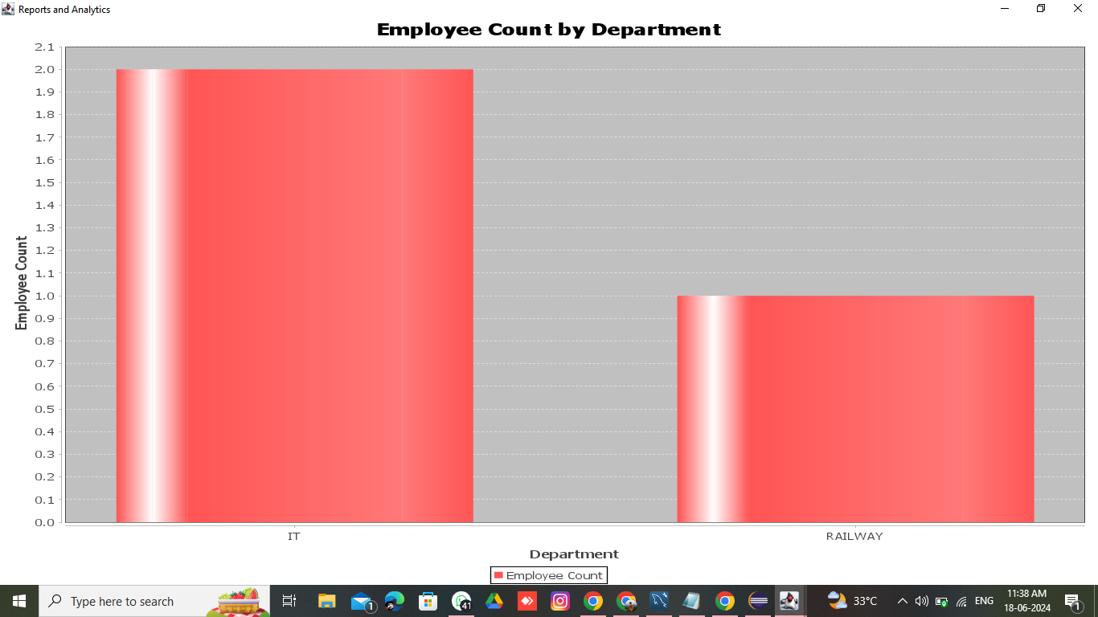
- Generate Report

Slide 19
Conclusion
- Overview of EMS functionalities and technical stack
- Summary of future enhancements

Slide 20
THANK YOU

