Slide 1



BTP-B22AB02
MEDICALBOT
DISEASE PREDICTOR AND PRECAUTION ADVISOR

Slide 2
FINAL REVIEW
DR.ANSUSHREE BABLANI
G.VIKRAM
S20190010055
G.BHARGAVRAM
S20190010060
G.SRAVANKUMAR
S20190010056

Slide 3
RECAP->
In the last review, we introduced the dataset that is taken from Kaggle website to implement the medical chatbot.
We completed building models for intent classification and disease prediction.
We used a few models to find the best model with the highest accuracy among them.

Slide 4
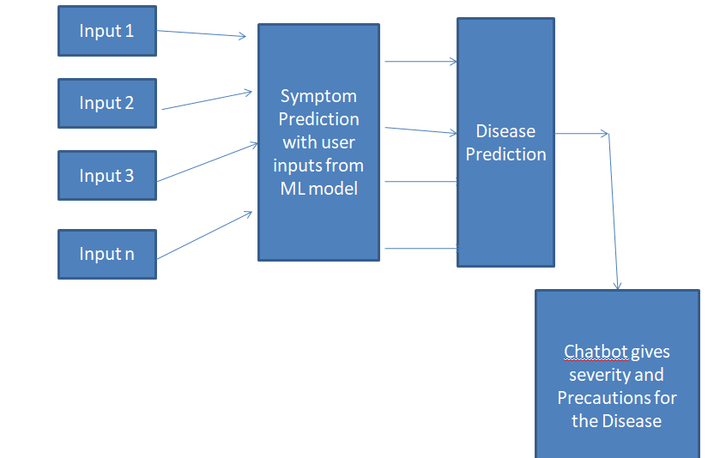
RECAP(CONTINUED)

Slide 5
WEB APP
We created a chatbot web app using React js for the front end.
We used the Flask web framework for the backend.
Based on the user Input, our Chatbot predicts the Symptoms and If true it gives the Disease and the necessary Precautions.
If the severity score of the disease is high, the Chatbot recommends meeting a real doctor.

Slide 6
Functionalities Of Web App
1
SYMPTOM PREDICTION:
The user needs to enter the symptoms one by one and the chatbot will predict these symptoms. The statements should be as accurate as possible for correct prediction.
2
DISEASE PREDICTION:
The user has to enter at least 3 symptoms for an accurate disease prediction. For irrelevant sentences, the chatbot will return that it doesn't understand. After entering 3 or more symptoms the disease is given.
3
PRECAUTIONS AND SEVERITY:
Disease precautions are displayed along with that the chatbot will advise the user to consider a real doctor If the severity is high.

Slide 7
BACKEND
We used flask APIs and created two routes, one for symptom prediction and the other for disease prediction.
We loaded both models into the pickle files for further use.
We preprocessed the input sentence using NLTK library.
We used the pickle files to use the models in flask.

Slide 8
FRONTEND WEBAPP
We used ReactJs for the front-end web application.
We use react states to implement a chatbot user interface.
We used axios library to implement HTTP methods.
When a user enters the symptoms request is sent to the symptom prediction API.
When a user is done with the symptoms request is sent to the disease prediction API.
.

Slide 9
DEMO

Slide 10
RESULTS:
INTENT CLASSIFICATION
TO MAINTAIN THE HIGHEST LEVELS OF QUALITY SERVICES SO THAT WE CAN PROVIDE THE BEST INTERNET SERVICES IN THE COUNTRY.
Models
SVM
Logistic Regression
Decision Tree
KNN
String Matching
Mission
Accuracy
0.79
0.78
0.76
0.69
0.68

Slide 11
RESULTS(CONTINUED):
DISEASE PREDICTION
Models
Logistic Regression
KNN
Decision Tree
SVM
Accuracy
0.94
0.88
0.71
0.71
Mission

Slide 12
REFERENCES
Nischal, C. N., Sachin, T., Vivek, B. K., & Taranath, K. G. (2020). Developing a chatbot using machine learning. International Journal of Research in Engineering, Science and Management, 3(8), 40-43.
Chen, M., Hao, Y., Hwang, K., Wang, L., & Wang, L. (2017). Disease prediction by machine learning over big data from healthcare communities. Ieee Access, 5, 8869-8879.
Hussain, H., Aswani, K., Gupta, M., & Thampi, G. T. (2020). Implementation of Disease Prediction Chatbot and Report Analyzer using the Concepts of NLP, Machine Learning and OCR.
Adamopoulou, E., & Moussiades, L. (2020, June). An overview of chatbot technology. In IFIP International Conference on Artificial Intelligence Applications and Innovations (pp. 373-383). Springer, Cham.

Slide 13
THANK YOU

