Slide 1
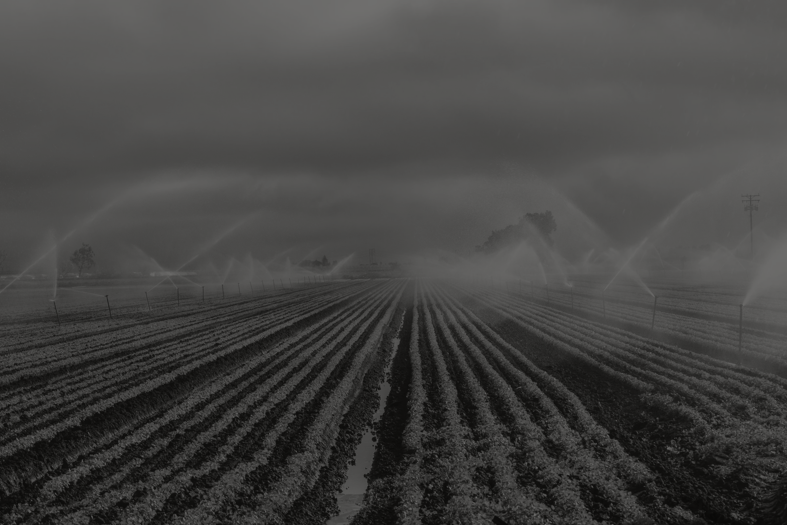
YEAR 1997 TO 2014
CROP PRODUCTION ANALYSIS
Presented by: Bharti Matami

Slide 2
Overview
About Data
This dataset contains information about crop production across various states and districts . Attributes include State_Name, District_Name, Crop_Year, Season, Crop, Area, and Production.
Total number of entries: [184674]
Number of states: [29]
Number of unique districts: [512]
Time year of the dataset: [1997] to [2015]

Slide 3
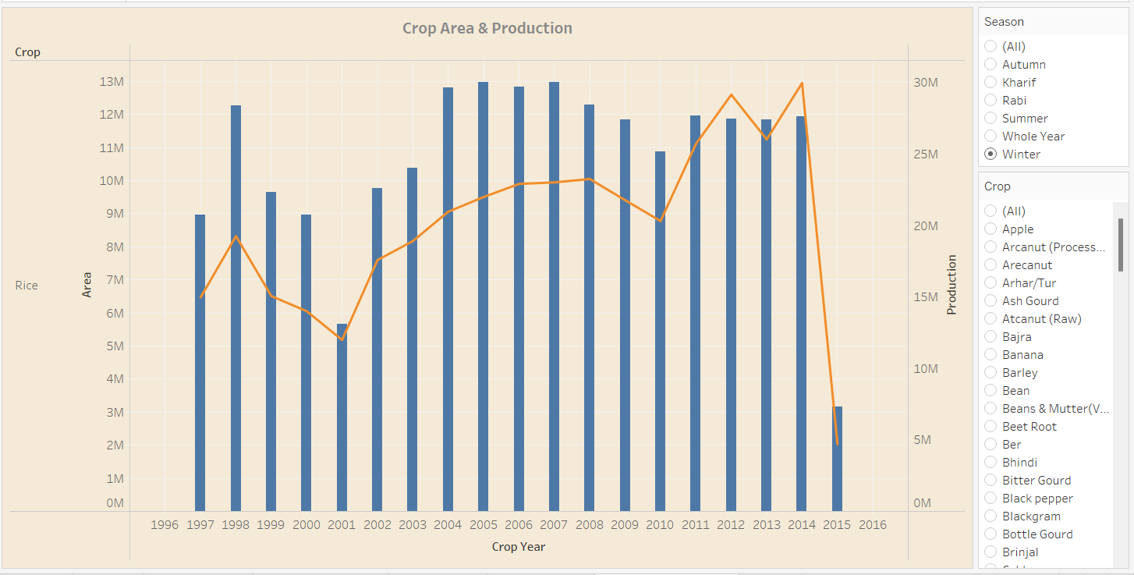
Year wise Production

Slide 4
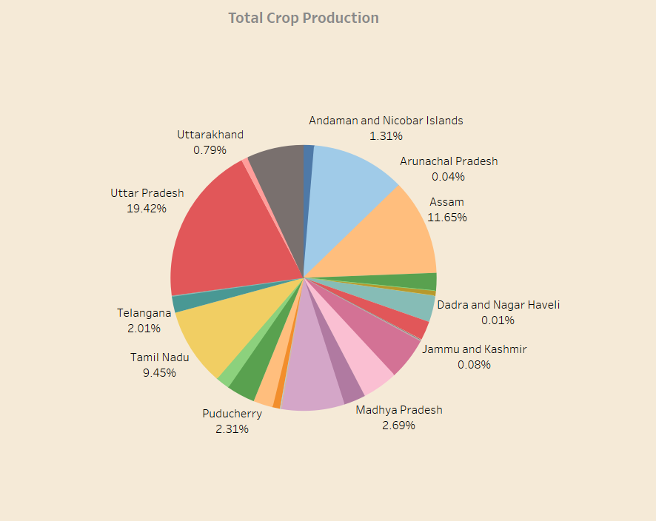
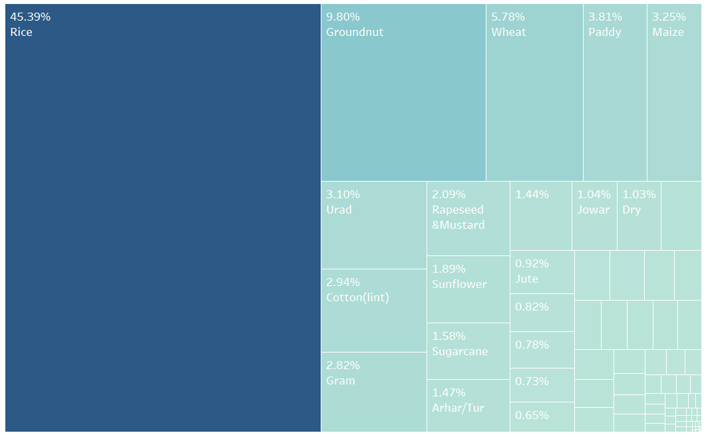
Total Crop Production and Area
Uttar Pradesh and Assam: Leading Agricultural Producers
Rice cultivation dominates the agricultural landscape

Slide 5
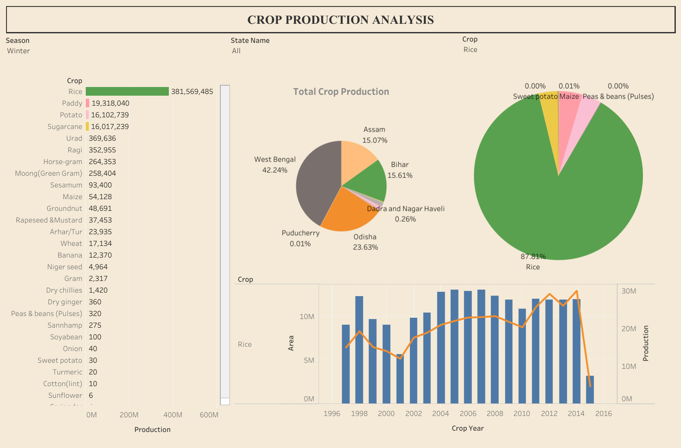
Crop Production Dashboard

Slide 6
Conclusion
Uttar and Assam: Leading Agricultural Producers
Rice cultivation dominates the agricultural landscape, covering 45.39% of the total area.
Noteworthy trend of heightened rice production during the Winter seasons 87.81 % of all rice production
Black Paper suddenly high production in 2014 .
Turmeric is single crop gives high production in small Area
Grapes suddenly down production in 2012, 2013, 2014

Slide 7
Thank You

