Slide 1
SECTION 1 — DASHBOARD PRESENTATION
POWER BI DASHBOARD REVIEW
Fraud Transaction Dashboard
PREPARED BY
ANKITA BHARTI
Student Code: AF0307596
Comprehensive analysis of $1Bn fraudulent loss exposure across 250K transactions, identifying core threat triggers.
01

Slide 2
STRUCTURE & AGENDA
Presentation Flow & Section Roadmap
15-Slide Overview
SECTION 01
SECTION 02
SECTION 03
SECTION 04
Dashboard Baseline
Chart Deep-Dives
Spatial & Sector Risk
Action & Q&A
Slide 01: Presenter Title Page
Slide 05: Hourly Velocity
Slide 09: Merchant Rating Matrix
Slide 12: Synthesis Insights
Slide 02: Agenda & Flow
Slide 06: Fraud Reason Drivers
Slide 13: Business Action Plan
Slide 03: Core Objectives
Slide 07: Card Tier Risk Split
Slide 10: State Fraud Exposure
Slide 14: Projected Outcomes
Slide 04: Macro KPI Baseline
Slide 08: Payment Rail Analysis
Slide 11: Sector Treemap Loss
Slide 15: Thank You & Q&A
02

Slide 3
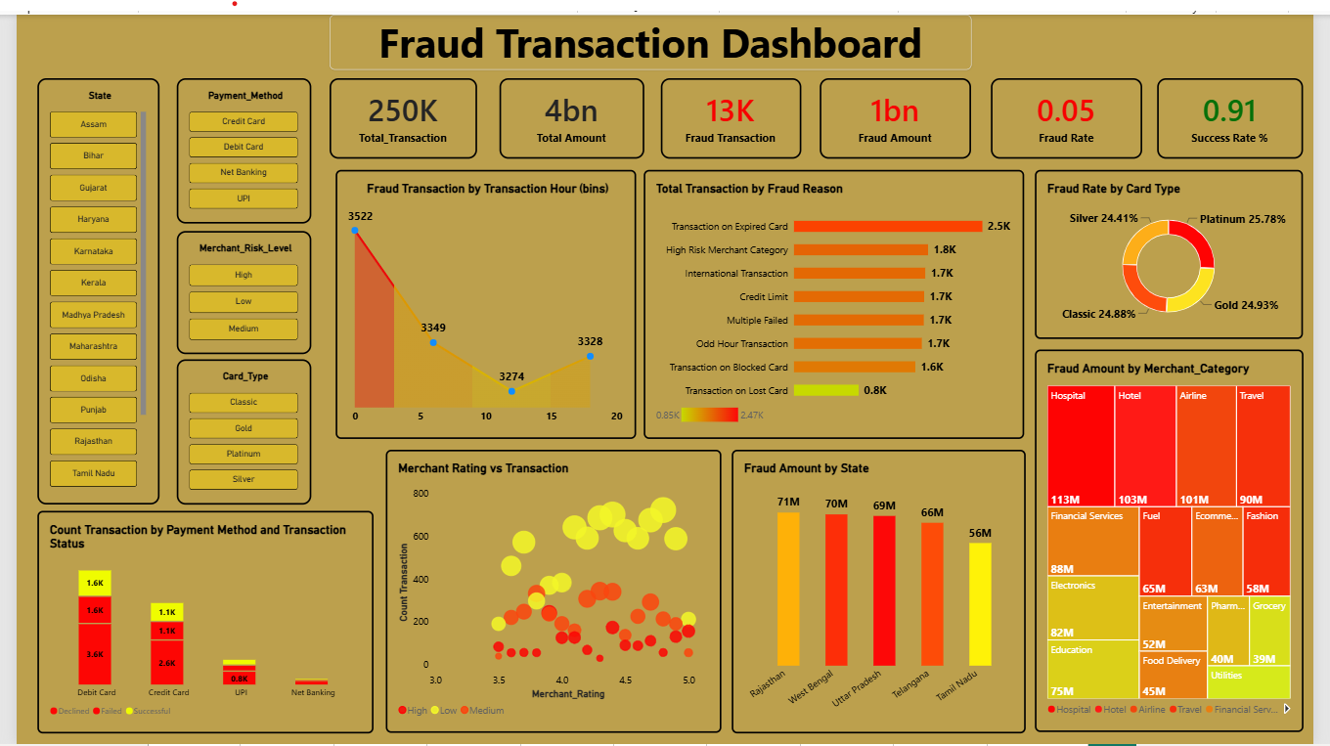
03

Slide 4



STRATEGIC PURPOSE
Dashboard Core Objectives & Scope
Slide 03
Detect Threat Vectors
Loss Distribution
Governance Action
Root Cause Isolation: Identify system logic gaps including expired cards, high-risk merchant categories, and off-hour transaction anomalies.
Financial Quantification: Measure loss exposure across 15 states, payment methods, card tiers, and vulnerable industry sectors.
Mitigation Controls: Formulate target authorization rules, dynamic 3DS filters, and regional risk scoring models.
Primary Target: Convert raw transaction logs into actionable authorization safeguards to protect $4Bn in total payment volume.
04

Slide 5


DASHBOARD BASELINE
Financial Metrics
$1Bn Fraud Exposure
250K
$4Bn
13K
$1Bn
Total Transactions Logged
Total Transaction Volume
Fraud Transactions
Fraud Amount
Fraud Exposure Rate
Authorization Success Rate
0.05 (5.2%)
0.91 (91.0%)
Critical Finding: Fraudulent incidents account for 5.2% of transaction count, but carry 25% of total monetary value ($1Bn of $4Bn), demonstrating high ticket targeting.
05

Slide 6

DASHBOARD ANALYSIS 01
Fraud Transaction by Transaction Hour (Bins)
Temporal Velocity Trend
Hour Bins Breakdown
Bin Size: 5 Hours
Midnight Surge: Highest fraud velocity occurs at Hour 0 bin (3,522 cases), taking advantage of lowered off-peak authorization scrutiny.
Hour 0 Peak: 3,522
Hour 20: 3,328
Bin 0 (Midnight)
Bin 5
Bin 10 (Low: 3,274)
Bin 20 (Night)
06

Slide 7
DASHBOARD ANALYSIS 02
Total Transaction by Fraud Reason
Root Cause Drivers
Expired Card Vulnerability
Fraud Cases by Trigger Reason
2.5K Expired Card Cases: Authorization gateway fails to enforce immediate hard blocks on expired credentials before authorization.
Transaction on Expired Card
2.5K
High Risk Merchant Category
1.8K
International / Credit Limit / Failed
1.7K Each
High-Risk Merchant Exposure
Blocked Card / Lost Card
0.8K – 1.6K
1.8K Category Fraud: High-risk merchant categories lack step-up authentication requirements, facilitating rapid authorization exploitation.
07

Slide 8
DASHBOARD ANALYSIS 03
Fraud Rate Distribution by Card Type
Card Tier Split
Donut Breakdown by Tier
Uniform Tier Vulnerability
~25% Equal Distribution: Fraud occurs at near identical rates across all four card tiers (Platinum, Gold, Classic, Silver).
Platinum Tier
Gold Tier
25.78%
24.93%
Classic Tier
Silver Tier
24.88%
24.41%
8

Slide 9
DASHBOARD ANALYSIS 04
Transaction Count by Payment Method & Status
Channel Breakdown
Card Rails Dominate
Method vs Transaction Status
Debit & Credit Concentration: Card channels represent over 80% of declined and failed fraud transaction attempts.
3.6K
2.6K
UPI Security Resellers
1.6K
1.1K
0.8K
Lower UPI Fraud: UPI displays significantly lower successful fraud attempts due to mandatory real-time two-factor PIN validation.
Debit Card
Credit Card
UPI
Net Banking
09

Slide 10

DASHBOARD ANALYSIS 05
Merchant Rating vs Transaction Scatter Analysis
Integrity Matrix
Rating Reputation Blindspot
High Rating Exposure: Heavy fraud volume exists among merchants rated 4.0 to 5.0, proving bad actors hijack reputable vendor profiles.
Scatter Matrix Density
High Cluster: Ratings 3.5 – 5.0
Merchant Account Takeover
Scatter plot demonstrates heavy fraud density on highly rated merchants.
Account Spoofing: High public review scores do not guarantee transactional integrity; automated checks are essential.
10

Slide 11
DASHBOARD ANALYSIS 06
Fraud Amount Concentration by State
Geographic Ranking
Top 5 Region Risk Cluster
$332M Loss Concentration: Rajasthan, West Bengal, UP, Telangana, and Tamil Nadu account for over 33% of total fraud exposure.
Top Fraud Loss States ($ Millions)
Rajasthan
$71M
West Bengal
$70M
Uttar Pradesh
$69M
Telangana
$66M
Targeted Regional Rules
Tamil Nadu
$56M
Localized Geo-Filters: High regional concentration enables targeted authorization filters without impacting low-risk territories.
11

Slide 12
DASHBOARD ANALYSIS 07
Fraud Amount by Merchant Category (Treemap)
High Exposure Sectors
High-Ticket Digital Resale
Category Treemap Losses ($ Millions)
$407M Combined Sector Loss: Healthcare, Hotels, Airlines, and Travel lead loss values due to rapid digital voucher resale before detection.
Hospital / Healthcare
Hotel / Hospitality
$113M
$103M
Airlines
Travel Booking
$101M
$90M
12

Slide 13
EXECUTIVE INSIGHTS
Synthesized Insights & Threat Vulnerabilities
Key Synthesis
1. System Logic Gaps
2. Nocturnal Scripting
3. High-Value Resale
Allowing transactions on expired and lost cards represents an authorization gap, causing over $1Bn in preventable loss exposure.
Peak fraud velocity occurs between midnight and early morning (Hour 0 Bin), exploiting lowered off-peak manual monitoring.
Hospital, Hotel, and Airline sectors represent $317M in loss, driven by non-refundable instant digital voucher liquidation.
Core Synthesis Takeaway
Fraud exposure is structured around gateway pre-authorization loopholes rather than individual user compromises.
13

Slide 14
ACTION ROADMAP
Strategic Business Recommendations
Execution Strategy
PHASE 01 — IMMEDIATE
PHASE 02 — 30 DAYS
PHASE 03 — 60 DAYS
Hard Authorization Blocks
Dynamic Off-Hour Step-Up
Sector & Geo Risk Scoring
Deploy real-time database validation to instantly reject expired or reported lost card attempts prior to payment gateway processing.
Enforce mandatory 3D-Secure biometric or OTP verification for transactions initiated between 11 PM and 5 AM exceeding $200.
Implement risk scoring for high-loss sectors (Healthcare, Airlines, Hotels) and top exposure states (Rajasthan, West Bengal, UP).
Governance Target: Mitigate ~$400M in annual fraudulent losses and reduce fraud exposure ratio under 2%.
14

Slide 15


IMPACT QUANTIFIED
Projected Strategic Impact & Outcomes
-75%
$400M
96.5%
Reduction in Expired Card Fraud
Capital Saved Annually
Target Authorization Success
15

Slide 16

CLOSING SESSION
Thank You!
Any Questions or Discussion Points?
Presenter: Ankita Bharti| Student Code: AF0307596
Power BI Dashboard Analysis
16

