Slide 1




AIRLINE BOOKING · BAGGAGE · STAFF OPERATIONS
ONE DATABASE.
EVERY STATION.
SkyRoute — one MySQL 8.0 database for every counter at every airport. Sixteen tables, 34,708 seeded bookings — every rule enforced by the engine itself.
5 airports
3 airlines
16 routes
336 departures
34,708 bookings
D. Sivasai Bhaskar Sarma
25STUCHH010868 · Section D · CS/AI/AIM/DS202
Faculty: Dr. Meena Kumari Parigi · Semester I · A.Y. 2026–27
2-minute reel · click to advance · stop anywhere
Notes:
SkyRoute — one airline database for bookings, bags and staff operations. MySQL 8.0, sixteen tables, thirty-four thousand seeded bookings. The reel plays click by click; stop anywhere.

Slide 2




STEP 02 — THE PROBLEM
PAPER, WHITEBOARDS,
AND A CALCULATOR.
Two booking counters, five airports, one truth — and nothing that remembers it.
THE DOUBLE SALE.
THE WANDERING GATE.
THE PERSONAL FEE.
Two agents, two counters, seat 14C on one flight. Storage has nothing to refuse the second sale — so it writes over the first.
Gate changes travel on a whiteboard from terminal to terminal. A clash is discovered at the gate, by people, out loud.
The excess-baggage charge depends on who is at the desk. Each station keeps its own passenger list and its own arithmetic.
Five failure modes → five named database mechanisms — each closable inside the schema
SKYROUTE — DBMS mini project · MySQL 8.0
02 / 17
Notes:
Before SkyRoute: two counters kept separate lists. Seat charts on paper, gates on a whiteboard, baggage fees by hand. Five ways to sell the same seat twice.

Slide 3



STEP 03 — FIVE FAILURES, FIVE MECHANISMS
EVERY FAILURE HAS A KEY.
The fix never lives in a queue or someone's memory — it compiles into a key, a view, or a trigger.
Two agents, one seat
UNIQUE(departure_id, seat_number) — the storage engine refuses the loser
Same gate, two flights
UNIQUE(terminal_id, gate_number) — a physical gate is exactly one row
The haggled fee
booking_receipt_view — 20 kg free · Rs 500 per excess kg
Station lists disagree
one skyroute_db, five airports — Airports is the root table
Oversold flights
trg_booking_capacity — seat count vs capacity, every insert
Each refusal left the row counts untouched — the rejections are features, cleanly named.
SKYROUTE — DBMS mini project · MySQL 8.0
03 / 17
Notes:
Five failures, five mechanisms. Each failure gets a named closure inside the schema — a key, a view, one database, a trigger. Nothing depends on goodwill.

Slide 4
STEP 05 — THE ENTITY-RELATIONSHIP MODEL
16 entities · 19 foreign keys
TIMETABLE MEETS CALENDAR.
One schedule row owns every dated departure the calendar needs — masters are referenced, never copied.
MASTERS — THE ROOTS
STAFF — ONE KEY, THREE FACES
AIRPORTS
root · 5 rows
FLIGHTS
DEPARTURES
BOOKINGS
EMPLOYEES
shared key
1 — N
1 — N
AIRLINES
3 · fleet hold
the timetable
a date on the calendar
seat · class · price
flight_number
dep ≠ arr
airline_id
scheduled_departure
aircraft_id
gate_id
booking_id
seat_number
price
1 — 1
PILOTS
AIRCRAFT
capacity lives here
N — 1 hangs below:
CREW MEMBERS
TERMINALS · GATES
a gate is one row
1 — 1
1 — 1
GROUND STAFF
BAGGAGE
weak · (booking_id, seq)
PAYMENTS
1 — 1
CHECK-INS
1 — 1
Staff hang off one employee key — a licence row cannot exist without its employee.
SKYROUTE — DBMS mini project · MySQL 8.0
04 / 17
Notes:
Sixteen entities on the Chen diagram. The timetable row is a template; each date becomes its own departure. Baggage hangs off bookings as a weak entity — numbered per booking.

Slide 5





STEP 06 — THE RELATIONAL MODEL
SIXTEEN TABLES, NINETEEN KEYS.
Normal form walked once: bags out of 1NF, passengers and masters out of 3NF — the determinants left are keys.
Bookings
Gates
Baggage
UNIQUE(departure_id, seat_number)
UNIQUE(terminal_id, gate_number)
(booking_id, baggage_seq)
The double sale dies at the storage engine. price >= 0 keeps the money positive.
A physical gate is one row — two flights can't own it at once.
Weak entity: bag 2 of booking 817 dies with booking 817. 0 < kg <= 100.
Payments · Check-ins
Flights
Delete strategy
1 — 1 to bookings
UNIQUE(flight_number) · dep != arr
CASCADE · RESTRICT · SET NULL
One receipt per booking, one boarding record — no stray history.
Same-airport routes are refused by trigger — a CHECK can't watch two FKs.
Bags/payments/check-ins vanish with bookings; airports RESTRICT; aircraft just unassign.
SKYROUTE — DBMS mini project · MySQL 8.0
05 / 17
Notes:
Sixteen tables, nineteen foreign keys. The booking key kills the double sale, a gate is one row, bags vanish with bookings, no flight flies home to itself.

Slide 6
STEP 07 — SEED 42, DEMONSTRATED AT VOLUME
MEASURED AT VOLUME.
Deterministic seed 42 — 21 days, load factors 35–80%, payments 92% settled. Pre-load checks: no duplicate seats, every FK inside its parent range.
34,708
43,314
4,000
336
BOOKINGS
BAGS
PASSENGERS
DEPARTURES
16 ROUTES
5 AIRPORTS
3 AIRLINES
11,544 CHECK-INS
At this volume, load factor and revenue are the report — and every number above was queried, not promised.
SKYROUTE — DBMS mini project · MySQL 8.0
06 / 17
Notes:
Measured at volume: thirty-four thousand bookings, forty-three thousand bags, four thousand passengers, three hundred thirty-six departures. Zero duplicate seats.

Slide 7


STEP 08 · GUARD 1 OF 5 — INTEGRITY
THE STORAGE ENGINE SAYS NO.
Politeness is the greyed-out seat map in the browser. Correctness is the key underneath: UNIQUE(departure_id, seat_number).
MYSQL 8.0.46 — skyroute_db
WHY IT CANNOT MISS
mysql> INSERT INTO Bookings (passenger_id, departure_id,
-> seat_number, travel_class, price)
-> VALUES (102, 41, '14C', 'Economy', 5124);
ERROR 1062 (23000): Duplicate entry '41-14C'
for key 'bookings.uq_booking_seat'
Engine-level
The refusal lives in InnoDB. No app, shell or procedure can route around it.
Named
The error names the rule that fired — uq_booking_seat — so logs read like sentences.
second writer: refused
rows written by loser: 0
Race-proof
Two writers inside one transaction window still resolve to one winner.
The refusal is instant, named and clean — the first booking never looked roughed up.
COUNT(*) afterwards — exactly as before the attempt
SKYROUTE — DBMS mini project · MySQL 8.0
07 / 17
Notes:
Guard one: a unique key on departure plus seat. Two writers racing for one seat — the storage engine refuses the loser by name: uq_booking_seat. Nothing half-written.

Slide 8

STEP 08 · GUARD 2 OF 5 — CAPACITY
SOLD OUT? THE FUSE SIGNALS.
A BEFORE INSERT trigger counts seats sold against aircraft capacity — on every insert, from every door into the data.
trg_booking_capacity — BEFORE INSERT ON Bookings
ATTEMPTED OVERSALE
SELECT COUNT(*) INTO sold FROM Bookings
WHERE departure_id = NEW.departure_id;
SELECT capacity INTO cap FROM Aircraft ...;
IF cap IS NOT NULL AND sold >= cap THEN
SIGNAL SQLSTATE '45000';
END IF;
34,708
bookings on the books — the total refused to move one row past capacity
counts seats on every insert — shell, procedure or web app
ERROR 1644 (45000): Booking refused
second guard under UNIQUE(departure_id, seat_number)
tested at T-c: fill a plane, book once more, watch it refuse
SKYROUTE — DBMS mini project · MySQL 8.0
08 / 17
Notes:
Guard two: a before-insert trigger counts seats sold against aircraft capacity and signals SQLSTATE 45000. The shell, the procedure, the web app — one refusal for every door.

Slide 9
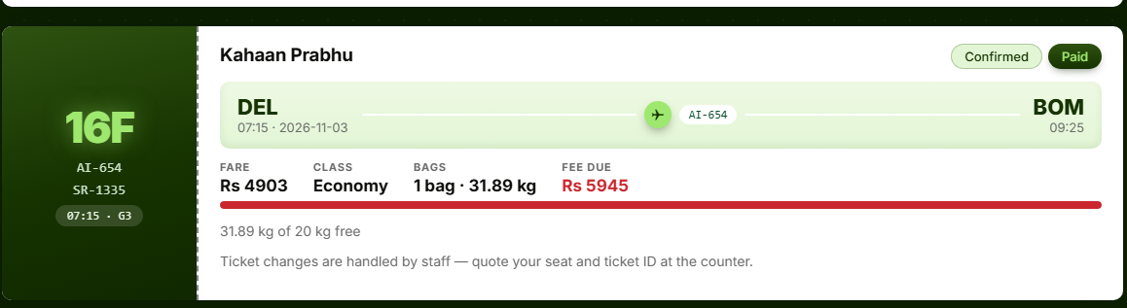
STEP 08 · THE MONEY RULE — BAGGAGE FEES
ONE FEE, EVERY RECEIPT.
The charge stopped depending on who is at the desk — the rule moved into a view and can't be haggled around.
THE RULE, AS COMPILED
20 kg FREE
₹500 / extra kg
baggage_fee_rs
= SUM(GREATEST(kg-20,0))*500
A scalar subquery inside booking_receipt_view — valid under ONLY_FULL_GROUP_BY, and the Flask maths agree to the rupee.
LIVE FROM THE FLASK APP · 31.89 kg carried → 11.89 kg over × ₹500 = ₹5,945 fee, printed red by the view the app calls. Two tracks, one arithmetic — the seed total agrees down to the rupee.
8,704 overweight bags in the seed
₹2,69,74,740 of fees summed in one view
~1.2 bags per booking · 80/20 split at 20 kg
SKYROUTE — DBMS mini project · MySQL 8.0
09 / 17
Notes:
The money rule is a view, not a person: twenty kilos free, five hundred rupees per extra kilo. That live ticket shows 31.89 kg — a 5,945 rupee fee, computed in MySQL.

Slide 10




STEP 09 — THE DESK QUESTIONS, ONE QUERY EACH
ONE QUERY, ONE TRUTH.
Ten joins and eight analytics cover the board, the routes, the load factors and the spenders — nothing summed twice.
THE DEPARTURE BOARD
THE BUSIEST ROUTE
flight_board_view joins timetable + both airports + airline + aircraft + gate + terminal — the board is one SELECT.
COUNT(*) grouped by route: MAA → BOM leads at 2,688 bookings, HYD → BOM two rows behind.
MAA→BOM
2688
HYD→BOM
2664
THE UNDER-LOADED FLIGHTS
THE BIG SPENDERS
Load factor = seats sold ÷ aircraft capacity; HAVING < 60 keeps the flights that need attention first.
A correlated subquery lists passengers above the average fare — the average is computed once, not per row.
SKYROUTE — DBMS mini project · MySQL 8.0
10 / 17
Notes:
Desk questions: the board is one view, the busiest route one GROUP BY, load factor one HAVING clause, big spenders one correlated subquery. One query, one truth.

Slide 11



STEP 10 — ATOMICITY ON STAGE
ONE CALL. TWO ROWS. OR NONE.
MakeBooking writes the seat and opens a Pending UPI payment inside one transaction — an EXIT HANDLER rolls the entire call back on any error.
10C
Riya Mehta
Confirmed
Paid
CALL sp_make_booking(pax, dep, seat, class, price, OUT id)
HYD
BLR
The booking row and its payment row leave together — or an error fired and neither exists.
6E-501
08:00 · 2026-11-01
6E-501
09:20
SR-101038
A taken seat trips the UNIQUE key inside the procedure: the EXIT HANDLER rolls back and re-signals.
FARE
CLASS
BAGS
SEAT
08:00 · G1
₹13,879
Business
2 · 18.69 kg
10C
The desk can't win the race by clicking faster. It gets words, not a crash.
Booking 38, exactly as the seed wrote it — one passenger row, one flight row, two bag rows (38,1) and (38,2). Nothing stored twice.
SKYROUTE — DBMS mini project · MySQL 8.0
11 / 17
Notes:
Atomicity on stage: MakeBooking writes the booking and opens a pending payment in one transaction. An exit handler rolls back on any error — a taken seat leaves nothing behind.

Slide 12



STEP 11 — TRANSACTIONS, WITH WITNESSES
ACID, WITH WITNESSES.
Three runs against the live database — each starts from a known state and ends by restoring it.
COMMIT
ROLLBACK
ISOLATION
Booking + payment appear together — two rows in one breath, both or neither.
Second passenger repeats a passport → ERROR 1062 → count afterwards: zero.
Session 2 waits 9.08 s on a locked row; when session 1 rolls back, the wait completes.
both rows visible after COMMIT
rows_left_behind: 0
row lock: 9.08 s elapsed
Reading the row again before COMMIT returns the old value — isolation, not poetry.
SKYROUTE — DBMS mini project · MySQL 8.0
12 / 17
Notes:
ACID with witnesses: commit keeps both rows; a failed rollback leaves the seat free; a lock held nine seconds makes isolation visible to a second session.

Slide 13
STEP 12 — THE BUSY PATHS
MEASURED, NOT GUESSED.
Four workload indexes, each stamped with an EXPLAIN pair before and after. Single-column FK indexes were already there — untouched.
idx_bookings_status
5,449 read
idx_bookings_status — same rows, different reads
5,449
Bookings(booking_status)
idx_departures_date
16 read
rows read through the index — bookings_status = 'Confirmed'
Departures(scheduled_departure)
with index
5449
257 read
idx_passengers_name
without index
33904
Passengers(last_name, first_name)
Same answer either way — what changes is how many rows the engine touches: about a sixth of the reads.
idx_baggage_weight
8,704 read
EXPLAIN before · after, captured
Baggage(weight_kg)
green figures = rows read with the index in place
SKYROUTE — DBMS mini project · MySQL 8.0
13 / 17
Notes:
Indexes measured, not guessed: the status query reads 5,449 rows through its index and 33,904 without it. Same answer either way — a sixth of the reads.

Slide 14


STEP 13 — ACCESS CONTROL, LEAST PRIVILEGE
THREE USERS, ONE DIALECT.
Checked live against the grant tables — a grant on a misspelled database name succeeds and protects nothing, so the names are character-exact.
sky_admin
sky_staff
sky_viewer
GRANT ALL PRIVILEGES ON `skyroute_db`.*
GRANT SELECT, INSERT, UPDATE ON `skyroute_db`.*
GRANT SELECT ON `skyroute_db`.*
Runs the schema, the data and the doors — the only user allowed to shape tables.
Operations: books, checks in, takes payments, adds bags — no DDL, no structural change.
Reads reports, records nothing — the INSERT was refused live, at line 1.
ERROR 1142 (42000): INSERT denied
SKYROUTE — DBMS mini project · MySQL 8.0
14 / 17
Notes:
Three database users: admin gets all, staff reads and writes operations, the viewer only reads. The viewer's INSERT is denied live against the grant tables — spelled exactly.

Slide 15
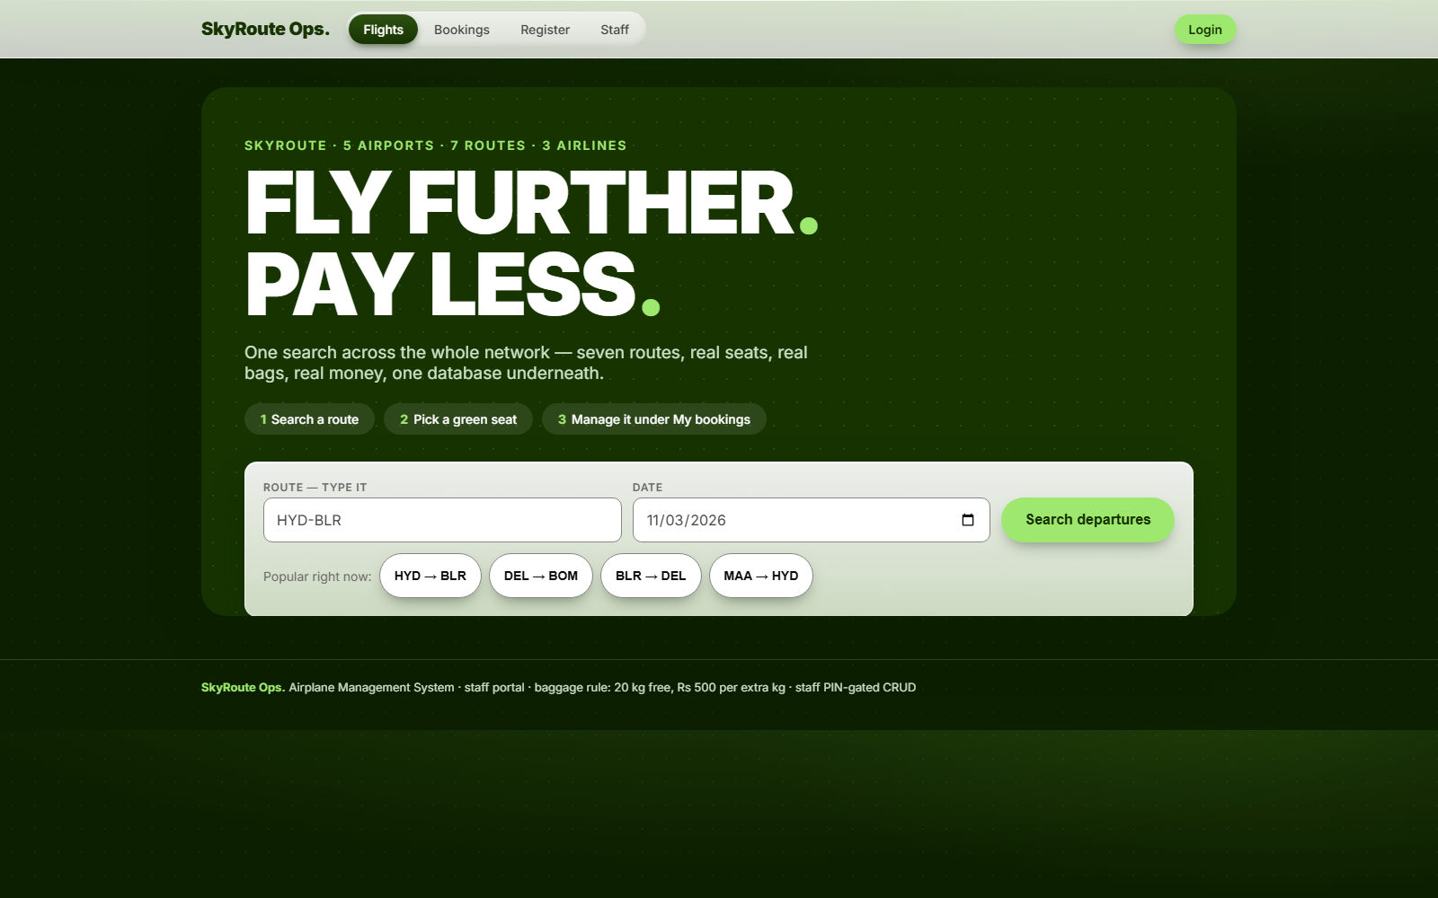
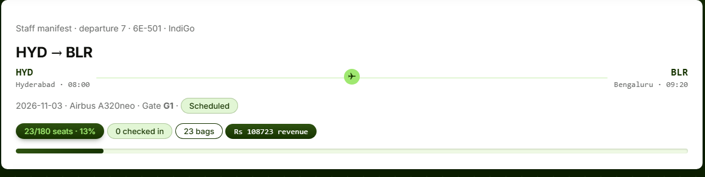
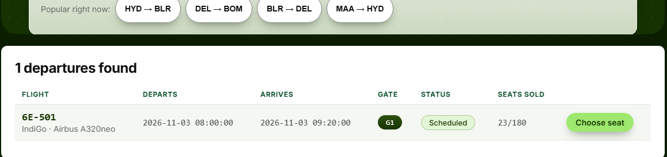
STEP 14 — THE WEB TIER · FLASK + MYSQL-CONNECTOR
SAME TABLES, ONE PORTAL.
Every page is a view, every booking one CALL to the procedure. The seat-grey courtesy lives in the browser; the refusal lives in the server.
STAFF MANIFEST — 6E-501 HYD→BLR
HOME — SEARCH HERO
12 tables
5 views
ROUTE SEARCH — ONE VIEW
+ 1 procedure
both tracks
TRAVELER TICKET — ₹5,945 FEE MATH
28 green
Framed evidence, captured live from the running portal — captions ride the frames.
SKYROUTE — DBMS mini project · MySQL 8.0
15 / 17
Notes:
Same design, web tier: Flask reads through views and books through the procedure — the staff manifest, the traveler ticket, the route search. Storage rules travel with every screen.

Slide 16
STEP 15 — TESTING & VALIDATION
EVERY CHECK STATES ITS EXPECTATION.
24 database checks in 8 groups + 28 application checks — the expectation is stated before the run, so the log reads as a protocol.
ERROR 1062
ERROR 1644
ERROR 3819
ERROR 1451
duplicate seat refused — '1-20B' on uq_booking_seat
same-airport route refused — trigger, not CHECK
0 kg / 100+ kg bag refused — baggage_chk_1
airport with flights protected — RESTRICT holds
SQLSTATE 45000
CASCADE
ERROR 1142
34,708
oversell refused — flight is fully booked
booking deleted → bags/payments/check-ins: 0 orphans
viewer INSERT denied — grants spelled exactly
total bookings unchanged after every refusal
What the refusals prove: the database rejects bad data at the door instead of storing it and hoping.
SKYROUTE — DBMS mini project · MySQL 8.0
16 / 17
Notes:
Twenty-four database checks in eight groups plus twenty-eight app checks, each stating its expectation first. The refusals are the feature: 1062, 1644, 1451, 45000 — all named.

Slide 17
THE REEL, REWOUND
THE RULES LIVE
IN THE DATABASE
NOW.
Every failure closed by a named mechanism; every mechanism closed by a test with a stated expectation. That was the brief — it still is.
16 tables + views + trigger + procedure
transactions on stage, 4 measured indexes
24 + 28 checks, all green
D. Sivasai Bhaskar Sarma · 25STUCHH010868 · Section D
CS/AI/AIM/DS202 · Dr. Meena Kumari Parigi · ICFAI Foundation for Higher Education
17 / 17
Notes:
Enforced in MySQL, reused by a Flask portal, measured at thirty-four thousand rows. That is SkyRoute. One database, every station. End of reel.

