Slide 1
BUSINESS CARD READER
MINOR PROJECT 6th SEMESTER

Slide 2
GROUP MEMBERS
KSHITIJ ARORA 1706047
SHUBHAM SHARMA 1706086
AMAN BHASKAR 1706107
AMRIT RAJ 1706109
KRISHNAKANT YADAV 1706135

Slide 3
Abstract
In this Digital age everything is shifting to digital format and as some experts say “data is new oil” the whole civilization is shifting to digital platforms to hold their data.
In this Digital age our communication is primarily digital and all the contacts have shifted to either email’s or mobile contacts so as in the early days people use to carry business cards of individuals they met so that they can contact them in the future, now it has become hard for us to manage all these cards physically.
A business card usually contains the name , contact, email address and the physical address of that individual.
All our contacts are stored on the internet or our mobile devices and it gets really hard to access our business cards and input the details manually every time and this problem escalates when the quantity of the cards increases.

Slide 4
REQUIREMENTS-
Hardware Requirements
For the product to run, you shall need an Android device.
To get accurate results, your device should have a high resolution camera. Also, since image processing is resource-hungry, your device should have modern RAM and CPU.
The physical camera is managed by the camera interface in the smart phone and the hardware connection to the Internet is managed by the underlying operating system on the mobile phone and the web server.

Slide 5
Software Requirements
Windows 7/8/8.1/10
Language: Python 3.4 above
As it has already been stated, product shall run on only Android devices, so it shall not need any specific software from the user's side other than it.
However, product shall depend on some libraries and tools to be developed. User interface module to be implemented shall interact with user and according to its input, shall activate image processing module.
Image processing module shall be implemented with OpenCV libraries which prepares input for OCR operation. Tesseract OCR, which is Open Source free software, shall convert numbers on image to text accurately.

Slide 6
Technologies used-
Open CV-
OpenCV-Python is a library of Python bindings designed to solve computer vision problems. ... OpenCV-Python makes use of Numpy, which is a highly optimized library for numerical operations with a MATLAB-style syntax. All the OpenCV array structures are converted to and from Numpy arrays.
Pytesseract
Python-tesseract is an optical character recognition (OCR) tool for python. That is, it will recognize and “read” the text embedded in images. ... Additionally, if used as a script, Python-tesseract will print the recognized text instead of writing it to a file.

Slide 7
NLP-
Natural Language Processing, usually shortened as NLP, is a branch of artificial intelligence that deals with the interaction between computers and humans using the natural language. The ultimate objective of NLP is to read, decipher, understand, and make sense of the human languages in a manner that is valuable.
Python Programming-
Python is a general purpose and high level programming language. You can use Python for developing desktop GUI applications, websites and web applications. Also, Python, as a high level programming language, allows you to focus on core functionality of the application by taking care of common programming tasks.
Regular Expressions-
Regular expressions are patterns used to match character combinations in strings.

Slide 8
Steps-
Step 1-
In this step the image is processed and the edges are detected
Then the is contro detection that is outline detection
The third sub step is perspective transform of the image
This converts the image graphics into the digital 2D format that will be further used to get the texts.
All these sub steps are under the step 1 of image preprocessing and the technologies that are used are OpenCV and 4 point transform function .

Slide 9
Step-2
Pyteserract is used to extect textual information from image
Here we will use pyteserract to extract the textual data from the transformed black and white image and store it.
Step -3
In the final stop we use Regular Expressions and NLP to make sense of the texts that are extracted from the image
We use Regular expressions to extract email and phone number from the data.
Then we use NLP to Extract Name from the Data.

Slide 10
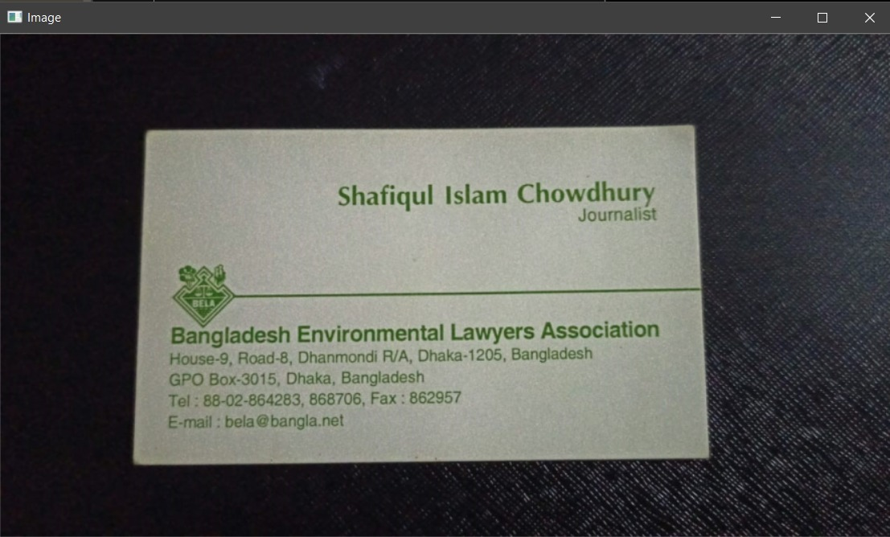
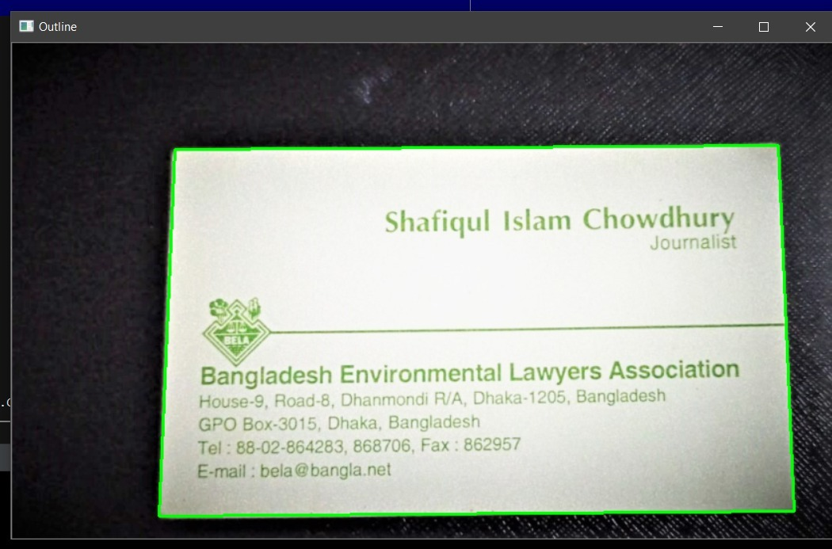
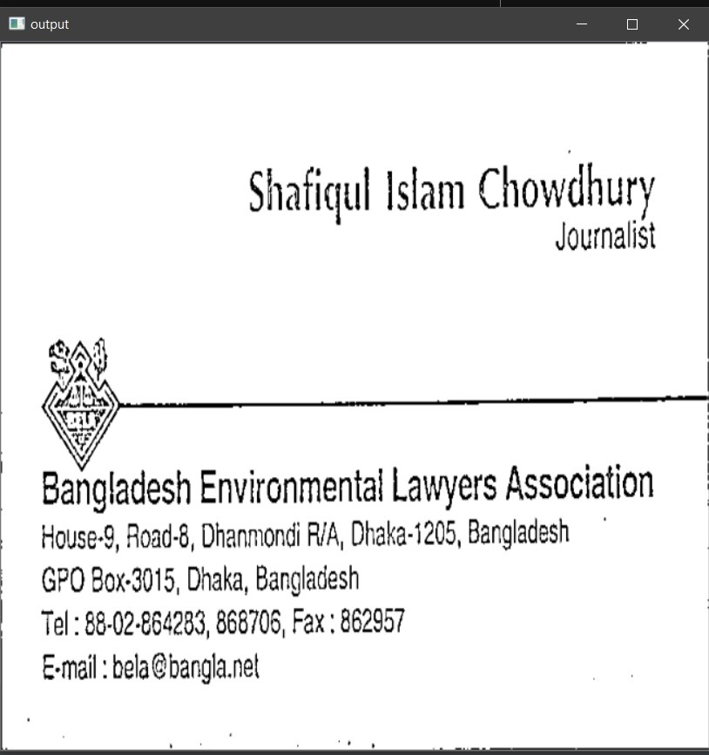
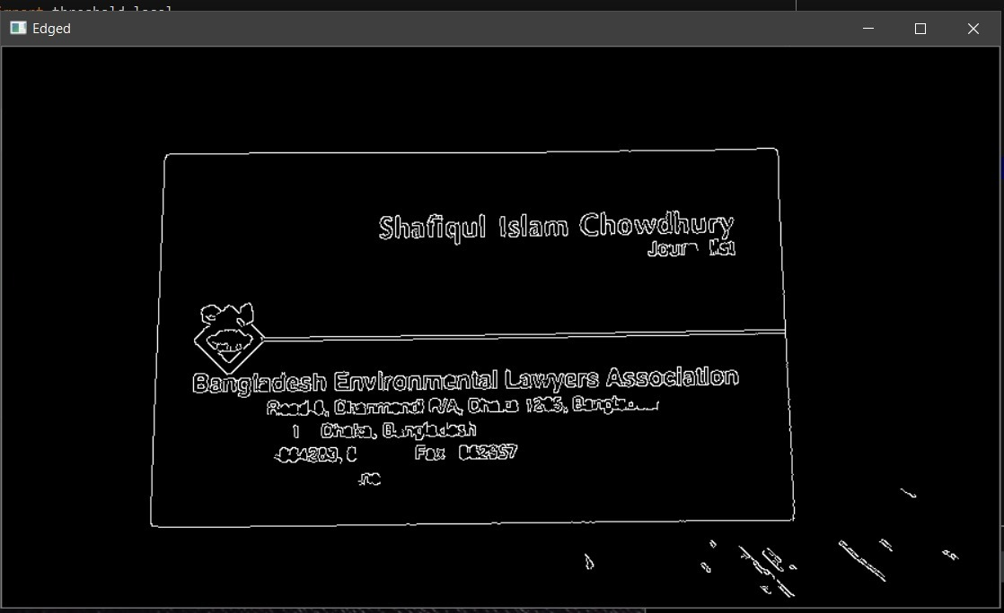
Results-

Slide 11
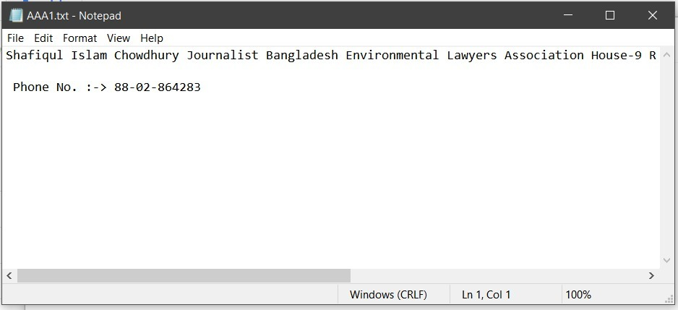
Final Output-
This is the final output that is generated using NLP and Regular Expressions

Slide 12
Future Scope-
The Future of this Technology can be extended in vast fields from corporate meeting cards to vendors cards.
In the future you can also use it to Scan anything Physical text , documents or real time street signs and make sense of them and store them.
You can use to scan anything written to save it in a digital format so that if you loose it in future it is all saved in the digital format.
Prescriptions, Grocerery list,To do list Menues of restauraunts everything can be stored using this and it takes up very less memory compared to a photograph.

Slide 13
Finish-
In this project we have tackeled the daily life problem of buisness professional's of carrying the buisness cards of every individual they meet and want to keep in contact with.
Keeping contact details in a textual format consumes very less storage than compared to keeping the actual photographs of the buisness cards
Photographs are also not easiy to organise and search in the huge nuber of photo's one might have in his galary . This projects the problem of organisation and storage space for the user and makes it easier to acess whenever required.

Slide 14
THANK YOU

