Slide 1
GAME OF TREASURES

Slide 2


Team Members Bhaskar Reddy Minupuri (S538310) Rajeshwari Rudravaram (S538361)

Slide 3
Introduction:-
Game of Treasures is a web-based gaming application where a user finds the treasures based on the treasure location and the application validates the user location and treasure location, if both matches then user gets the conformation with some UI effects.
Our project GitHub repo link:- https://github.com/Bhaskar2909/fsa-group4
Our project hosted Heroku app link:- https://fsagroup4.herokuapp.com/

Slide 4
Features of App:
A touch-based gaming app, where a user will find the target location with the help of directions provide by the app with respect to User location.
If a user touches or clicks the first color of app then it selects a random valid treasure location from a database where set of locations are stored.
If a user touches or clicks repeatedly on second color, then the device compares the current location coordinates with the target location and tells the user whether they are inside or outside the treasure location.
If a user is far from target location then, User will hear and see the directions in which he/she needs to move to reach the treasure location.
Finally, when user reaches the destination then the user will hear and see the confirmation of reaching the selected treasure location.

Slide 5
Stack:-
Platform: Node (v15.0.1)
Web Framework: Express
View engine: EJS
Web App Host: Heroku
ORM: Sequelize
Data store in Production:- PostgreSQL
Coding standards: Prettier/ESlint

Slide 6
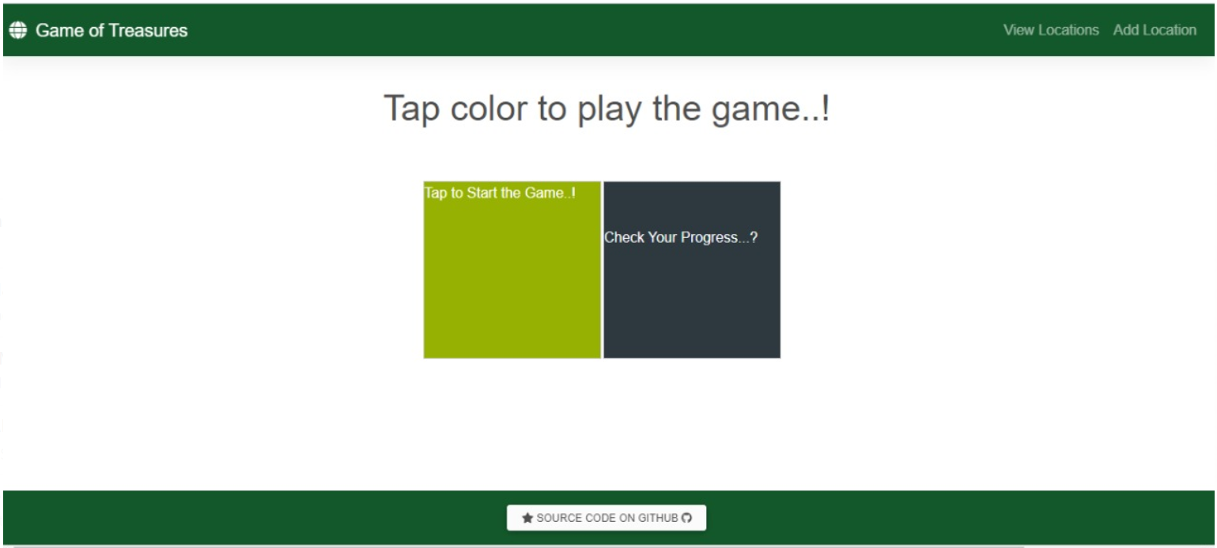
Homepage of our Application look like this. When a user clicks on logo or app name, it displays the same.

Slide 7
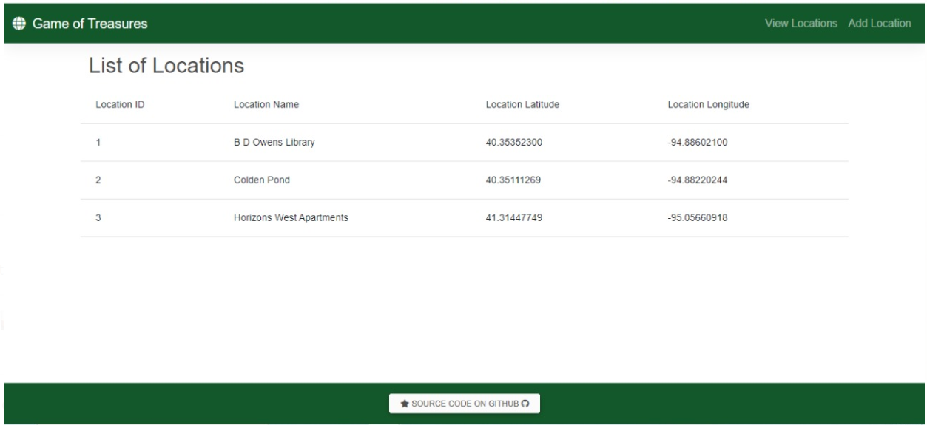
On Clicking the view Locations, we will be able to see list of locations

Slide 8
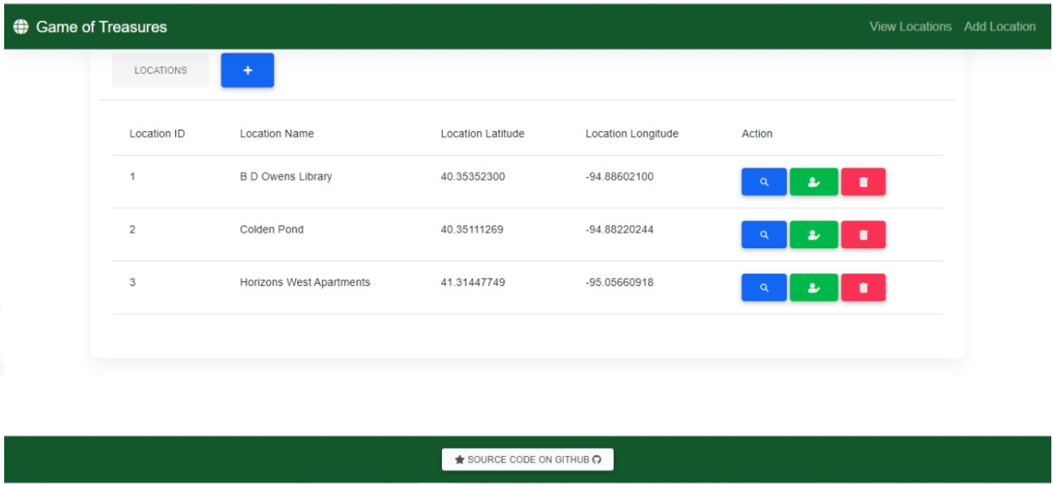
Add locations page looks like this where a User can perform all the CRUDL operations of location.

Slide 9
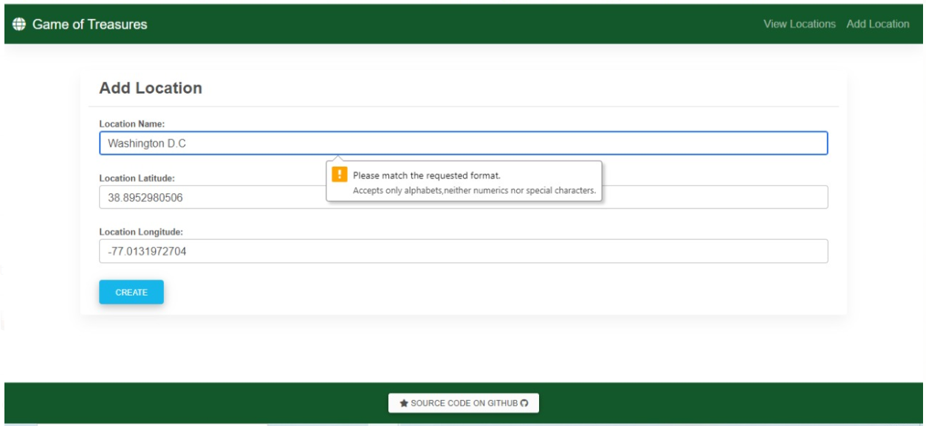
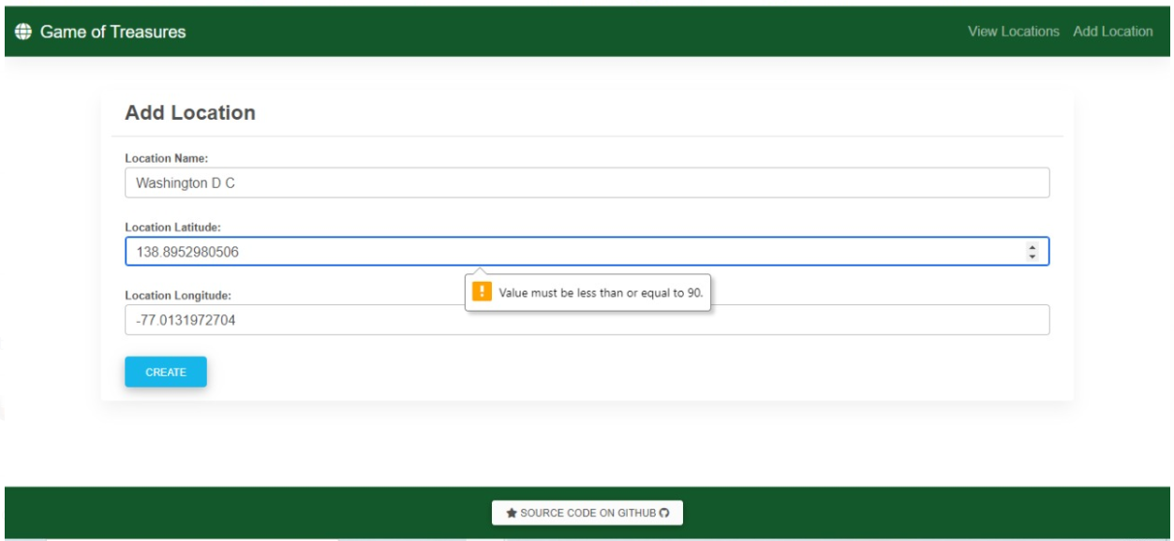
Validation on adding a location. We have white listed all the attributes of locations, where a user gets messages while entering invalid inputs.

Slide 10
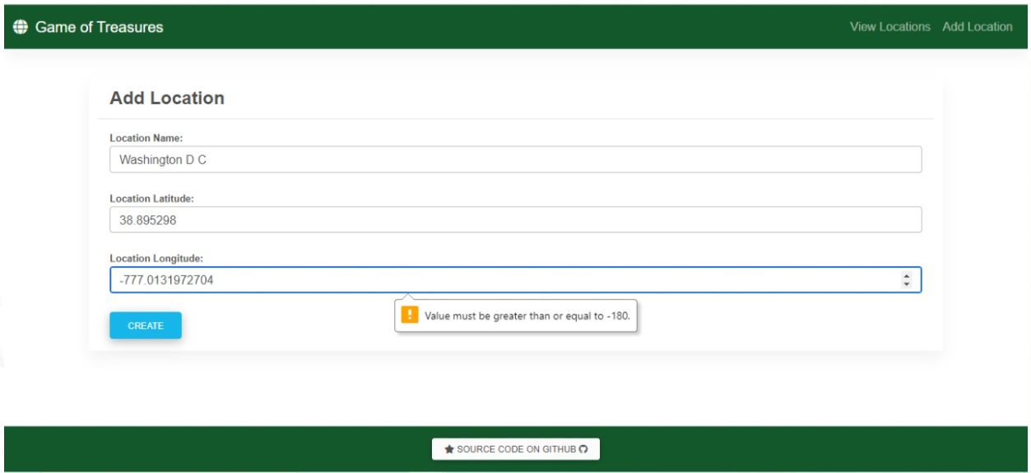
Validating the add location

Slide 11
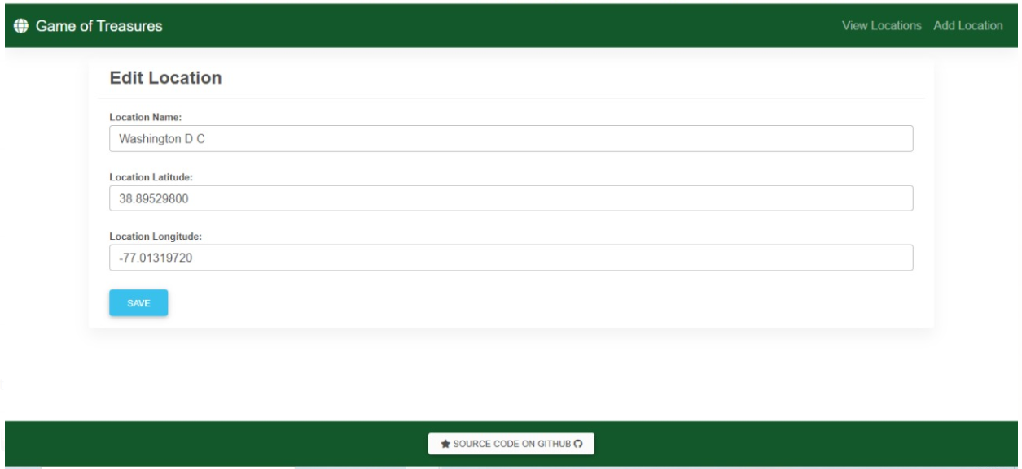
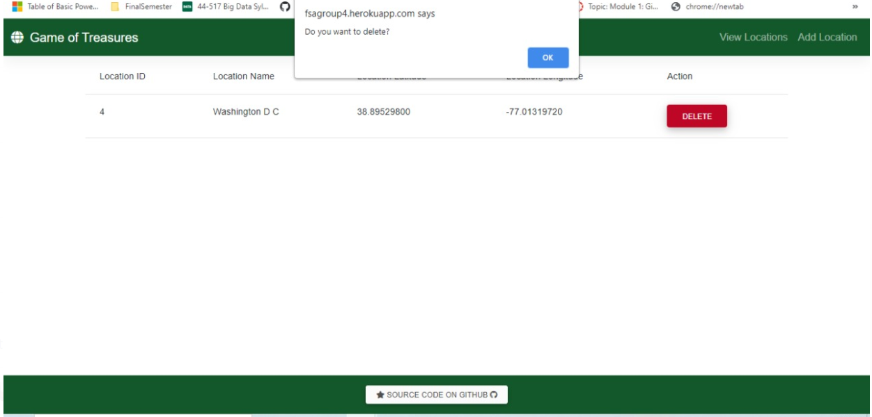
Edit location and Delete location

Slide 12
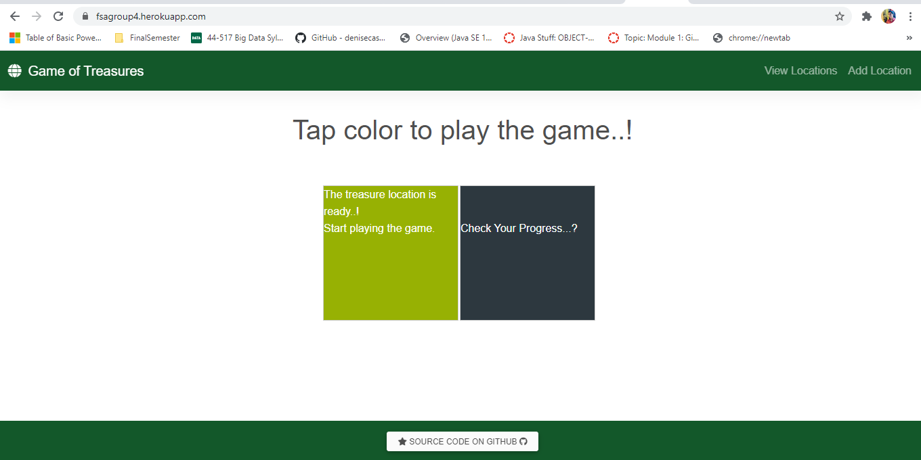
When a User clicks on first color component, then the app looks like below

Slide 13
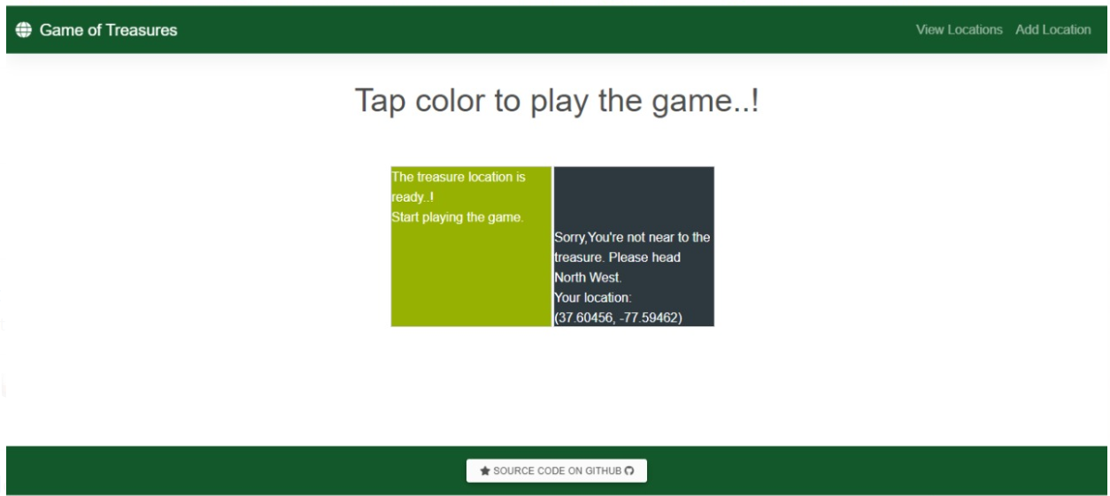
After clicking on second color, if a User is away from target location then our app displays like this and provides directions to reach the destination.

Slide 14
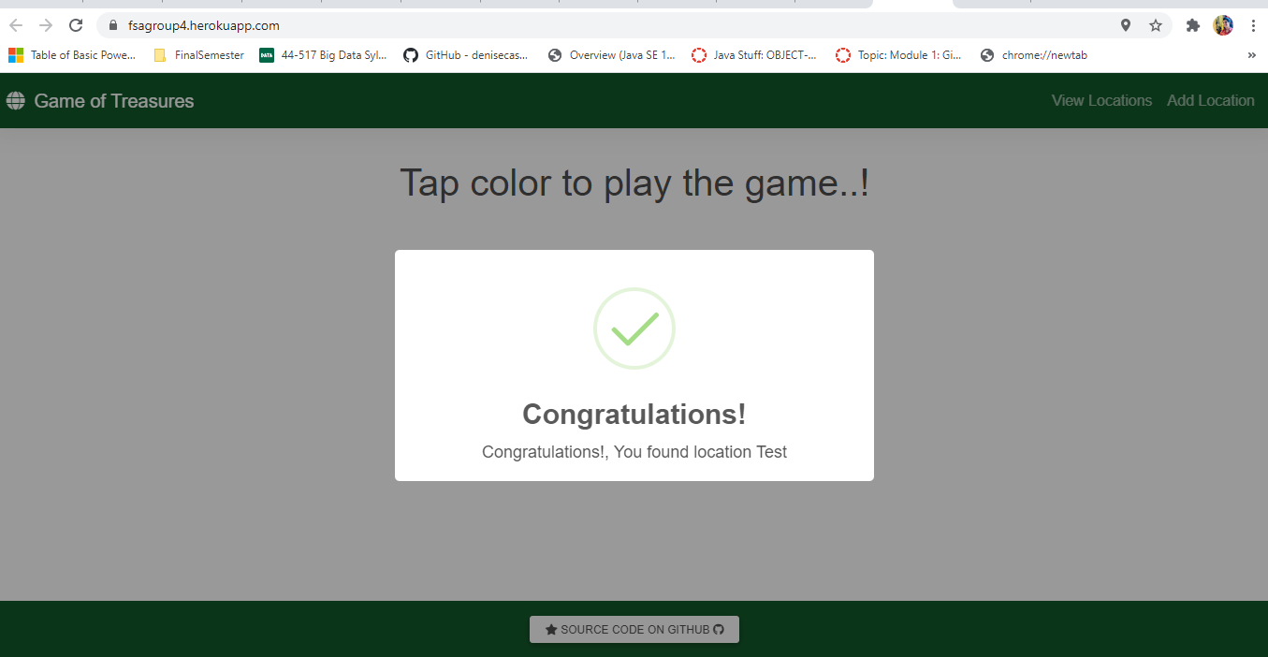
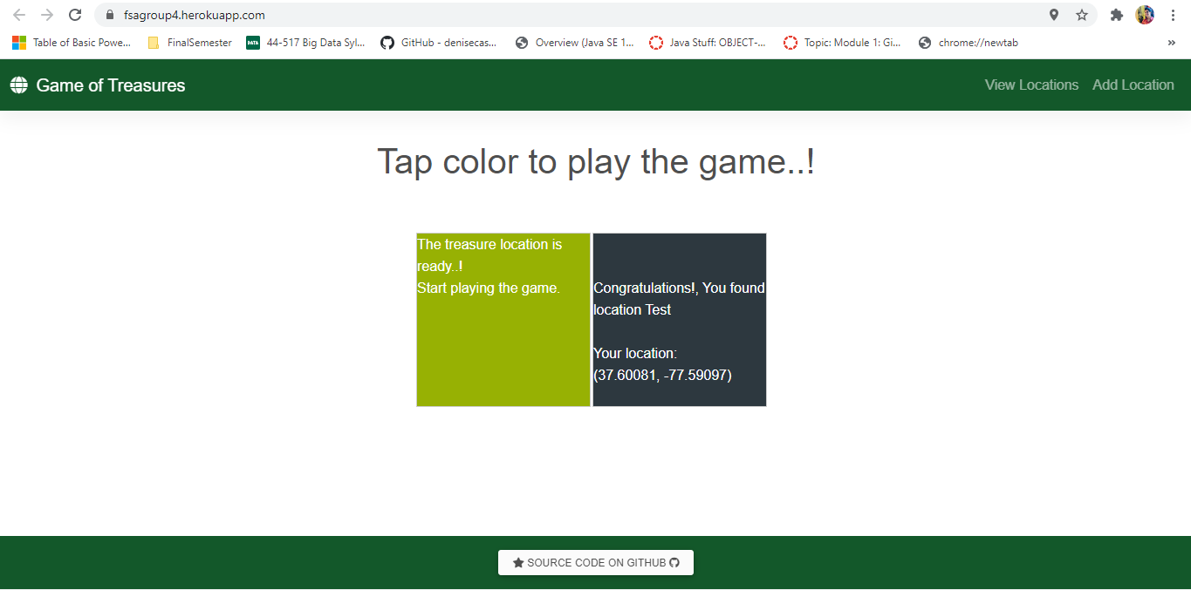
If a User is inside the selected target location, then our app says Congratulations and displays as below

Slide 15
Thank You

