Slide 1
GAME OF TREASURES

Slide 2


Team Members Bhaskar Reddy Minupuri Rajeshwari Rudravaram

Slide 3
Introduction
Game of Treasures is web-based application where a user finds the treasures based on the treasure location and the application validates the user location and treasure location, if both matches then user get the conformation with some UI effects.

Slide 4
Features of App:
A touch-based gaming app, where a user will find the target location with the help of directions provide by the app with respect to User location.
If a user touches or clicks the first color of app then it provides a valid treasure location from the given set of locations
If a user touches or clicks repeatedly on second color, then the device compares the current location coordinates with the target location and tells the user whether they are inside or outside the treasure location.
If a user is far from target location, then, User will hear and see the directions in which he/she needs to move to reach the treasure location.
Finally, when user reaches the destination then the user will hear and see the confirmation of reaching the selected treasure location.

Slide 5
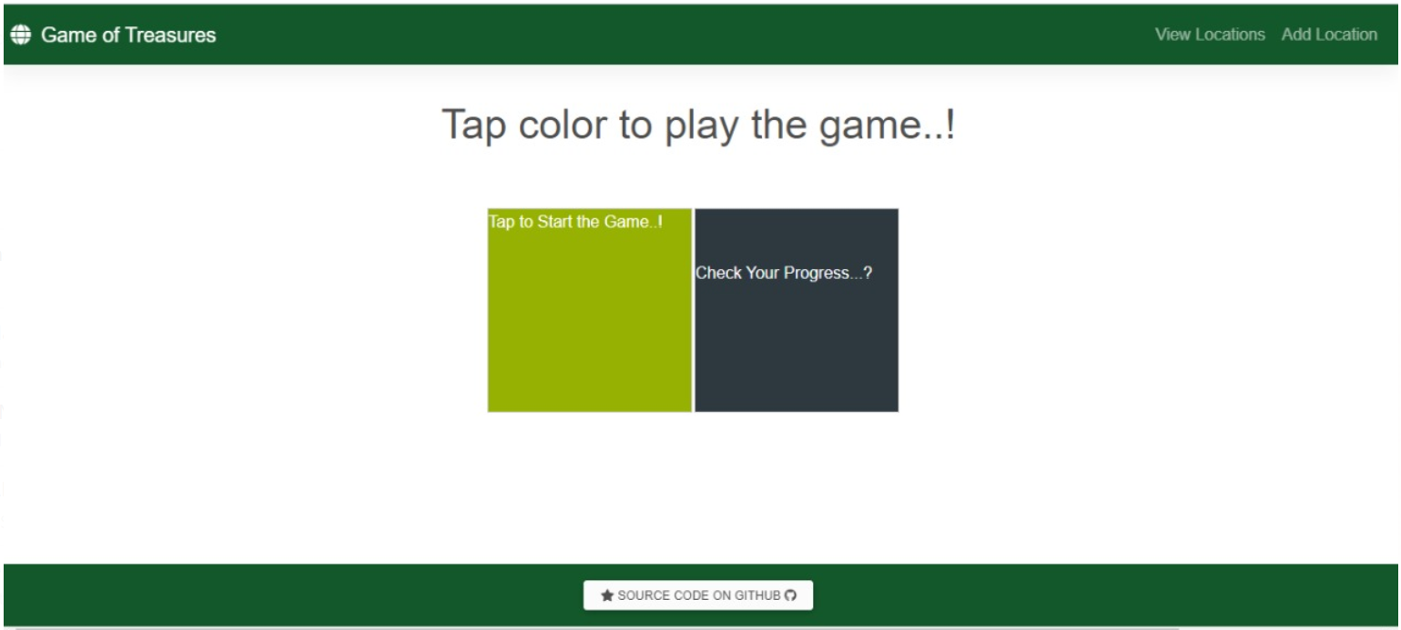
This is the Homepage of our Application

Slide 6
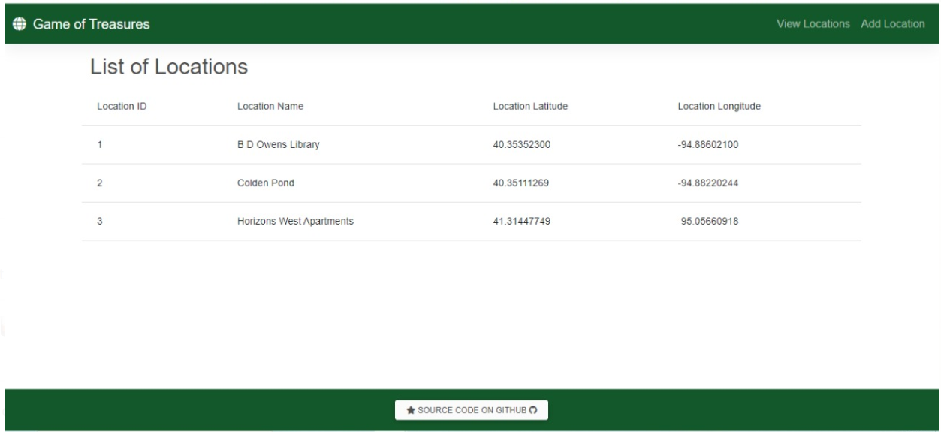
On Clicking the view Locations, we will be able to see list of locations

Slide 7
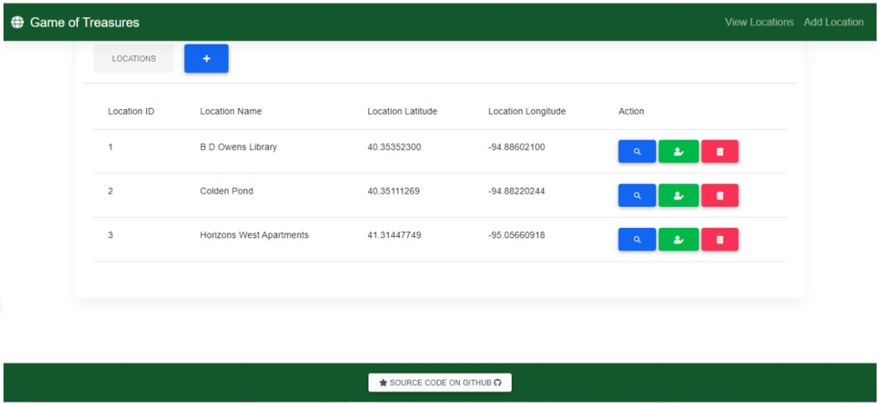
Add locations page

Slide 8
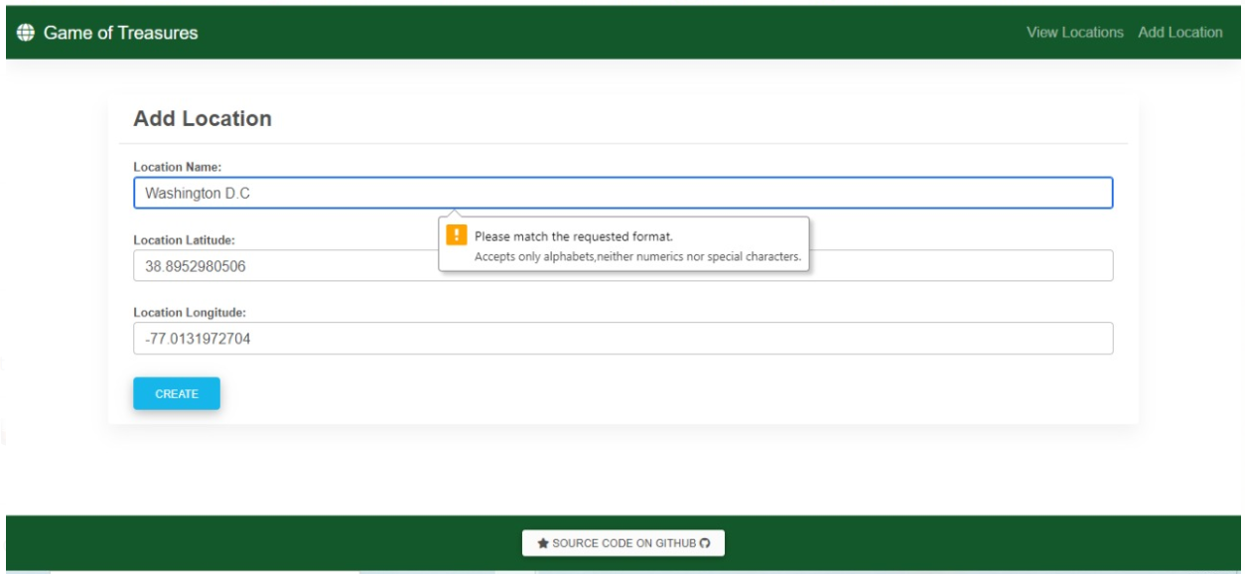
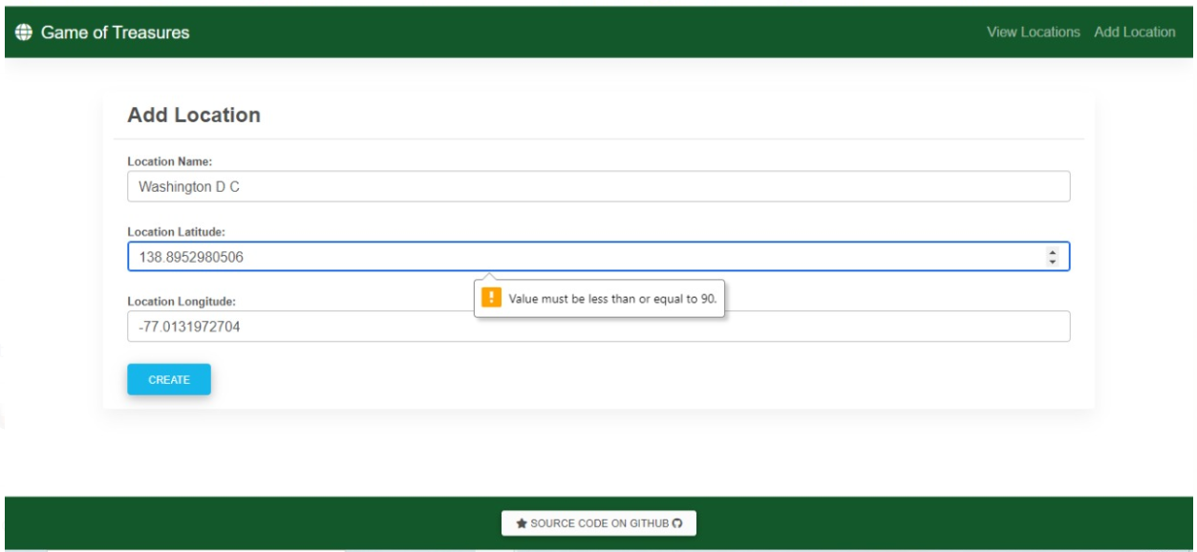
Validation on adding a location

Slide 9
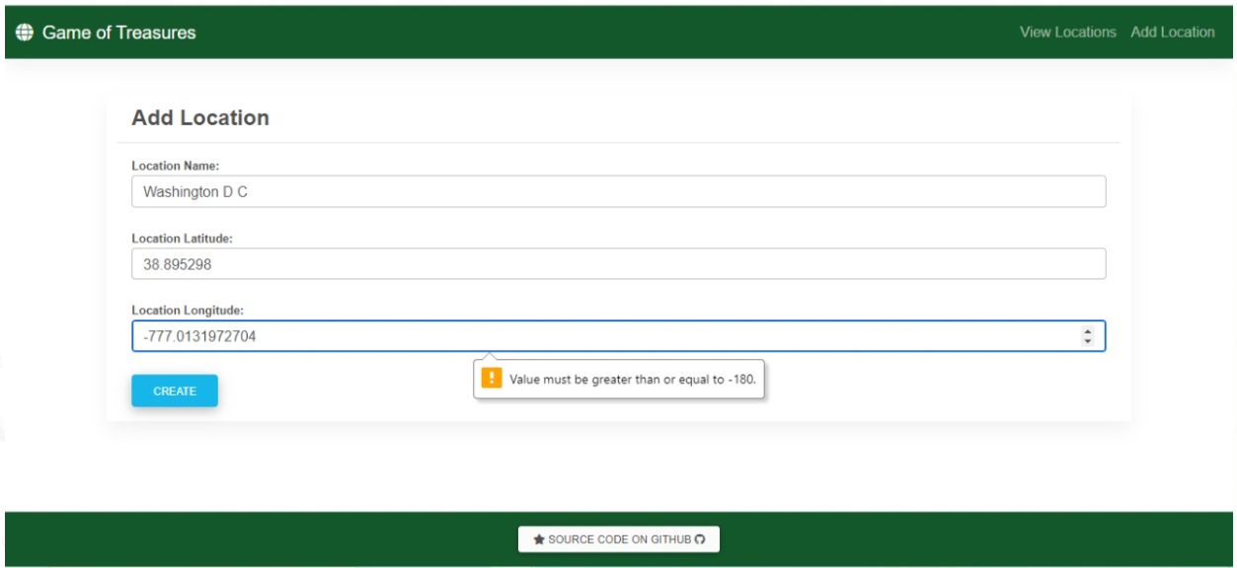
Validating the add location

Slide 10
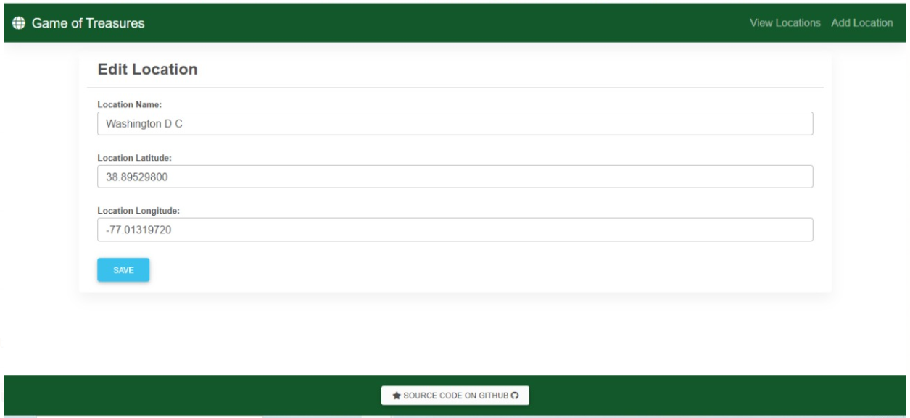
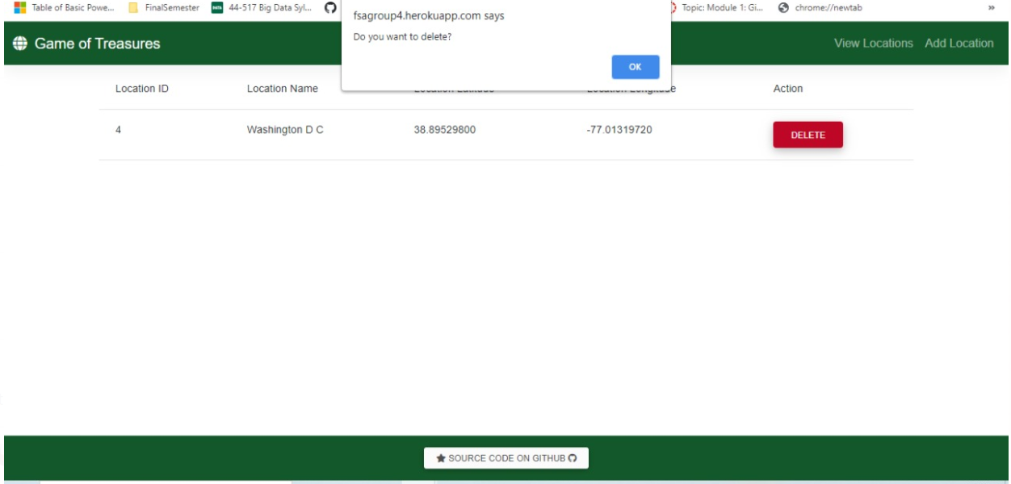
Edit location and Delete location

Slide 11
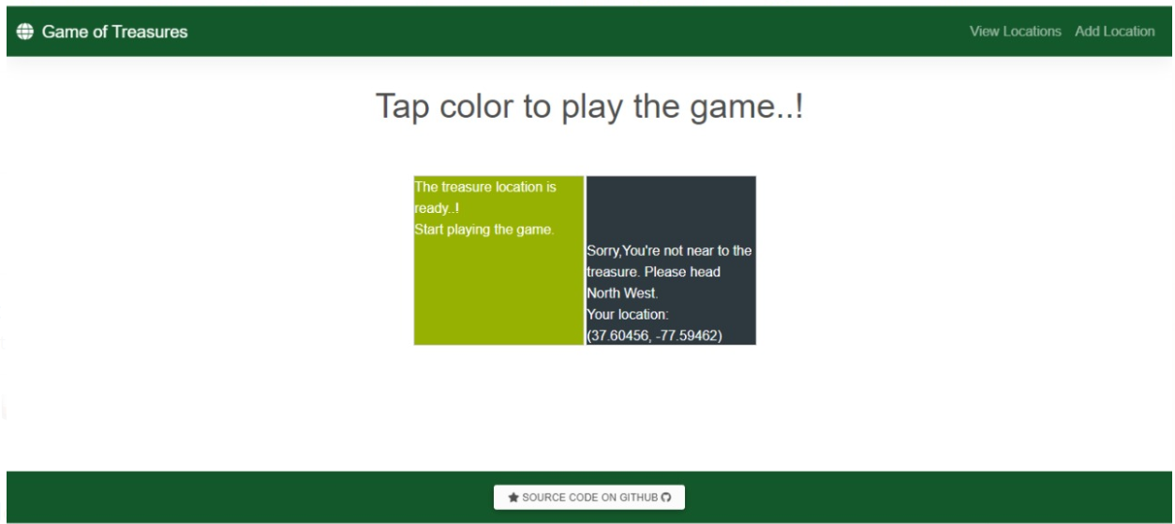
End Of Application

