Slide 1
Aspire Lifestyles Snowflake Migration

Slide 2
CONTENTS
Snowflake Environment
Environments and Structure
One Time Load (MS SQL to Snowflake)
Generic Load design
Load logging
Error capturing
Incremental Load
Main architecture
3NF and DWH Snowflake data loads
Batch and Logging Implementation
Stored Procedures in Snowflake
Demo: Database Load
Demo: File Load
Automated Recon (count) process

Slide 3
Snowflake Structure
Databases
DEV
QA
PROD
Schemas
CONCIERGE_PROFILING
CONCIERGE_STAGING
CONCIERGE_3NF
ASPIRE_STAGING
ASPIRE_CONFIGURATION
ASPIRE_DWH
OTL
Objects
Tables
Views
Stored Procedures
Functions
File Formats

Slide 4
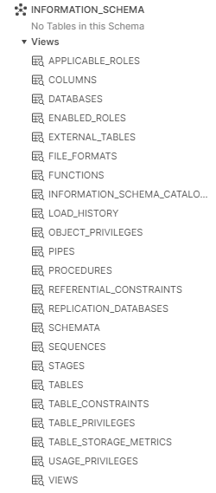
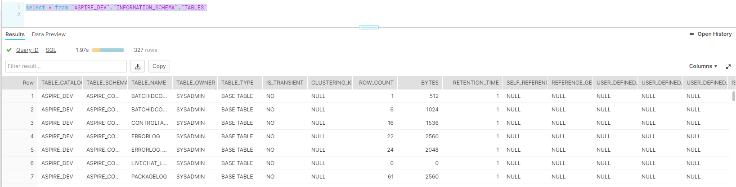
Snowflake Information Schema
Each Database contains an INFORMATION_SCHEMA that contains object related information. Some details are restricted and visible to only users with higher privileges

Slide 5
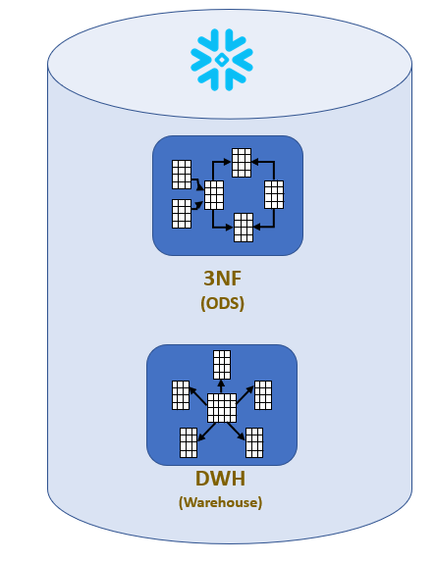


One Time Load Design
Generic Load
Talend
3NF
Snowflake Copy
Windows
authentication
AZURE BLOB
DWH
Snowflake Staging Area
Data unloaded in batches for bigger tables based on date filter

Slide 6
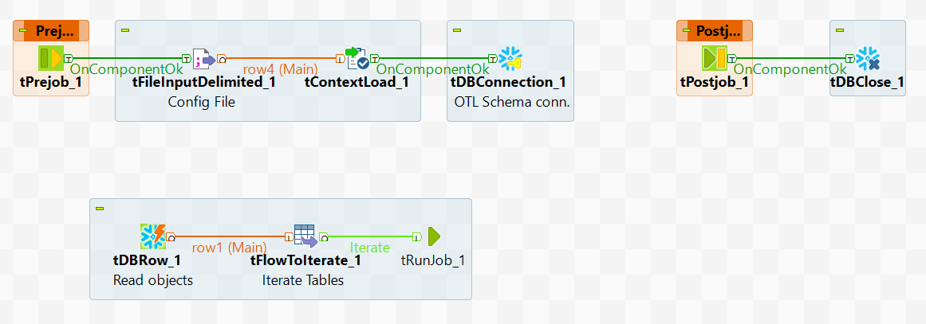
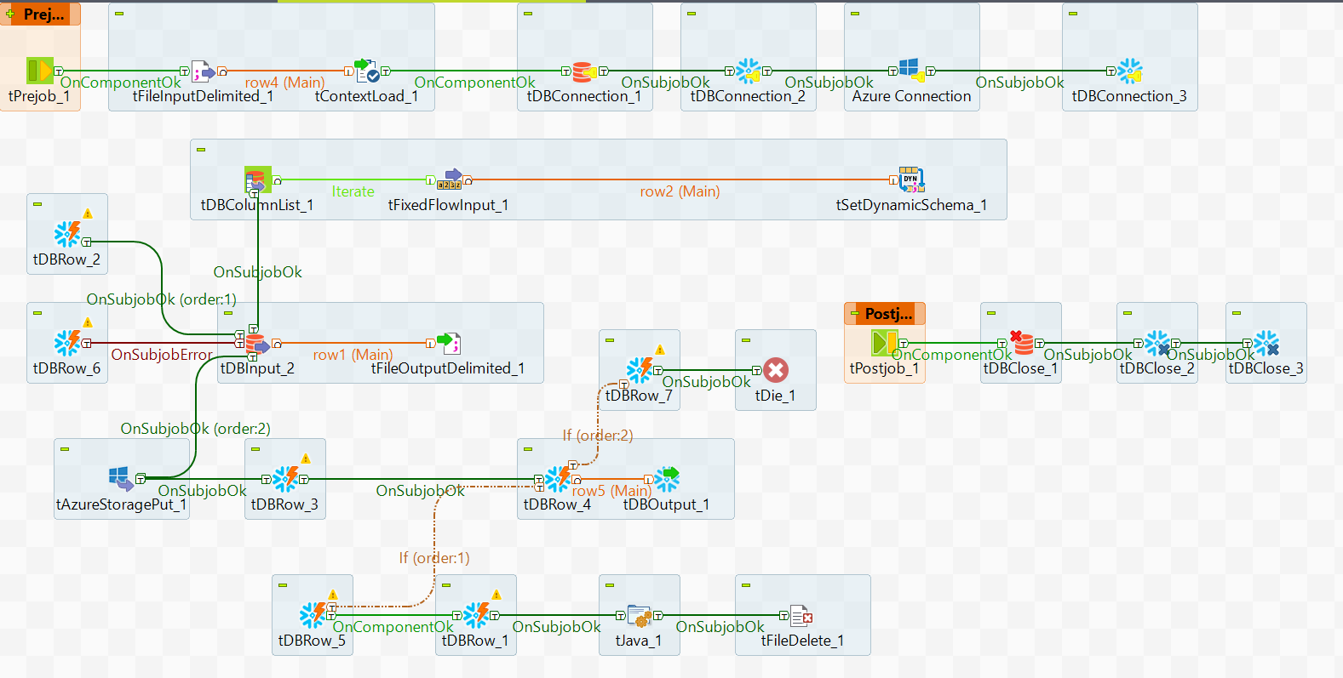
Generic Talend Job for One Time Load
Reads Table names one by one from the Object List Control table that contains the list of objects to be loaded from MS SQL Server to Snowflake
Iterates and passes the table name to the generic job
Generic job unloads data from MS SQL Table that was passed from the Initial Job into a temporary file in the execution server
The file is transferred from the Talend server to the Azure Blob location which has been created as a staging area for Snowflake
The data from the file is copied into the corresponding Snowflake Table.
The temporary file in the execution server is deleted

Slide 7
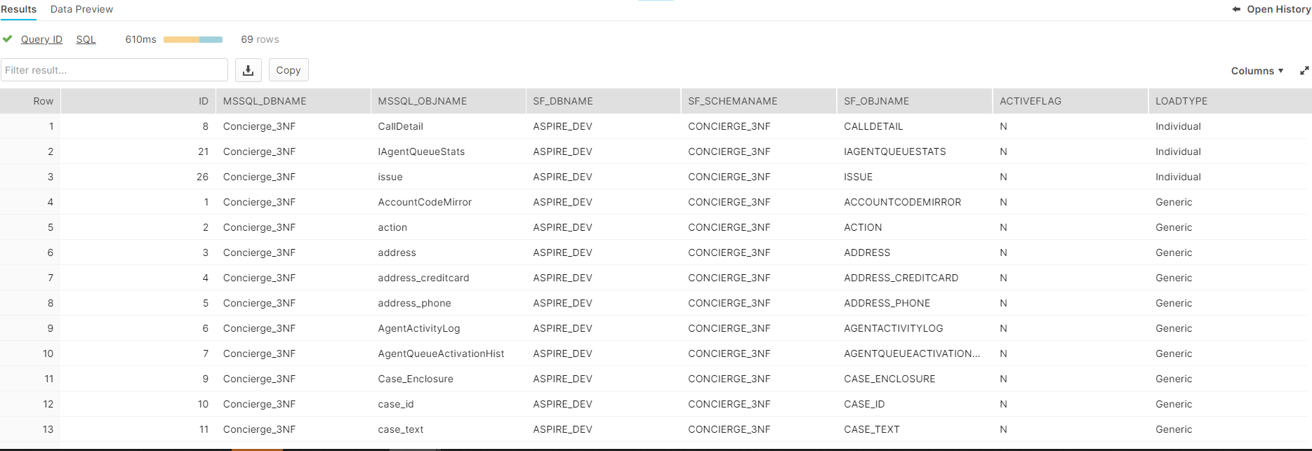
Object List Table in Snowflake
SELECT * FROM ASPIRE_DEV.OTL.OBJECTLIST
OBJECTLIST table that consists of the Object names of MS SQL and corresponding Snowflake tables that has to be loaded as a one-time activity
Any new table can be added by adding an entry or tables can be selectively loaded by accordingly adjusting the ActiveFlag

Slide 8
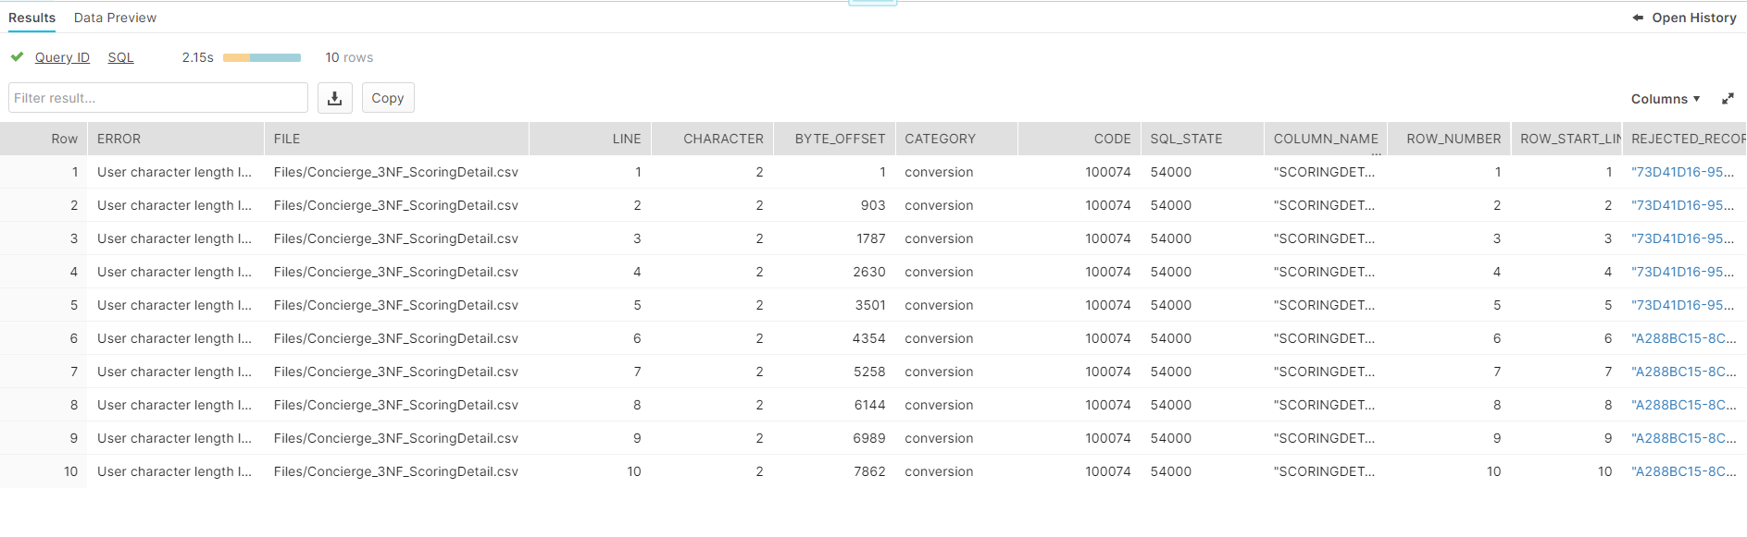
One Time Load Error Catching and Logging
SELECT * FROM ASPIRE_DEV.OTL.LOADERROR
Any errors encountered in the load process is captured in the LOADERROR table with detailed description.

Slide 9
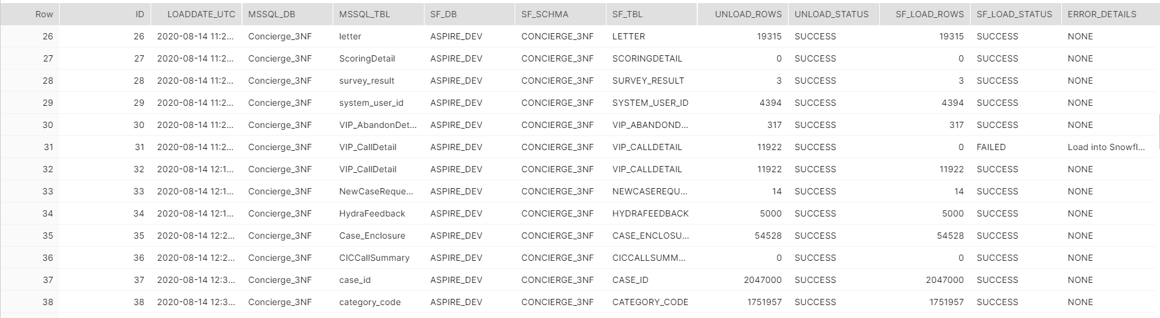
One Time Load Audit and Logging
SELECT * FROM ASPIRE_DEV.OTL.OTL_LOGGING
Log table captures the details of the load and status of unloading from SQL server and load in Snowflake along with error details.
It also performs a basic validation and recon on the fly by getting the counts of data unloaded and loaded in Snowflake

Slide 10






On-Prem
Talend Cloud
Hydra
CIC 4.0
SwitchFly
Database
NewCase
Database Connections
Jobs: Schedule, Run & Monitor
EPC (Moscow)
Talend Service account (windows authentication)
Data Masking
(ePC)
EPC
Incremental Data Transfer
File Read
(Uses Authentication )
Security Users
Files
Network Shared Path (AspireDA)
Talend Engine ETL
(On Prem)
Extracts
Rpt Files
Schemas (Snowflake DB)
REST API Access
Other Adhoc Files
(future scope)
Incremental Load Architecture
Applications
Live Chat

Slide 11

Data Flow within Snowflake (3NF)
3NF
Data Profiling and filtering error rows
Insert/Update data into Final Tables
Profiling
Staging
3NF
Data from external sources
Masked if required
Talend Components
(less volume of data)
Executing Stored Procedures in Snowflake using Talend
Data remains within Snowflake
Improved performance and faster processing of data

Slide 12
Data Flow within Snowflake (DWH)
DWH
Merging data into Dimension tables
Transformation and Upsert into Fact Tables
Facts
Staging
Dimension Tables
Executing Stored Procedures or merge queries in Snowflake using Talend
Executing Stored Procedures in Snowflake using Talend
Data from 3NF and
external sources
Data remains within Snowflake
Improved performance and faster processing of data
Data remains within Snowflake
Improved performance and faster processing of data

Slide 13
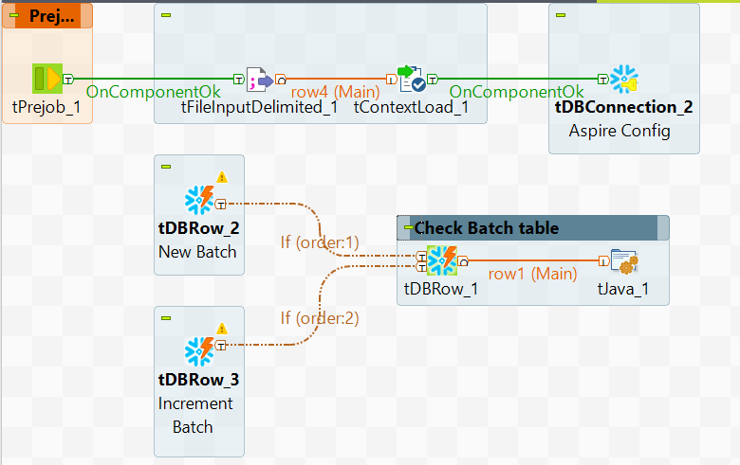
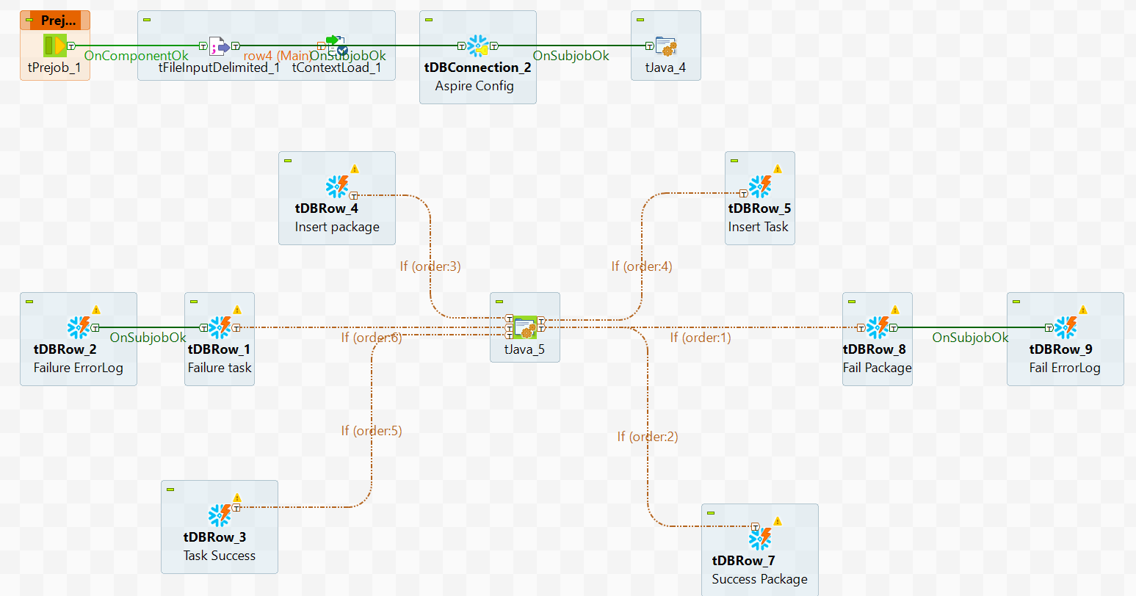
Batch and Logging Generic Talend Job (DWH)
Generic Talend Job for Batch initiation/increment and Logging (Package, Task and Error Log)

Slide 14
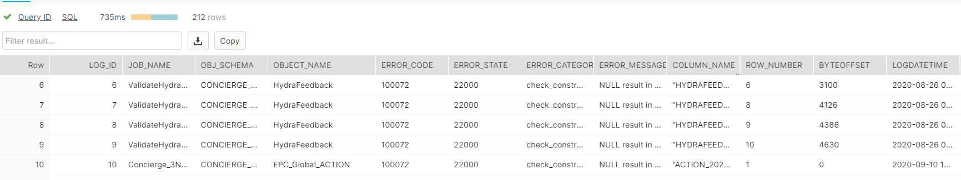
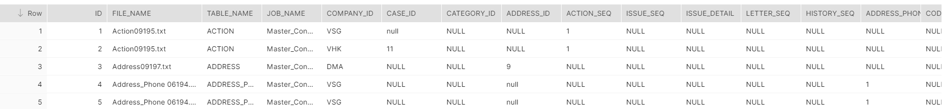
Talend Error Log and File Error Log tables
SELECT * FROM ASPIRE_DEV.CONCIERGE_CONFIGURATION.TALEND_ERROR_LOGS
Talend Error Log table for capturing ETL related errors
SELECT * FROM ASPIRE_DEV.CONCIERGE_CONFIGURATION.FILE_ERROR_LOG
File Error Log for capturing rejected records from files based on rejection rules

Slide 15
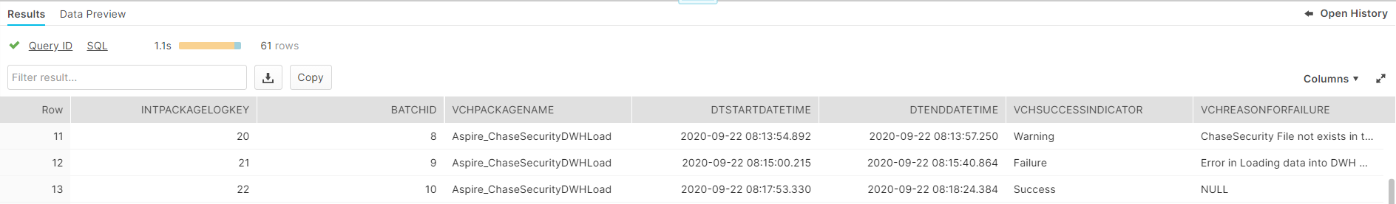
Package, Task and Error Log tables
Package log table logging status of Talend Package execution, run time and high level errors
Task log table logging details of each task execution within a package
Error Log table having detailed errors encountered in both ETL and execution of Stored Procedures

Slide 16
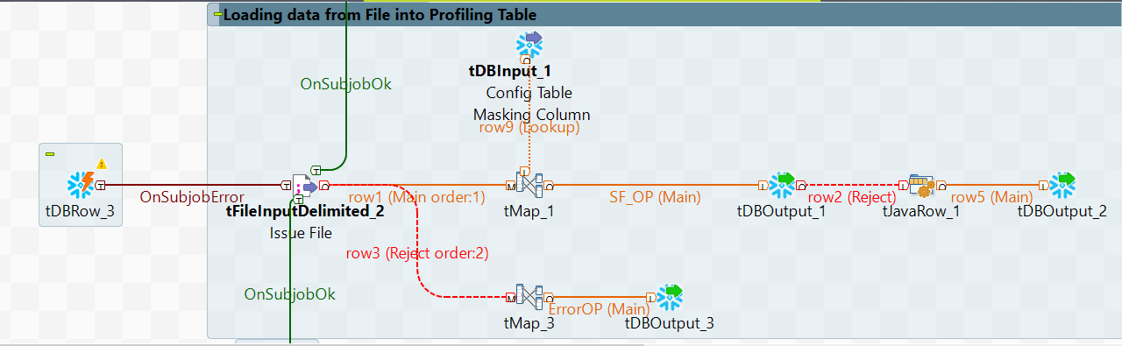
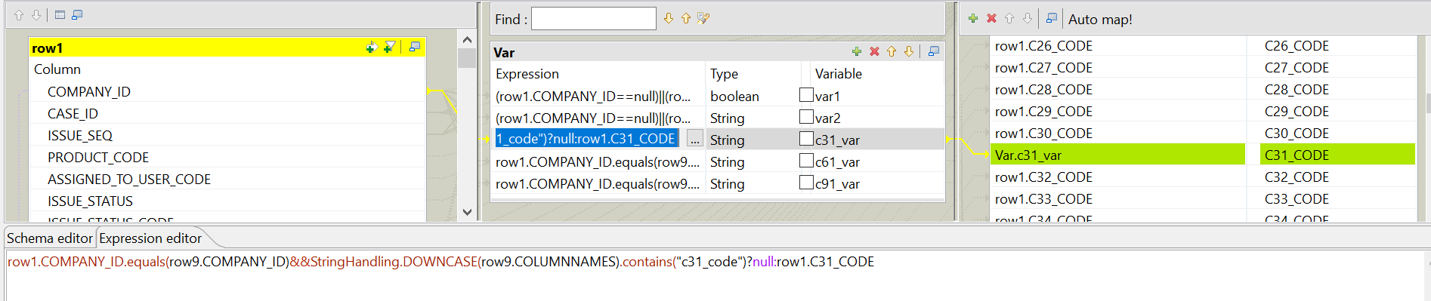
Data Masking as per existing rule (ePC)
Sensitive Data Masked in Talend ( ePC) before being loaded into Profiling layer (existing columns)

Slide 17
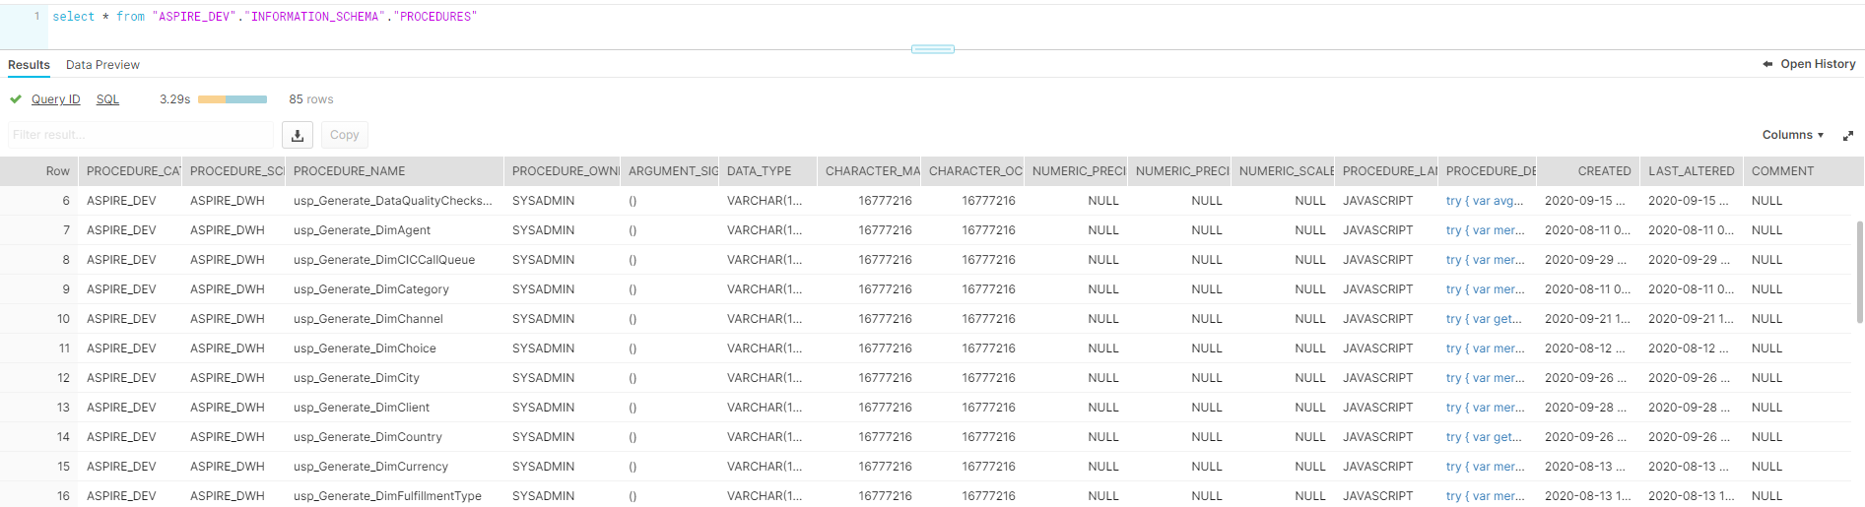
Snowflake Stored Procedures
Details of Stored Procedures in Snowflake can be obtained from "INFORMATION_SCHEMA"."PROCEDURES“ System View including creation date, altered date, procedure script etc
Alternatively Stored Procedures DDLs can be obtained by executing the get_ddl query
e.g: select get_ddl('procedure','"usp_Generate_DimCity"()')

Slide 18
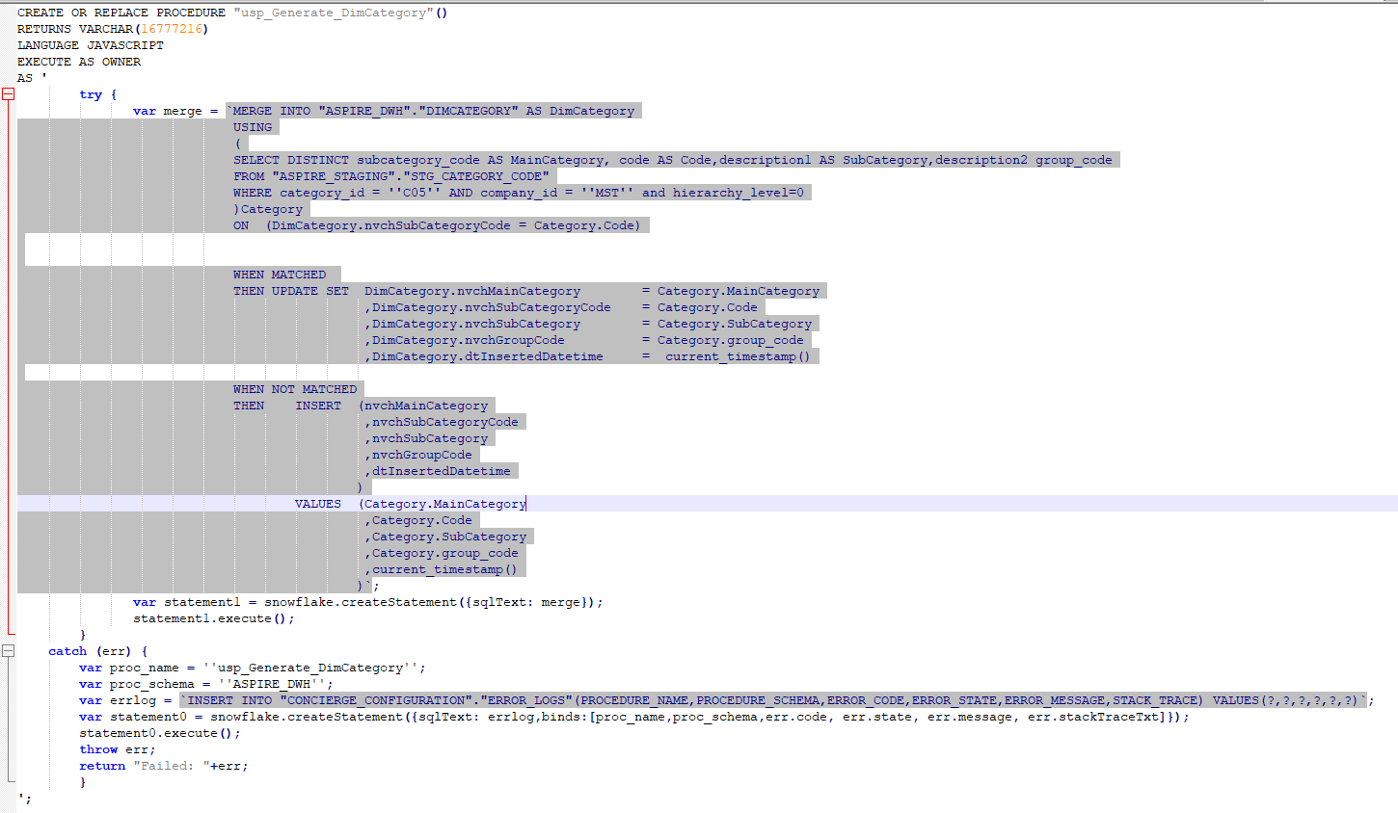
Snowflake Stored Procedure Structure
Stored Procedure in Javascript
Main Code
Error Catching

Slide 19


Case: Source DB Load (HydraFeedback)
Hydra Server
Data Ingestion
Data Load
Incremental data
Load
Windows Auth using
Talend Service
Accounts
Data Profiling
and filtering out
error rows
Executing USP
spImportHydraFeedback
client_vwRptFB_832764_AC_Concierge_Specialty
Profiling Layer
HydraFeedback
Staging Layer
HydraFeedback
3NF
HydraFeedback
Stage Load based
On last load
time
NewCase
Fact Load
Profiling | NEWCASEREQUESTDETAILS
Staging | NEWCASEREQUESTDETAILS
3NF | NEWCASEREQUESTDETAILS
Executing Merge Queries in Snowflake
DWH Fact
FactHydraFeedback
DWH Staging
STG_HYDRAFEEDBACK

Slide 20

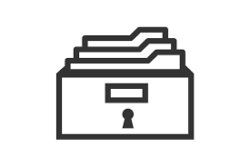
Case: Source File Load (ePC Global)
Check file name
pattern
Last
Modified
Date>Last
load
date
File
exists?
YES
YES
Add file
Names in
load table
Data Profiling
Filtering error
rows
NO
NO
Data Ingestion
Data Masking
Staging Layer
Update Warning Status
in Log tables
Profiling Layer
Merging using USP in
Snowflake
Don’t load files
Moving files
Into archive path
3NF Table

Slide 21
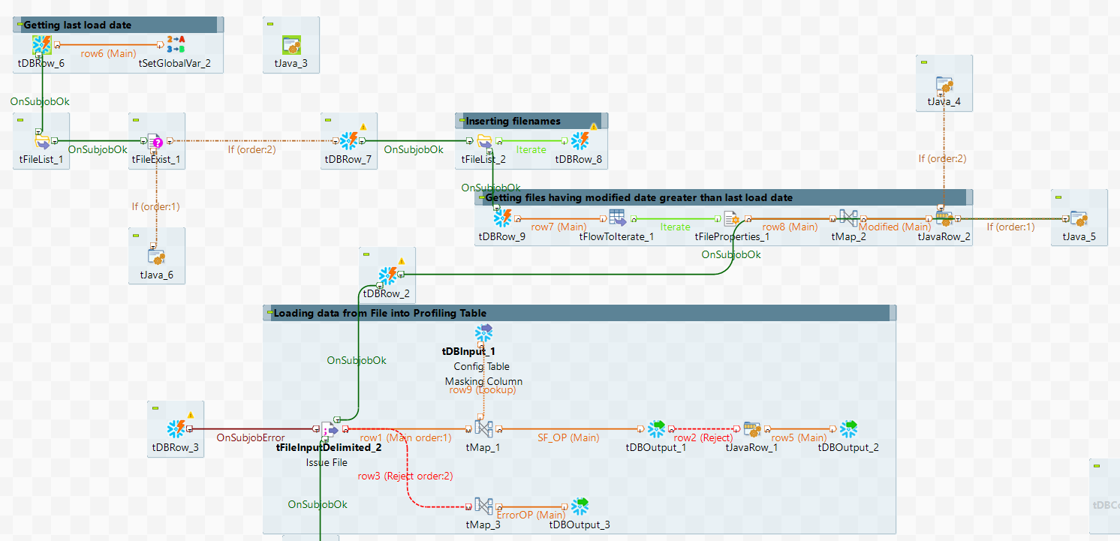
Case: Source File Load (ePC Global) cont..

Slide 22
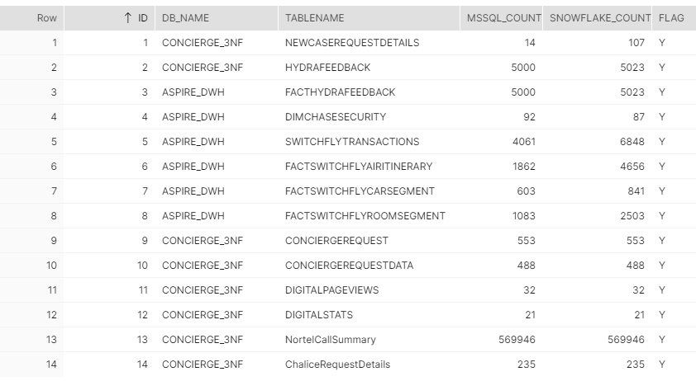
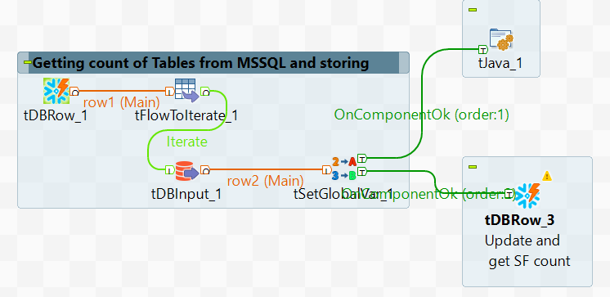
Automated Recon Count Process
select * from "ASPIRE_QA"."OTL"."RECON"
Generic count validation job that reads table names from recon table , captures MS SQL counts, Snowflake counts for the table and updates in the same table
New tables can be added and selective execution can be made by activating Flag.
N.B.: Counts of Hydra, NewCase and SwitchFly is more as Snowflake has extra incremental data compared to MS SQL DEV.

