Slide 1
Smart Car Parking System
Project by:
D Mabu Jaheer Abbas – S20190020209
Thota Datta Aneesh – S20190010181
Thorlikonda Lakshmi Sai Gopinadh – S20190010180
Veduruparthi Sai Bhaskar – S20190010188

Slide 2
Contents
Components Used
Functional Block diagram
Outcome for Phase 1
Outcome for Phase 2
Images of prototype and output

Slide 3
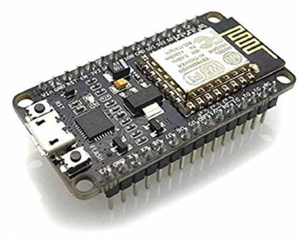
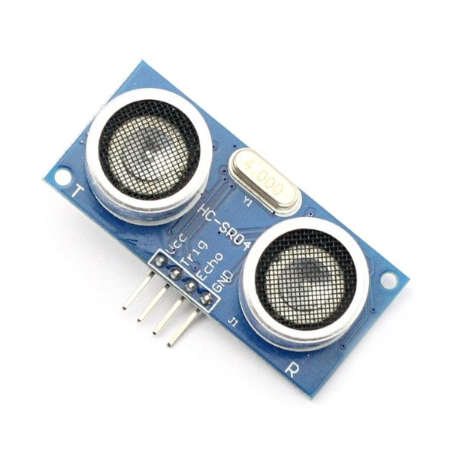
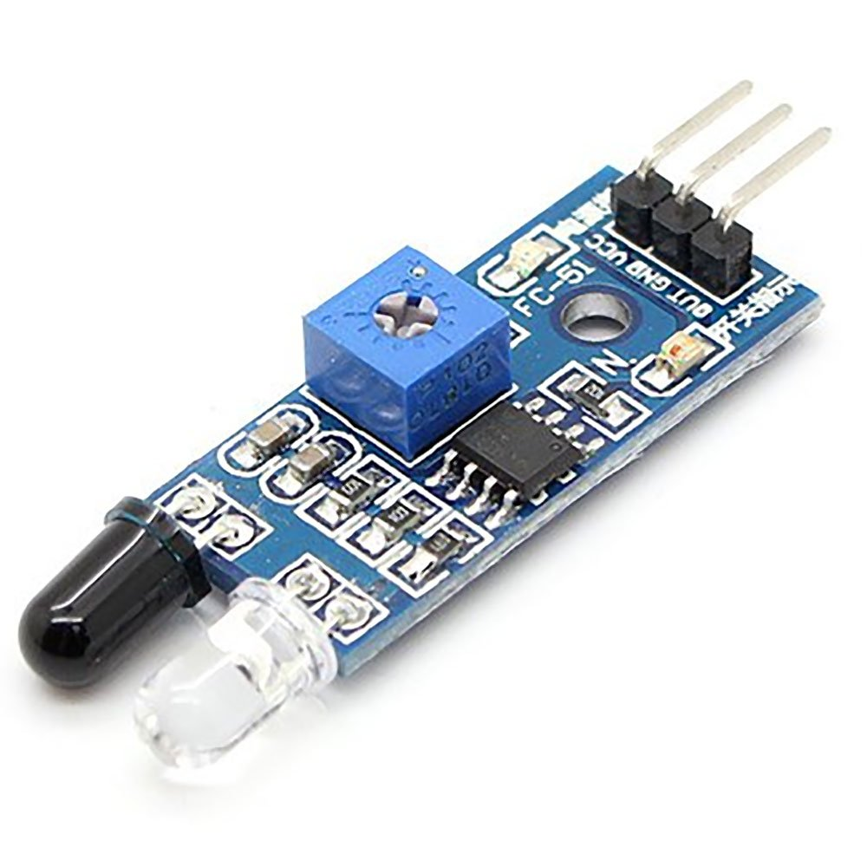
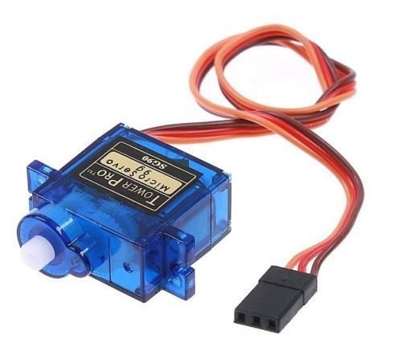
Components used for this phase:

Slide 4
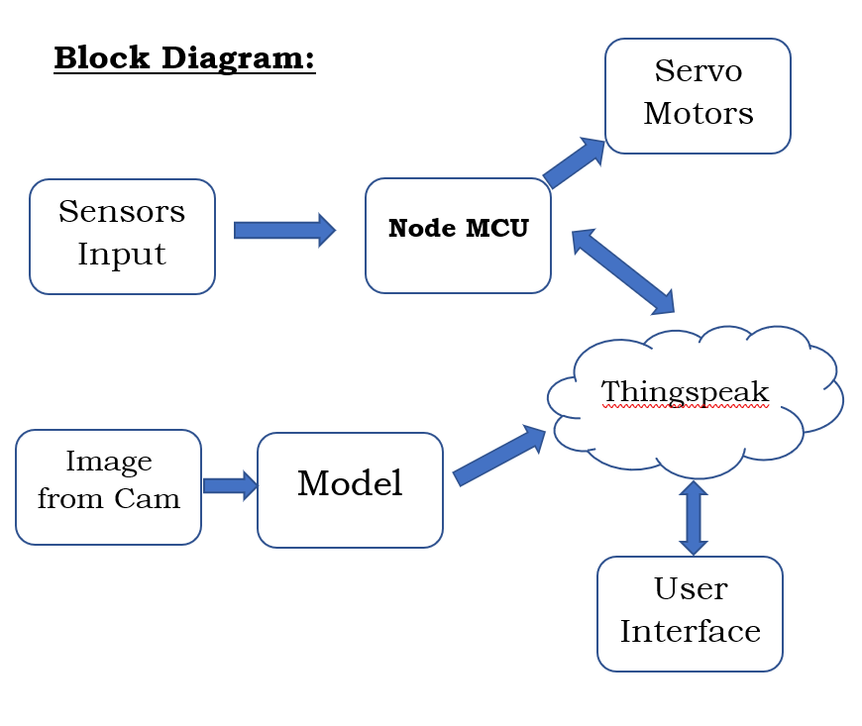
Block Diagram for this phase:

Slide 5
Outcome for Phase-I
As part of phase 1, we have build a NodeMcu based car parking system using IR sensors and Ultrasonic sensors.
We have coded NodeMcu such that it will be continuously monitor the status of given parking slots i.e.. Empty or Filled.
Here each Ultrasonic sensor is used for monitoring each parking slot given.
And IR sensor is used to give way at entrance and exit points.
And also published the data of parking slots to cloud via MQTT protocol.

Slide 6
Outcome for Phase-II
As part of phase 2, we have build a license plate extraction model from image.
We have updated our app such that one can book the slot by giving his car number.
Comparing extracted number and booked number from app to allow the car into parking slot.

Slide 7
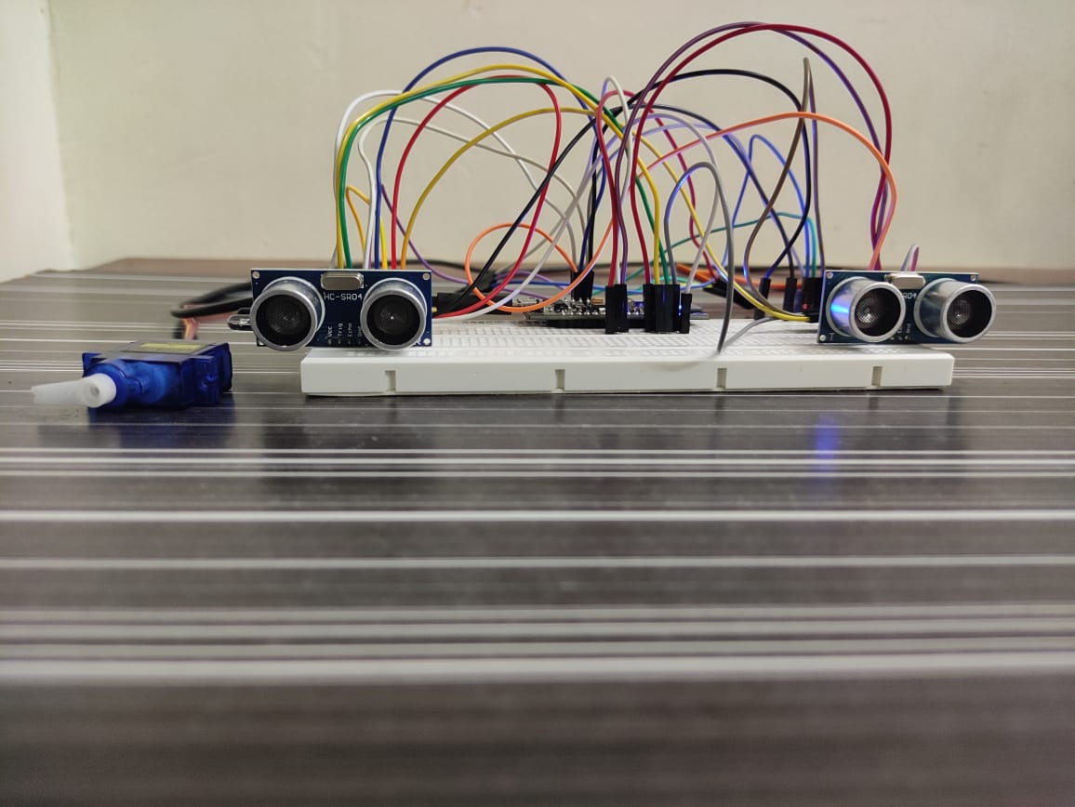
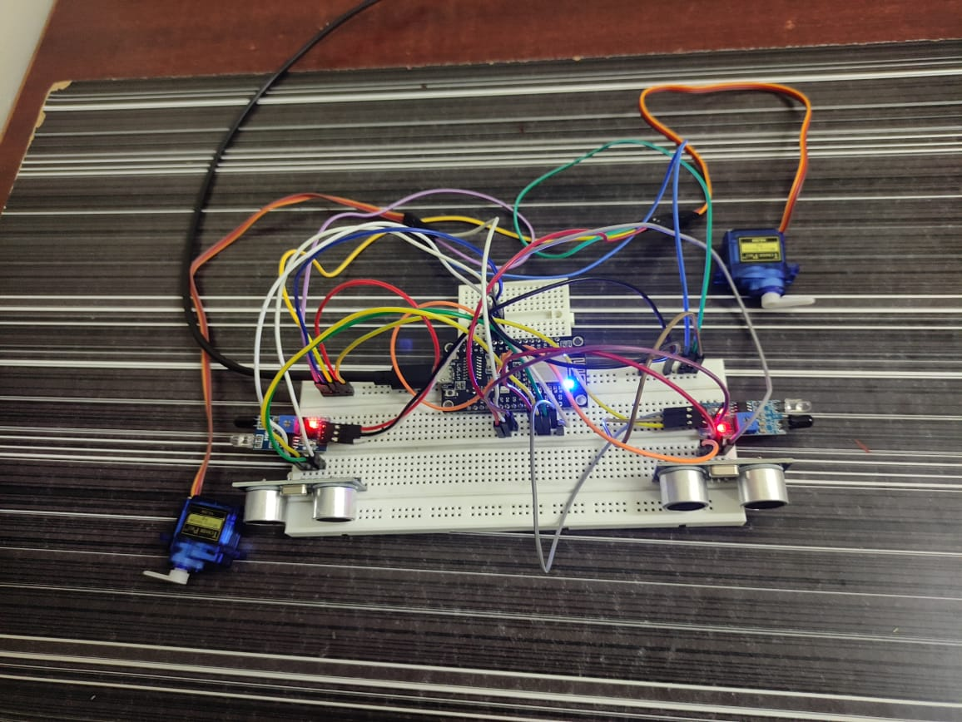
Image of Integrated Prototype

Slide 8
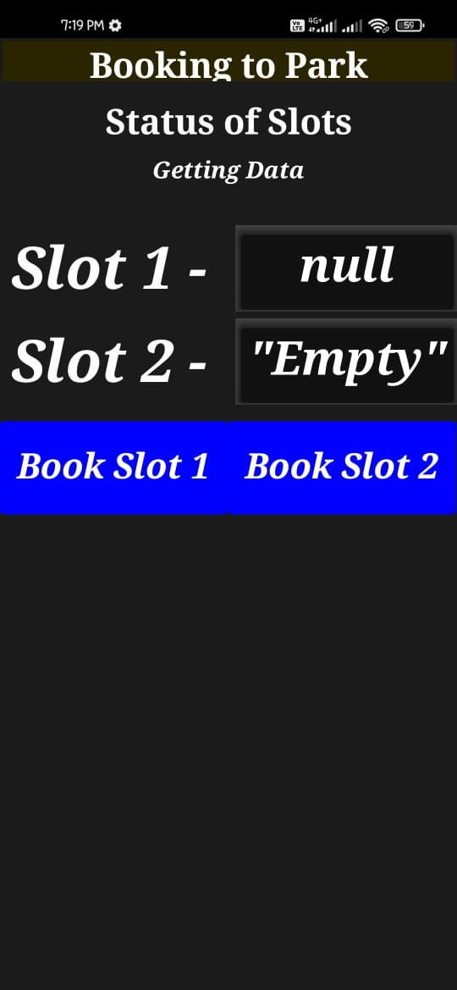
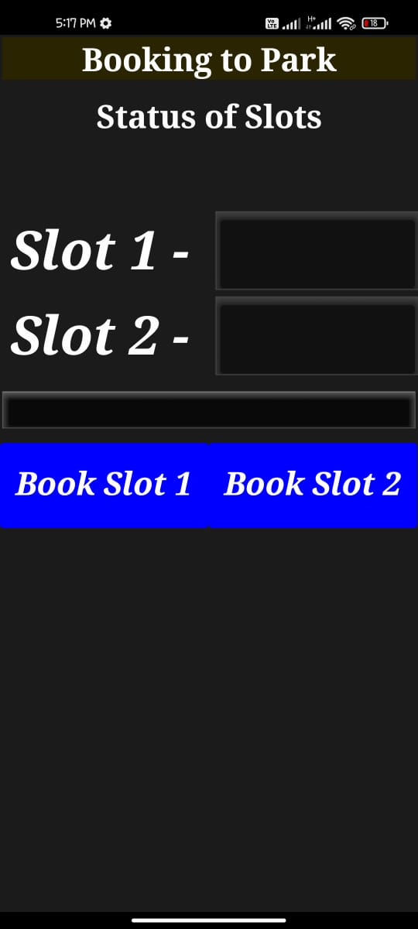
App Interface

Slide 9
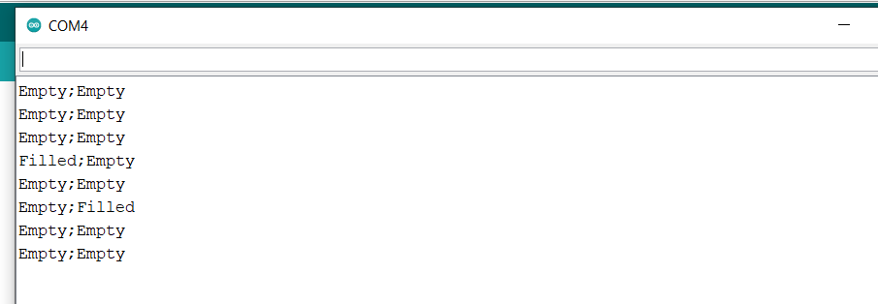
Slots Status output

Slide 10
Thank You

