Slide 1

Kubeflow Control Plane
Weiqiang Zhuang
wzhuang@us.ibm.com
IBM CODAIT
Github id: adrian555

Slide 2
High level code walkthrough
kfctl & manifests
Document https://www.kubeflow.org/docs/started/getting-started/
kfctl https://github.com/kubeflow/kfctl
manifests https://github.com/kubeflow/manifests
kfctl is the control plane for deploying and managing Kubeflow.
Run kfctl as a CLI with KfDef configurations for different Kubernetes flavors
KfDef configurations are bespoke configuration, ie. kustomization and resources used by kustomize
manifests is the repo for KfDef configurations
kfctl also incubates an operator to deploy and monitor Kubeflow

Slide 3
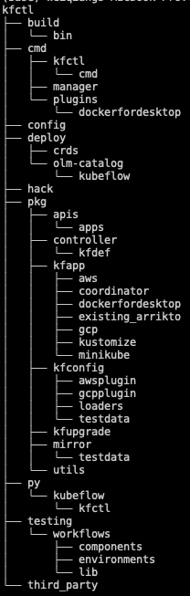
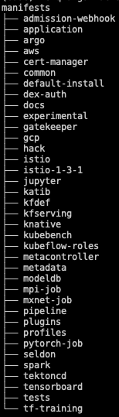
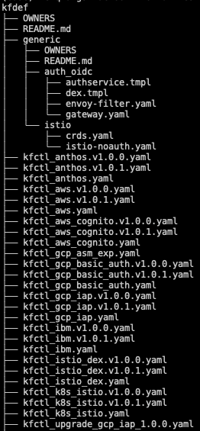
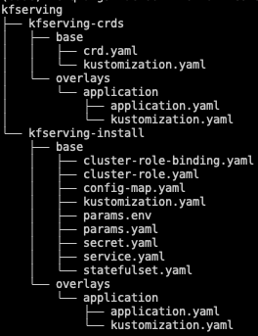
High level code walkthrough
Directories

Slide 4
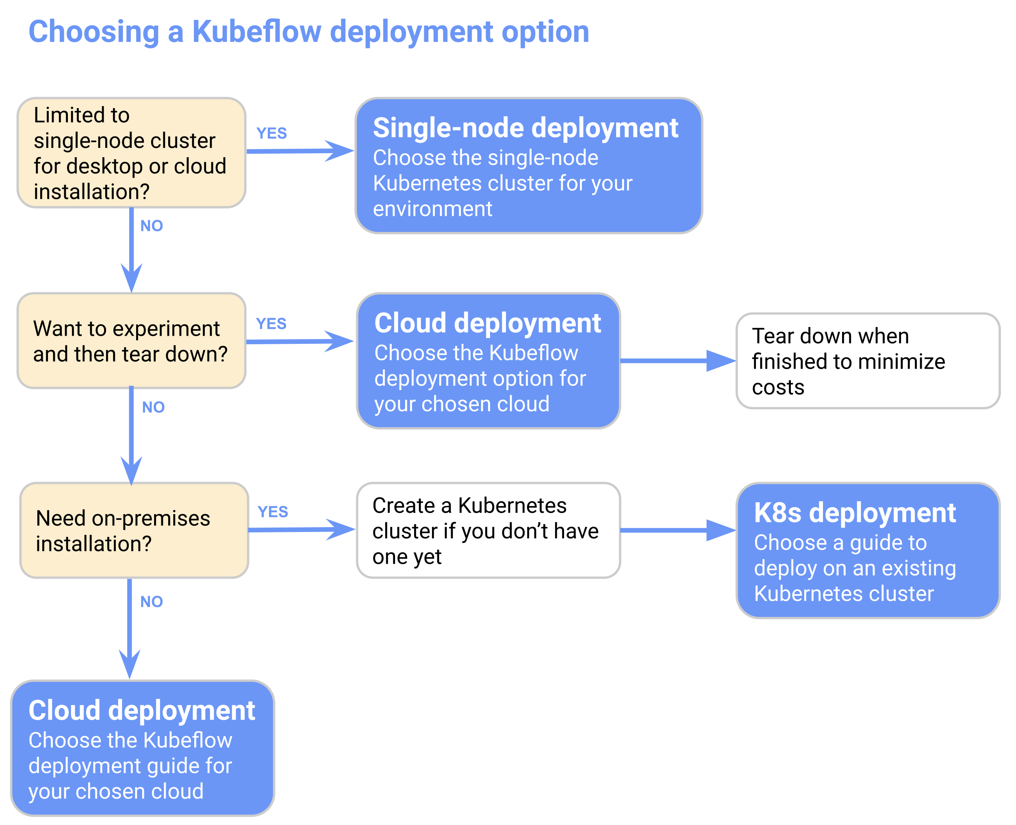
Kubeflow control plane
Deploy, manage and monitor Kubeflow
On various environments
GCP/AWS/AKS/IKS/OpenShift
Other K8S
On-prem Linux/MacOS/Windows
minikube/miniKF
Configurations
Use one from manifests repo, or
Create your own
https://www.kubeflow.org/docs/images/kubeflow-getting-started-diagram.svg

Slide 5
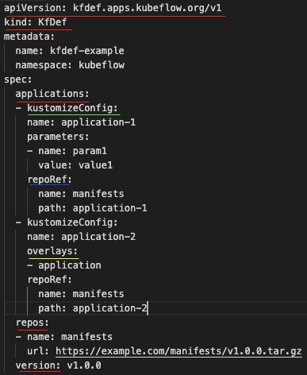
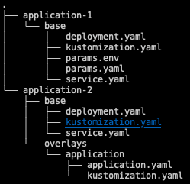
Kubeflow control plane
KfDef
Configuration through yaml
Code https://github.com/kubeflow/kfctl/blob/master/pkg/kfconfig/types.go
applications are in kustomize form
Also support plugins for certain platforms (ie. Aws, Gcp)
Manifest repo can be either remote archive or local directory
The directory structure for manifests follows kustomize requirement
Eg. Argo
Configuration in yaml
Directory structure

Slide 6
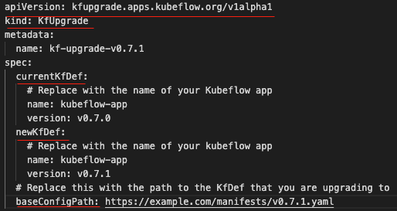
Kubeflow control plane
KfUpgrade

Slide 7
Kubeflow control plane
Kubeflow manifests repo
Maintains the manifests for Kubeflow’s common applications
Argo, centraldashboard, admission-webhook, basic-auth, metadata, profiles and more
Other applications
Each application can be built with kustomize tool
$> kustomize build
$> kubectl apply -k

Slide 8
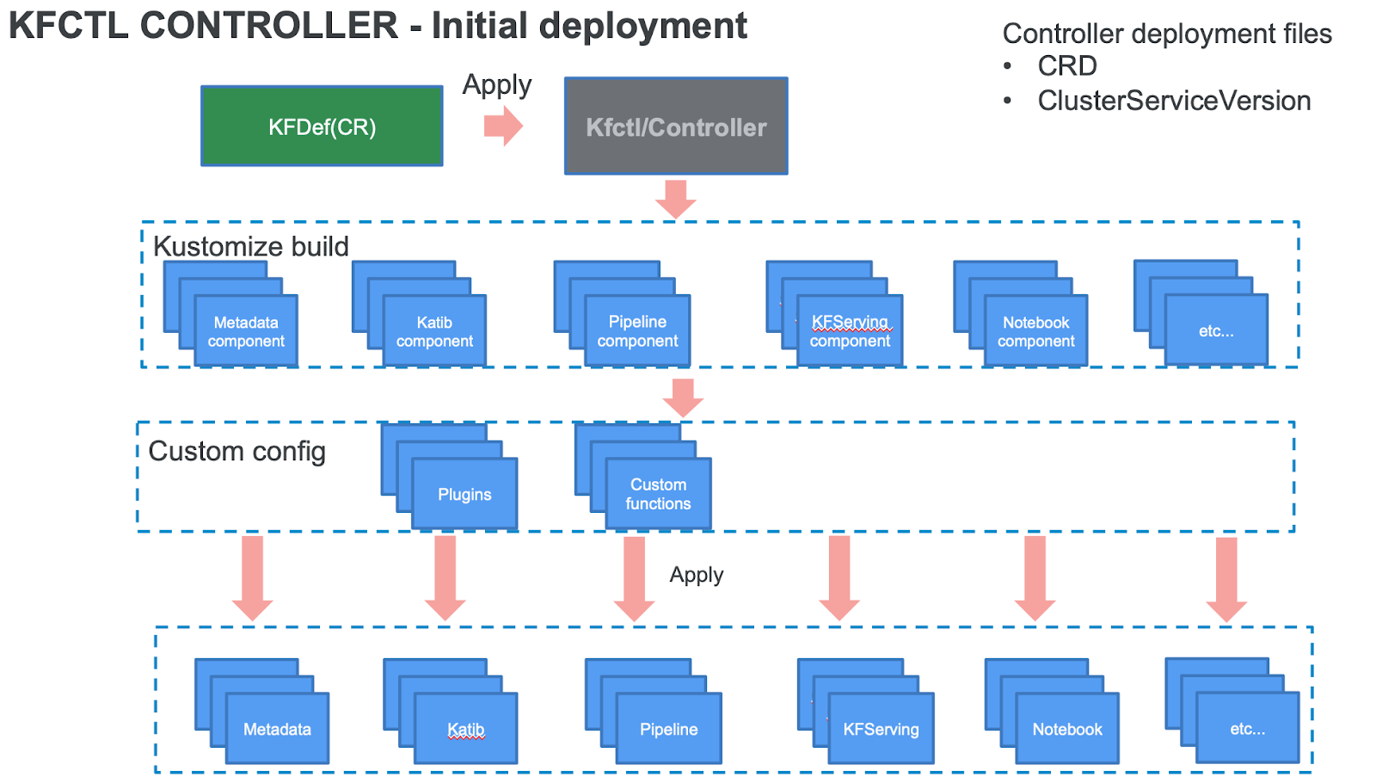
Kubeflow control plane
kfctl

Slide 9
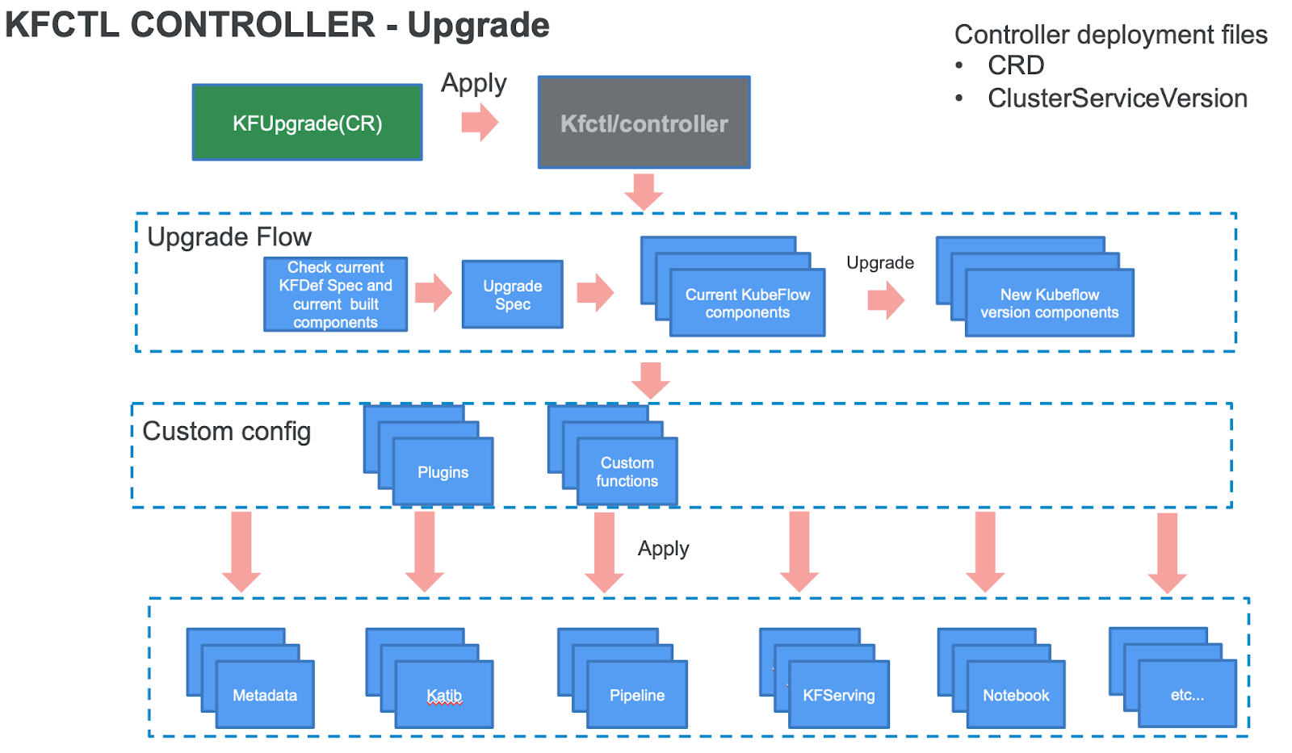
Kubeflow control plane
kfctl

Slide 10
Kubeflow control plane
kfctl
Command line to install/upgrade Kubeflow
$> kfctl build –f <config_uri>
$> kfctl apply –f <config_uri>
$> kfctl delete –f <config_uri>
<config_uri> can be remote or local
Downloads the manifests for applications (if remote) from the repo:uri defined in the configuration file, and caches in the local disk
Loops through all applications’ kustomization configuration and build/deploy
Runs platform special handling if the configuration contains plugins section

Slide 11
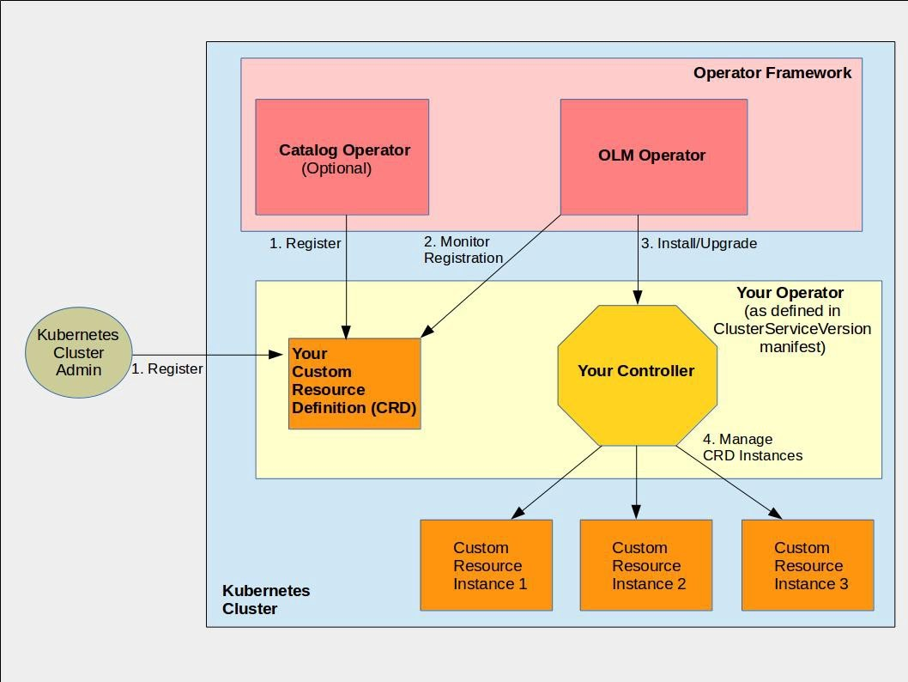
Kubeflow control plane
Kubeflow operator
Operator helps deploy, monitor and manage the lifecycle of applications deployed on Kubernetes and OpenShift clusters
Learn more about operators - link
Shares the same apply function with kfctl command
delete function diffs from kfctl command
Configuration file is the custom resource (CR)
Document
https://github.com/kubeflow/kfctl/blob/master/operator.md
https://miro.medium.com/max/2116/1*GYLAUB7KGCysjPgwek-pPA.jpeg

Slide 12
Kubeflow control plane
Kubeflow operator
Code structure
/deploy: Contains all the k8s resources for deploying the operator image and crd
/build: Operator image build script
/pkg/controller: main package for operator controller logic
/cmd/manager: main.go file for the operator go program
Kubeflow operator watches the KfDef and other related resources
Two steps to install Kubeflow
Deploy the Kubeflow operator, then
Install the Kubeflow by creating the KfDef CR
Kubeflow operator continues to monitor and manage any KfDef CR created

Slide 13
Kubeflow control plane
Kubeflow operator
Operator can be deployed by command line
$> kubectl create -f deploy/operator.yaml -n ${OPERATOR_NAMESPACE}
Operator is registered on operatorhub.io, can be installed through OLM console or OpenShift web console
OLM discovers the Kubeflow operator from its catalog source
Kubeflow is installed by creating a KfDef CR from command line, or
$> kubectl apply –f <configuration_uri>
Creating a subscription to the operator from the web console

