Slide 1

Kubeflow PR workflow
Weiqiang Zhuang
wzhuang@us.ibm.com
IBM CODAIT
Github id: adrian555

Slide 2
Get ready
Up to now, you
Know what the Kubeflow open source project is about
Identify the project/repo/area/code to contribute
Have the development environment set up
Git, Go tools and IDE
Have a cloud cluster to run tests
And, most important, you should
Follow the Kubeflow contributing guide to
Sign the Contributor License Agreement (CLA)
Join the community
Move on to create Pull Request (PR)
Pull requests let you tell others about changes you've pushed to a branch in a repository on GitHub. Once a pull request is opened, you can discuss and review the potential changes with collaborators and add follow-up commits before your changes are merged into the base branch. --- About pull requests

Slide 3
Kubeflow PR Workflow
Pull requests are a collection of commits submitted to be merged into the main source repo
Four step process
Find and claim an issue to work on
Write codes + tests
Submit the patch for review
PR is merged

Slide 4
Find an Issue
Work items in Kubeflow are tracked on Github using issues
Each repository in Kubeflow org tracks its own issues, e.g.
https://github.com/kubeflow/kubeflow/issues
https://github.com/kubeflow/kfctl/issues
Helpful to attend the Kubeflow community meetings to stay up-to-date on areas to focus on
Community call calendar
Mailing list
Slack workspace
Read description, look at tag, etc. to find good first issues to start with
E.g. issues labeled good first issue, help wanted.
Open new issues

Slide 5
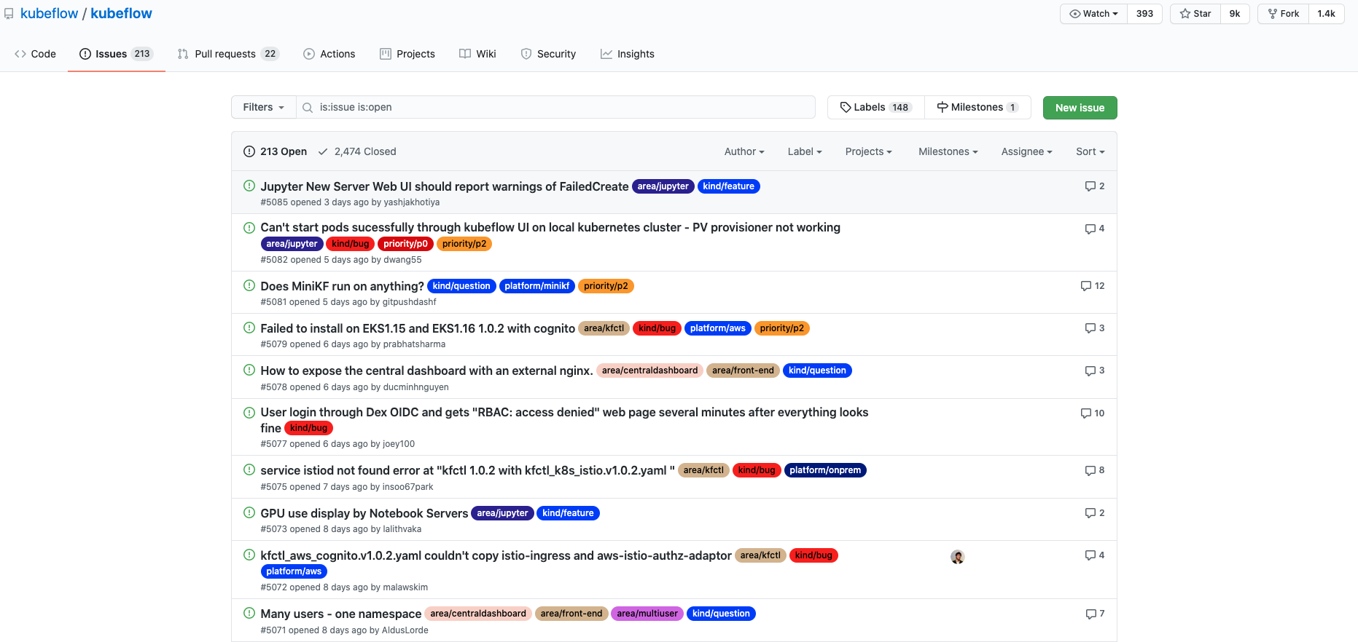
Find an Issue

Slide 6
Write codes + tests
Fork and Clone
Always fork from the master repo
Clone
Instead of working on master branch, create and checkout a new branch for each issue
Write codes with favorite IDEs, e.g.
Visual studio code, good for Golang, Java, Python and more
PyCharm, good for Python
Follow contribution guide, pay special attention to code style, conventions etc.
Tests
Write test cases, debug and test
New test cases may need to be pushed to the repo as well
Follow contribution guide to run other tests before PR submission
Eg. make test is common for projects in golang

Slide 7
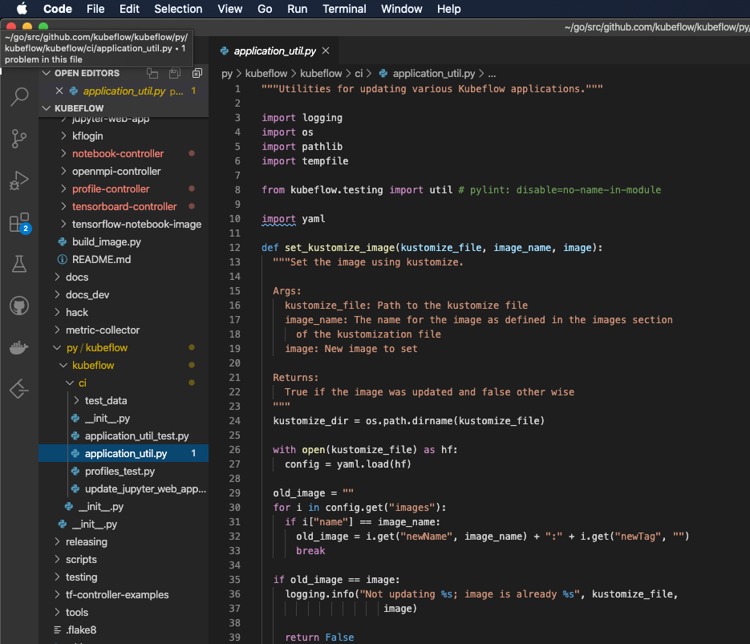
Write codes + tests

Slide 8
Submit PR
Commit and push to forked repo
Create upstream remote and merge with the latest upstream/master
Commit (and sign off) the code changes
Push to forked repo
Open PR against the master repo
Create pull request from browser navigating to the forked repo
E.g. https://github.com/kubeflow/kfctl/compare/master...adrian555:update-README
Refer the issue this PR fixes in the description, if the PR is fixing an issue
Automated CI pipeline will run test suites against your submitted code
Unit tests
Integration tests
Code style & formatting

Slide 9
PR is merged
Kubeflow members and contributors review the PR and comment
Code quality, Style changes, Functional changes, Correctness etc.
Address comments
Respond to comments
Make necessary code changes then commit and push
Resolve branch conflict
Two kinds of reviewers
Reviewers
Any member of Kubeflow org
Add /lgtm label once the reviewers approve
Approvers
Involved maintainers responsible for the code you’re changing
Add /approve label once the approver accept

Slide 10
PR is merged
Merge (automatically)
PR must be approved by at least one approver
Any branch conflict must be resolved by you
Pass all pre-submit test and other checks
Once merged, submitted commits will show up in commit history of the master repo
New features won’t show up until a new release is cut

