Slide 1
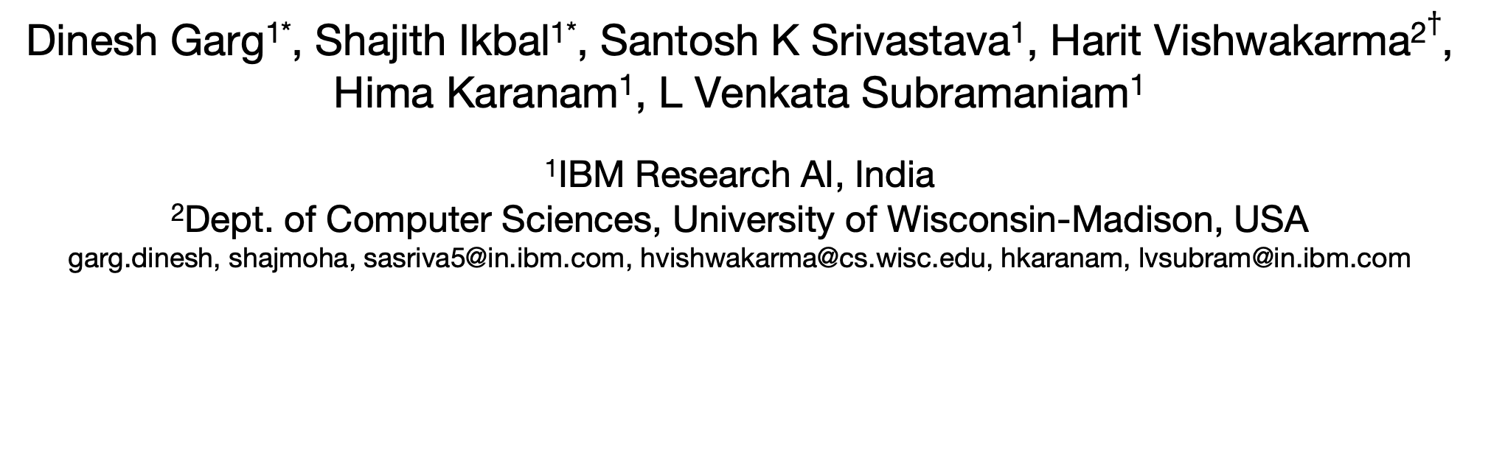
Quantum Embedding of Knowledge for Reasoning
Paper # 2995
@ NeurIPS’19
Dinesh Garg^{1*}, Shajith Ikbal^{1*}, Santosh K Srivastava¹, Harit Vishwakarma²$†$, Hima Karanam¹, L Venkata Subramaniam¹
¹IBM Research AI, India
²Dept. of Computer Sciences, University of Wisconsin-Madison, USA
garg.dinesh, shajmoha, sasriva5@in.ibm.com, hvishwakarma@cs.wisc.edu, hkaranam, lvsubram@in.ibm.com
* The first two authors contributed equally.
$†$ This work was done when the author was with IBM Research, New Delhi, India.

Slide 2
What and Why?
What are we trying to do?
Design a technique to embed Symbolic Knowledge Base (KB) into a vector space while preserving its logical structure.
Why are we doing this? What’s the use?
Such embeddings can be leveraged by several non-symbolic (e.g. neural and vector) methods to accomplish various reasoning tasks, such as
One should be able to perform logical operations on such embeddings in a manner similar to the Boolean Logical operations on a symbolic KB.
Knowledge completion (Inductive Reasoning)
Complex Membership Queries (Deductive Reasoning)

Slide 3
Input Knowledge: Entities, Predicates, & Hierarchy
Unary Predicates Hierarchy
(aka Concept Hierarchy)
Binary Predicates Hierarchy
(aka Relation Hierarchy)
everything
any relation
Predicate Hierarchy
Based on Hypernymy Relation
(T-Box)
doctor
blood_relation
physician
surgeon
dentist
Brother_of
Parent_of
Sister_of
pulmonologist
cardiologist
Father_of
Mother_of
Entities & Class Membership
(A-Box)
Bob
Alice
Sam
Alex
(Alice, Bob)
(Alice, Maria)

Slide 4
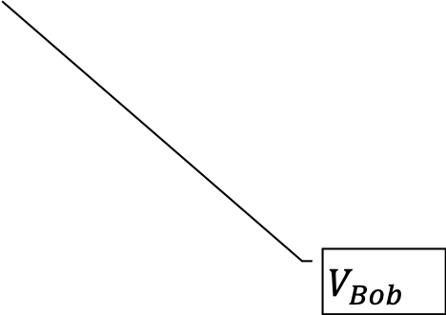
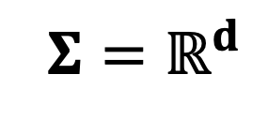
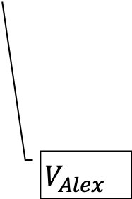
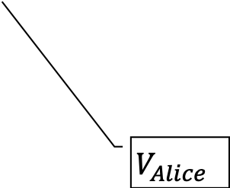
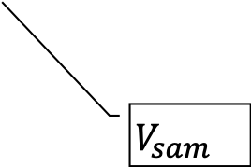
Quantum Embedding of Concept Hierarchy
INPUT
OUTPUT
everything
axis d
$${Σ=ℝ}^{d}$$
cardiologist
doctor
dentist
physician
surgeon
dentist
physician
pulmonologist
pulmonologist
cardiologist
axis 1
$$V_{Alex}$$
Bob
Alice
Sam
Alex
$$V_{Alice}$$
axis 2
$$V_{Bob}$$
$$V_{sam}$$
A concept is represented by the subspace of the real vector space
An Entity is represented by a real vector
In the above (as well as subsequent) diagram, the diagram of 3D space is just for graphical illustration sake and should not be understood as 3D space literally. We are using it just to as a cartoon illustration of any d-dimensional vector space.

Slide 5
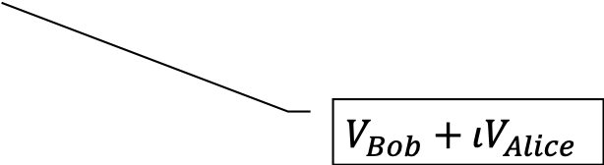
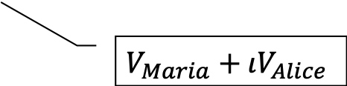
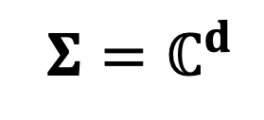
Quantum Embedding of Relation Hierarchy
INPUT
OUTPUT
any relation
axis d
$${Σ=ℂ}^{d}$$
Mother_of
blood_relation
Brother_of
Brother_of
Parent_of
Sister_of
Parent_of
Father_of
Father_of
Mother_of
axis 1
$$V_{Bob}+ιV_{Alice}$$
(Bob, Alice)
(Maria, Alice)
axis 2
$$V_{Maria}+ιV_{Alice}$$
A relation is represented by the subspace of the complex vector space
An entity pair is represented by a complex vector

Slide 6
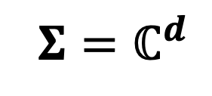
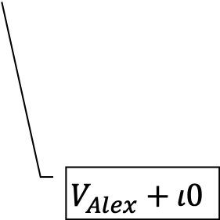
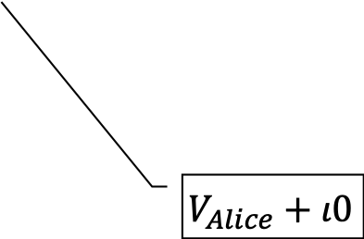
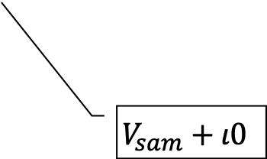
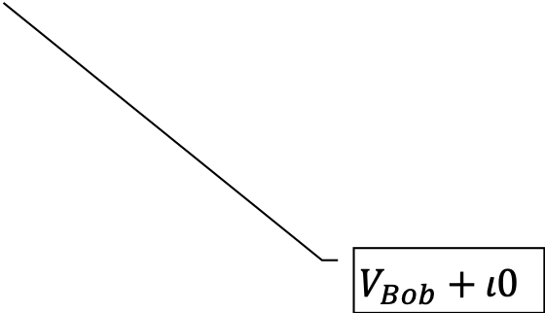
Canonicalization Generalize Concepts → Relations, Entities → Entity Pairs
INPUT
OUTPUT
everything
axis d
$${Σ=ℂ}^{d}$$
cardiologist
doctor
dentist
physician
surgeon
dentist
physician
pulmonologist
pulmonologist
cardiologist
axis 1
$$V_{Alex}+ι0$$
(Bob,0)
(Alice, 0)
(Sam, 0)
(Alex, 0)
axis 2
$$V_{Alice}+ι0$$
$$V_{Bob}+ι0$$
$$V_{sam}+ι0$$
In general, quantum embedding space $Σ$ could be any finite/infinite dimensional Hilbert space
An entity can be viewed as a pair of entities by pairing it with a dummy entity called 0

Slide 7

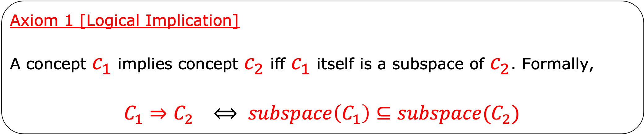
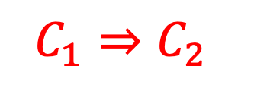

Axioms of Quantum Logic
Axiom 1 [Logical Implication]
A concept $c_{1}$ implies concept $c_{2}$ iff $c_{1}$ itself is a subspace of $c_{2}$. Formally,
$$C_{1}⇒C_{2} ⟺ subspace\left(C_{1}\right)⊆subspace(C_{2})$$
$c_{1}$
axis d
$$C_{1}⇒C_{2}$$
$c_{2}$
axis 1
G. Birkhoff and J. von Neumann, *The Logic of Quantum Mechanics, Annals of Mathematics, Vol. 37, pp. 823–843, 1936.
axis 2
[Image Sources]
https://commons.wikimedia.org/wiki/File:George_David_Birkhoff.gif
http://www.lanl.gov/history/atomicbomb/images/NeumannL.GIF

Slide 8
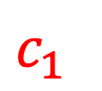
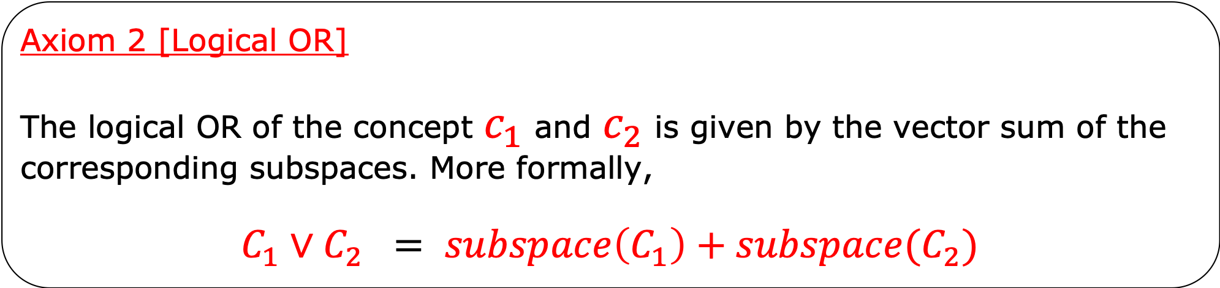
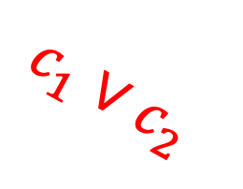
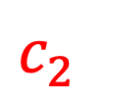
Axioms of Quantum Logic
Axiom 2 [Logical OR]
The logical OR of the concept $c_{1}$ and $c_{2}$ is given by the vector sum of the corresponding subspaces. More formally,
$$C_{1}∨C_{2} = subspace\left(C_{1}\right)+subspace(C_{2})$$
axis 3
$c_{1}∨c_{2}$
$c_{1}$
$c_{2}$
axis 1
axis 2

Slide 9
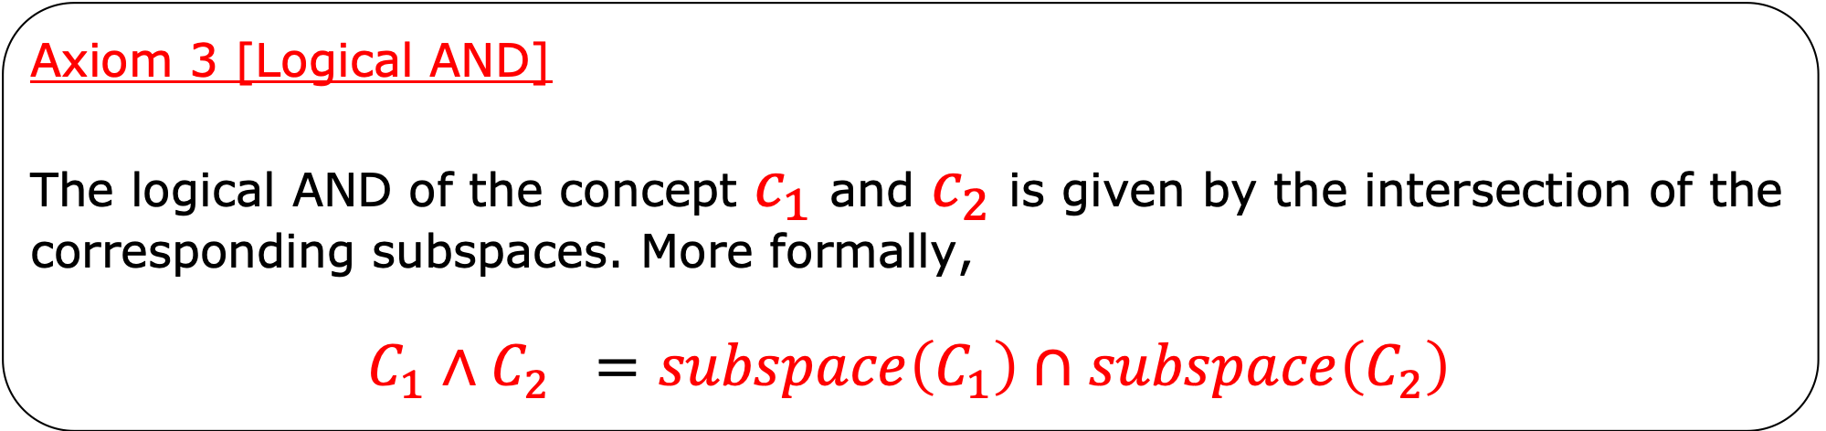
Axioms of Quantum Logic
Axiom 3 [Logical AND]
The logical AND of the concept $c_{1}$ and $c_{2}$ is given by the intersection of the corresponding subspaces. More formally,
$$C_{1}∧C_{2} =subspace\left(C_{1}\right)∩subspace\left(C_{2}\right)$$
axis d
$c_{1}$
$c_{2}$
axis 1
axis 2
${c_{1}∧c}_{2}$

Slide 10
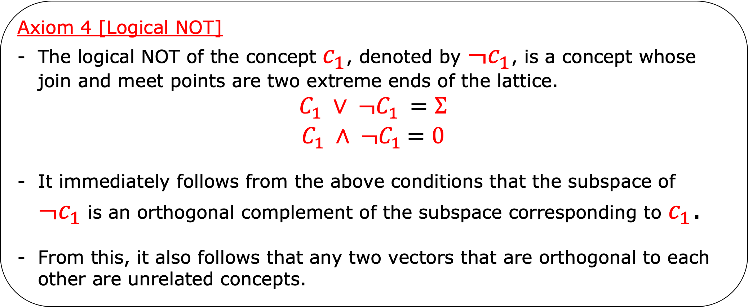
Axioms of Quantum Logic
Axiom 4 [Logical NOT]
The logical NOT of the concept $c_{1}$, denoted by $¬c_{1}$, is a concept whose join and meet points are two extreme ends of the lattice.
$$C_{1} ∨ {¬C}_{1} =Σ$$
$$C_{1} ∧ {¬C}_{1} =0$$
It immediately follows from the above conditions that the subspace of $¬c_{1}$is an orthogonal complement of the subspace corresponding to $c_{1}$.
From this, it also follows that any two vectors that are orthogonal to each other are unrelated concepts.
axis d
Logical NOT
$$¬c_{1}$$
axis 1
$c_{1}$
axis 2

Slide 11
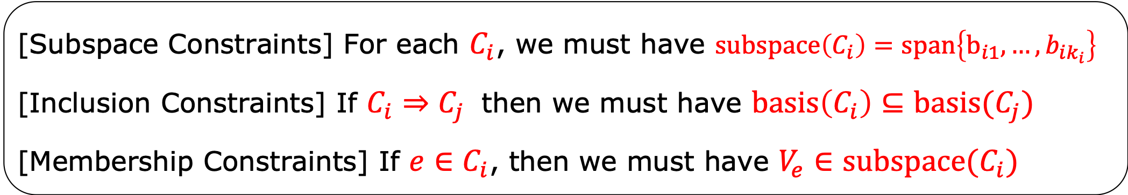
Formulating Quantum Embedding as a CSP
INPUT
OUTPUT
$Anything$
axis d
$c_{6}$
$c_{5}$
$c_{6}$
$c_{7}$
$c_{5}$
$$e_{2}$$
$c_{1}$
$c_{1}$
$c_{2}$
$c_{3}$
$c_{4}$
$$e_{1}$$
axis 1
$$e_{3}$$
$$e_{5}$$
$$e_{4}$$
$$e_{6}$$
axis 2
$$e_{1}$$
$$e_{2}$$
$c_{2}$
$$Nothing=φ$$
[Subspace Constraints] For each $C_{i}$, we must have $subspace\left(C_{i}\right)=span\left\{b_{i1}, …, b_{ik_{i}}\right\}$
[Inclusion Constraints] If $C_{i}⇒C_{j}$ then we must have $basis\left(C_{i}\right)⊆basis(C_{j})$
[Membership Constraints] If $e∈C_{i}$, then we must have $V_{e}∈subspace(C_{i})$

Slide 12



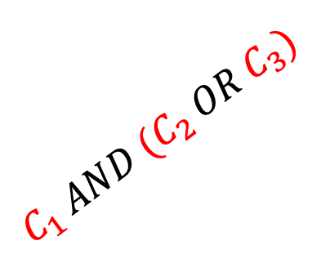
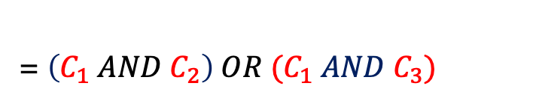
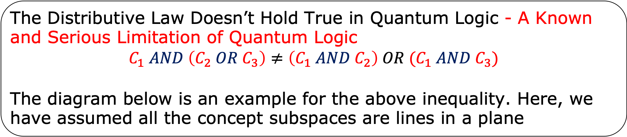






But Wait, There is a Twist
The Distributive Law Doesn’t Hold True in Quantum Logic - A Known and Serious Limitation of Quantum Logic
$$C_{1} AND \left(C_{2} OR C_{3}\right)≠\left(C_{1} AND C_{2}\right) OR (C_{1} AND C_{3})$$
The diagram below is an example for the above inequality. Here, we have assumed all the concept subspaces are lines in a plane
$$LHS≠RHS$$
axis 2
axis 2
$${(C}_{2} OR C_{3})$$
$$C_{1} AND (C_{2} OR C_{3})$$
$$C_{2}$$
$$C_{2}$$
axis 1
axis 1
$(C_{1} AND C_{2})$ = $\left(C_{1} AND C_{3}\right)$
= $\left(C_{1} AND C_{2}\right) OR (C_{1} AND C_{3})$
$$C_{1}$$
$$C_{3}$$
$$C_{1}$$
$$C_{3}$$

Slide 13


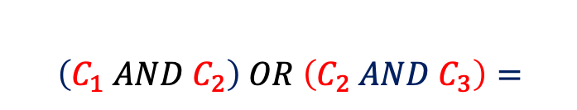



The good news is that there is a fix for it
[Theorem] The distributive law will hold true in Quantum Logic if we work with axis-parallel subspaces only.
$$C_{1} AND \left(C_{2} OR C_{3}\right) = \left(C_{1} AND C_{2}\right) OR (C_{1} AND C_{3})$$
axis 2
axis 2
$${(C}_{2} OR C_{3})$$
$$\left(C_{1} AND C_{2}\right) OR \left(C_{2} AND C_{3}\right)=$$
$$C_{2}$$
$$C_{1} AND (C_{2} OR C_{3})$$
$$C_{2}$$
$$(C_{1} AND C_{2})$$
axis 1
axis 1
$$C_{1}$$
$$C_{1}$$
$$\left(C_{1} AND C_{3}\right)$$
$$C_{3}$$
$$C_{3}$$

Slide 14
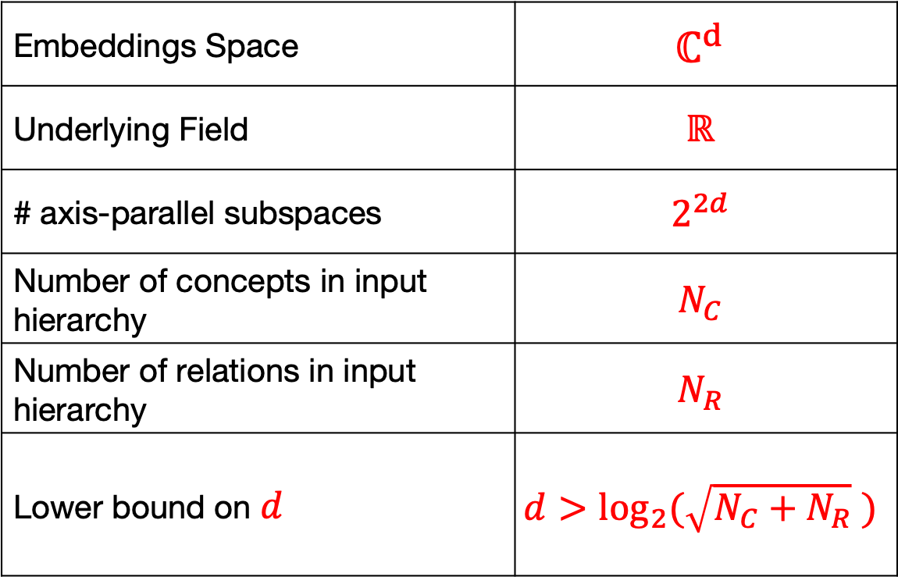
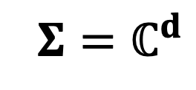

Learning Axis-Parallel Quantum Embedding
Setup
Embeddings Space | $$ℂ^{d}$$
Underlying Field | $$ℝ$$
# axis-parallel subspaces | $$2^{2d}$$
Number of concepts in input hierarchy | $$N_{C}$$
Number of relations in input hierarchy | $$N_{R}$$
Lower bound on $d$ | $$d>\log_{2}(\sqrt{N_{C}+N_{R}} )$$
Complex axis d
$${Σ=ℂ}^{d}$$
Complex axis 1
Complex axis 2
Suppose $d$ = 3 for the sake of illustration. Then, due to the assumption of field being $ℝ,$ we have
Set of Standard Basis for $ℂ^{3}$ = $\left(\begin{matrix}1 & 0 & 0 \\ 0 & 1 & 0 \\ \begin{aligned}0 \\ 0 \\ 0 \\ 0\end{aligned} & \begin{aligned}0 \\ 0 \\ 0 \\ 0\end{aligned} & \begin{aligned}1 \\ 0 \\ 0 \\ 0\end{aligned}\end{matrix} \begin{matrix}1 & 0 & 0 \\ 0 & 1 & 0 \\ \begin{aligned}0 \\ ι \\ 0 \\ 0\end{aligned} & \begin{aligned}0 \\ 0 \\ ι \\ 0\end{aligned} & \begin{aligned}0 \\ 0 \\ 0 \\ ι\end{aligned}\end{matrix}\right)$
Real axes
Imaginary axes

Slide 15

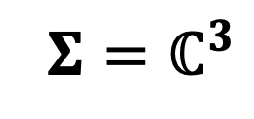
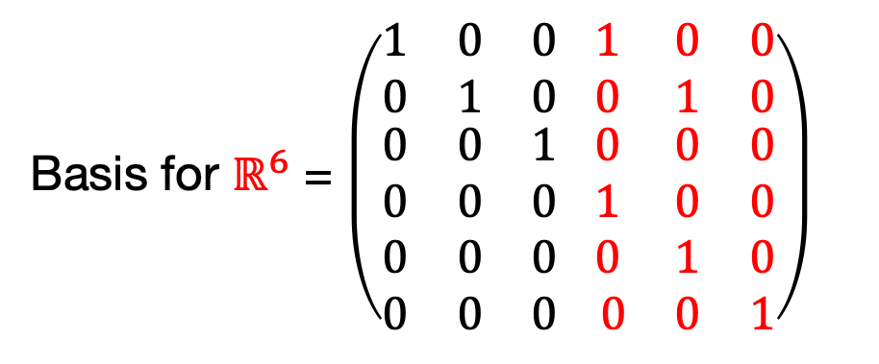
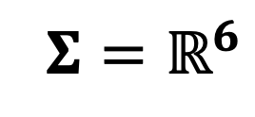

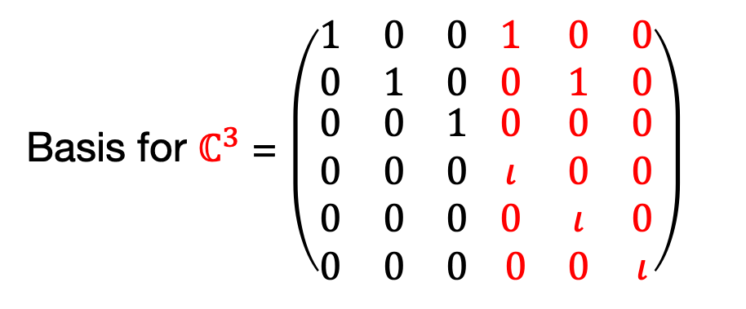

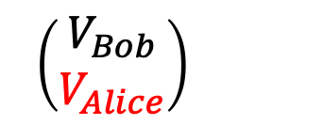
Isomorphism between $ℂ^{d}$ and $ℝ^{2d}$
Due to the real field assumption, we have an isomorphism between $ℂ^{d}$ and $ℝ^{2d}$. For the sake of illustration, suppose $d$ = 3, then we can write
Real axis 6
Complex axis 3
$${Σ=ℝ}^{6}$$
$${Σ=ℂ}^{3}$$
$$≅$$
$$\left(\begin{matrix}V_{Bob} \\ V_{Alice}\end{matrix}\right)$$
$$V_{Bob}+ιV_{Alice}$$
Real axis 1
Complex axis 1
Real axis 2
Complex axis 2
Basis for $ℂ^{3}$ = $\left(\begin{matrix}1 & 0 & 0 \\ 0 & 1 & 0 \\ \begin{aligned}0 \\ 0 \\ 0 \\ 0\end{aligned} & \begin{aligned}0 \\ 0 \\ 0 \\ 0\end{aligned} & \begin{aligned}1 \\ 0 \\ 0 \\ 0\end{aligned}\end{matrix} \begin{matrix}1 & 0 & 0 \\ 0 & 1 & 0 \\ \begin{aligned}0 \\ ι \\ 0 \\ 0\end{aligned} & \begin{aligned}0 \\ 0 \\ ι \\ 0\end{aligned} & \begin{aligned}0 \\ 0 \\ 0 \\ ι\end{aligned}\end{matrix}\right)$
Basis for $ℝ^{6}$ = $\left(\begin{matrix}1 & 0 & 0 \\ 0 & 1 & 0 \\ \begin{aligned}0 \\ 0 \\ 0 \\ 0\end{aligned} & \begin{aligned}0 \\ 0 \\ 0 \\ 0\end{aligned} & \begin{aligned}1 \\ 0 \\ 0 \\ 0\end{aligned}\end{matrix} \begin{matrix}1 & 0 & 0 \\ 0 & 1 & 0 \\ \begin{aligned}0 \\ 1 \\ 0 \\ 0\end{aligned} & \begin{aligned}0 \\ 0 \\ 1 \\ 0\end{aligned} & \begin{aligned}0 \\ 0 \\ 0 \\ 1\end{aligned}\end{matrix}\right)$
$$≅$$
Real axes
Imaginary axes
Real axes
Imaginary axes

Slide 16
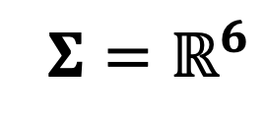


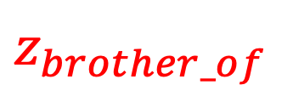
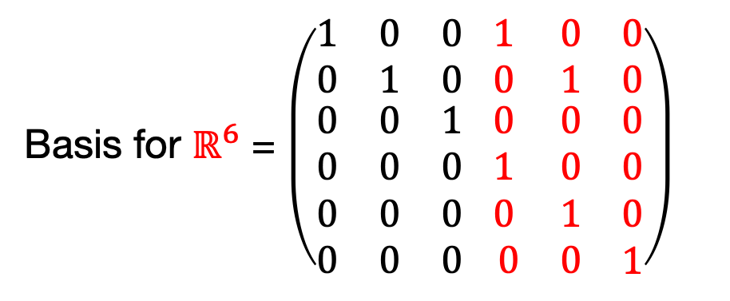
Learning Axis-Parallel Quantum Embedding
Indicator vectors can be used to represent concept / relation subspaces in $ℝ^{2d}$. Suppose $d$ = 3 for the illustration sake. Then,
$${Σ=ℝ}^{6}$$
Real axis 6
Basis for $ℝ^{6}$ = $\left(\begin{matrix}1 & 0 & 0 \\ 0 & 1 & 0 \\ \begin{aligned}0 \\ 0 \\ 0 \\ 0\end{aligned} & \begin{aligned}0 \\ 0 \\ 0 \\ 0\end{aligned} & \begin{aligned}1 \\ 0 \\ 0 \\ 0\end{aligned}\end{matrix} \begin{matrix}1 & 0 & 0 \\ 0 & 1 & 0 \\ \begin{aligned}0 \\ 1 \\ 0 \\ 0\end{aligned} & \begin{aligned}0 \\ 0 \\ 1 \\ 0\end{aligned} & \begin{aligned}0 \\ 0 \\ 0 \\ 1\end{aligned}\end{matrix}\right)$
Brother_of
Pyysician
$$z_{brother_of}$$
0 | 1 | 1 | 0 | 1 | 0
Real axis 1
$$z_{physician}$$
0 | 1 | 1 | 0 | 0 | 0
Real axis 2
Learnable parameters

Slide 17


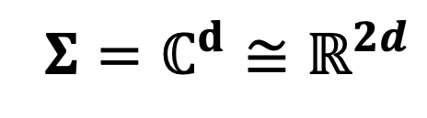



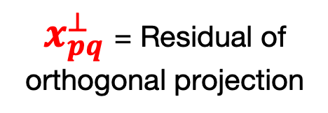
Learning Loss for Membership Constraint
$${Σ=ℂ}^{d}≅ℝ^{2d}$$
Complex axis d
$$x_{pq}=x_{p}+ιx_{q}$$
$$R_{i}$$
$x_{pq}^{⊥}$= Residual of orthogonal projection
$$R_{i}$$
Complex axis 1
$$(O_{p}, O_{q})$$
Complex axis 2
$L_{R_{i}(O_{p},O_{q})}={\left\langle x_{pq}^{⊥} ,x_{pq}^{⊥}\right\rangle }^{2}+ {\left\|{Re( x}_{pq})−x_{p}\right\|}^{2}$+ ${\left\|{Re( x}_{pq})−x_{q}\right\|}^{2}$
Because of real field assumption, we use the following valid formula for inner product ${\left\langle x, y \right\rangle }^{2}={\left({y^{∗}}^{⊤} x\right)}^{∗}\left({y^{∗}}^{⊤} x\right)$ where * denotes complex conjugate operation.
For the membership of an entity $O_{i}$ to a unary predicate $C_{j}$ , one can write a loss function $L_{{(O}_{i}∈C_{j})}$in a similar manner. The last two terms will be missing there but an unitary length constraint would show up there (refer Eq. 4 in the paper).

Slide 18
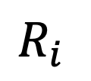

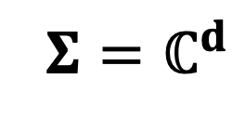
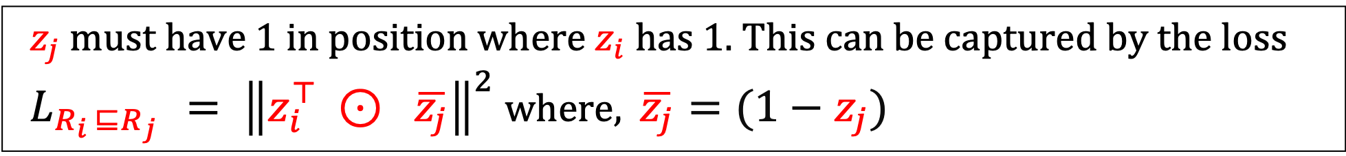
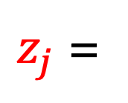


Learning Loss for Implication Constraint
$${Σ=ℂ}^{d}$$
axis 2d
$z_{i}$ =
$$R_{i}$$
0 | 1 | 1 | 0 | 1 | 0
$$R_{j}$$
$z_{j}$ =
 | 1 | 1 |  | 1
$$R_{j}$$
$$R_{i}$$
axis 1
axis 2
$z_{j}$ must have 1 in position where $z_{i}$ has 1. This can be captured by the loss
$L_{R_{i} ⊑R_{j} }= {\left\|z_{i}^{⊤} ⊙ \overline{z_{j}}\right\|}^{2}$where, $\overline{z_{j}}=(1−z_{j})$
A similar loss function can be written down for the case of unary predicates (refer Eq. 5 in the paper).

Slide 19
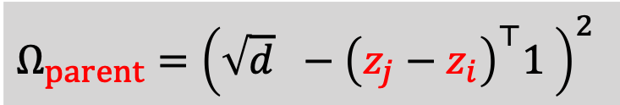







Regularization Loss
[Observation] A degenerate solution is to map all the predicates to a single subspace and all the entities to a single vector
Regularizing Parental Space
Regularizing Sibling Space
$$R_{j}$$
$$R_{i}$$
$$R_{k}$$
$$R_{i}$$
Have minimum difference in the dimensions of the subspaces of $R_{i}$ and $R_{j}$
Have the subspaces of $R_{k}$ and $R_{i}$ orthogonal to each other as much as possible
$$Ω_{parent}={\left(\sqrt{d} −{\left(z_{j}−z_{i}\right)}^{⊤}1 \right)}^{2}$$
$$Ω_{sibling}={\left(z_{k}^{⊤}z_{i}\right)}^{2}$$
A similar regularization loss function can be written down for the case of unary predicates (refer Eq. 11-12 in the paper).

Slide 20
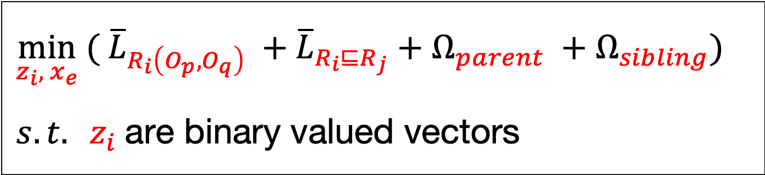
Overall Learning Problem
$$\min_{z_{i}, x_{e}}{( {\overline{L}}_{R_{i}\left(O_{p},O_{q}\right)} +{\overline{L}}_{R_{i}⊑R_{j}}+Ω_{parent} +Ω_{sibling})}$$
$s. t. z_{i}$are binary valued vectors
In final problem, all losses related to unary predicates are also included (Eq 10)
Each loss term is averaged over all training instances
Binary constraints are folded into objective function (Eq 3)
Non-convex combinatorial optimization - Closed form solution is hard
Used SGD to get (approximate) local minima
Resulting embeddings are approximation to the quantum embedding

Slide 21
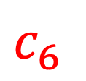
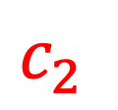
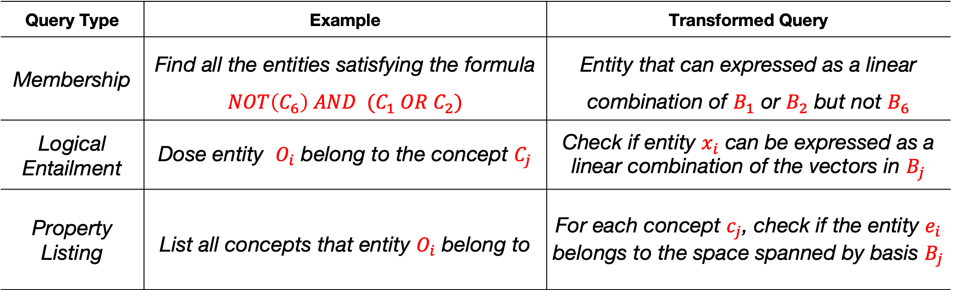
Query Processing
axis 3
$c_{6}$
$c_{5}$
Query Parser
Converts a logical query into a vector algebraic query
$$e_{2}$$
$c_{1}$
Logical Query
$$e_{1}$$
axis 1
axis 2
$c_{2}$
Query Type | Example | Transformed Query
Membership | Find all the entities satisfying the formula $NOT\left(C_{6}\right) AND (C_{1} OR C_{2})$ | Entity that can expressed as a linear combination of $B_{1}$ or $B_{2}$ but not $B_{6}$
Logical Entailment | Dose entity $O_{i}$ belong to the concept $C_{j}$ | Check if entity $x_{i}$ can be expressed as a linear combination of the vectors in $B_{j}$
Property Listing | List all concepts that entity $O_{i}$ belong to | For each concept $c_{j}$, check if the entity $e_{i}$ belongs to the space spanned by basis $B_{j}$
In the above table, $B_{i}$ denotes the set of basis vectors for the subspace $C_{i}$

Slide 22
Experiments Plan
Task | Link Prediction | Finding Members of a Complex Concept
Type of Reasoning | Predictive | Deductive
Dataset | FB15K, WN18 | LUBM1U
T-Box | Absent | Present
A-Box | Present | Present
Predicate Types | [WN18] Only binary Predicates [FB15K] Only binary Predicates | Both Unary and Binary
Input KB Size | [A-Box for WN18] 141442 triples [A-Box for FB15K] 483142 triples | [A-Box] 69628 triples [T-Box] 18 triples
Test Set Size | [WN18] 5000 [FB15K] 59071 | 8 membership queries for non-leaf concepts
Performance Metrics | Mean Rank, MRR, Hits@1, Hits@10 | Mean Rank, MRR, Hits@1, Hits@10
Baslines | TransE [1], ComplEx [2] | TransE [1], ComplEx [2]
[1] Antoine Bordes, Nicolas Usunier, Alberto García-Durán, JasonWeston, and Oksana Yakhnenko. Translating embeddings for modeling multi-relational data. In NIPS, pages 2787–2795, 2013.
[2] Théo Trouillon, Johannes Welbl, Sebastian Riedel, Eric Gaussier, and Guillaume Bouchard. Complex embeddings for simple link prediction. In ICML, pages 2071–2080, 2016.

Slide 23
LUBM1U Dataset Details
Data is synthetically generated
Data represent knowledge about various elements of an hypothetical university-setup. For example, Faculty, Students, Job Roles, Research Interests, Departments, etc.
The data has two components:
A-Box – It captures the assertions related to entities and predicates
* Unary Predicate – Membership of entities to unary predicates (aka concepts)
* Binary Predicate – Relationship among different pairs of entities
T-Box – It captures information related to the concepts/relations hierarchy
* Unary Predicate – hierarchy among categories
* Binary Predicate – hierarchy among relations
Both A-Box and T-Box are represented in the form of triples
A-Box
* Unary Predicates – (H, #type, C) – H: head entity, C: concept (aka category)
* Binary Predicate – (H, R, T) – H: head entity, T: tail entity, R: relation
T-Box
* unary – (C1, #type, C2) – C1: child category, C2: parent category
* binary – (R1, #type, R2) – R1: child relation, P2: parent relation
A-box triples=69628, T-box triples=18, Entities=17174, Categories=19, Relations=13

Slide 24
LUBM1U – Unary Predicates Hierarchy
List of Unary Predicates (19 – Concepts)
Person
Faculty
Lecturer
Professor
FullProfessor
AssociateProfessor
AssistantProfessor
Student
GraduateStudent
UndergraduateStudent
Organization
University
Department
ResearchGroup
Course
GraduateCourse
ResearchAssistant
TeachingAssistant
Publication
All
Pub
Person
TA
Organization
Course
RA
Faculty
Student
University
ResearchGroup
Professor
Lecturer
GraduateCourse
Grad Stud
UG Stud
Department
Full Prof
Assoc Prof
Asst Prof

Slide 25
LUBM1U – Binary Predicates Hierarchy
List of Binary Relations (13 – Relations)
advisor
degreeFrom
doctoralDegreeFrom
mastersDegreeFrom
undergraduateDegreeFrom
memberOf
publicationAuthor
SubOrganizationOf
teacherOf
teachingAssistantOf
takesCourse
headOf
worksFor
All
advisor
takesCourse
degreeFrom
memberOf
teaching
AssistantOf
pub
Author
worksFor
teacherOf
doctoral
DegreeFrom
undergraduate
DegreeFrom
subOrgOf
headOf
masters
DegreeFrom

Slide 26
Experimental Results
Data |  | Mean Rank |  |  |  | MRR |  |  |  | Hits@1 |  |  |  | Hits@10
 |  | E2R | TE | CE |  | E2R | TE | CE |  | E2R | TE | CE |  | E2R | TE | CE
FB15K |  | 72 | 68 | 114 |  | 0.96 | 0.49 | 0.61 |  | 96 | 34 | 49 |  | 96 | 76 | 81
WN18 |  | 5780 | 409 | 468 |  | 0.71 | 0.63 | 0.90 |  | 71 | 41 | 87 |  | 71 | 93 | 95
LUBM1U |  | 220 | 1292 | 5742 |  | 0.46 | 026 | 0.12 |  | 45 | 18 | 12 |  | 45 | 49 | 12
E2R often ranks a ground truth entity either at Rank-1 or at a quite low rank
For WN18 dataset, binary relation satisfy transitivity property (e.g. hypernym) and have inverse relations (e.g. hypernym/hyponym).
Baselines approaches are primarily distanced based and hence capture transitivity/inversion properties better than E2R.
Insights

Slide 27
Conclusions
The proposed E2R approach can embed a hierarchical KB into a vector space while preserving the structure of all logical propositions.
Advantage is to be able to answer complex reasoning queries (both deductive and predictive) in accurate manner using distributional representation of the KB.
In future, we wish to extend this idea for more expressive logic forms as well as natural language KB and also handle noisy inputs.

