Slide 1

Type-Driven Automated Learning with Lale
Martin Hirzel, Kiran Kate, Avi Shinnar, Subhrajit Roy, Pari Ram, and Guillaume Baudart
Wednesday 29 May 2019
Global Data Scientist Profession 1/2 Day Conference

Slide 2
Value Proposition
Augment, but don’t replace, the data scientist.
Automation
Easy search and tuning of pipelines
Usability
Like scikit learn plus types
Portability
Python building blocks & beyond

Slide 3
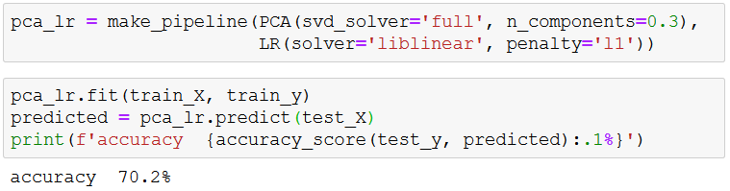
Manual ML with Sklearn
Prior work: scikit learn, popular machine learning package
1
2
3
4
5
6

Slide 4
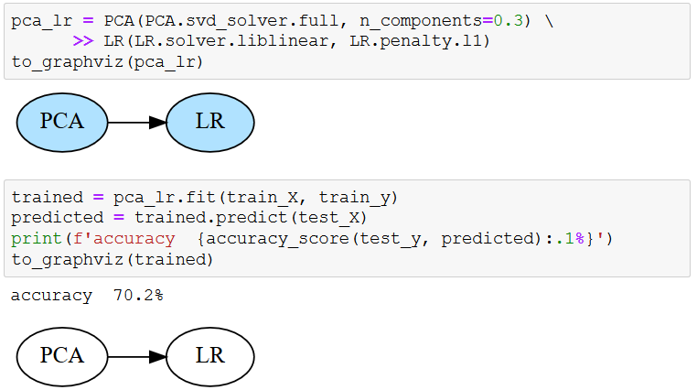
Manual ML with Lale
Our work: Language for Automated Learning Exploration
1
2
3
4
5
6
7
8
9
10

Slide 5
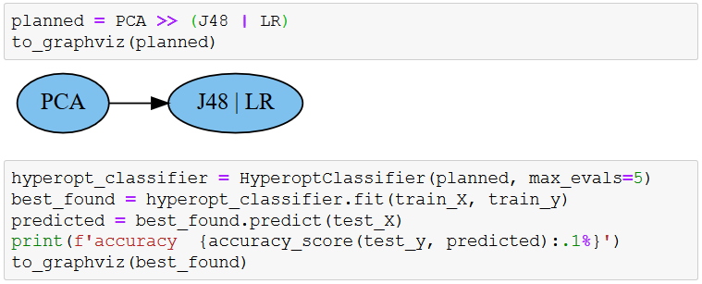
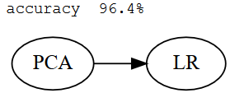
Automated ML with Lale
Combined algorithm selection and hyperparameter tuning
1
2
3
4
5
6
7
8
9
10

Slide 6
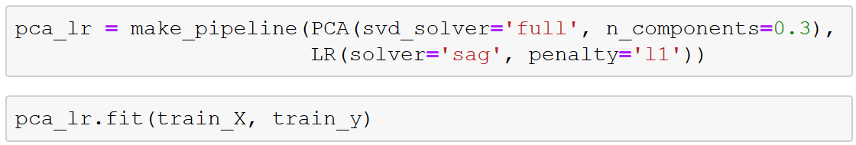
Constraints in Manual ML
Conditional hyperparameters
1
2
3
28
---------------------------------------------------------------------------
ValueError Traceback (most recent call last)
<ipython-input-7-de82d92d1962> in <module>
----> 1 pca_lr.fit(train_X, train_y)
~/python3.7venv/lib/python3.7/site-packages/sklearn/pipeline.py in fit(self, X, y, **fit_params)
265 Xt, fit_params = self._fit(X, y, **fit_params)
266 if self._final_estimator is not None:
--> 267 self._final_estimator.fit(Xt, y, **fit_params)
268 return self
269
~/python3.7venv/lib/python3.7/site-packages/sklearn/linear_model/logistic.py in fit(self, X, y, sample_weight)
1275 "positive; got (tol=%r)" % self.tol)
1276
-> 1277 solver = _check_solver(self.solver, self.penalty, self.dual)
1278
1279 if solver in ['newton-cg']:
~/python3.7venv/lib/python3.7/site-packages/sklearn/linear_model/logistic.py in _check_solver(solver, penalty, dual)
445 if solver not in ['liblinear', 'saga'] and penalty != 'l2':
446 raise ValueError("Solver %s supports only l2 penalties, "
--> 447 "got %s penalty." % (solver, penalty))
448 if solver != 'liblinear' and dual:
449 raise ValueError("Solver %s supports only "

Slide 7
Constraints in AutoML
Problem: Some automated iterations raise exceptions
Solution 1: Unconstrained search space
{S:[linear,sag,lbfgs], P: [l1,l2]}
Catch exception
Return made-up loss np.float.max
Solution 2: Constrained search space
{S:[linear,sag,lbfgs], P: [l1,l2]} and (if S: [sag,lbfgs] then P: [l2])
No exceptions
No made-up loss

Slide 8
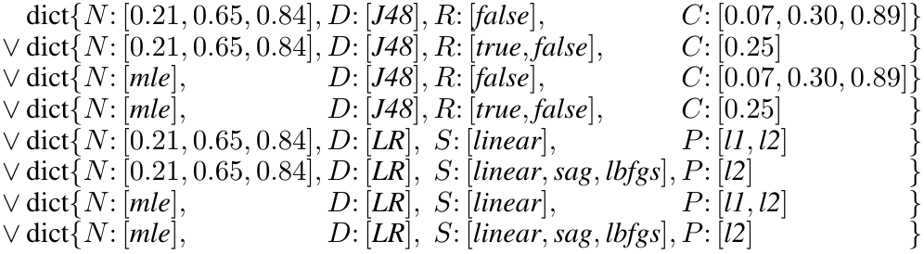
GridSearchCV Search Space
AutoML included with Sklearn
PCA
J48 | LR

Slide 9
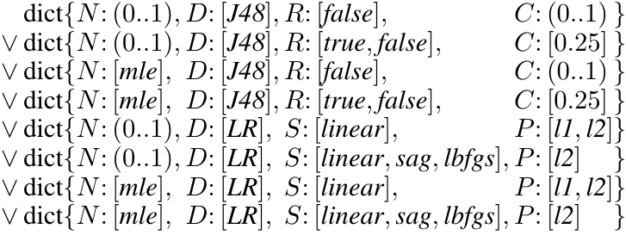
SMAC Search Space
Sequential Model-based Algorithm Configuration
PCA
J48 | LR

Slide 10
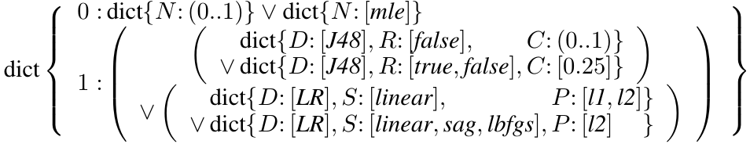
Hyperopt Search Space
Supports parallel search
PCA
J48 | LR

Slide 11
Types as Search Spaces
Lale auto-generates search spaces for AutoML tools
Planned pipeline
Operator schemas
PCA: … J48: … LR: …
PCA
J48 | LR
Compiler
GridSearchCV
SMAC
hyperopt

Slide 12
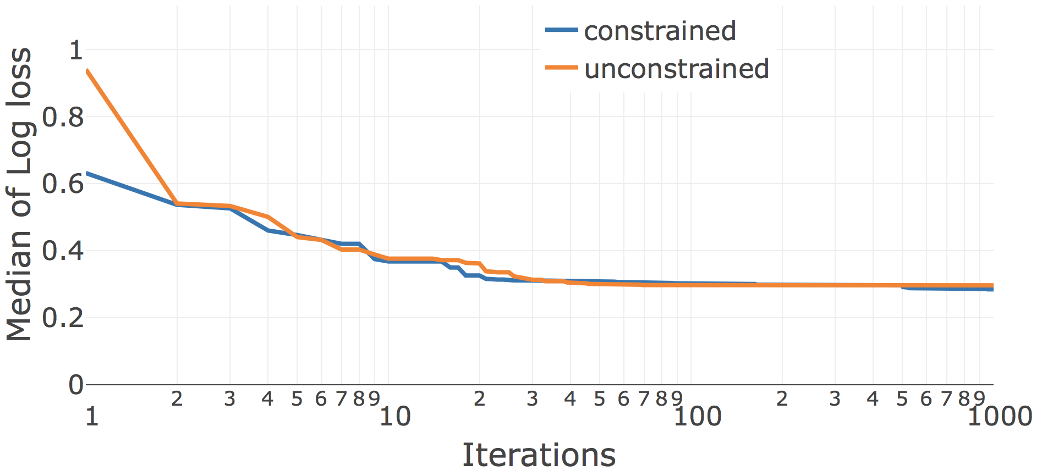
Search Convergence (1/3)
LR | KNN
Car dataset
hyperopt

Slide 13
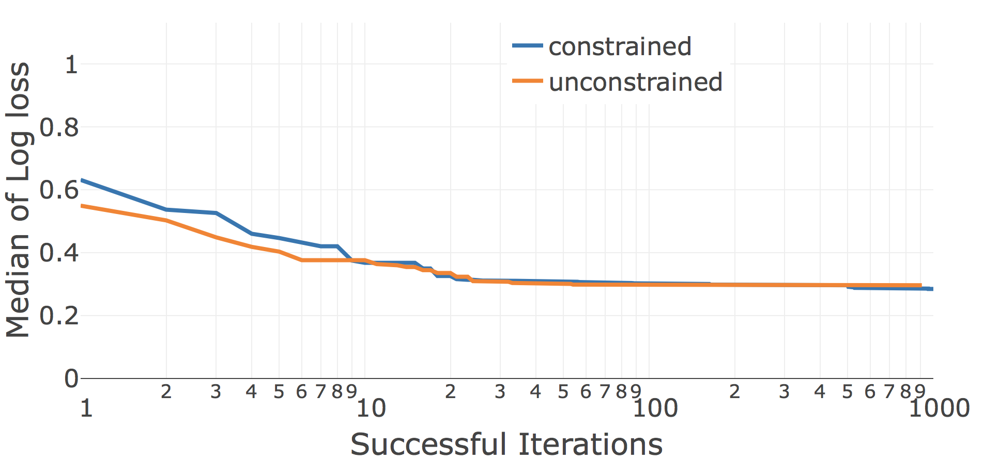
Search Convergence (2/3)
LR | KNN
Car dataset
hyperopt

Slide 14
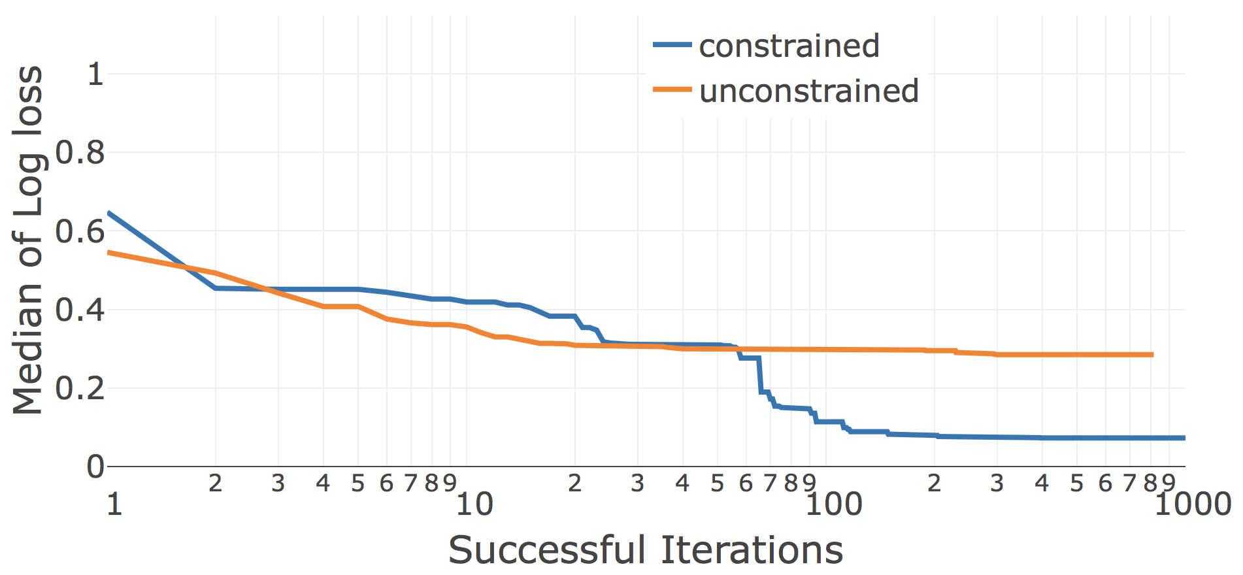
Search Convergence (3/3)
J48 | LR | KNN
Car dataset
hyperopt

Slide 15
Portability
Modality | Dataset | Pipeline (bold: best found choice)
Text | Movie reviews (sentiment analysis) | (BERT | TFIDF) >> (LR | MLP | KNN | SVC | PAC)
Table | Car (structured with categorical features) | J48 | ArulesCBA | LR | KNN
Images | CIFAR-10 (image classification) | ResNet50
Time-series | Epilepsy (seizure classification) | WindowTransformer >> (KNN | XGBoost | LR) >> Voting

Slide 16
Status
https://github.ibm.com/aimodels/lale
Automation
hyperopt, grid search, SMAC
Usability
IBM-internal alpha version
Portability
Python, Java, R; non-DL and DL

