Slide 1
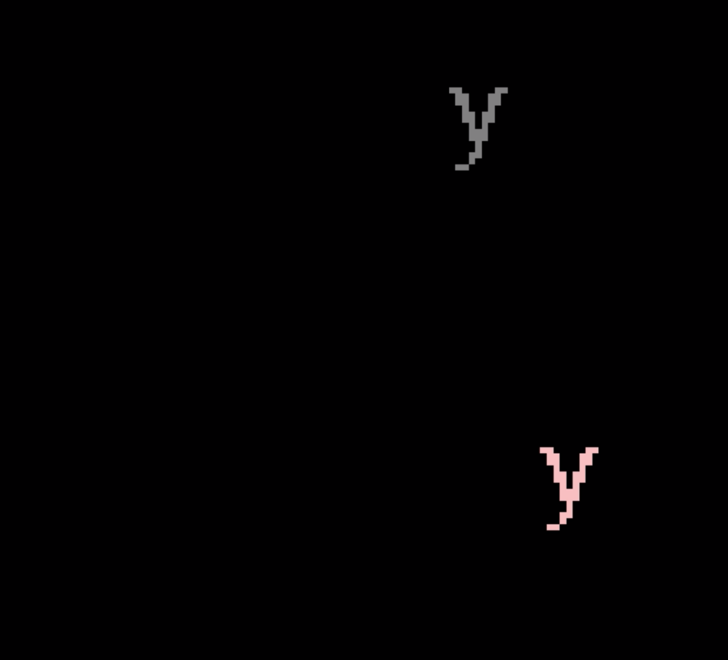
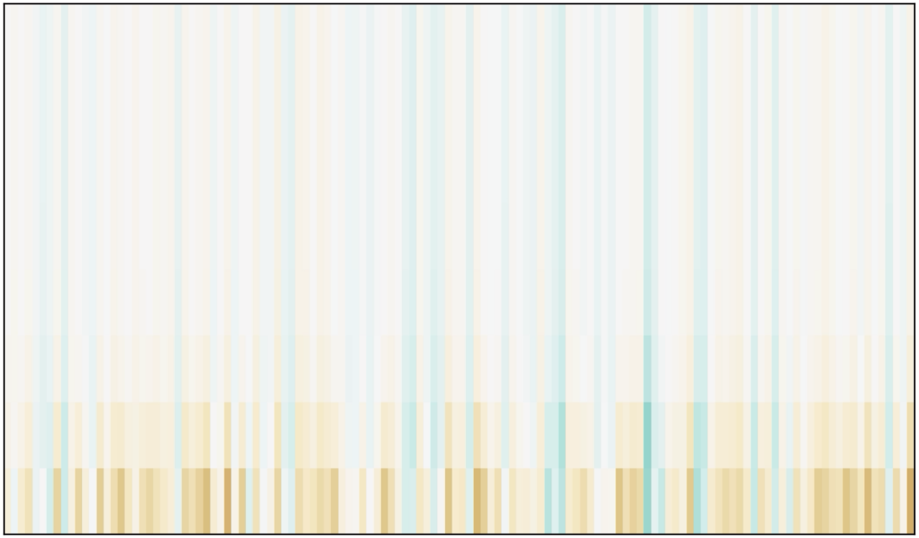
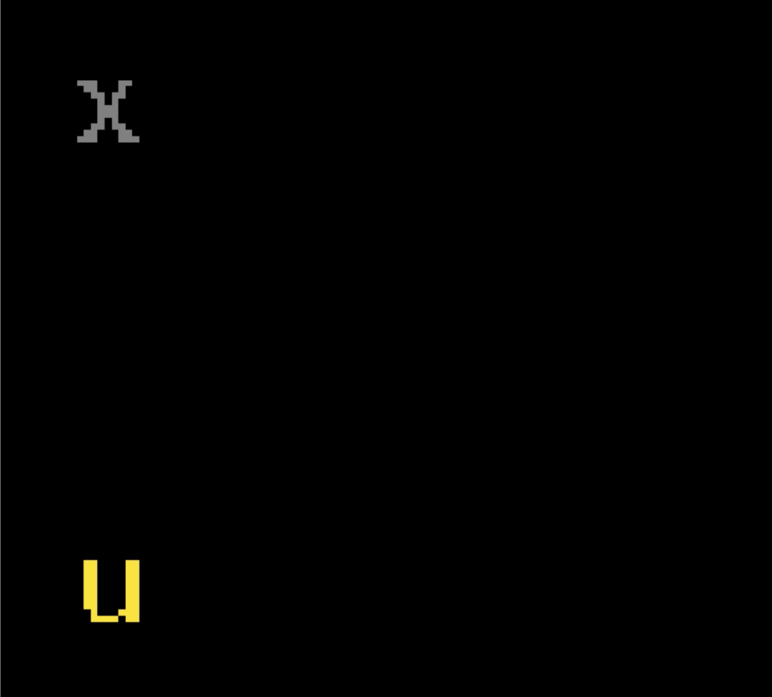

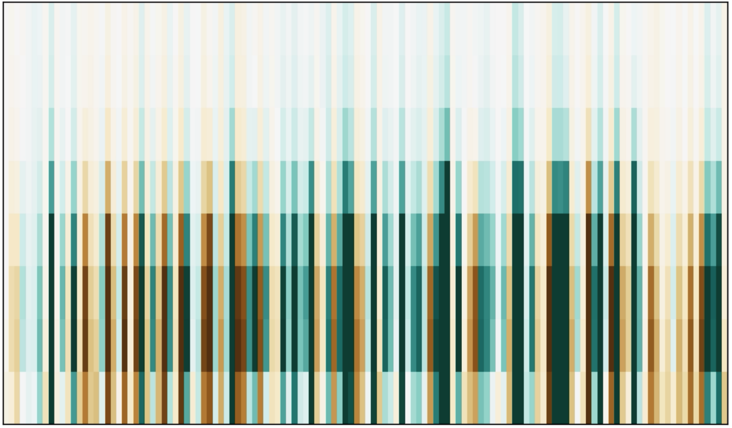
y equal shape
of last
grey object ?
frame₁
1
frame_{k}
contextual
words
prediction₁
memory_{k-1}
question
Image
Encoder
Question Encoder
feature
map_{k}
contextual
words
SAM
Cell
question
encoding
question
encoding
k
prediction_{k}
summary object_{k}
frame
by
frame
frame_{k}
Output
Unit
SAM Network
false
prediction_{k}
memory_{k}

