Slide 1
MAC + VWM Model
Question ≡ word embeddings
context of a word is taken into account
Frame ≡ feature vectors
correspond approximately to objects in frame
State comprises of 2 components:
focus of attention over words
focus of attention over feature vectors
VWM stores the temporally most relevant feature vectors across all frames
Uses both content addressing as well as sequential addressing
Model is fully differentiable
Recurrent Network
Question
MAC Cell
State
Frame
Visual Working Memory
(VWM)

Slide 2
Naming…
MAC + VWM
D-VWM: Dynamic VWM
T-VWM: Temporal VWM
N-VWM: Neuro-symbolic VWM
Something short and sweet, similar to “Transformer”

Slide 3
Design of the new model
Based on interpreting MAC operations as operating on a differentiable memory
amount of information is fixed …
… and depends on the size of the feature map
attention is equivalent to content addressing
In the new model the VWM will be dynamic
updated with temporally relevant objects
content addressing used for searching stored objects

Slide 4
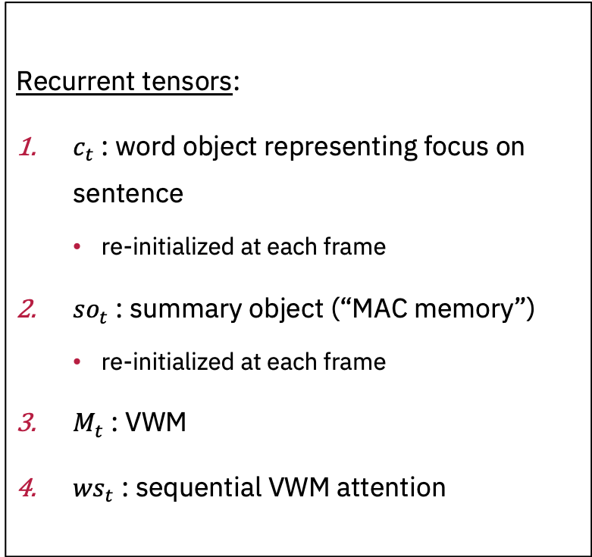
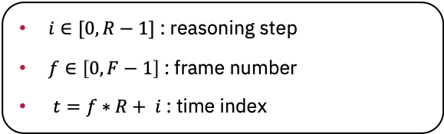
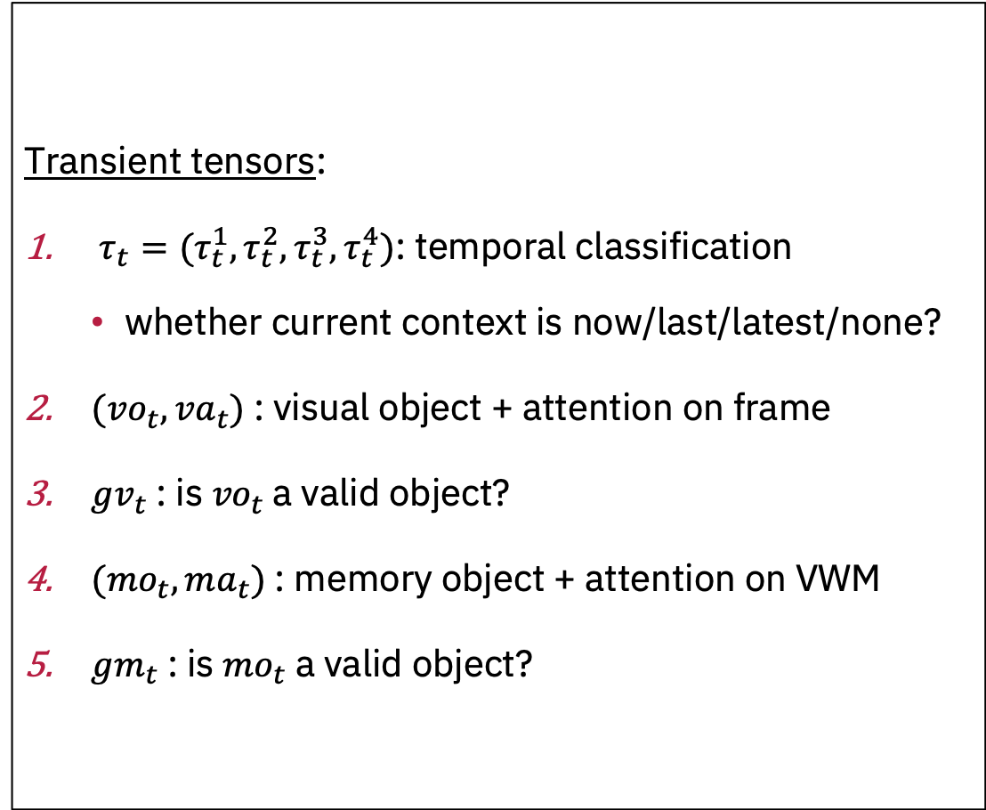
Notation
$i∈[0,R−1]$ : reasoning step
$f∈\left[0,F−1\right]$ : frame number
$t=f∗R+ i$ : time index
Transient tensors:
$τ_{t}=(τ_{t}^{1},τ_{t}^{2},τ_{t}^{3},τ_{t}^{4})$: temporal classification
whether current context is now/last/latest/none?
$(vo_{t},va_{t})$: visual object + attention on frame
${gv}_{t}$: is ${vo}_{t}$a valid object?
$(mo_{t},ma_{t})$: memory object + attention on VWM
${gm}_{t}$: is ${mo}_{t}$ a valid object?
Recurrent tensors:
$c_{t}$: word object representing focus on sentence
re-initialized at each frame
${so}_{t}$ : summary object (“MAC memory”)
re-initialized at each frame
$M_{t}$ : VWM
${ws}_{t}$ : sequential VWM attention

Slide 5

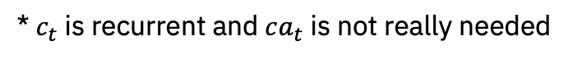
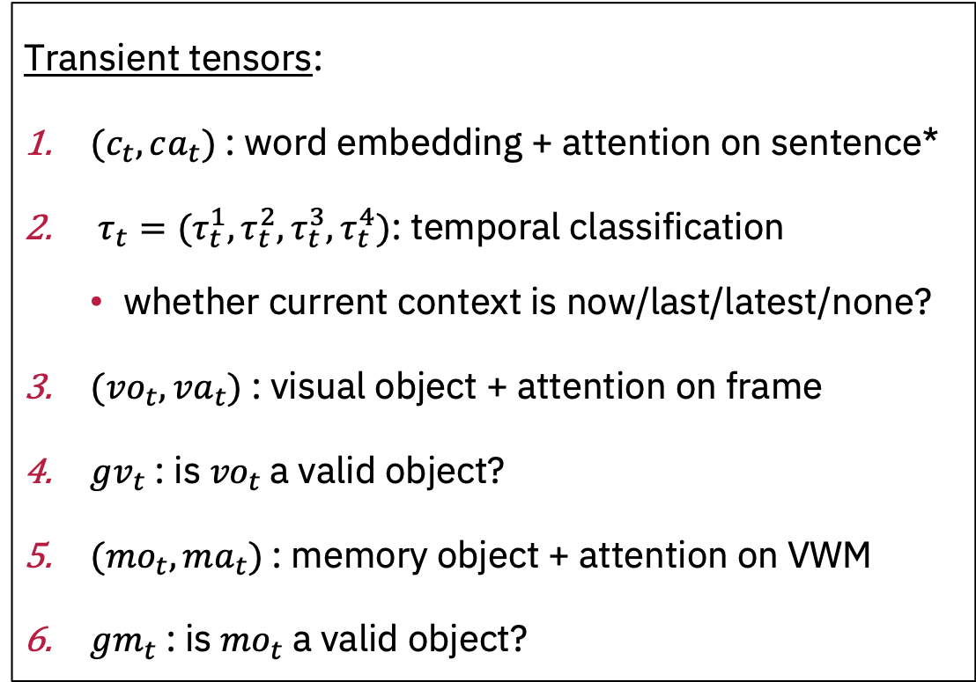


Equations for transient tensors
Transient tensors:
${(c}_{t},ca_{t})$: word embedding + attention on sentence*
$τ_{t}=(τ_{t}^{1},τ_{t}^{2},τ_{t}^{3},τ_{t}^{4})$: temporal classification
whether current context is now/last/latest/none?
$(vo_{t},va_{t})$: visual object + attention on frame
${gv}_{t}$: is ${vo}_{t}$a valid object?
$(mo_{t},ma_{t})$: memory object + attention on VWM
${gm}_{t}$: is ${mo}_{t}$ a valid object?
control unit of MAC cell
FFN with inputs $c_{t}$
read unit of MAC cell on frame
FFN with input ${vo}_{t}$ and $c_{t}$
read unit of MAC cell on VWM
FFN with input ${mo}_{t}$and $c_{t}$
* $c_{t}$ is recurrent and $ca_{t}$ is not really needed

Slide 6
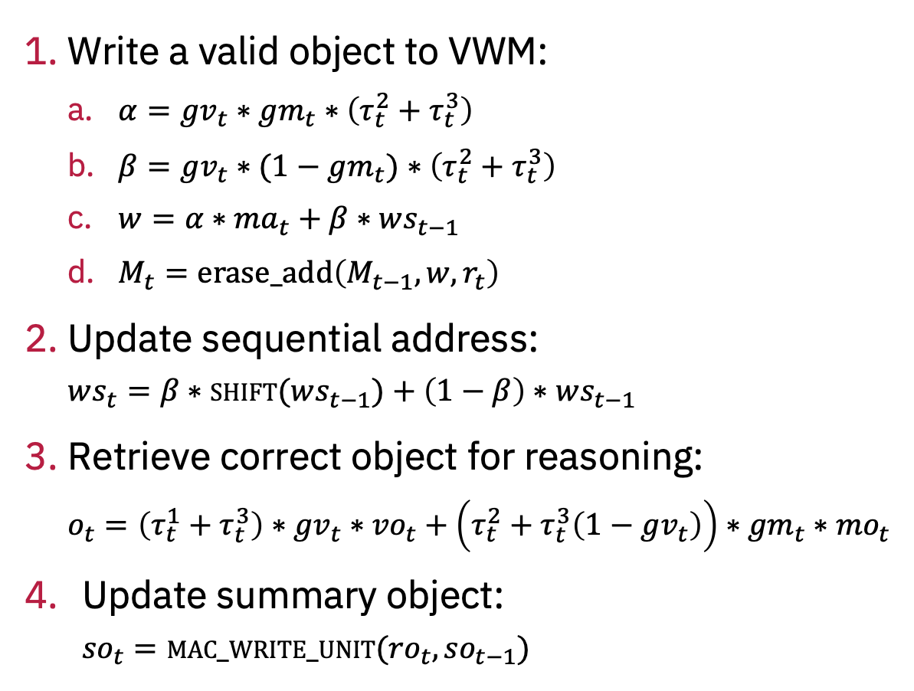
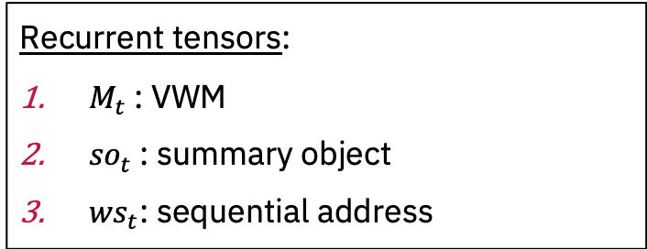
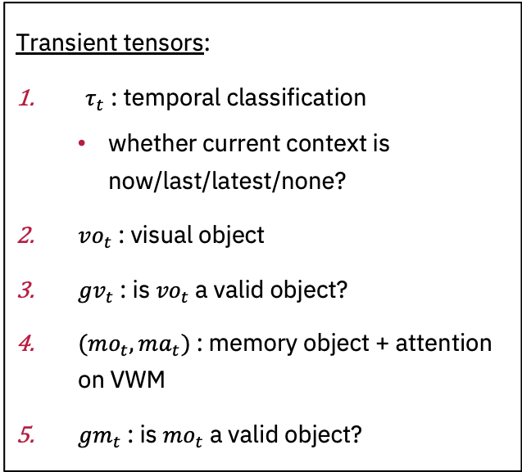
Equations for recurrent tensors
Recurrent tensors:
$M_{t}$: VWM
${so}_{t}$: summary object
${ws}_{t}$: sequential address
Write a valid object to VWM:
$α={gv}_{t}∗{gm}_{t}∗\left(τ_{t}^{2}+τ_{t}^{3}\right)$
$β={gv}_{t}∗(1−{gm}_{t})$ $∗\left(τ_{t}^{2}+τ_{t}^{3}\right)$
$w={α∗ma}_{t}+β∗ws_{t−1}$
$M_{t}=erase_add\left(M_{t−1},w,r_{t}\right)$
Update sequential address:
$$ws_{t}=β∗\operatorname{shift}{(ws_{t−1})}+\left(1−β\right)∗ws_{t−1}$$
Retrieve correct object for reasoning:
$$o_{t}=\left(τ_{t}^{1}+τ_{t}^{3}\right)∗{gv}_{t}∗{vo}_{t}+\left(τ_{t}^{2}+τ_{t}^{3}\left(1−{gv}_{t}\right)\right)∗{gm}_{t}∗{mo}_{t}$$
Update summary object:
$${so}_{t}=mac_write_unit({ro}_{t},{so}_{t−1})$$
Transient tensors:
$τ_{t}$ : temporal classification
whether current context is now/last/latest/none?
$vo_{t}$: visual object
${gv}_{t}$: is ${vo}_{t}$a valid object?
$(mo_{t},ma_{t})$: memory object + attention on VWM
${gm}_{t}$: is ${mo}_{t}$ a valid object?

Slide 7
VWM Cell
Code Diagram
Every rectangle is a python Class
Question-driven Controller
Visual read Unit
Memory read Unit
Image Encoder
Matching Unit
Output Unit
Memory update Unit
Question Encoder
Thought Unit

Slide 8
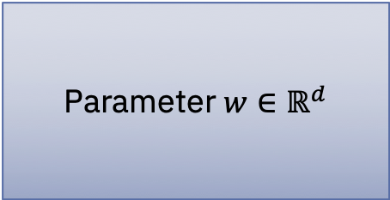

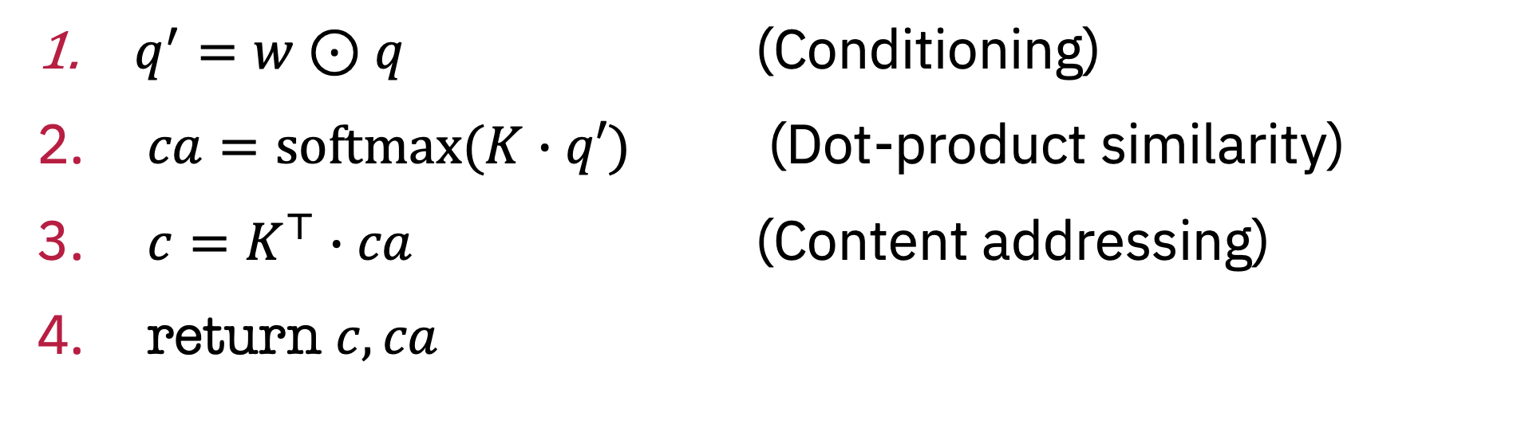



Attention
Query $q∈ℝ^{d}$
Parameter $w∈ℝ^{d}$
Content $c∈ℝ^{d}$
Keys $K∈ℝ^{N×d}$
Attention $ca∈ℝ^{N}$
$q^{′}=w⊙q$ (Conditioning)
$ca=\operatorname{softmax}{(K∙q′)}$ (Dot-product similarity)
$c=K^{⊤}∙ca$ (Content addressing)
return $c,ca$

Slide 9


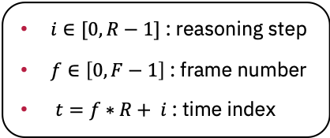
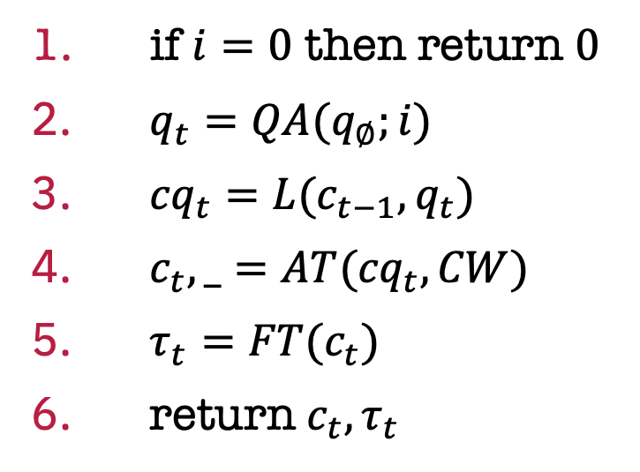
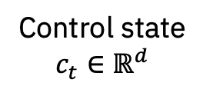
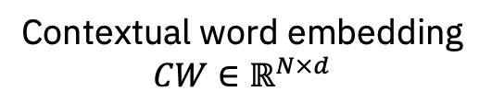


Question-driven controller
Global context
$q_{∅}∈ℝ^{2d}$
Parameters:
$QA$: position-aware mapping
$L$: biasing operation
$AT$: attention module
$FT$: temporal classifier
Control state
$c_{t}∈ℝ^{d}$
Contextual word embedding $CW∈ℝ^{N×d}$
Temporal classification
$τ_{t}∈ℝ^{d}$
$c_{t−1}∈ℝ^{d}$
if $i=0$ then return $0$
$q_{t}=QA(q_{∅};i)$
${cq}_{t}=L({c_{t−1},q}_{t})$
$c_{t}, _=AT({cq}_{t},CW)$
$τ_{t}=\operatorname{FT}{(c_{t})}$
return $c_{t}, τ_{t}$
// linear layer
// linear layer
// 2-layer FFN with ELU hidden activation
$i∈[0,R−1]$ : reasoning step
$f∈\left[0,F−1\right]$ : frame number
$t=f∗R+ i$ : time index

Slide 10
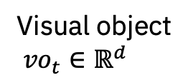


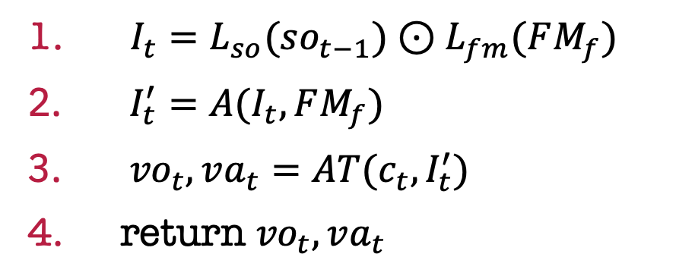
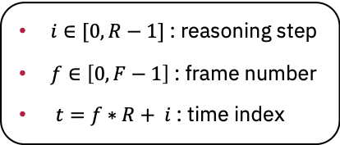
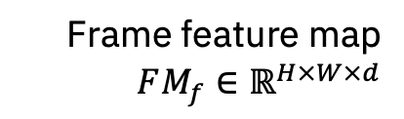
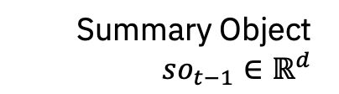

Visual Retrieval Unit
Summary Object
$so_{t−1}∈ℝ^{d}$
Parameters:
$L_{so}$: summary object projection
$L_{fm}$: feature map projection
$A$: aggregator
$AT$: attention module
Visual object
${vo}_{t}∈ℝ^{d}$
Frame feature map
$FM_{f}∈ℝ^{H×W×d}$
Visual attention
${vo}_{t}∈ℝ^{d}$
Control state
$c_{t}∈ℝ^{d}$
// both linear layers
// linear layer
$I_{t}=L_{so}(so_{t−1})⊙L_{fm}(FM_{f})$
$I_{t}^{′}=A(I_{t},FM_{f})$
${vo}_{t}, va_{t}=AT(c_{t},I_{t}^{′})$
return ${vo}_{t}, va_{t}$
$i∈[0,R−1]$ : reasoning step
$f∈\left[0,F−1\right]$ : frame number
$t=f∗R+ i$ : time index

Slide 11
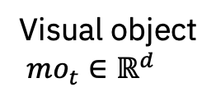


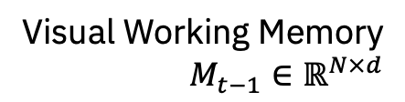

Memory Retrieval Unit
Summary Object
$so_{t−1}∈ℝ^{d}$
Parameters:
$L_{so}$: summary object projection
$L_{fm}$: VWM projection
$A$: aggregator
$AT$: attention module
Visual object
${mo}_{t}∈ℝ^{d}$
Visual Working Memory
$M_{t−1}∈ℝ^{N×d}$
Visual attention
${mo}_{t}∈ℝ^{d}$
Control state
$c_{t}∈ℝ^{d}$
// both linear layers
// linear layer
$I_{t}=L_{so}(so_{t−1})⊙L_{fm}(M_{t−1})$
$I_{t}^{′}=A(I_{t},M_{t−1})$
${mo}_{t}, {ma}_{t}=AT(c_{t},I_{t}^{′})$
return ${mo}_{t}, ma_{t}$
$i∈[0,R−1]$ : reasoning step
$f∈\left[0,F−1\right]$ : frame number
$t=f∗R+ i$ : time index

Slide 12
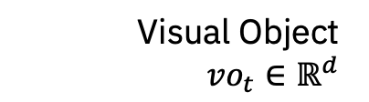
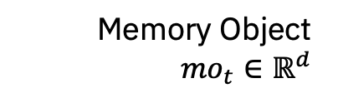
Matching Unit
Visual Object
${vo}_{t}∈ℝ^{d}$
Parameters:
$L_{so}$: summary object projection
$L_{fm}$: VWM projection
$A$: aggregator
$AT$: attention module
Visual object
${mo}_{t}∈ℝ^{d}$
Memory Object
${mo}_{t}∈ℝ^{d}$
Visual attention
${mo}_{t}∈ℝ^{d}$
Control state
$c_{t}∈ℝ^{d}$
// both linear layers
// linear layer
$I_{t}=L_{so}(so_{t−1})⊙L_{fm}(M_{t−1})$
$I_{t}^{′}=A(I_{t},M_{t−1})$
${mo}_{t}, {ma}_{t}=AT(c_{t},I_{t}^{′})$
return ${mo}_{t}, ma_{t}$
$i∈[0,R−1]$ : reasoning step
$f∈\left[0,F−1\right]$ : frame number
$t=f∗R+ i$ : time index

Slide 13
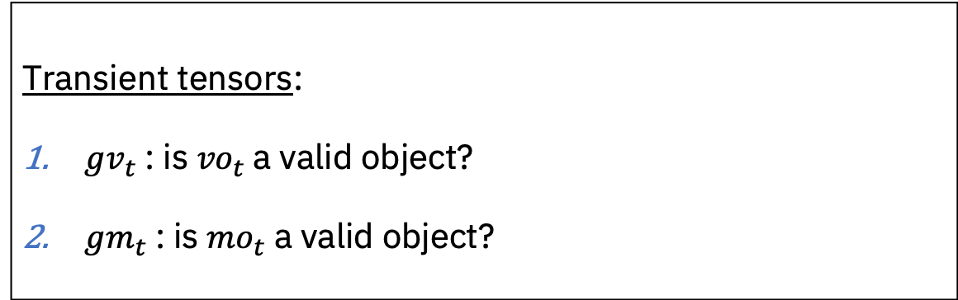
Matching Unit
Transient tensors:
${gv}_{t}$: is ${vo}_{t}$a valid object?
${gm}_{t}$: is ${mo}_{t}$ a valid object?

Slide 14
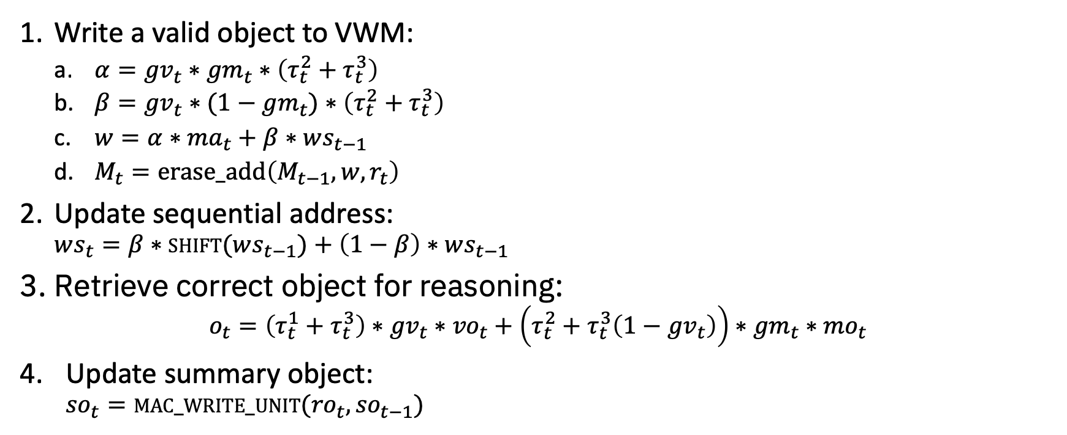
Memory Update Unit
Write a valid object to VWM:
$α={gv}_{t}∗{gm}_{t}∗\left(τ_{t}^{2}+τ_{t}^{3}\right)$
$β={gv}_{t}∗(1−{gm}_{t})$ $∗\left(τ_{t}^{2}+τ_{t}^{3}\right)$
$w={α∗ma}_{t}+β∗ws_{t−1}$
$M_{t}=erase_add\left(M_{t−1},w,r_{t}\right)$
Update sequential address:
$$ws_{t}=β∗\operatorname{shift}{(ws_{t−1})}+\left(1−β\right)∗ws_{t−1}$$
Retrieve correct object for reasoning:
$$o_{t}=\left(τ_{t}^{1}+τ_{t}^{3}\right)∗{gv}_{t}∗{vo}_{t}+\left(τ_{t}^{2}+τ_{t}^{3}\left(1−{gv}_{t}\right)\right)∗{gm}_{t}∗{mo}_{t}$$
Update summary object:
$${so}_{t}=mac_write_unit({ro}_{t},{so}_{t−1})$$

Slide 15
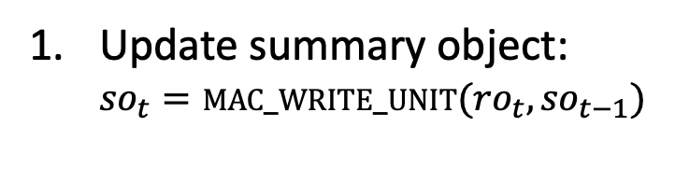
Thought Unit
Update summary object:
$${so}_{t}=mac_write_unit({ro}_{t},{so}_{t−1})$$

