Slide 1
Learning Multi-Step Spatio-Temporal Reasoning with Selective Attention Memory Network
T.S. Jayram, Tomasz Kornuta, Vincent Albouy,
Emre Sevgen, Ahmet Ozcan
IBM Research AI
KR2ML, NeurIPS 2019

Slide 2
System 1 vs System 2 Cognition*
System 1 - Current DL
Intuitive and fast
unconscious
non-linguistic, habitual
System 2 – Future DL
Slow, logical, and sequential
conscious
linguistic, algorithmic, planning, reasoning
*Bengio, NeurIPS 2019 Keynote
building on Daniel Kahneman, Thinking Fast and Slow

Slide 3
Main Contribution
A memory-augmented neural architecture for performing relational and temporal multi-step reasoning on a visual question and answer dataset.

Slide 4
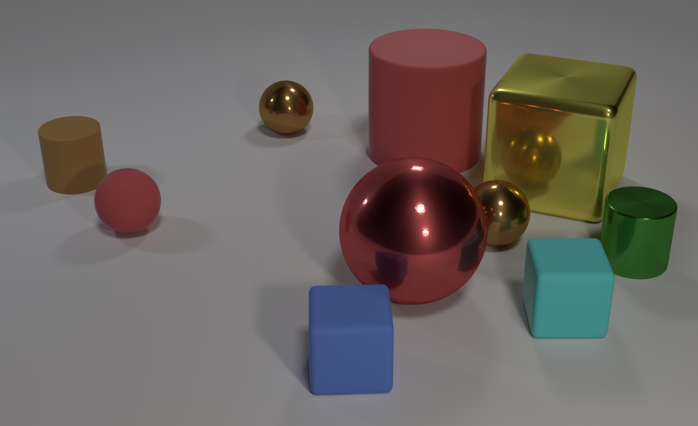
Visual Reasoning with Static Images
CLEVR [Johnson et al.’15]
Program-based
Object-attribute associations
Object-object comparisons
Spatial relationships
Counting
Q: How many objects are either small cylinders or blue things?
A: 3
What’s missing: Temporal Reasoning
Notes:
Popular dataset that brought into sharp focus the challenges of visual reasoning

Slide 5
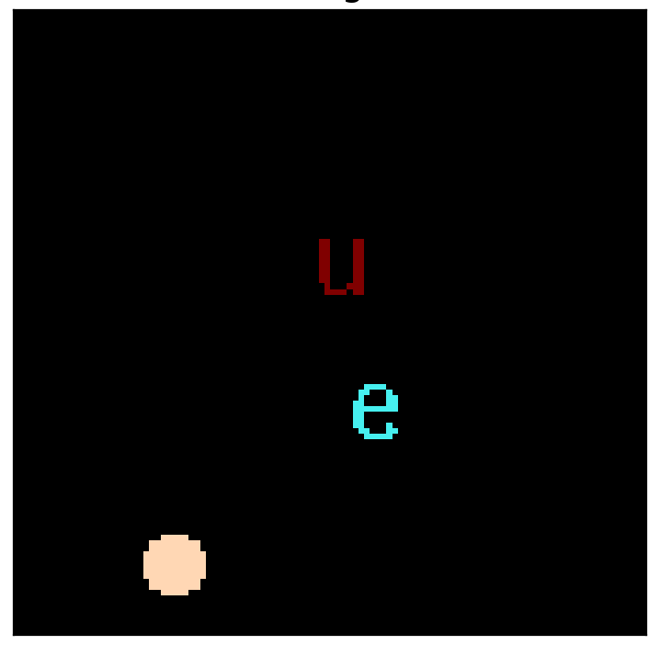
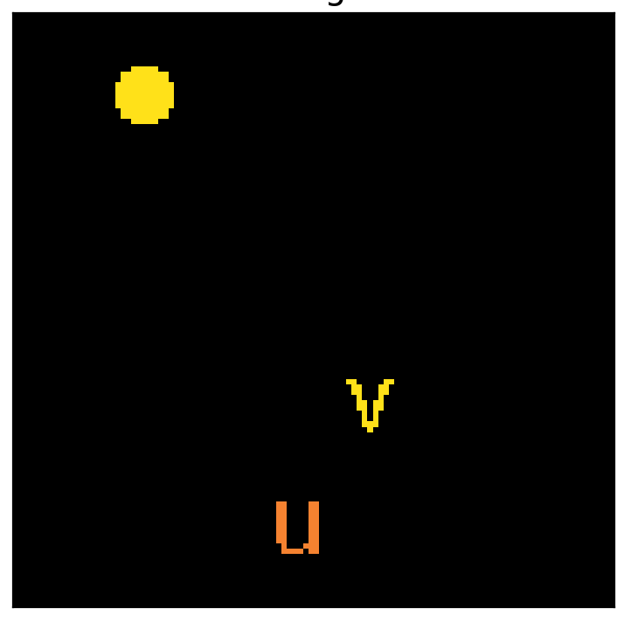
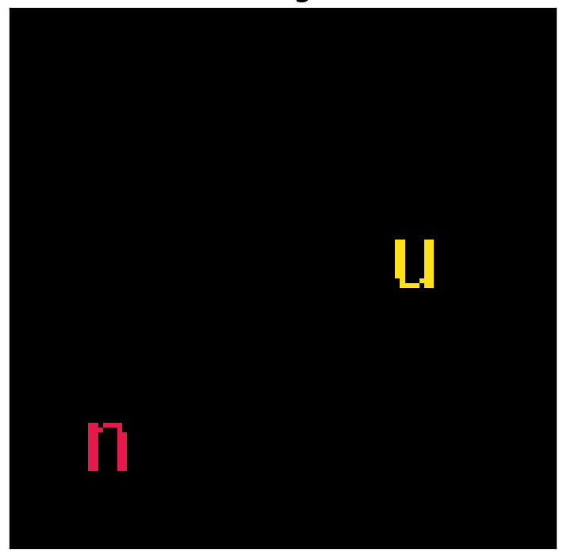
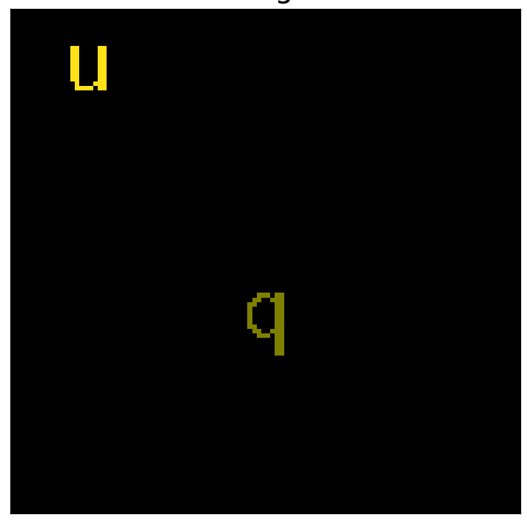
Visual Reasoning with Multiple Frames
Frame 1
Frame 2
Frame 3
Frame 4
Q: Does color of u now equal color of latest circle? A: True
COG [Yang et al., ECCV 18]

Slide 6
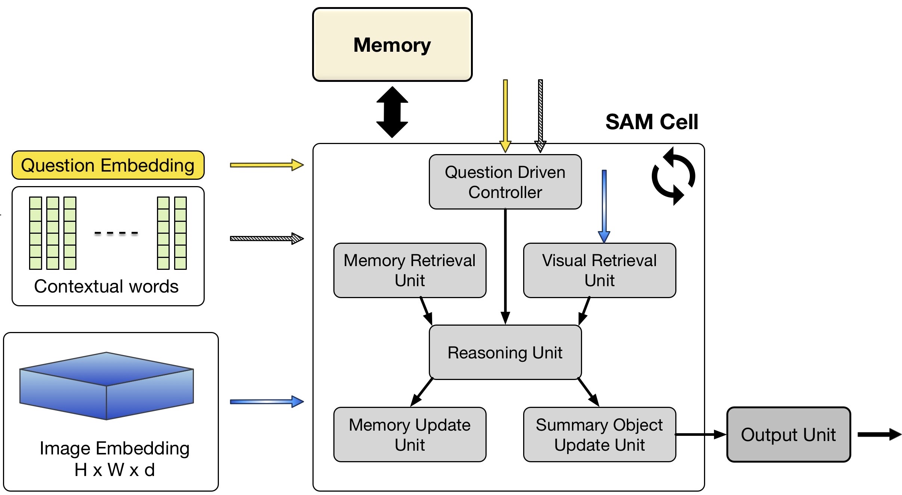
Selective Attention Memory Network

Slide 7
Location- and Content-based addressing
Selective Attention Memory Network

Slide 8
Recurrent unit, performing multi-step reasoning
Selective Attention Memory Network

Slide 9
Determines temporal context, e.g., “latest”
Selective Attention Memory Network

Slide 10
Selective Attention Memory Network
Update memory with a new object
Replace or add new object
Extract relevant object for reasoning

Slide 11
SAMNet obtains 96.1% accuracy (~16% improvement over baseline) on the Hard COG dataset

Slide 12
SAMNet generalizes across frame size + scene complexity (zero-shot)
Finetuning achieves better performance

Slide 13
Visual Reasoning with Multiple Frames
Frame 1
Frame 2
Frame 3
Frame 4
Q: Does color of u now equal color of latest circle? A: True
COG [Yang et al., ECCV 18]

Slide 14
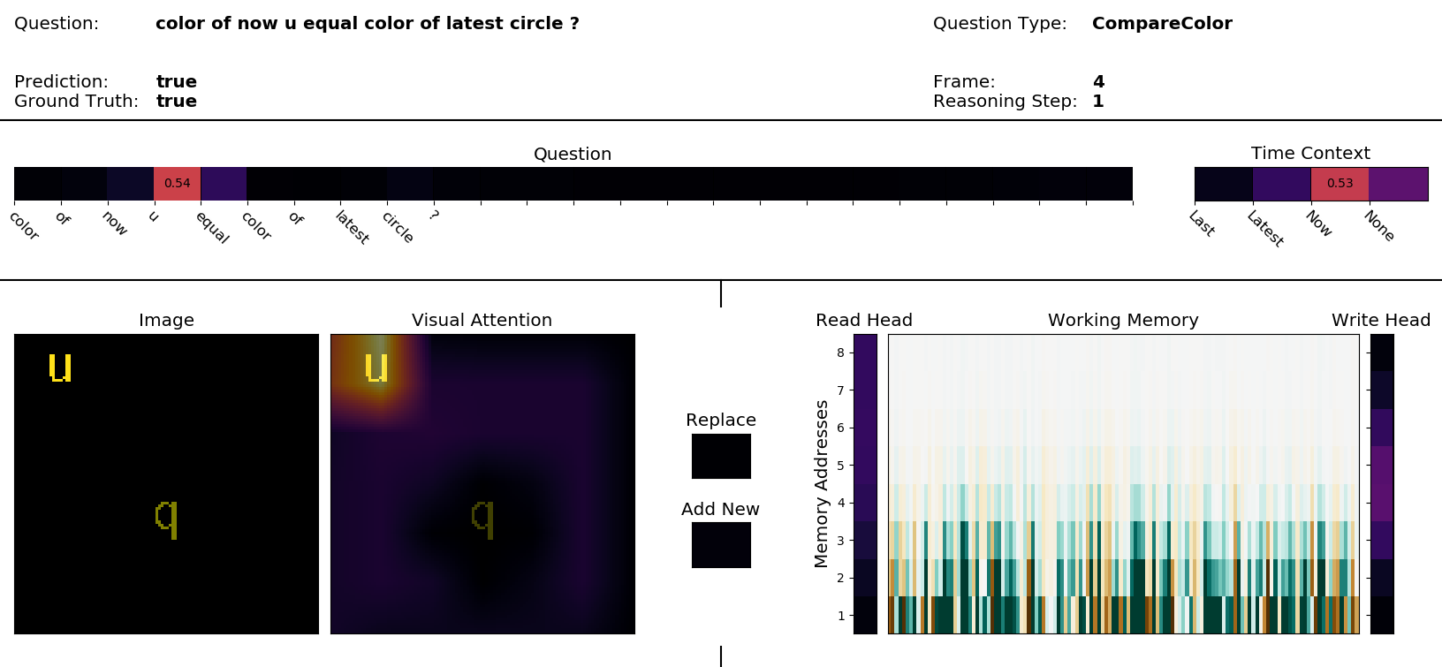

Slide 15
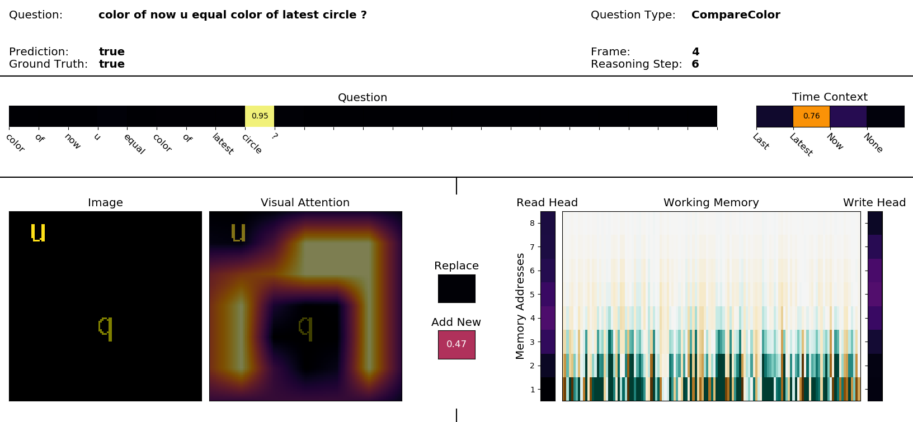

Slide 16
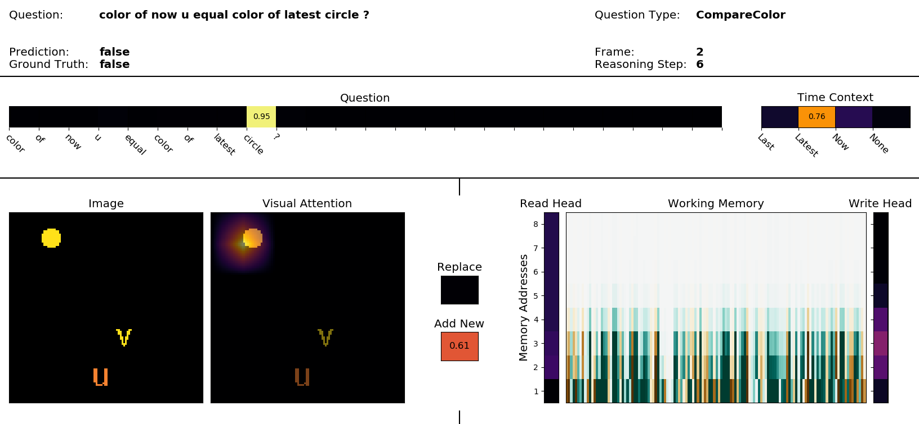

Slide 17
Thank you!

Slide 18
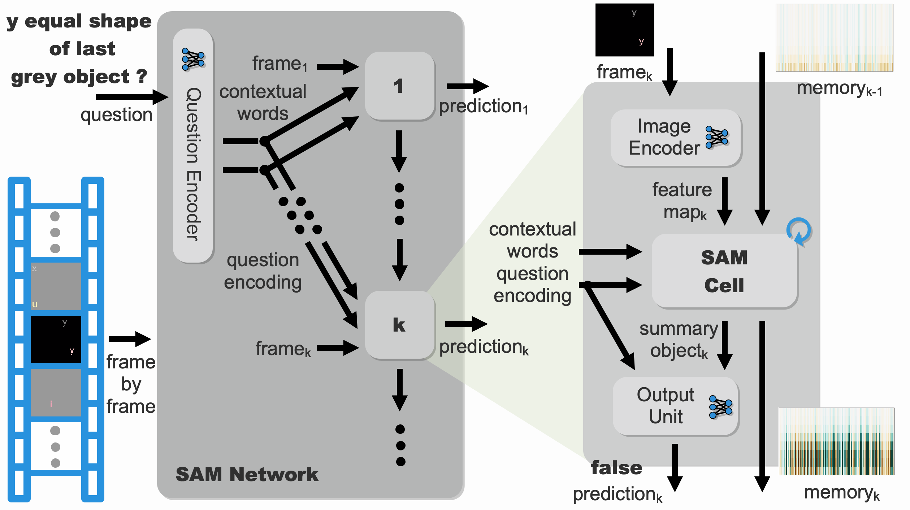

Slide 19
memory
wh_{t-1}
M_{t-1}
so_{t-1}
c_{t-1}
cw
q
F_{k}
SAM Cell
1
Question-driven Controller
contextual
words
c_{t}
c_{t}
so_{t-1}
τ_{t}
Memory Retrieval Unit
Visual
Retrieval Unit
question
encoding
t
rh_{t}
mo_{t}
va_{t}
vo_{t}
rh_{t}
c_{t}
feature
map
Reasoning
Unit
h_{t}ª,h_{t}^{u}
g_{t}^{v},g_{t}^{m}
vo_{t}
mo_{t}
vo_{t}
so_{t-1}
T
Memory
Update Unit
Summary Object
Update Unit
memory
summary object
wh_{t}
M_{t}
c_{t}
so_{t}

