Slide 1














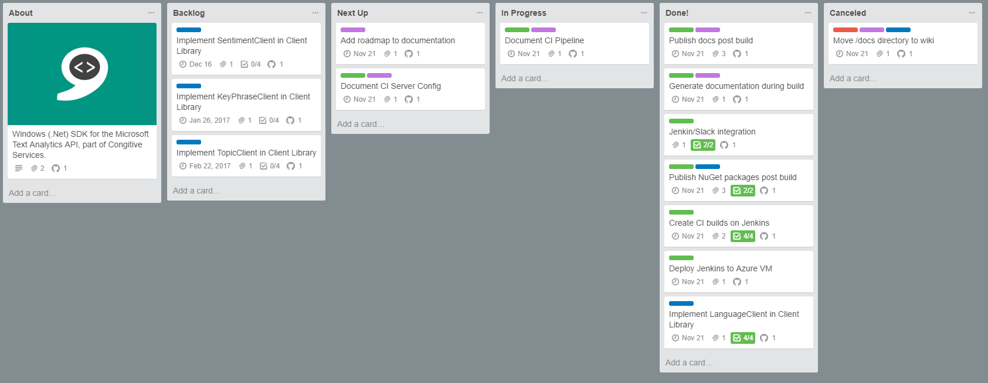




oxford-ci
Microsoft.ProjectOxford.Text
oxfordci
oxford-docs
MyGet
jenkins
develop
master
Microsoft.ProjectOxford.Text
develop
master
NuGet
Azure
#jenkins-develop
#jenkins-master
cognitive-textanalytics-windows
oxford-docs
#github
#trello
Slack
develop
master
develop
master
master
cognitive-textanalytics-windows
GitHub
Trello

Slide 2










oxford-ci
Microsoft.ProjectOxford.Text
oxfordci
oxford-docs
MyGet
jenkins
develop
master
Microsoft.ProjectOxford.Text
develop
master
NuGet
Azure
#jenkins-develop
#jenkins-master
cognitive-textanalytics-windows
oxford-docs
#github
#trello
Slack
develop
master
develop
master
master
cognitive-textanalytics-windows
GitHub
Trello

