Slide 1














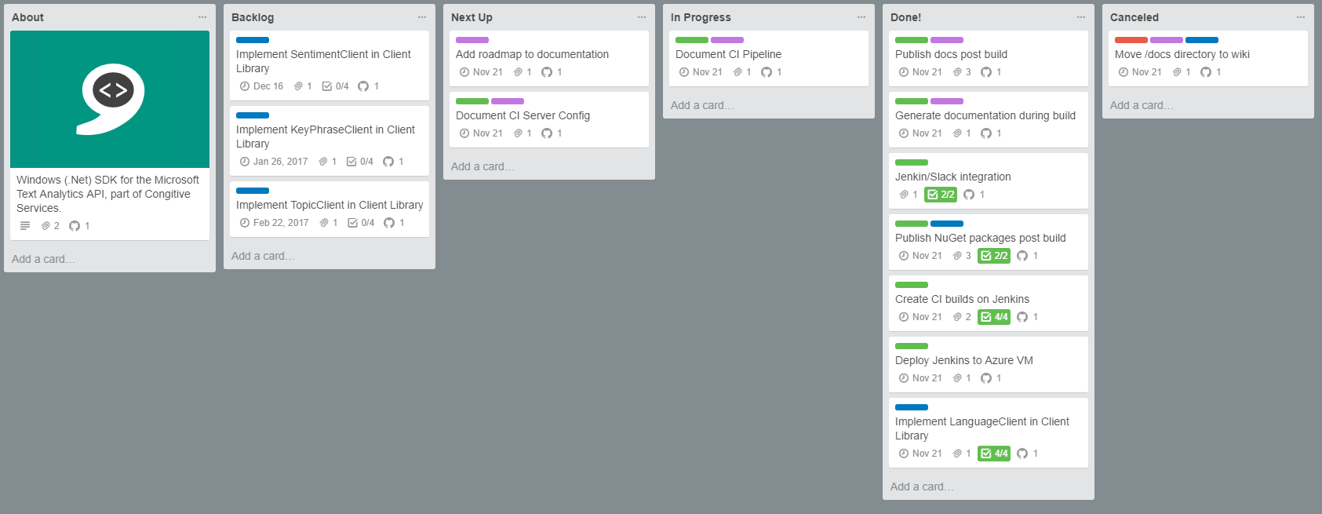



oxford-ci
Microsoft.ProjectOxford.Text
oxfordci
oxford-docs
MyGet
jenkins
develop
master
Microsoft.ProjectOxford.Text
develop
master
NuGet
NuGet Package Sources
Azure
#jenkins-develop
#jenkins-master
cognitive-textanalytics-windows
oxford-docs
#github
#trello
develop
master
Slack
master
develop
master
cognitive-textanalytics-windows
GitHub
Trello
Cognitive-TextAnalytics-Windows CI Pipeline

Slide 2

oxford-ci
Microsoft.ProjectOxford.Text
oxfordci
oxford-docs
MyGet
jenkins
develop
master
Microsoft.ProjectOxford.Text
develop
master
NuGet
NuGet Package Sources
Azure
#jenkins-develop
#jenkins-master
cognitive-textanalytics-windows
oxford-docs
#github
#trello
develop
master
Slack
master
develop
master
cognitive-textanalytics-windows
GitHub
Developer pushes changes from local git repo to GitHub.
Trello
Cognitive-TextAnalytics-Windows CI Pipeline

Slide 3

oxford-ci
Microsoft.ProjectOxford.Text
oxfordci
oxford-docs
MyGet
jenkins
develop
master
Microsoft.ProjectOxford.Text
develop
master
NuGet
NuGet Package Sources
Azure
#jenkins-develop
#jenkins-master
cognitive-textanalytics-windows
oxford-docs
#github
#trello
develop
master
Slack
master
develop
master
cognitive-textanalytics-windows
GitHub
GitHub sends a notification of the push to oxford-hq #github channel on Slack.
Trello
Cognitive-TextAnalytics-Windows CI Pipeline

Slide 4

oxford-ci
Microsoft.ProjectOxford.Text
oxfordci
oxford-docs
MyGet
jenkins
develop
master
Microsoft.ProjectOxford.Text
develop
master
NuGet
NuGet Package Sources
Azure
#jenkins-develop
#jenkins-master
cognitive-textanalytics-windows
oxford-docs
#github
#trello
develop
master
Slack
master
develop
master
cognitive-textanalytics-windows
GitHub
GitHub initiates a build on the Jenkins CI server via a webhook.
Trello
Cognitive-TextAnalytics-Windows CI Pipeline

Slide 5

oxford-ci
Microsoft.ProjectOxford.Text
oxfordci
oxford-docs
MyGet
jenkins
develop
master
Microsoft.ProjectOxford.Text
develop
master
NuGet
NuGet Package Sources
Azure
#jenkins-develop
#jenkins-master
cognitive-textanalytics-windows
oxford-docs
#github
#trello
develop
master
Slack
master
develop
master
cognitive-textanalytics-windows
GitHub
Jenkins sends build status updates to the appropriate #jenkins channel for the oxford-hq Slack team.
Trello
Cognitive-TextAnalytics-Windows CI Pipeline

Slide 6

oxford-ci
Microsoft.ProjectOxford.Text
oxfordci
oxford-docs
MyGet
jenkins
develop
master
Microsoft.ProjectOxford.Text
develop
master
NuGet
NuGet Package Sources
Azure
#jenkins-develop
#jenkins-master
cognitive-textanalytics-windows
oxford-docs
#github
#trello
develop
master
Slack
master
develop
master
cognitive-textanalytics-windows
GitHub
Upon a successful build, Jenkins creates a publishes a NuGet packate to the appropriate source (MyGet for the develop branch, NuGet for the master branch).
Trello
Cognitive-TextAnalytics-Windows CI Pipeline

Slide 7

oxford-ci
Microsoft.ProjectOxford.Text
oxfordci
oxford-docs
MyGet
jenkins
develop
master
Microsoft.ProjectOxford.Text
develop
master
NuGet
NuGet Package Sources
Azure
#jenkins-develop
#jenkins-master
cognitive-textanalytics-windows
oxford-docs
#github
#trello
develop
master
Slack
master
develop
master
cognitive-textanalytics-windows
GitHub
Upon a successful build, Jenkins push generated documentation to the oxford-docs GitHub repo.
Trello
Cognitive-TextAnalytics-Windows CI Pipeline

Slide 8

oxford-ci
Microsoft.ProjectOxford.Text
oxfordci
oxford-docs
MyGet
jenkins
develop
master
Microsoft.ProjectOxford.Text
develop
master
NuGet
NuGet Package Sources
Azure
#jenkins-develop
#jenkins-master
cognitive-textanalytics-windows
oxford-docs
#github
#trello
develop
master
Slack
master
develop
master
cognitive-textanalytics-windows
GitHub
The oxford-docs repo is pushed to an Azure web app.
Trello
Cognitive-TextAnalytics-Windows CI Pipeline

Slide 9

oxford-ci
Microsoft.ProjectOxford.Text
oxfordci
oxford-docs
MyGet
jenkins
develop
master
Microsoft.ProjectOxford.Text
develop
master
NuGet
NuGet Package Sources
Azure
#jenkins-develop
#jenkins-master
cognitive-textanalytics-windows
oxford-docs
#github
#trello
develop
master
Slack
master
develop
master
cognitive-textanalytics-windows
GitHub
Developer updates work items on the Cognitive-TextAnalytics-Windows Trello board.
Trello
Cognitive-TextAnalytics-Windows CI Pipeline

Slide 10

oxford-ci
Microsoft.ProjectOxford.Text
oxfordci
oxford-docs
MyGet
jenkins
develop
master
Microsoft.ProjectOxford.Text
develop
master
NuGet
NuGet Package Sources
Azure
#jenkins-develop
#jenkins-master
cognitive-textanalytics-windows
oxford-docs
#github
#trello
develop
master
Slack
master
develop
master
cognitive-textanalytics-windows
GitHub
Trello sends a notification of the work item update to oxford-hq #trello channel on Slack.
Trello
Cognitive-TextAnalytics-Windows CI Pipeline

Slide 11
oxford-ci
Microsoft.ProjectOxford.Text
oxfordci
oxford-docs
MyGet
jenkins
develop
master
Microsoft.ProjectOxford.Text
develop
master
NuGet
NuGet Package Sources
Azure
#jenkins-develop
#jenkins-master
cognitive-textanalytics-windows
oxford-docs
#github
#trello
develop
master
Slack
master
develop
master
cognitive-textanalytics-windows
GitHub
Trello
Cognitive-TextAnalytics-Windows CI Pipeline

