Slide 1
Connected Service Templates

Slide 2
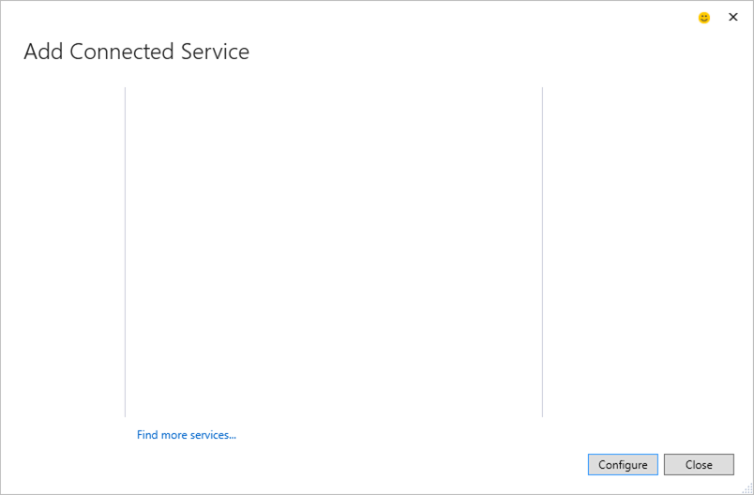

Change the background color of containing box to represent selection
Each customizable element is represented as a PPT element
Microsoft
Add Service Reference
Created By: Microsoft
Datalogics
Add SOAP, WCF and OData v1-3 service references
Version: 1.0.0
Salesforce
More information
SAP
Azure Mobile Services
Supported Technologies:
Store data in the cloud, and authentication, and deliver push notifications for mobile apps
SOAP
WCF
OData v1-v3
Azure Storage
Store and access data with Azure Storage services like Blobs, Queues and Tables
Office 365 APIs
Office Integrate your applications with Office 365 services such as mail, calendar, contacts, files and more

Slide 3
Microsoft
Add Service Reference
Created By: Microsoft
Datalogics
Add SOAP and WCF service references
Version: 1.0.0
Salesforce
More information
SAP
OData Service References
Supported Technologies:
Add OData service references
SOAP
WCF
Azure Mobile Services
Store data in the cloud, and authentication, and deliver push notifications for mobile apps
Azure Storage
Store and access data with Azure Storage services like Blobs, Queues and Tables
Office 365 APIs
Office Integrate your applications with Office 365 services such as mail, calendar, contacts, files and more

Slide 4
Microsoft
Add Service Reference
Created By: Microsoft
Datalogics
Add SOAP and WCF service references
Version: 1.0.0
Salesforce
More information
SAP
OData Service References
Supported Technologies:
Add OData service references
OData v1-3
Azure Mobile Services
Store data in the cloud, and authentication, and deliver push notifications for mobile apps
Azure Storage
Store and access data with Azure Storage services like Blobs, Queues and Tables
Office 365 APIs
Office Integrate your applications with Office 365 services such as mail, calendar, contacts, files and more

Slide 5

Microsoft
Add Service Reference
Created By: Microsoft
Datalogics
Add SOAP and WCF service references
Version: 1.0.0
Salesforce
More information
SAP
OData Service References
Supported Technologies:
Add OData service references
Web API
Swagger
RAML
Web API
Add Web API service references using various metadata formats such as Swagger and RAML
Azure Mobile Services
Store data in the cloud, and authentication, and deliver push notifications for mobile apps
Office 365 APIs
Azure Storage
Office Integrate your applications with Office 365 services such as mail, calendar, contacts, files and more
Store and access data with Azure Storage services like Blobs, Queues and Tables

Slide 6
Microsoft
Add Service Reference
Created By: Microsoft
Datalogics
Add SOAP and WCF service references
Version: 1.0.0
Salesforce
More information
SAP
OData Service References
Supported Technologies:
Add OData v1-v4 service references using T4 templates and code scaffolding
OData v1-v4
Azure Mobile Services
Store data in the cloud, and authentication, and deliver push notifications for mobile apps
Azure Storage
Store and access data with Azure Storage services like Blobs, Queues and Tables
Office 365 APIs
Office Integrate your applications with Office 365 services such as mail, calendar, contacts, files and more

Slide 7
SinglePage Template

Slide 8
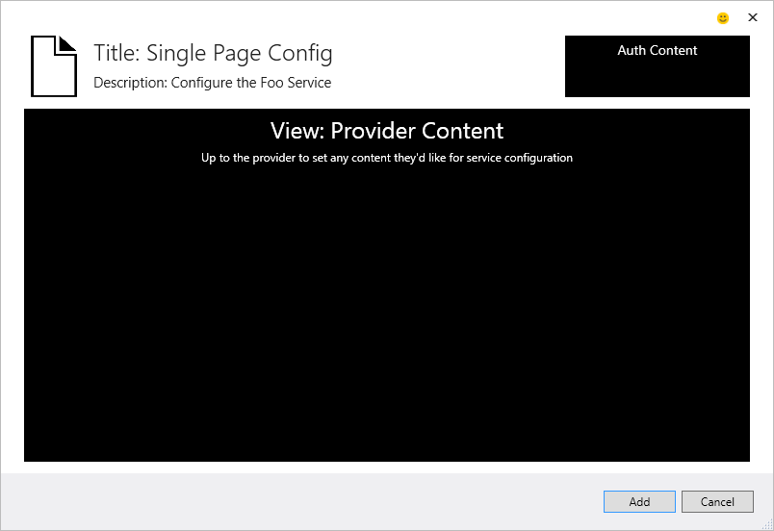
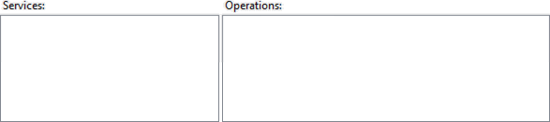
Add Service Reference UI re-done, with very close proximity to original for familiarity, and to not set expectations we’ve done more than re-host it
Add Service Reference
To see a list of available services on a specific server, enter a service URL and click Go. To browse for available services, click Discover.

Slide 9
Add Service Reference UI re-done, with very close proximity to original for familiarity, and to not set expectations we’ve done more than re-host it
DataLogics PDF Web API
Configure Keys

Slide 10


Slide 11
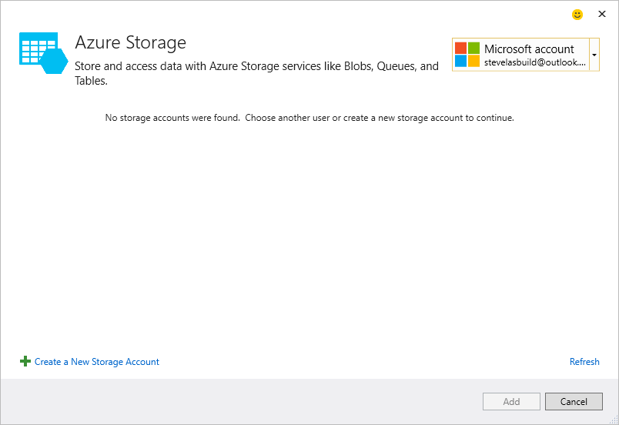

Slide 12
Wizard Template

Slide 13
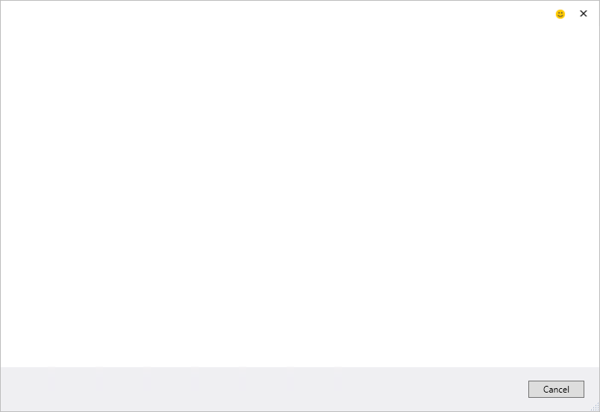

Prev, Next, Finish Buttons are layered with disabled buttons underneath the enabled buttons
Change the colors of the Page Legends to reflect selection
Page 1
Page 1 Description
Page 1 Legend
Page 2 Legend
Page 3 Legend

Slide 14
Implemented as a wizard
Feels like a Connected Service, with ASR features
“Cheese is moved, but familiar”
Service Endpoint
Enter a service endpoint and click Go for external services, or click Discover to load services within your solution
Service Endpoint
Client Options
Data Type Options

Slide 15
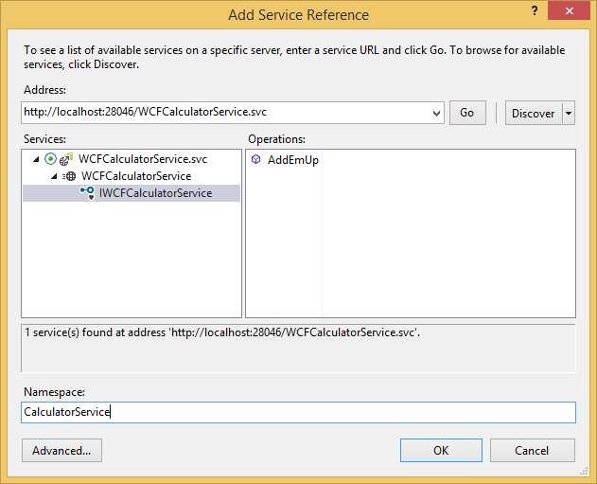
Enter a URI, click Go
Finish Enabled
Service Endpoint
Enter a service endpoint and click Go for external services, or click Discover to load services within your solution
Service Endpoint
Client Options
http://localhost:28046/WCFCalculatorService.svc
Data Type Options

Slide 16
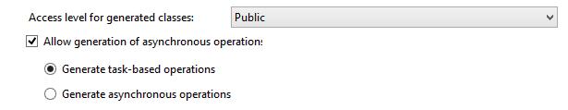
Can optionally configure advanced options
Split on two pages to fit in the wizard panes
Client Code Generation Options
Optionally change how the proxy code will be generated
Service Endpoint
Client Options
Data Type Options

Slide 17
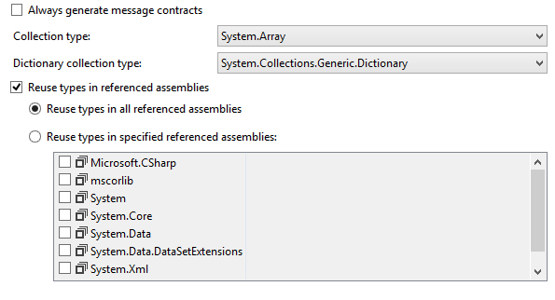
TBD – validate which collections work
Data Type Options
Optionally chose how the data objects will be generated, or reuse objects in referenced assemblies
Service Endpoint
Client Options
Data Type Options

