Slide 1

Introduction to Quantum Computing
Mariia Mykhailova Bettina Heim
Paige Frederick
#Hopperx1Seattle
Notes:
Opening Page/ Tittle Screen

Slide 2

What is Quantum Computing?
#Hopperx1Seattle
Notes:
Quantum computing is a new computing paradigm, dramatically different from normal (classical) computing, which relies on quantum-mechanical phenomena to perform computation.
The promise of quantum computing is that it will allow to solve problems that would take billions of years to solve with our existing technology.
Today you will learn how quantum computing works on the example of the easiest algorithm there is – Deutsch-Jozsa algorithm that you will be able to implement yourselves.
Time is very short, so I’ll focus on the ideas more than on the math.
Let’s start by reviewing two fundamental principles of quantum computing: superposition and measurement.

Slide 3
Superposition
Classical data: bits
Quantum data: qubits
0
|0⟩
|0⟩
|1⟩
probability
amplitude
amplitude
state
state
state
1
|1⟩
|0⟩
|1⟩
probability
amplitude
amplitude
state
state
state
#Hopperx1Seattle
Notes:
In classical computing, the data is stored as bits, zeros and ones, each value has a probability of 1.
In quantum computing, the data is stored as qubits, which can also be in zero state and one state, but they can also be in a superposition of states 0 and 1 – a combination of these two. When we want to describe a superposition state in details, we talk about “amplitudes” of the basis states of which the superposition state consists. The interesting thing about amplitudes is that they can be negative, so when they add up they can cancel each other – we’ll see that later today.

Slide 4
Measurement
|0⟩
“0” (100%)
|00⟩
|01⟩
|10⟩
|11⟩
|1⟩
“1” (100%)
|0⟩
|1⟩
“0” (50%)
“01”
(66%)
“10”
(17%)
“11”
(17%)
“1” (50%)
#Hopperx1Seattle
Notes:
Measurement is the only way to get information out of the quantum system.
When you measure a system in a superposition, you can get each of the basis states included in it with probability equal to the amplitude of this state squared.
So, if you measure a basis state 0 or 1, you’ll get the corresponding result with 100% certainty; and if a basis state has amplitude of 0, you’re guaranteed to never get it as a measurement result – we’ll use this later today.

Slide 5
Deutsch-Jozsa Algorithm
#Hopperx1Seattle
Notes:
This is actually enough to start understanding how quantum algorithms work! Let’s look at one algorithm in more details, as I’m walking you through the steps which can typically be found in all quantum algorithms

Slide 6
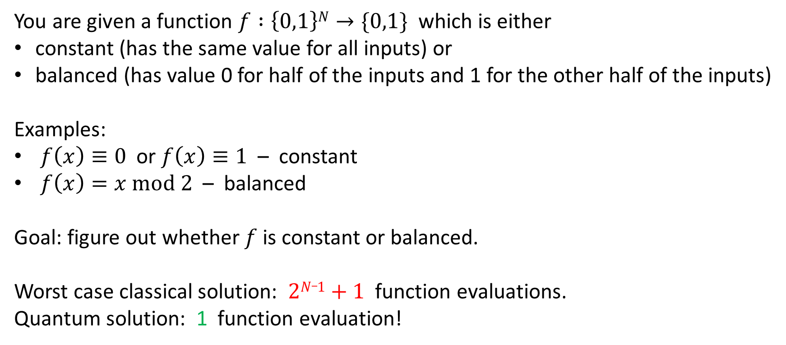
The problem
You are given a function $f :\left\{0,1\right\}N→\{0,1\}$ which is either
constant (has the same value for all inputs) or
balanced (has value 0 for half of the inputs and 1 for the other half of the inputs)
Examples:
$f\left(x\right)≡0$ or $f\left(x\right)≡1$ – constant
$f\left(x\right)=x mod 2$ – balanced
Goal: figure out whether $f$ is constant or balanced.
Worst case classical solution: $2N_1+1$ function evaluations.
Quantum solution: 1 function evaluation!
#Hopperx1Seattle
Notes:
The problem solved by the algorithm is completely artificial, but it is interesting because this is one of the simplest quantum algorithms to explain, and at the same time it offers a quantum speedup over the best classical algorithm.

Slide 7
Step 1: Prepare superposition of all inputs
|0⟩
|1⟩
|0⟩
|1⟩
Apply H gate
Apply H gate
to each qubit
|00⟩
|01⟩
|10⟩
|11⟩
|00⟩
|01⟩
|10⟩
|11⟩
#Hopperx1Seattle
Notes:
You start by preparing an equal superposition of all basis states.
This is done using H gates. Applying an H gate to the qubit splits a 0 state in a superposition of 0 and 1 states.
If we have several qubits, we can apply an H gate to each qubit to split the 0..0 state in a superposition of all basis states.

Slide 8


Step 2: Evaluate the function on all inputs
How to evaluate a classical function on a quantum input?
|001⟩
|011⟩
|101⟩
|111⟩
$$f\left(x\right)=0$$
|000⟩
|010⟩
|100⟩
|110⟩
$$f\left(x\right)=1$$
#Hopperx1Seattle
Notes:
Now you need to evaluate the function on all inputs at once. All information in a quantum state is stored in the amplitudes, so we need to somehow modify the amplitude of each basis state depending on whether f(x) is 0 or 1 for it.

Slide 9
Step 2: Evaluate the function on all inputs
Apply an oracle which flips the phase of state $x$ if $f\left(x\right)=1$
|001⟩
|011⟩
|101⟩
|111⟩
$$f\left(x\right)=0$$
|000⟩
|010⟩
|100⟩
|110⟩
$$f\left(x\right)=1$$
#Hopperx1Seattle
Notes:
To do this, we can use an oracle – this is a black box operation which implements the classical function we’re given in a quantum way.
Implementing the oracles is often the interesting part about the quantum algorithms, but in our case we assume we already have an oracle implemented.
The effect of the oracle is: leave the amplitude unchanged if f(x) = 0, and multiply it by -1 if f(x) = 1.

Slide 10



Step 3: Aggregate the results
Apply H gate to each qubit again
$$f\left(x\right)=0$$
$$f\left(x\right)=1$$
$f\left(x\right)$ is balanced
|000⟩
|000⟩
#Hopperx1Seattle
Notes:
Now the amplitudes of the states have information about all the values of f(x); but how to extract this information? You can not just measure it, so you have to come up with some clever trick to aggregate it.
In this case, the trick is the following: do you remember how we applied H gate to each qubit to go from 0 state to a superposition state? Now apply the inverse of this transformation (which is the same – apply H gate to each qubit again). In quantum computing this is called adjoint of an operation.
What will this do?
If the function is constant, the state after applying the oracle is actually the same state as before applying it (if f(x) = 1, there is a phase of -1 applied to all basis states, this is called global phase and can actually be ignored). This means that applying the adjoint transformation will just undo the effect of preparing the superposition, and we’ll get the 0 state back!
If the function is balanced, half of the amplitudes are negative, and when you apply the adjoint transformation they will cancel out to give you zero amplitude of the 0 state. The other states will have non-zero amplitudes but that doesn’t really matter.
Now, if you measure all qubits, there are two options: either you’ll get all zeroes as measurement results – this means the first scenario, constant function – or you’ll get at least one non-zero – this means the second scenario, balanced function.

Slide 11
Let’s write some code!
#Hopperx1Seattle

Slide 12
Deutsch-Jozsa algorithm: end to end
Apply H gate to each qubit
Apply the oracle
Apply H gate to each qubit again
Measure each qubit
If all qubits were measured in |0⟩ state, the function is constant, otherwise the function is balanced
https://github.com/Microsoft/GHC18-IntroToQuantumComputing
Try It Online: https://aka.ms/GHC18-IntroToQuantumComputing
#Hopperx1Seattle

Slide 13
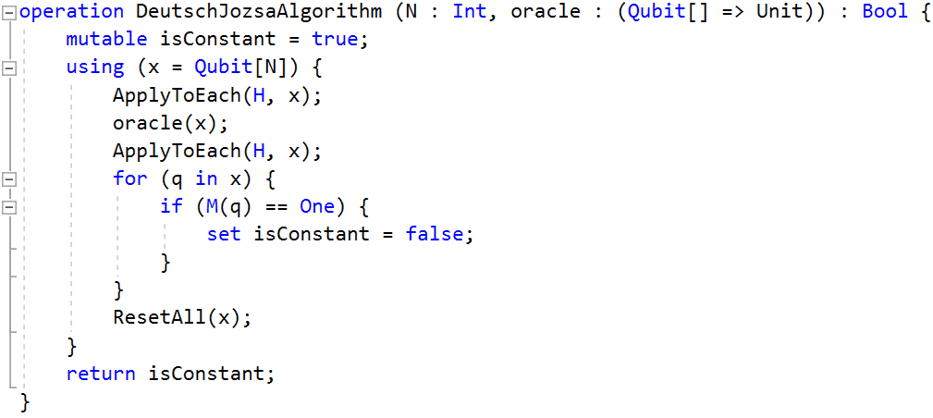
Deutsch-Jozsa algorithm: the code
#Hopperx1Seattle

Slide 14
Thank you!
#Hopperx1Seattle

