Slide 1

Introduction to Quantum Computing with Grover’s Search
Mariia Mykhailova, Megan Brown & Cathy Palmer
#GHC19
Notes:
Opening Page/ Tittle Screen

Slide 2
Introduction
#GHC19
Notes:
Quantum computing is a new computing paradigm, dramatically different from normal (classical) computing, which relies on quantum-mechanical phenomena to perform computation.
The promise of quantum computing is that it will allow to solve problems that would take billions of years to solve with our existing technology.
Today you will implement and explore one of the most famous algorithms of quantum computing – Grover’s search algorithm.
Time is very short, so I’ll focus on the ideas more than on the math.
To start, we’ll take a look at the problem we’re trying to solve today and talk about some high-level ideas about the algorithm.

Slide 3
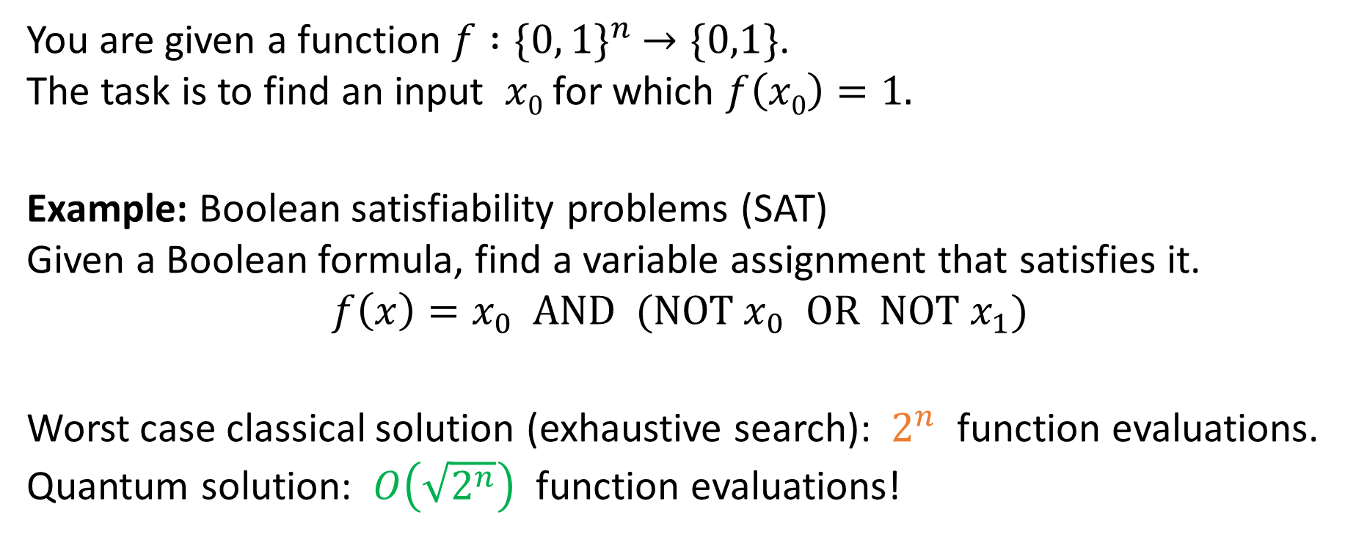
The problem
You are given a function $f :{\{0, 1\}}^{n} →\{0,1\}$.
The task is to find an input $x0$ for which $f\left(x0\right)=1.$
Example: Boolean satisfiability problems (SAT)
Given a Boolean formula, find a variable assignment that satisfies it.
$$f\left(x\right)=x_{0} AND ({\text{NOT} x}_{0} OR NOT{ x}_{1})$$
Worst case classical solution (exhaustive search): $2^{n}$ function evaluations.
Quantum solution: $O\left(\sqrt{2^{n}}\right)$ function evaluations!
#GHC19
Notes:
The problem solved by the algorithm is inverting a function: you are given a function and want to find an input on which its output will be 1.
An example of such a function are SAT problems…
This formula reads as “find a pair of variables x0, x1 such that (x0 is true) and (x0 is false or x1 is false)”
This instance is easy to solve – from the first clause you know that x0 is true, and from the second one you know that x1 has to be false.
But in general case a function can be hard to invert, so it is an interesting problem to consider.

Slide 4
Is Grover’s algorithm always practical?
A lot of problems can be represented as inverting a function, but…
Grover’s algorithm uses no information about problem structure; best classical algorithms exploit problem structure
Classical algorithms can use parallel processing (easier)
Implementing the quantum oracle which encodes a problem instance on a quantum computer can be hard
Complexity is compared in terms of queries (function evaluations); if quantum function evaluation is time-consuming, advantage disappears
Not really a database search…
#GHC19
Notes:
Before we look at the Grover’s algorithm itself, let’s consider some of the practical aspects of its applications
A lot of problems can be represented as inverting a function – you just have to phrase it as a yes/no question (integer factoring: is x a divisor of number N; database search: does the table contain this entry at index x)
But this does not mean that Grover’s search is going to be a magic bullet to speed up everything
First of all, we compare Grover’s search with the worst classical algorithm, exhaustive search. For a lot of problems classical algorithms do a lot better than that – databases don’t search for a query by checking each entry and comparing it to a query, they use indices

Slide 5
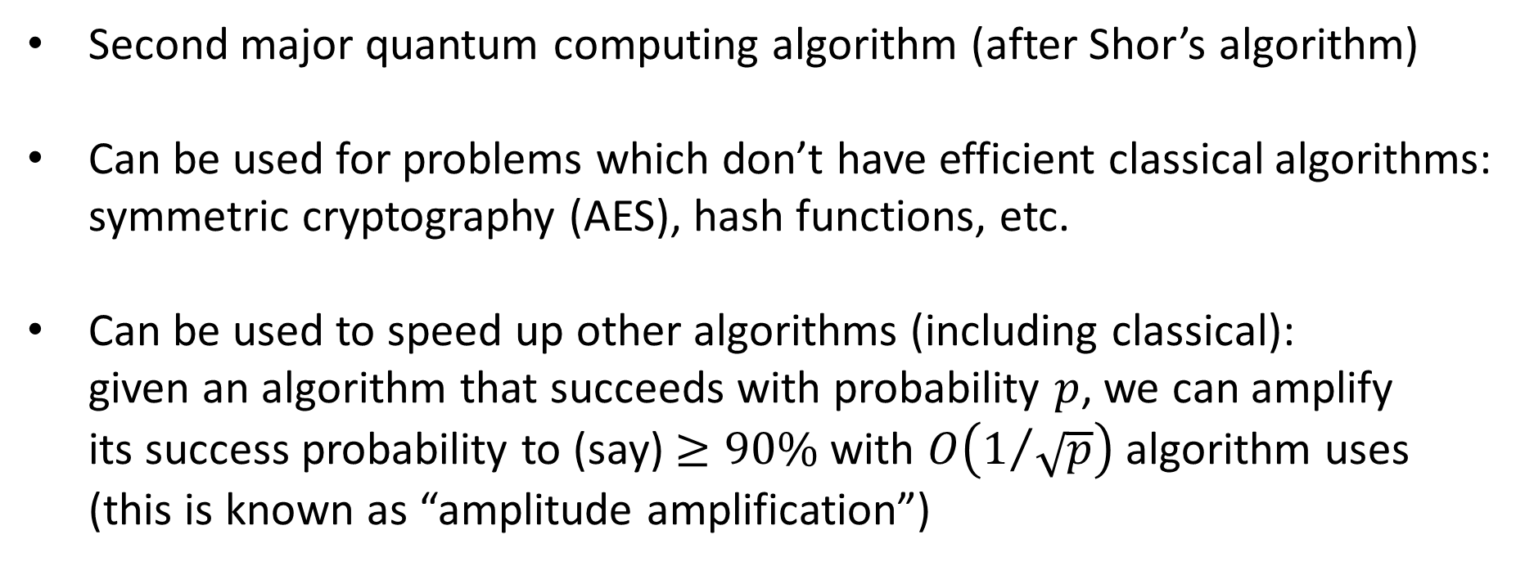
Why are we talking about it?
Second major quantum computing algorithm (after Shor’s algorithm)
Can be used for problems which don’t have efficient classical algorithms: symmetric cryptography (AES), hash functions, etc.
Can be used to speed up other algorithms (including classical): given an algorithm that succeeds with probability $p$, we can amplify its success probability to (say) $≥90\%$ with $O\left(1/{\sqrt{p}}\right)$ algorithm uses (this is known as “amplitude amplification”)
#GHC19

Slide 6
Fundamental Concepts of Quantum Computing
#GHC19
Notes:
Before we go into the overview of the algorithm, we’ll need to review a couple of fundamental concepts of quantum computing.
Quantum computing is a new computing paradigm, dramatically different from normal (classical) computing, which relies on quantum-mechanical phenomena to perform computation.
The two concepts we’ll need today are superposition and measurement

Slide 7
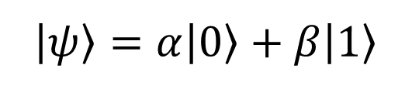


Superposition
Classical data: bits
Quantum data: qubits
0
|1⟩
$$|ψ〉=α|0〉+β|1〉$$
|0⟩
probability
$$β$$
state
|1⟩
1
|0⟩
$$α$$
probability
state
#GHC19
Notes:
You will see some unusual notation on the following slides; this is Dirac notation, the language of quantum computing, and it just means “certain quantum state”. Try not to focus too much on the notation or on the exact formulas – there is a lot of math behind it which I don’t have time for, but you won’t need it for the hands-on part of the workshop.
In classical computing, the data is stored as bits, zeros and ones, each value has a probability of 1.
In quantum computing, the data is stored as qubits, which can also be in zero state and one state, but they can also be in a superposition of states 0 and 1 – a combination of these two. When we want to describe a superposition state in detail, we talk about “amplitudes” of the basis states of which the superposition state consists.

Slide 8
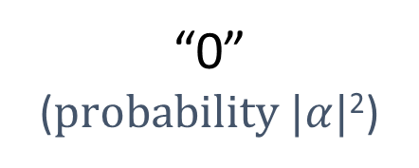
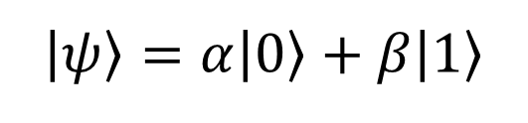
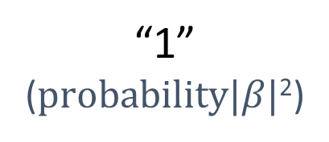
Measurement
$$|ψ〉=α|0〉+β|1〉$$
“0” (100%)
“1” (100%)
“0” (50%)
“0”
($probability |α|$²)
“1”
($probability|β|$²)
“1” (50%)
#GHC19
Notes:
Measurement is the only way to get information out of the quantum system.
When you measure a system in a superposition, you can get each of the basis states included in it with probability equal to the amplitude of this state squared.
So, if you measure a basis state 0 or 1, you’ll get the corresponding result with 100% certainty; the larger is the amplitude of the state, the higher is the probability you will measure it.
You can also think of it as the closer the state is to a certain state, the higher is the probability you will measure that state

Slide 9
Grover’s Search Algorithm
#GHC19
Notes:
Now that we are armed with these two concepts, let’s dive in the Grover’s algorithm itself!
Here we will look at a general Grover’s algorithm, not tuned to solving any specific problem

Slide 10

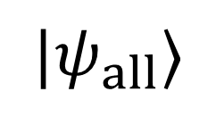
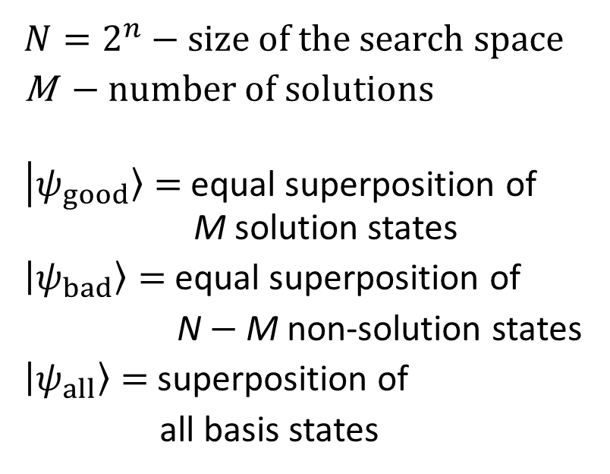

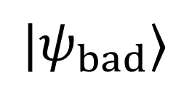
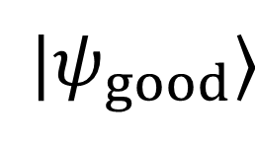
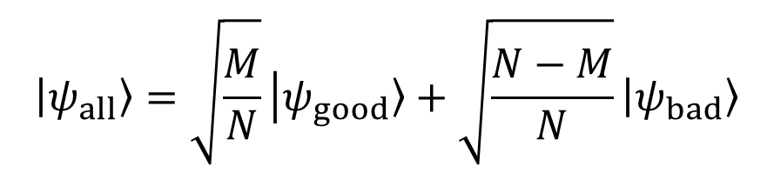
$$|ψ_{good}〉$$
Definitions and context
$N=2^{n}$ $−$ size of the search space
M $−$ number of solutions
$|ψ_{good}〉=$ equal superposition of M solution states
$|ψ_{bad}〉=$ equal superposition of
N $−$M non-solution states
$|ψ_{all}〉=$ superposition of
all basis states
$$|ψ_{all}〉$$
$$θ$$
$$|ψ_{bad}〉$$
$$θ≈\sqrt{\frac{M}{N}}$$
$$|ψ_{all}〉=\sqrt{\frac{M}{N}}|ψ_{good}〉+\sqrt{\frac{N−M}{N}}|ψ_{bad}〉$$
#GHC19
Notes:
We start with an equal superposition of all states
We can think of it as a superposition of two vectors – all solutions and all non-solutions
If you perform a measurement now, you will get any random state with equal probability, and the fewer solution states there are, the worse are the chances of us getting one of them
Our goal is to increase the probability of getting a solution state as the measurement result

Slide 11
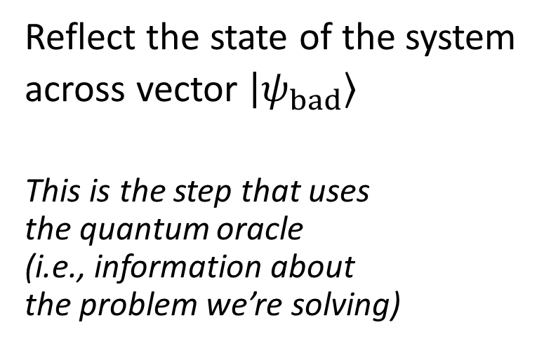
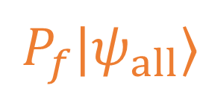

$$|ψ_{good}〉$$
Grover iteration, step 1
Reflect the state of the system
across vector $|ψ_{bad}〉$
This is the step that uses the quantum oracle (i.e., information about the problem we’re solving)
$$|ψ_{all}〉$$
$$θ$$
$$|ψ_{bad}〉$$
$$θ$$
$$P_{f}|ψ_{all}〉$$
#GHC19
Notes:
To do this, we perform a sequence of two steps, called Grover iteration
The first step is reflecting the state of the system across the vector that is a superposition of all non-solution states
You can do this if you have access to the quantum oracle – a black box which implements the classical function we’re inverting in a quantum way

Slide 12

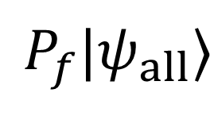
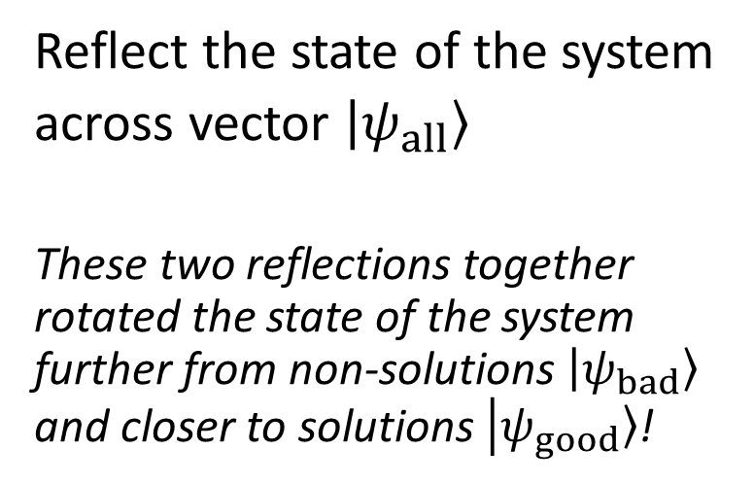


$$|ψ_{good}〉$$
Grover iteration, step 2
Reflect the state of the system
across vector $|ψ_{all}〉$
These two reflections together rotated the state of the system further from non-solutions $|ψ_{bad}〉$ and closer to solutions $|ψ_{good}〉$!
$$GP_{f}|ψ_{all}〉$$
$$2θ$$
$$|ψ_{all}〉$$
$$θ$$
$$|ψ_{bad}〉$$
$$θ$$
$$P_{f}|ψ_{all}〉$$
#GHC19
Notes:
The second step is reflecting the state of the system across the vector that is superposition of all states
These two reflections combine to make a rotation, which brings the state of the system further away from the non-solution states and closer to the solution states?
This means that if do the measurement now, we have a higher probability of getting a solution than we had when we started

Slide 13
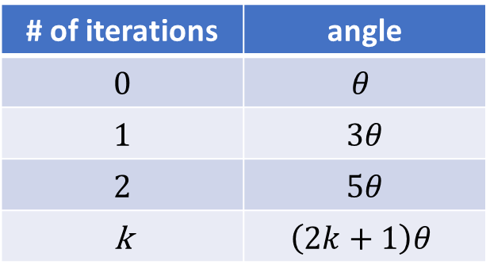




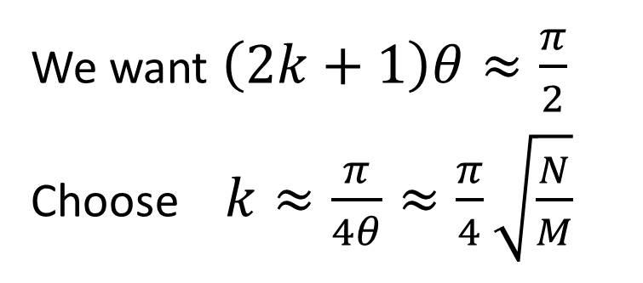
$$|ψ_{good}〉$$
Repeat Grover iteration
$${\left(GP_{f}\right)}^{2}|ψ_{all}〉$$
$$GP_{f}|ψ_{all}〉$$
# of iterations | angle
0 | $$θ$$
1 | 3$θ$
2 | 5$θ$
k | $$\left(2k+1\right)θ$$
$$2θ$$
$$2θ$$
$$|ψ_{all}〉$$
$$θ$$
$$|ψ_{bad}〉$$
$$θ$$
$$P_{f}|ψ_{all}〉$$
We want $\left(2k+1\right)θ≈\frac{π}{2}$
Choose $k≈\frac{π}{4θ}≈\frac{π}{4}\sqrt{\frac{N}{M}}$
#GHC19
Notes:
We can repeat the iteration multiple times to bring the state of the system closer to the superposition of solution states
Note that this works only up to a certain point – if you do too many iterations, you cross the vertical axis and start going further away from the solution states, back to non-solution states
There is a sweet spot – the number of iterations you want to do to maximize success probability of the algorithm
This is one of the properties of the algorithm that you will observe closer in the hands-on part of the workshop

Slide 14
Exploring Grover’s Search
#GHC19

Slide 15
Let’s write some code!
Pick one of these links at random: https://aka.ms/GHC19-Grover-1 https://aka.ms/GHC19-Grover-2 https://aka.ms/GHC19-Grover-3 https://aka.ms/GHC19-Grover-4
All workshop materials (GitHub): https://aka.ms/GHC19-GroverSearch
#GHC19

