Slide 1
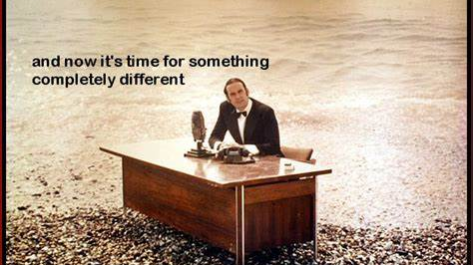

Slide 2
Reinforcement Learning Outline
Reinforcement Learning compared to Supervised Learning (10min)
Program Flow for RL (10 min)
Navigation example (20 min)
- maze representation
- function approximation
Personalization example (20 min)
Context, unobservable belief state
Demo Azure Personalizer

Slide 3
Supervised Machine Learning
Predict
Current features
Prediction
Model
Train
Historic features
Data labels

Slide 4
Reinforcement Learning
Supervised Machine Learning
Current data
Predict
Prediction
Model
Historic data
Train
Data labels
Observed features
Agent
Action
Policy
Environment
State features
Data labels
reward

Slide 5
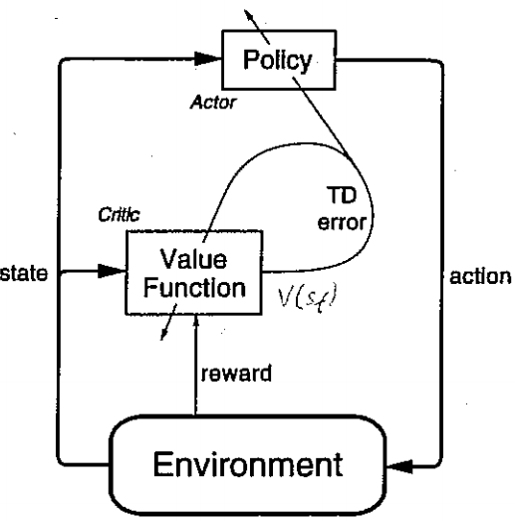
(This should look familiar).

Slide 6
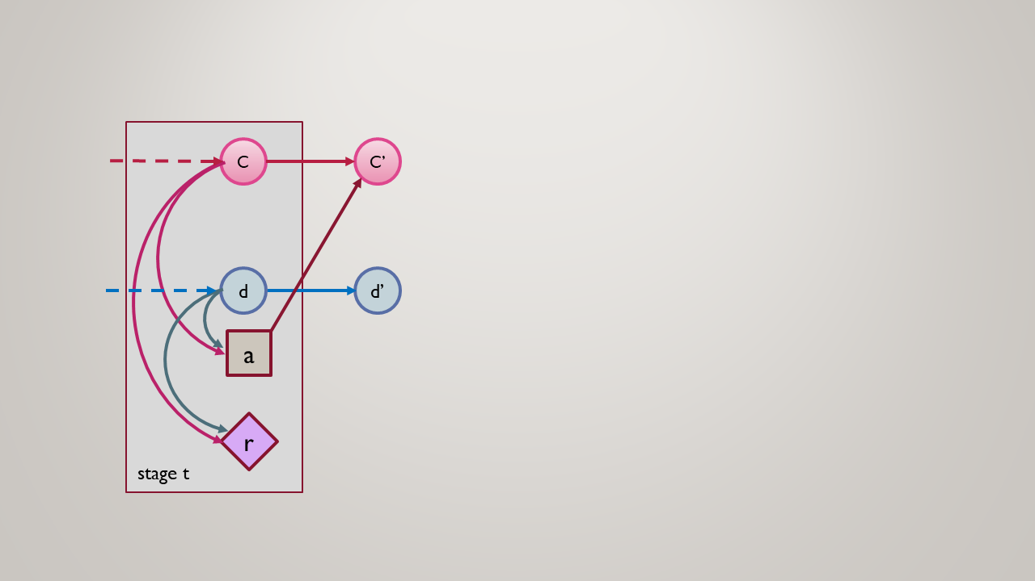
Reinforcement learning MDP
RL is the problem of controlling a Markov Chain with unknown probabilities.*

Slide 7
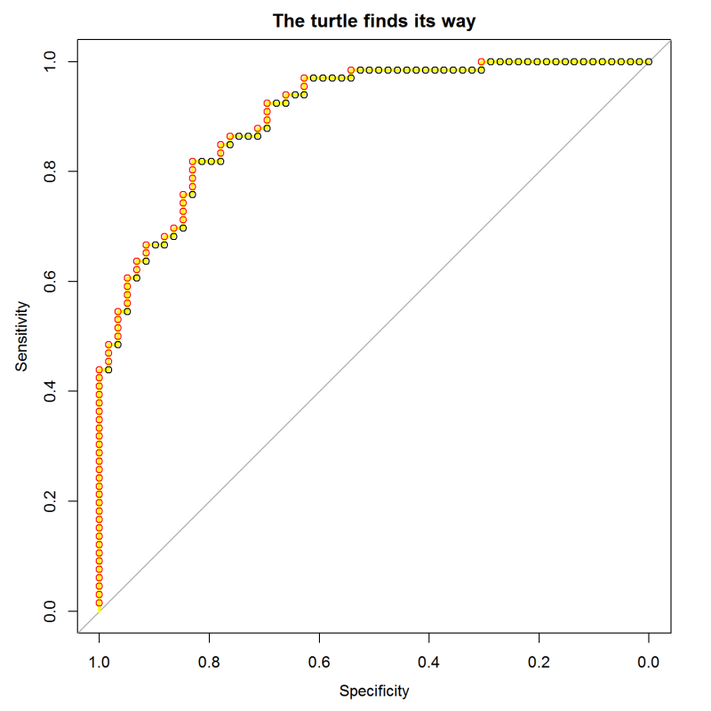

ROC Curve:
sort test cases by their score from the model
march along the sequence, stepping up for positives and right for negatives
This is the same as scanning across possible cutoff threshold values.
The slope of the curve shows the concentration of positives.
TPR
0.0 0.2 0.4 0.6 0.8 1.0
FPR
Notes:
The “turtle’s eye view” of ROC curves is described here:
https://blog.revolutionanalytics.com/2016/08/roc-curves-in-two-lines-of-code.html

Slide 8
Demo
Speaker name

Slide 10
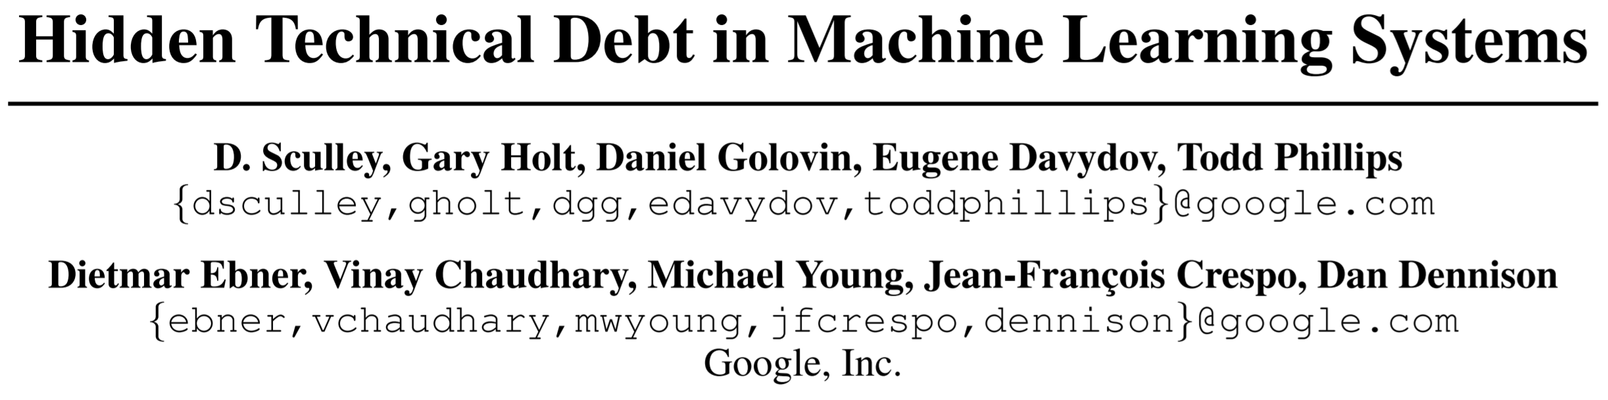
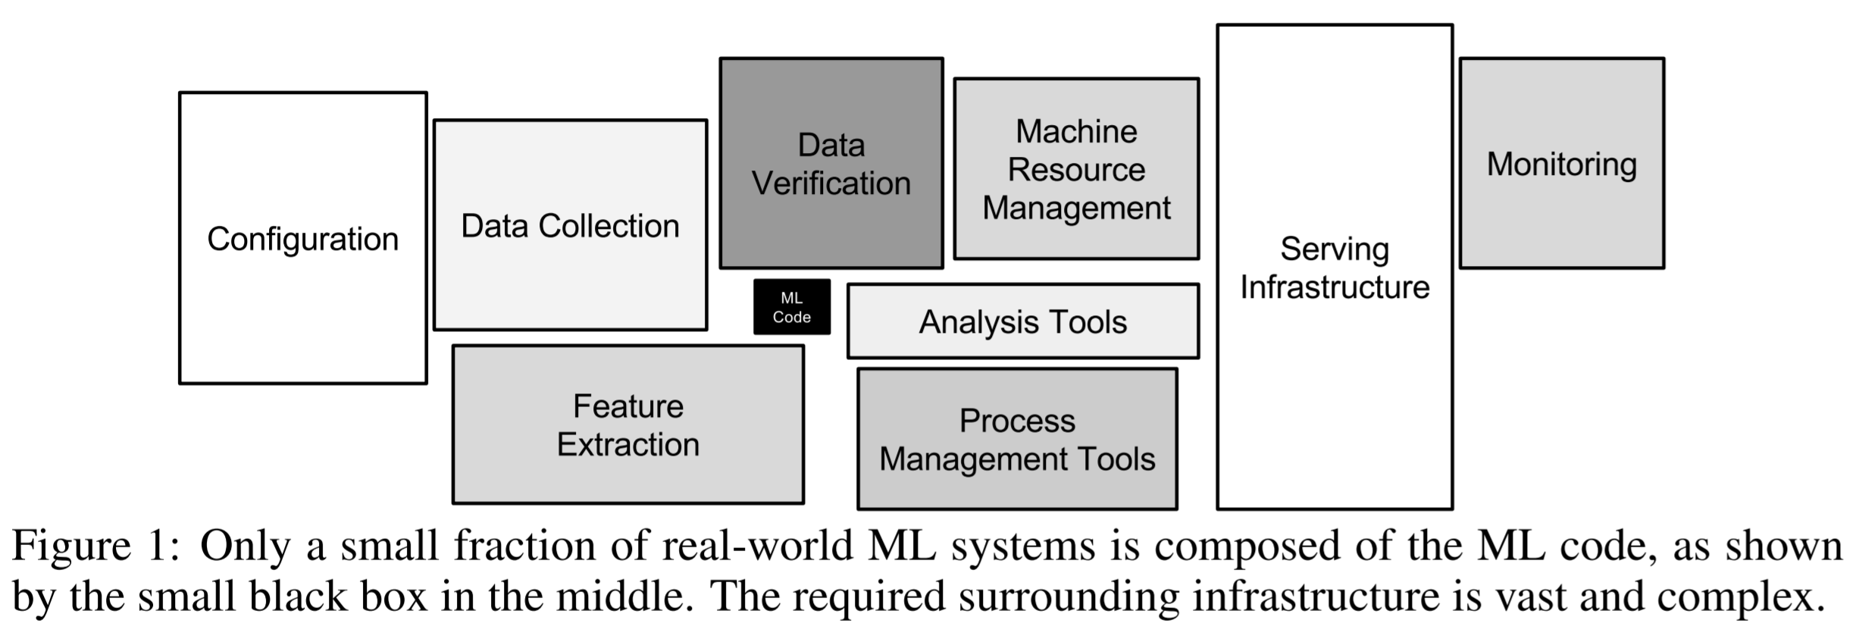
Notes:
ML code is just the little black box in the middle.

